Slide 1
Arts & culture
Parramatta
Notes:
Before starting online meeting:
Select Slide show from top bar and click “From beginning”
You will be able to see the notes; participants will only see slides
Before starting quiz:
Check that participants have a pen and paper at the ready, to write down their answers.
Each correct answer is worth 1 point.
If playing in teams, remind groups to mute their mic as they discuss their answer, so they don’t accidentally tell other teams.
Remember to speak slowly and clearly, so everyone understands the questions.
Check that everyone is ready before moving on to next question.

Slide 2
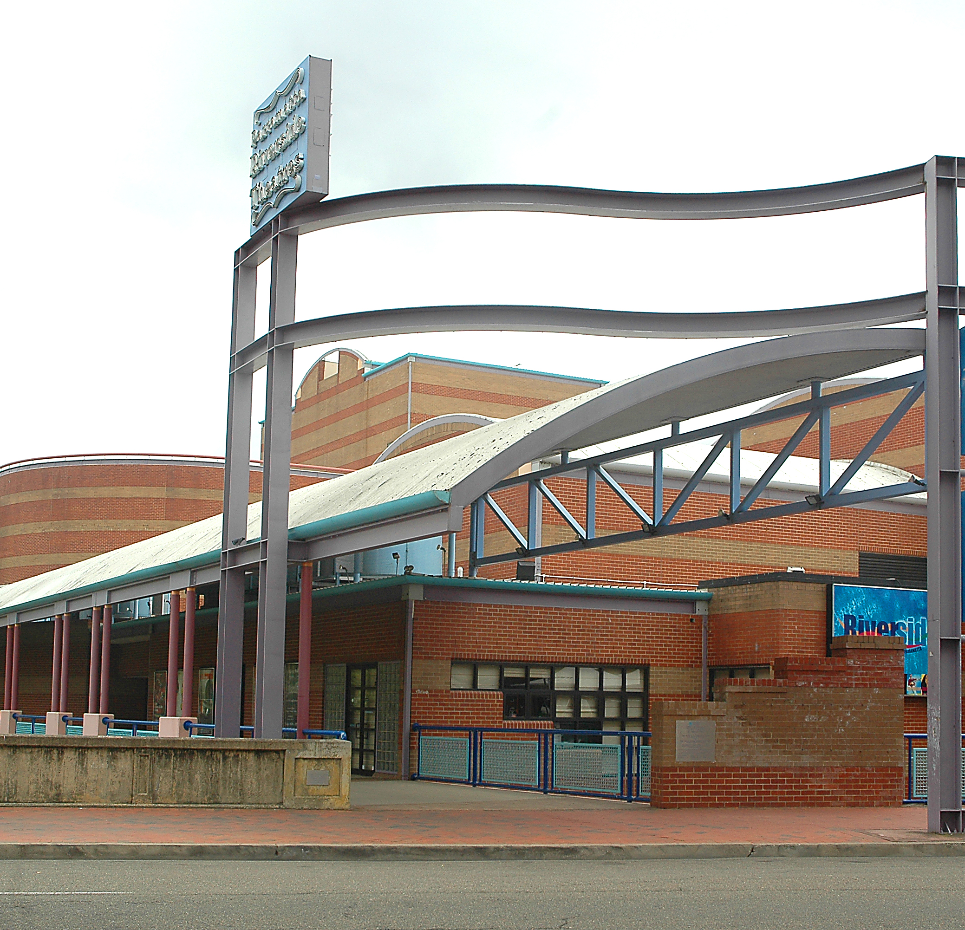
Arts & culture
Q1
Where is the home of the National Theatre of Parramatta?

Slide 3
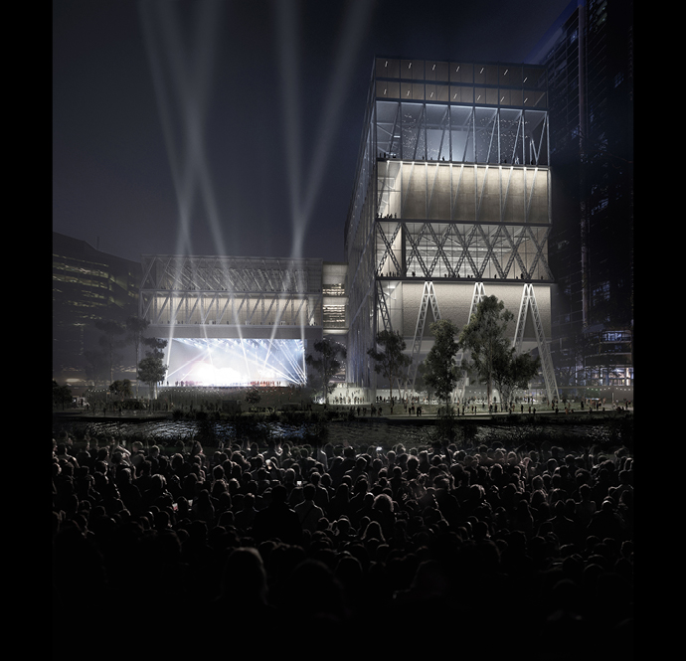
Arts & culture
Q2
Which major museum is soon to move to Parramatta?

Slide 4
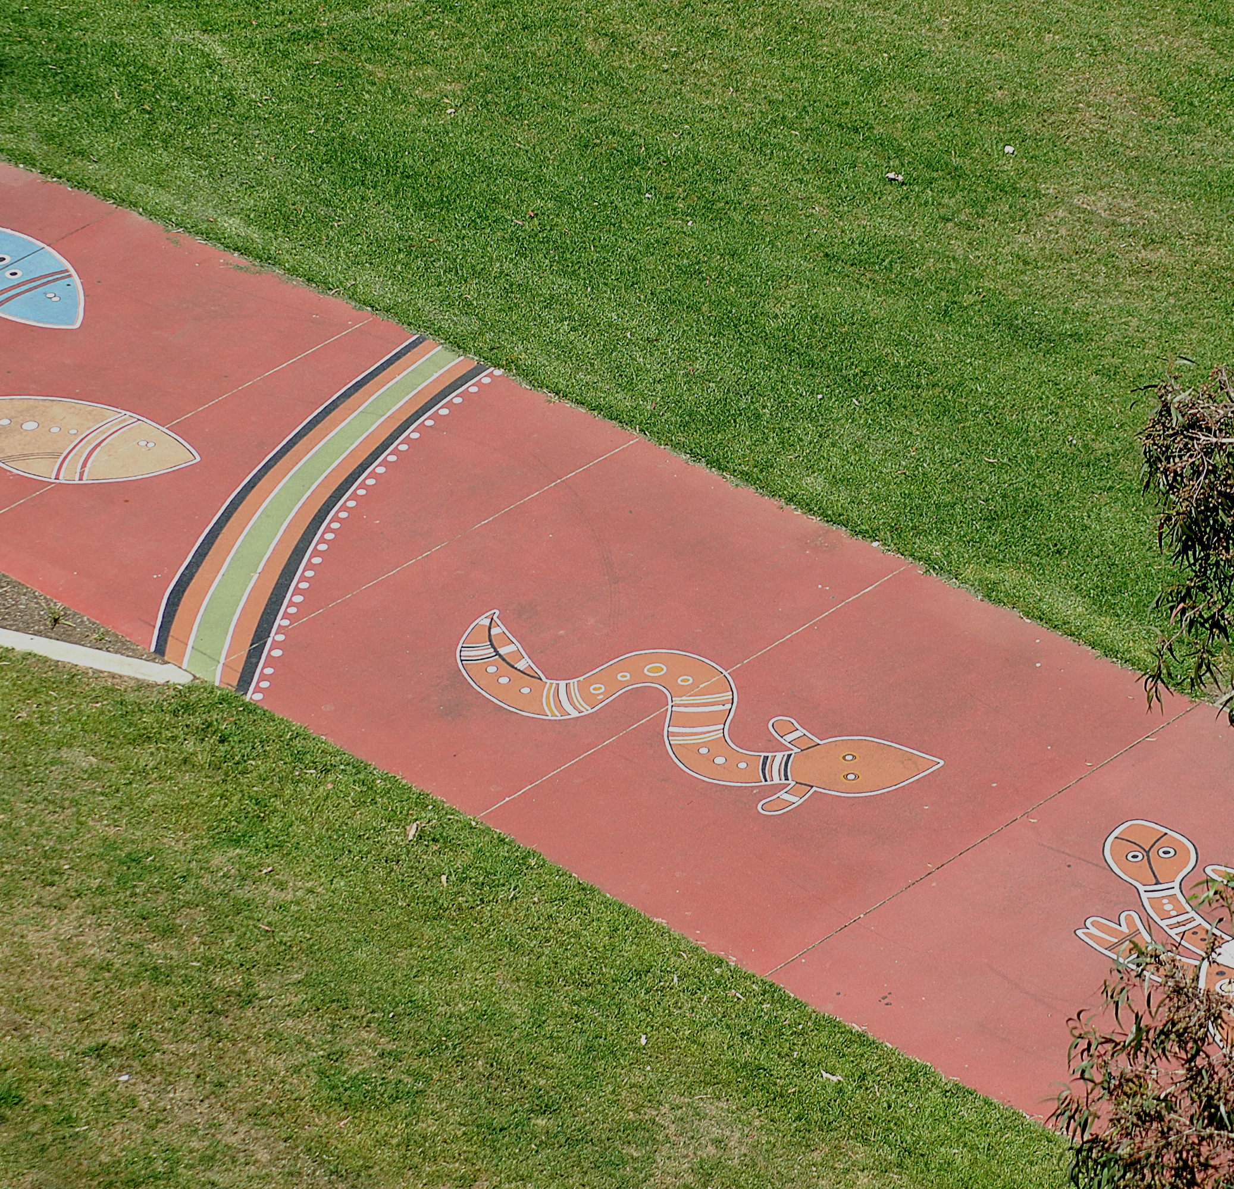
Arts & culture
Q3
Where would you find Jamie Eastwood’s Reconciliation Pathway?

Slide 5
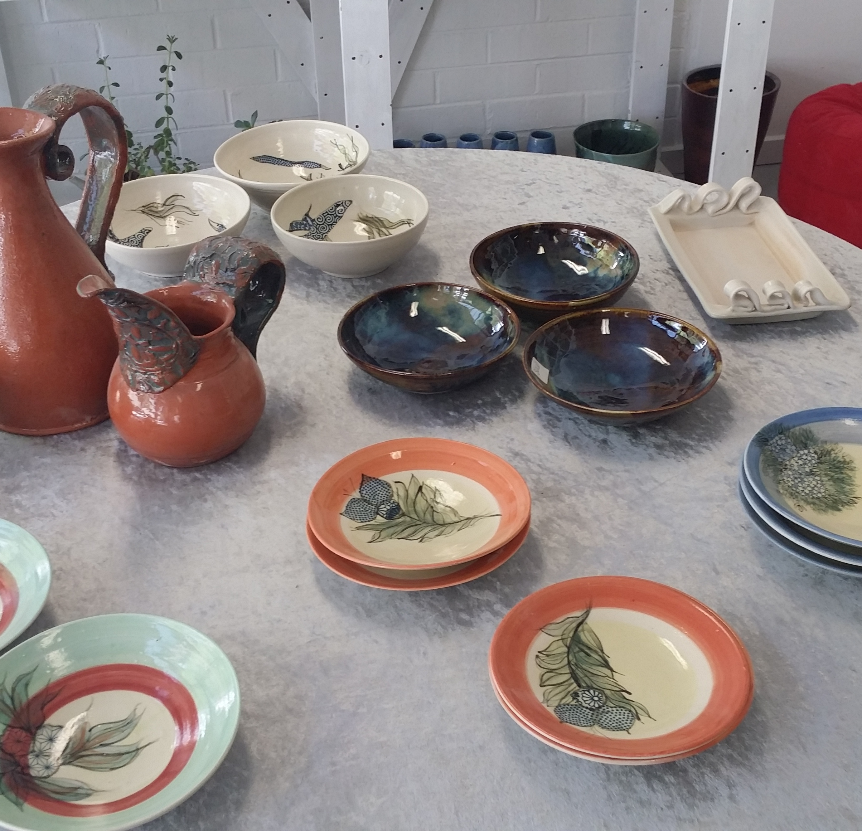
Arts & culture
Q4
What Parramatta association provides keen ceramicists with access to training, facilities and a public gallery?

Slide 6
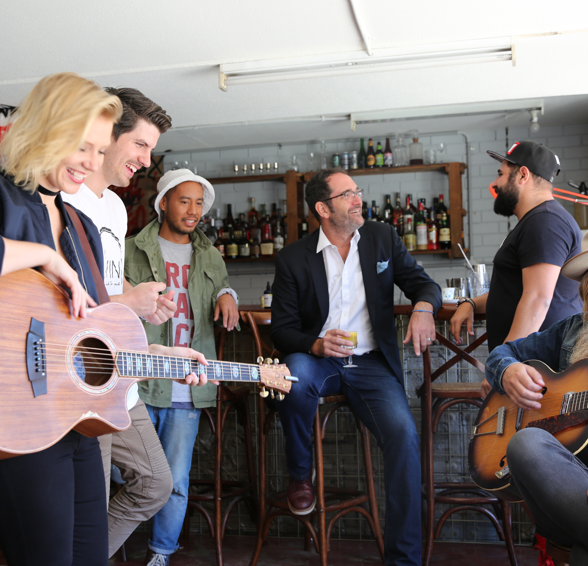
Arts & culture
Q5
What local event brings live music to both traditional and unusual venues?

Slide 7
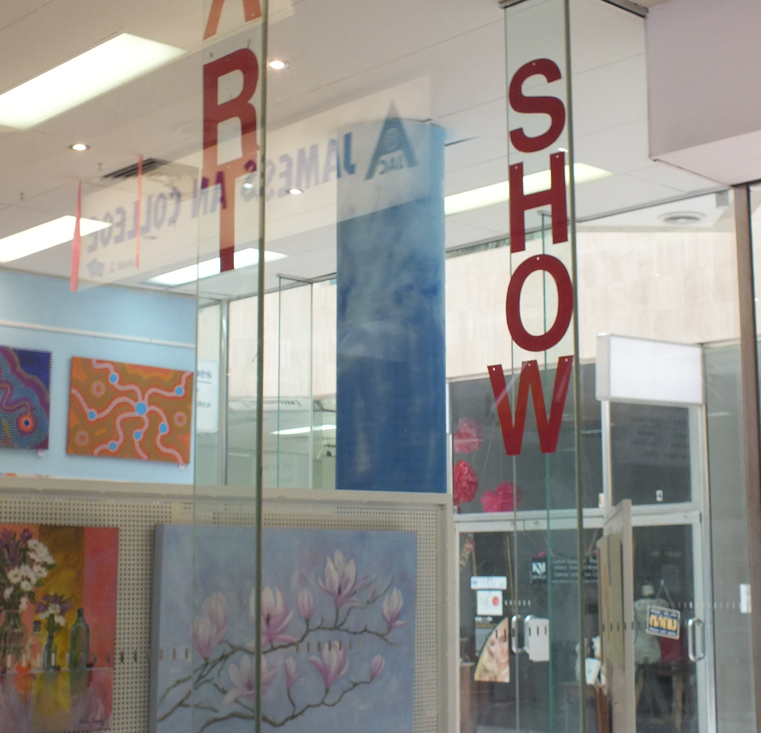
Arts & culture
Q6
Where is the City of Parramatta Art Society’s Gallery located?

Slide 8
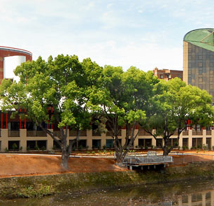
Arts & culture
Q7
Name four accessibility options available at Riverside Theatres?

Slide 9
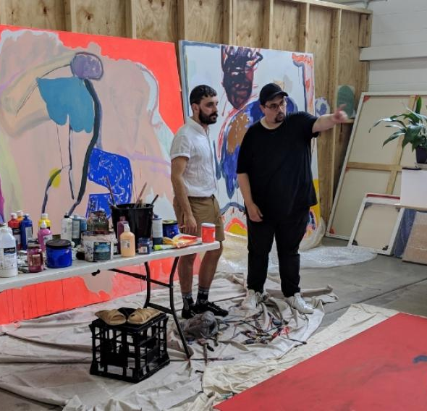
Arts & culture
Q8
What year did City of Parramatta launch its warehouse-style artists’ studios in Rydalmere?

Slide 10
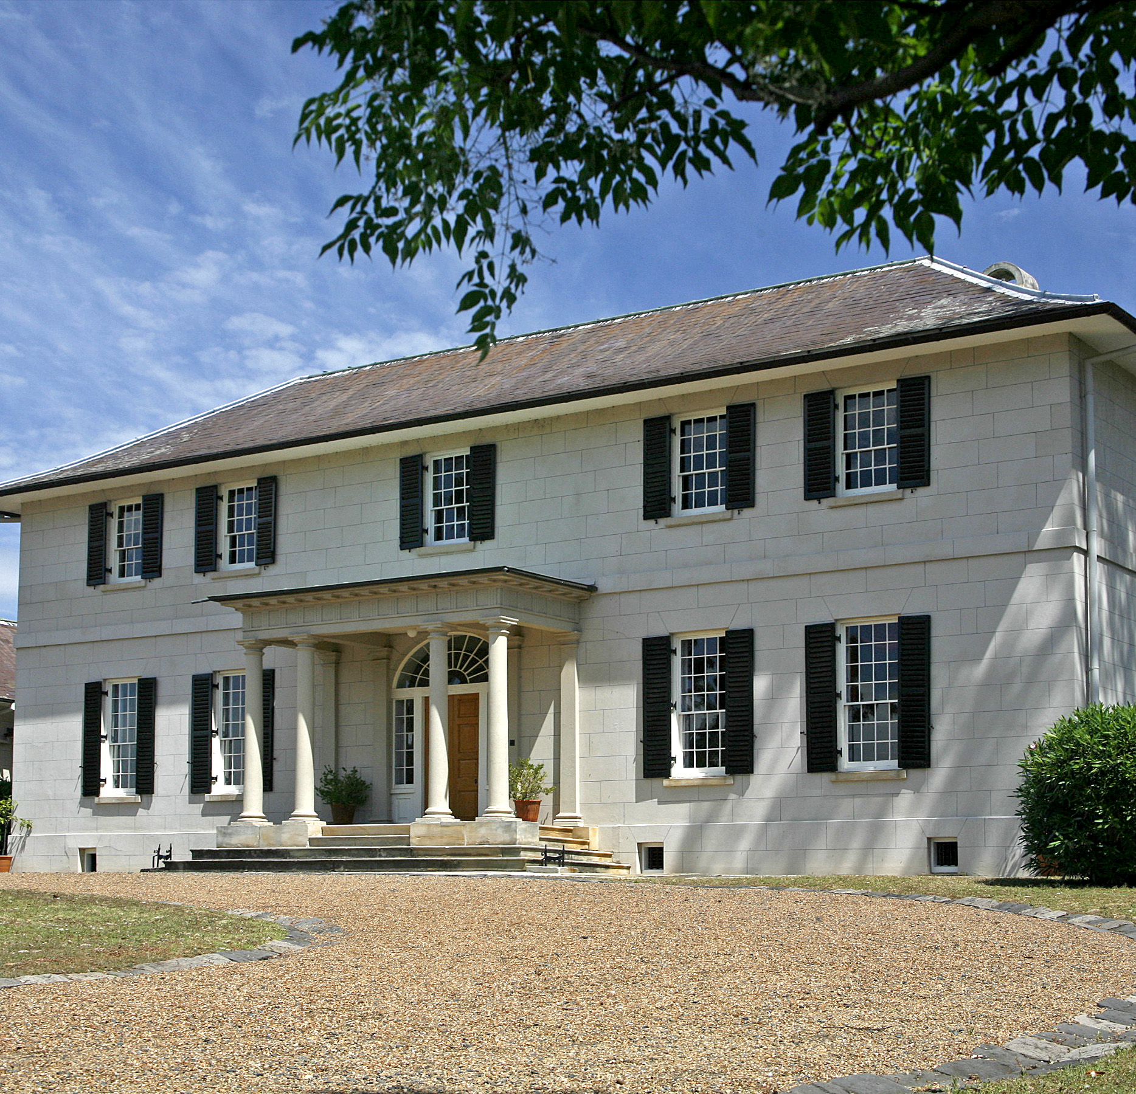
Arts & culture
Q9
What World Heritage site in Parramatta holds a changing program of heritage themed exhibitions?

Slide 11
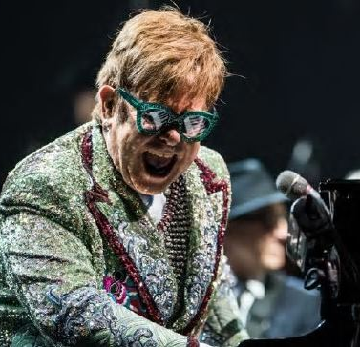
Arts & culture
Q10
Where did Sir Elton John play his final concert in Australia?

Slide 12
Arts & culture - answers
Riverside Theatres
Museum of Applied Arts and Sciences
North side of the Parramatta River, between Church Street and the Ferry Wharf. It looks at Aboriginal life before, during and after colonisation
Parramatta Clay & Arts Inc.
Live and Local
Hunter Street
Any four of these: level access; wheelchair space; courtesy wheelchair; accessible parking and toilets; assistance animals welcome; audio described performance; tactile tours; English subtitles, Auslan interpretation and open captions for some performances; hearing assistance; companion card recognised; relaxed performances; special seating requests
2019
Old Government House
Bankwest Stadium

Slide 13
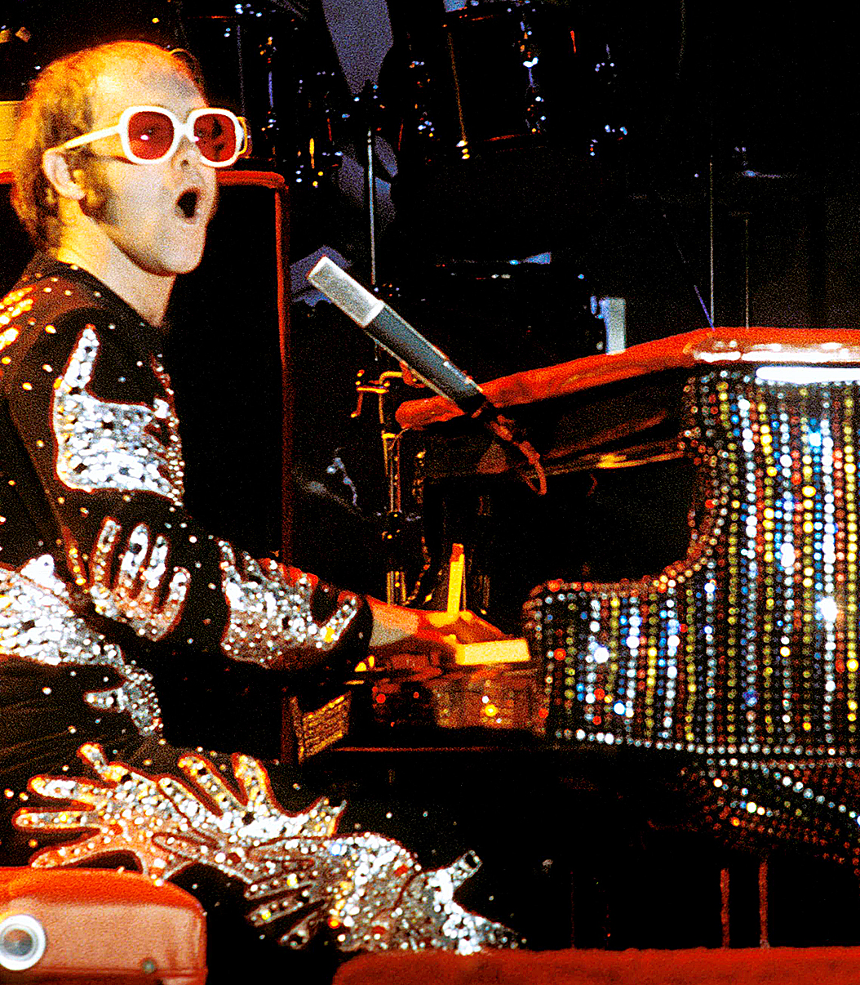
WHo AM I?
I was knighted in 1998 and awarded the Legion D’honneur in 2019
At times I have struggled with drug and alcohol addictions
Among my many awards are a Disney Legends Award, two Academy Awards and two Golden Globe Awards
I married my Australian wife on Valentine’s Day 1984
I have performed at many royal events, including the Queen’s Diamond Jubilee Concert
I was inducted into the Rock and Roll Hall of Fame in 1994
I have released over 30 albums, and sold over 300 million records
I have been heavily involved in the fight against AIDs and raised over $600 million to support HIV related causes
I was a close friend of Princess Diana, rewriting my hit Candle in the Wind as a tribute to perform at her funeral
My final Australian concert was also the first major event to be held at the Bankwest Stadium, Parramatta
Sir Elton John

