Slide 1
Cool & quirky
Parramatta
Notes:
Before starting online meeting:
Select Slide show from top bar and click “From beginning”
You will be able to see the notes; participants will only see slides
Before starting quiz:
Check that participants have a pen and paper at the ready, to write down their answers.
Each correct answer is worth 1 point.
If playing in teams, remind groups to mute their mic as they discuss their answer, so they don’t accidentally tell other teams.
Remember to speak slowly and clearly, so everyone understands the questions.
Check that everyone is ready before moving on to next question.

Slide 2
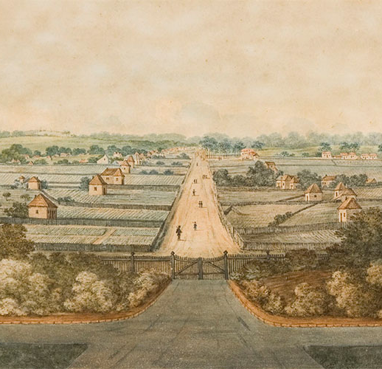
Cool & quirky
Q1
Where was the first horse race in the colony run and which horse, appropriately, won it?

Slide 3
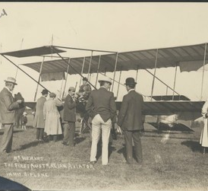
Cool & quirky
Q2
What was Billy Hart famous for?

Slide 4
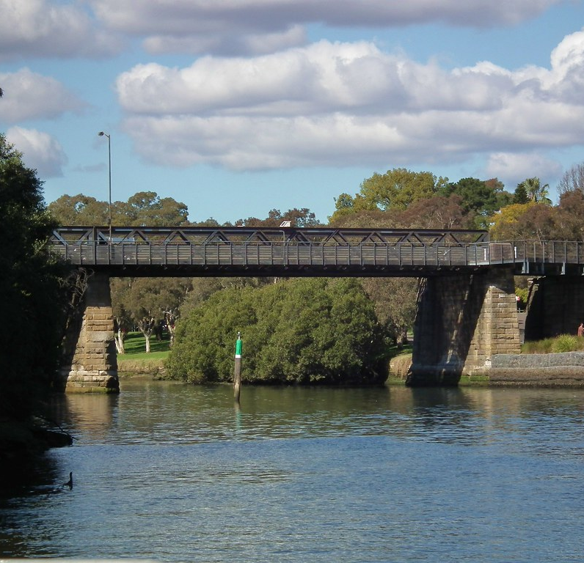
Cool & quirky
Q3
Local greyhound trainers once trained their dogs by tying them to the back of a rowboat and swimming them down the Parramatta River; why did they stop using this training method?

Slide 5
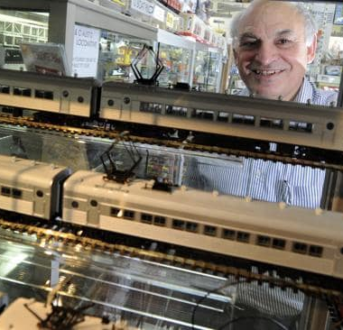
Cool & quirky
Q4
What specialist hobby store opened in 1958, specialising in model trains, and has since traded from seven different locations in Parramatta?

Slide 6
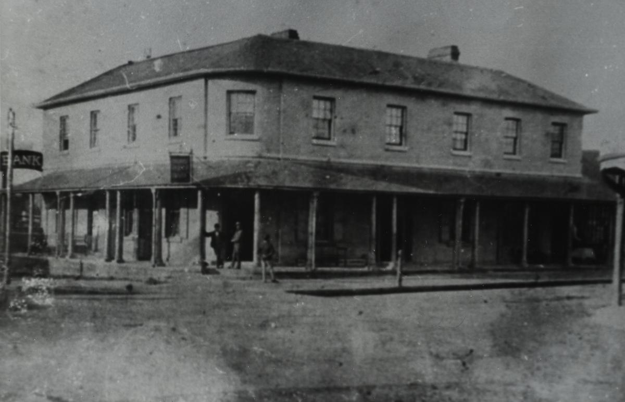
Cool & quirky
Q5
In 1874 you could down a schooner while withdrawing the money from the bank to pay for it from which Hotel?

Slide 7
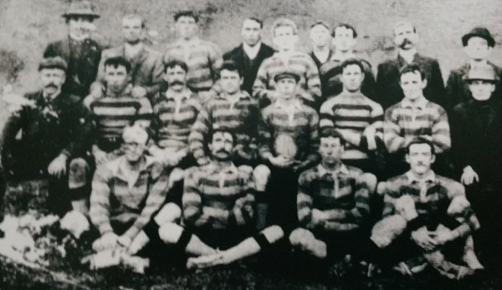
Cool & quirky
Q6
What was Parramatta’s first Rugby League team called and what year was it formed?

Slide 8
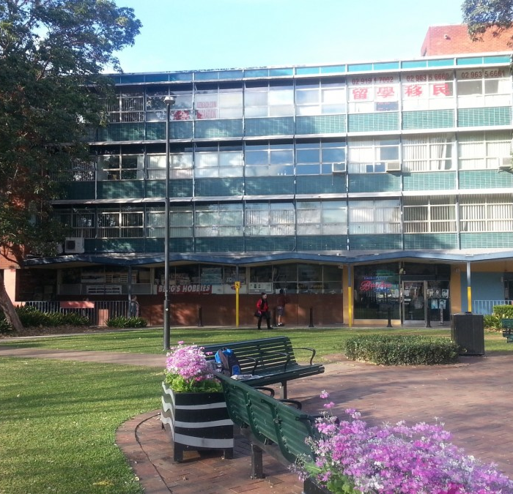
Cool & quirky
Q7
What centrally located, small shopping precinct provided Parramatta’s first taste of hip modern living?

Slide 9
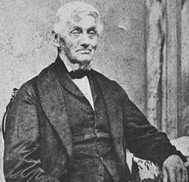
Cool & quirky
Q8
Before coming to New South Wales, which great engineer did David Lennox, builder of Parramatta’s iconic bridge, work for?
  Isambard Kingdom Brunel
  Thomas Telford
  John A Roebling
  None of the above

Slide 10
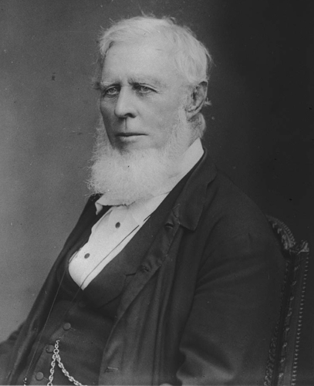
Cool & quirky
Q9
Byrnes Avenue commemorates the Byrnes family, who contributed to Parramatta in which of the following ways?
  Pioneers of steam ferry transport on the Parramatta River
  Owned a brewery on Charles Street
  James Byrnes was a politician and public servant
  All of the above

Slide 11
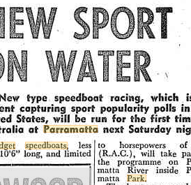
Cool & quirky
Q10
What class of boat were first raced on the Parramatta River, in Parramatta Park, in 1956?
  Model yachts
  NS14 skiffs
  Midget speedboats
  Sculls

Slide 12
Cool & quirky - answers
Down George St, Parramatta, finishing outside the Woolpack Hotel; won by Parramatta
He was Australia’s first qualified pilot, gaining aviation Licence No 1 in 1911.
A greyhound was taken by a shark
Berg’s Hobbies – their motto is “Berg’s Hobbies Empower Your Hobby”. You can order online to enrich your social isolation with inspired creativity
The Australian Arms Hotel – when the Bank of NSW bought the site it agreed to cohabit with the pub while the publican looked for a new location to transfer the license to.
Cumberland, in 1908.
The Queensland Arcade, opened in June 1960.
B – he worked on both Telford’s iconic Menai Suspension Bridge and his stone arch bridge over the Severn
D – All of the above
C – Midget speedboats
Notes:
Down George St, Parramatta, finishing outside the Woolpack Hotel; won by Parramatta
He was Australia’s first qualified pilot, gaining aviation Licence No 1 in 1911.
A greyhound was taken by a shark
Berg’s Hobbies – their motto is “Berg’s Hobbies Empower Your Hobby”. You can order online to enrich your social isolation with inspired creativity.
The Australian Arms Hotel – when the Bank of NSW bought the site it agreed to cohabit with the pub while the publican looked for a new location to transfer the license to. They shared the site on the corner of George and Church for three months; a bit like having an ATM in the pub, but, in typical Parramatta style, way ahead of its time
Cumberland, in 1908. They hold in interesting record: they were one of the original nine teams in the NSWRL; they are the shortest-lived team in the history of first-grade rugby league; they had no home ground, and statistically they have the worst record in league, losing seven of their eight matches. Their colours were blue and gold, just like the more famous Parramatta Eels.
The Queensland Arcade, opened in June 1960. The London-style arcade was home to the ultra-cool Le Petite Carlton Coffee House, the first continental style café in Parramatta (there was even pavement seating!). The arcade also housed By Bret’s, a men’s outfitter whose motto was Modern as Tomorrow. This proved to be prescient; there was concern at the time that the building’s four storey height and modern façade would loom over Parramatta Park, a fear shared by some regarding recent nearby developments; indeed the Cumberland Argus described it as a “glass palace dominating the city’s park”. Parramatta in the 21st century is very proud of its café culture; but it’s not really anything new.
B – he worked on both Telford’s iconic Menai Suspension Bridge and his stone arch bridge over the Severn
D – All of the above
C - Midget speedboats

Slide 13
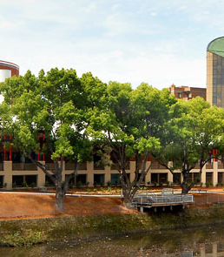
WHo AM I?
Controversy due to escalating costs and concerns over the quality of facilities dogged my construction
I am a popular site for corporate events
I am located on a site that was once a Government Reserve
For many years my site was a popular swimming facility
Later it was used as retail space and a council vehicle depot
I was opened in 1988 by Barry Unsworth, as part of the Bicentenary Programme, with Prime Minister Bob Hawke in attendance
I went through a period of decline in the 1990s, with a revival at the start of the new millennium
My original name was the Parramatta Cultural Centre
I am home to Form Dance, the National Theatre of Parramatta, Beyond the Square and the Dance Makers Collective
My facilities include a 700 seat theatre, a 200 seat performance space, a 100 seat recital room and open air courtyard and a fully licensed foyer/function space
Riverside Theatres

