Slide 1
First people
Parramatta
Notes:
Before starting online meeting:
Select Slide show from top bar and click “From beginning”
You will be able to see the notes; participants will only see slides
Before starting quiz:
Check that participants have a pen and paper at the ready, to write down their answers.
Each correct answer is worth 1 point.
If playing in teams, remind groups to mute their mic as they discuss their answer, so they don’t accidentally tell other teams.
Remember to speak slowly and clearly, so everyone understands the questions.
Check that everyone is ready before moving on to next question.

Slide 2
We thank Aunty corina norman, aunty Julie bukhari webb and uncle chris tobin for sharing culture
Notes:
Before starting online meeting:
Select Slide show from top bar and click “From beginning”
You will be able to see the notes; participants will only see slides
Before starting quiz:
Check that participants have a pen and paper at the ready, to write down their answers.
Each correct answer is worth 1 point.
If playing in teams, remind groups to mute their mic as they discuss their answer, so they don’t accidentally tell other teams.
Remember to speak slowly and clearly, so everyone understands the questions.
Check that everyone is ready before moving on to next question.

Slide 3
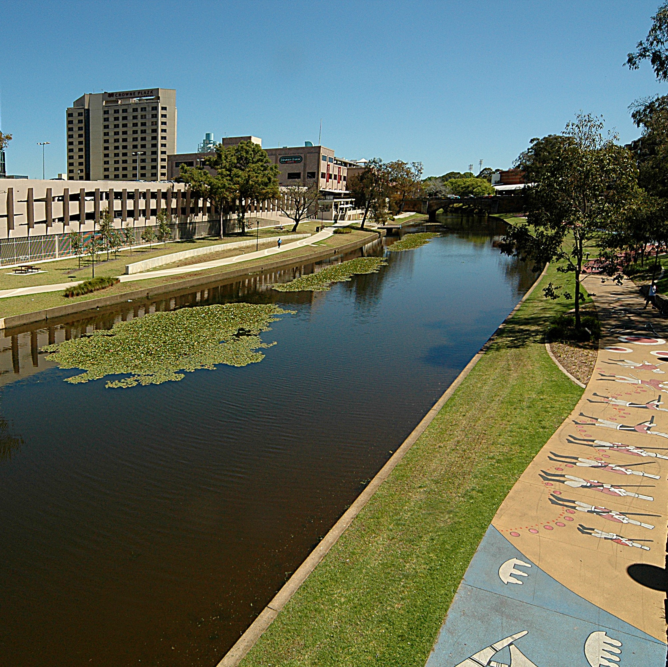
First people
Q1
Where does the name Parramatta come from?

Slide 4
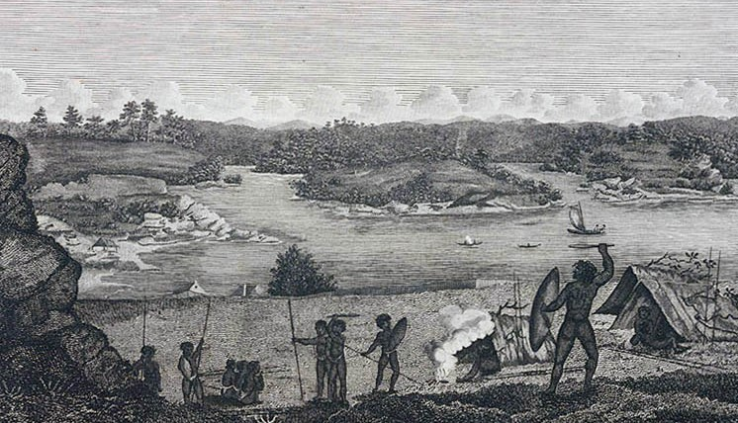
First people
Q2
What significance did the Parramatta River have for Dharug people?
  As a transport and trade route
  As a meeting place of saltwater and freshwater communities
  As a major source of food and fresh water
  All of the above

Slide 5
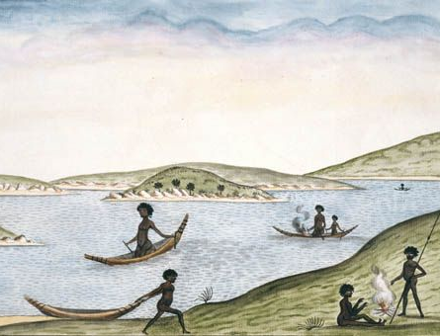
First people
Q3
What is a Dharug canoe called?

Slide 6
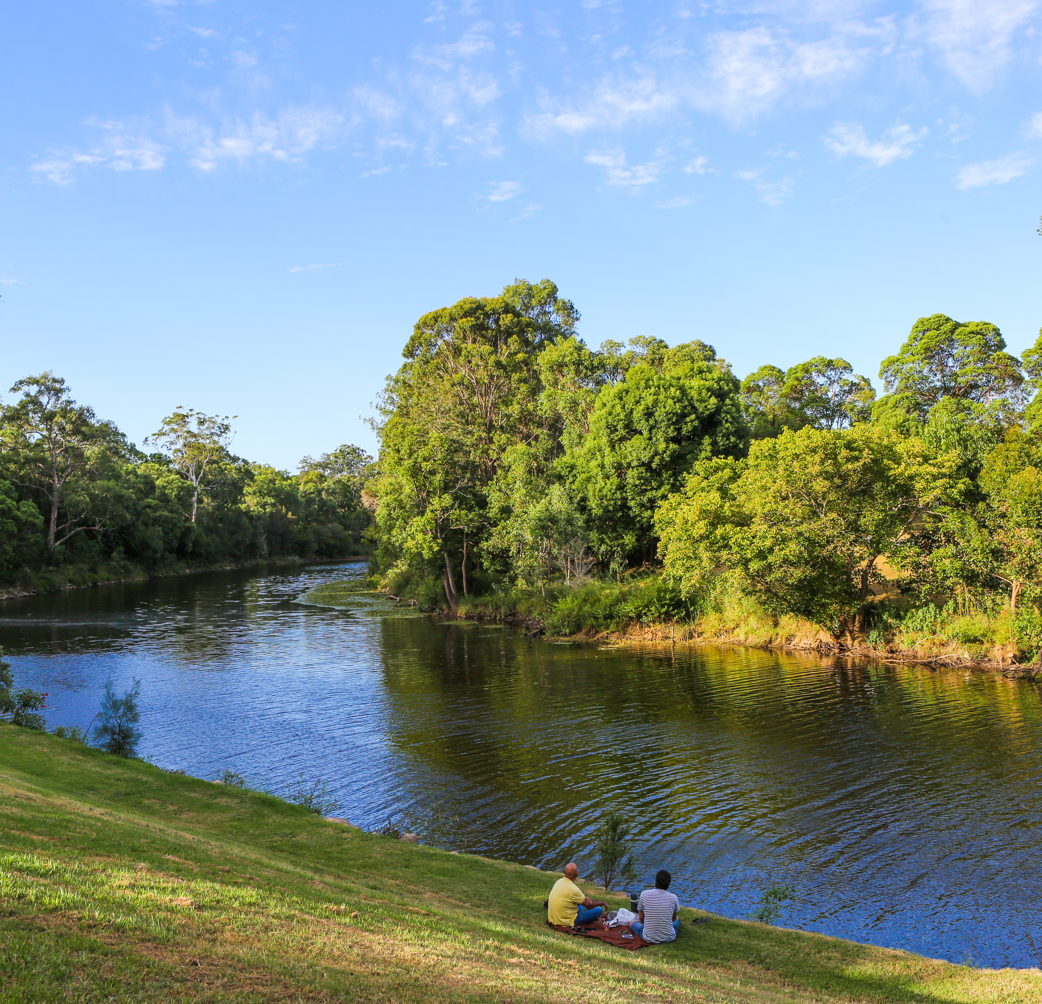
First people
Q4
What staple food of the Burramattagal grew on the floodzones of the Parramatta River?

Slide 7
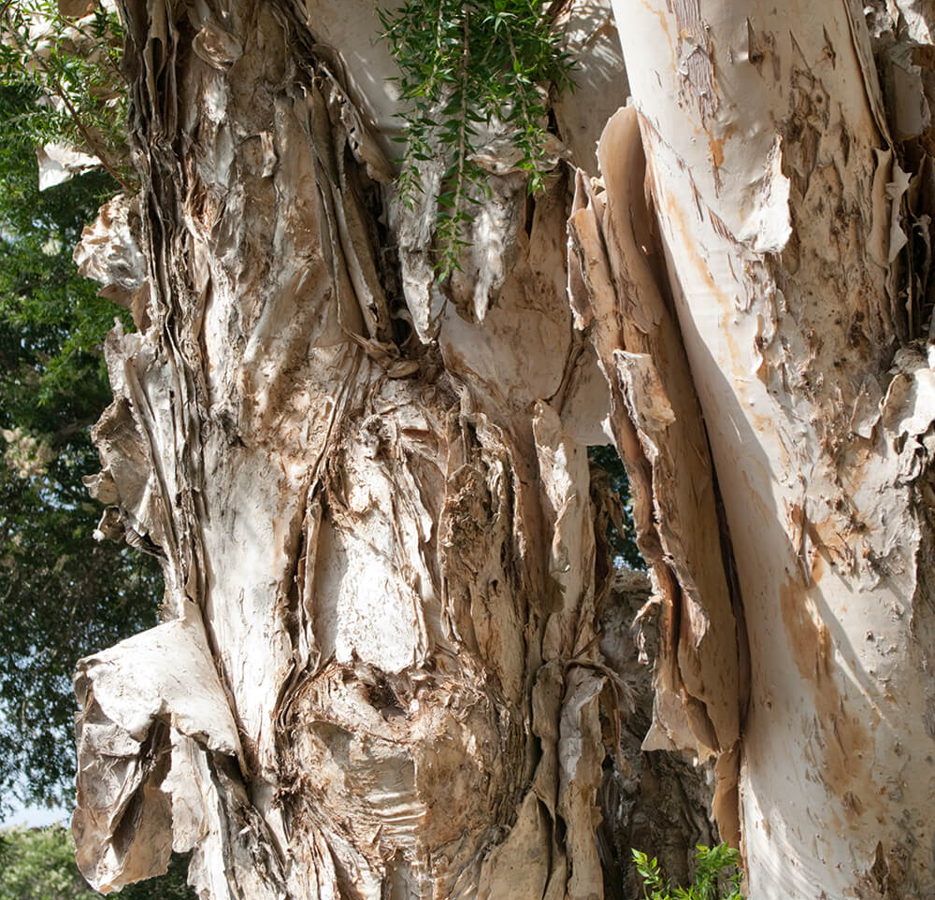
First people
Q5
What was the bark of the paper bark tree used for?
  Making shelters
  Making paper
  Wrapping babies and food
  Both A & C

Slide 8
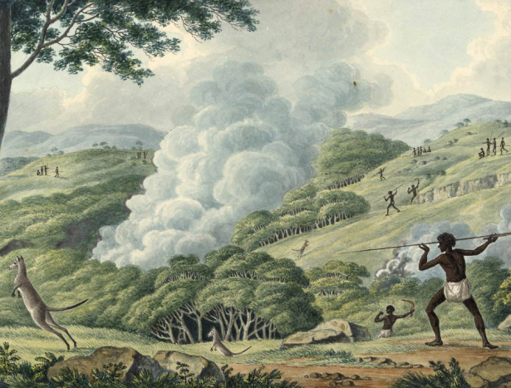
First people
Q6
What is the name given to the traditional Aboriginal use of fire for land management?

Slide 9
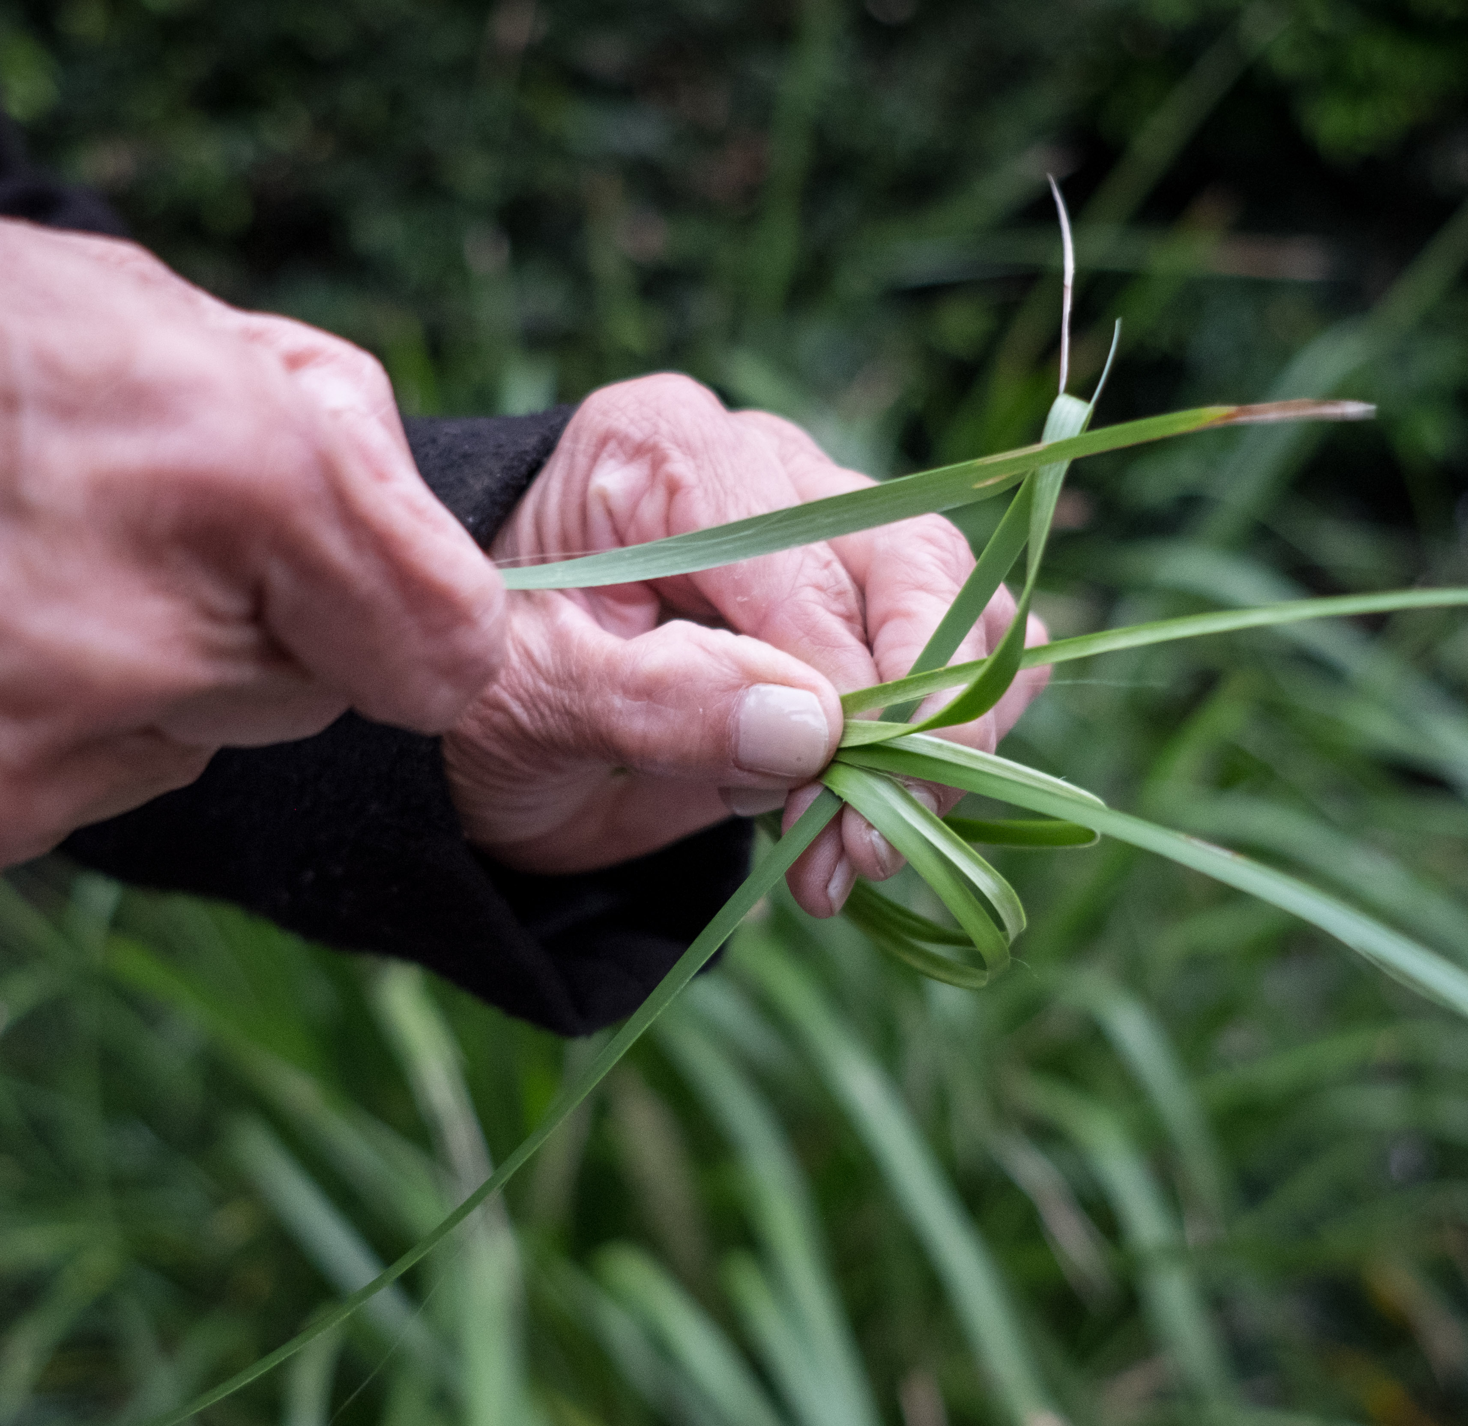
First people
Q7
The spiny mat-rush, or lomandra, is used for both weaving and as a food source. True or false?

Slide 10
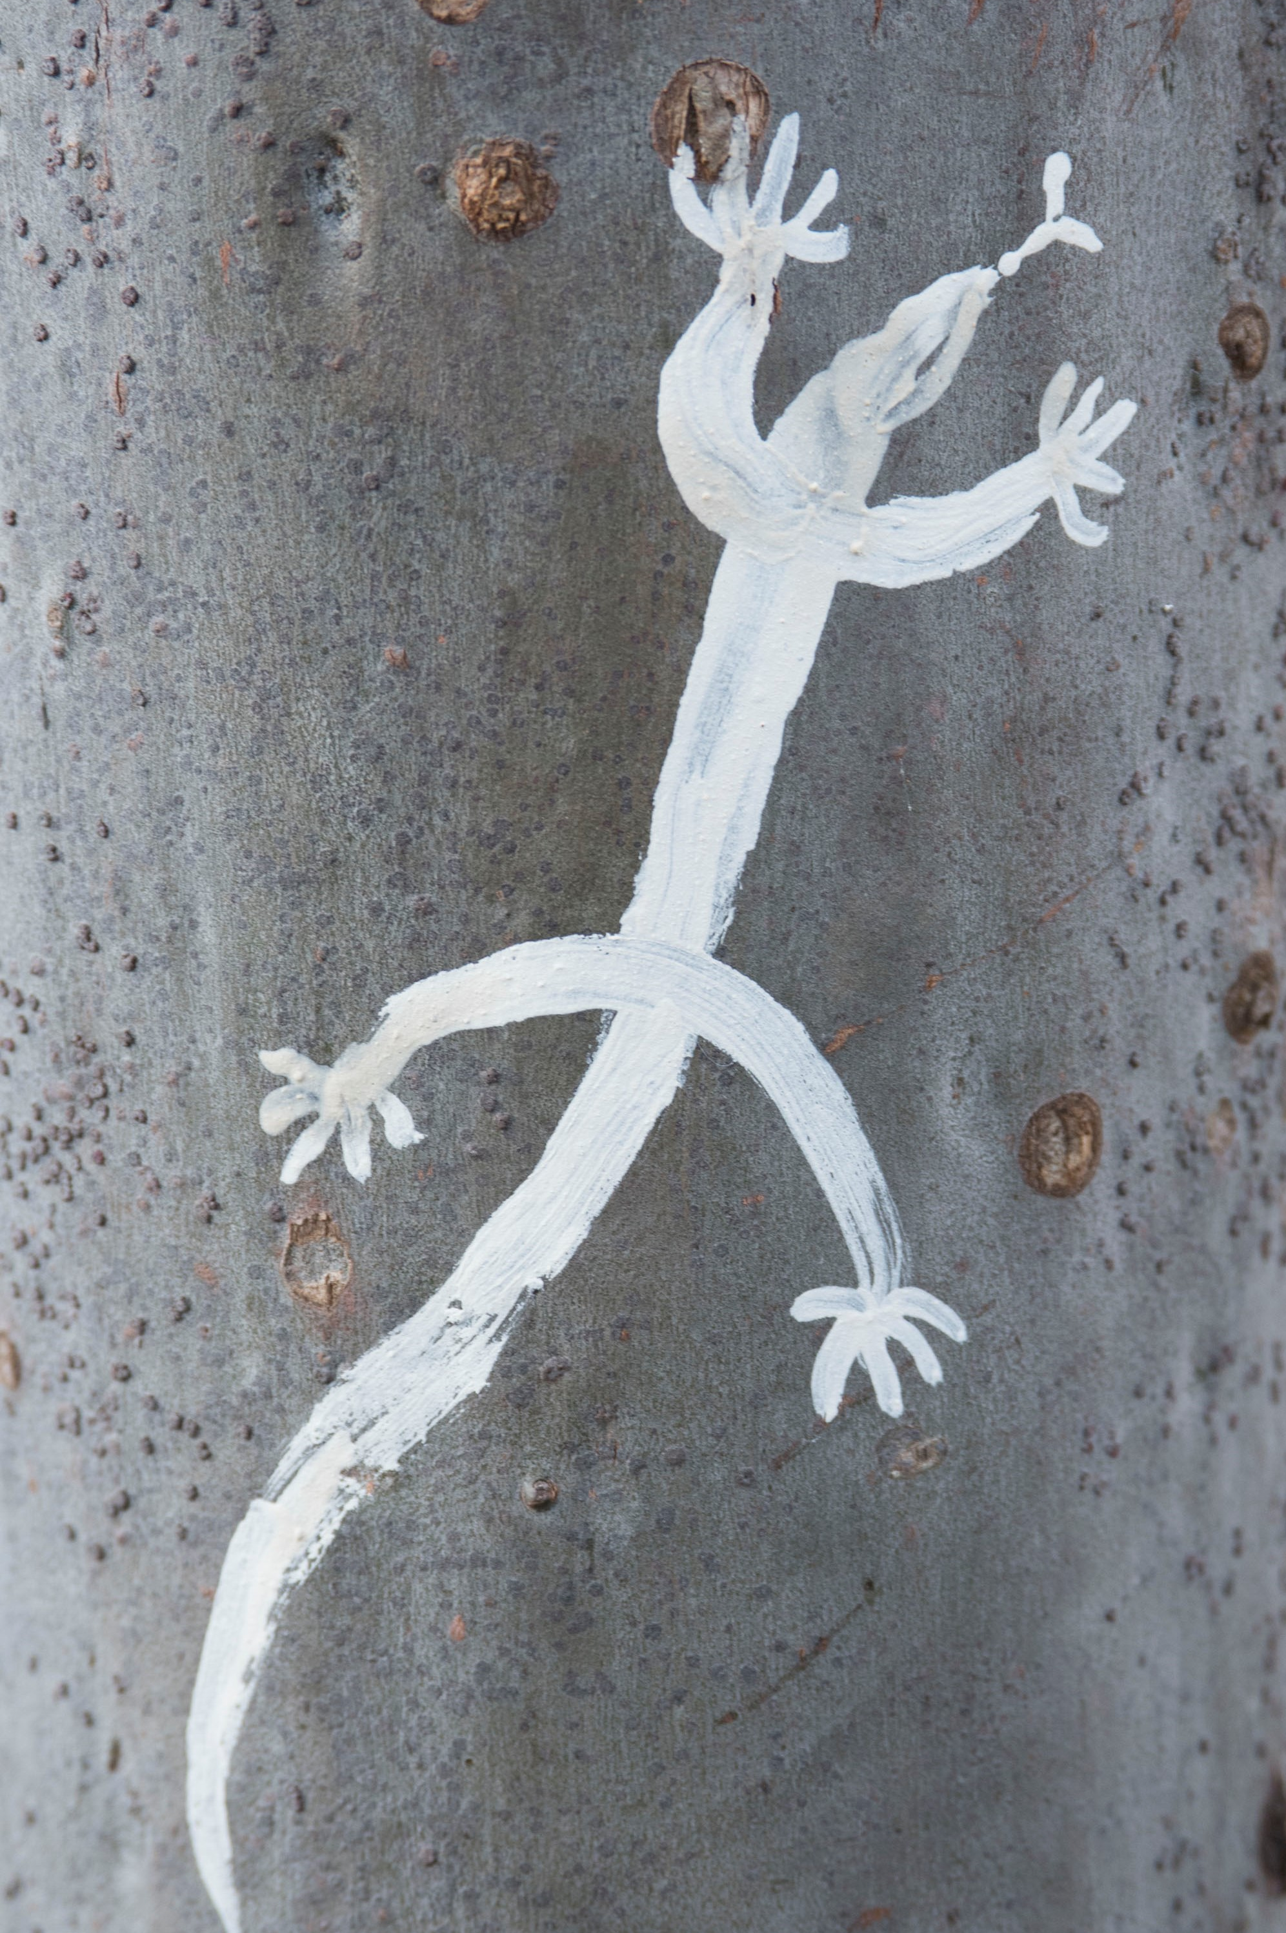
First people
Q8
Along what local creek was there an ochre source, used for both ceremony and trade?

Slide 11
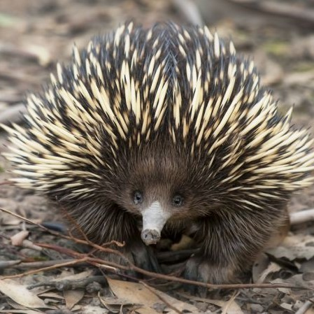
First people
Q9
Match the Dharug name with the correct animal:
Buru Goanna
Mariyung Emu
Wiriga Kangaroo
Barragin Echidna

Slide 12
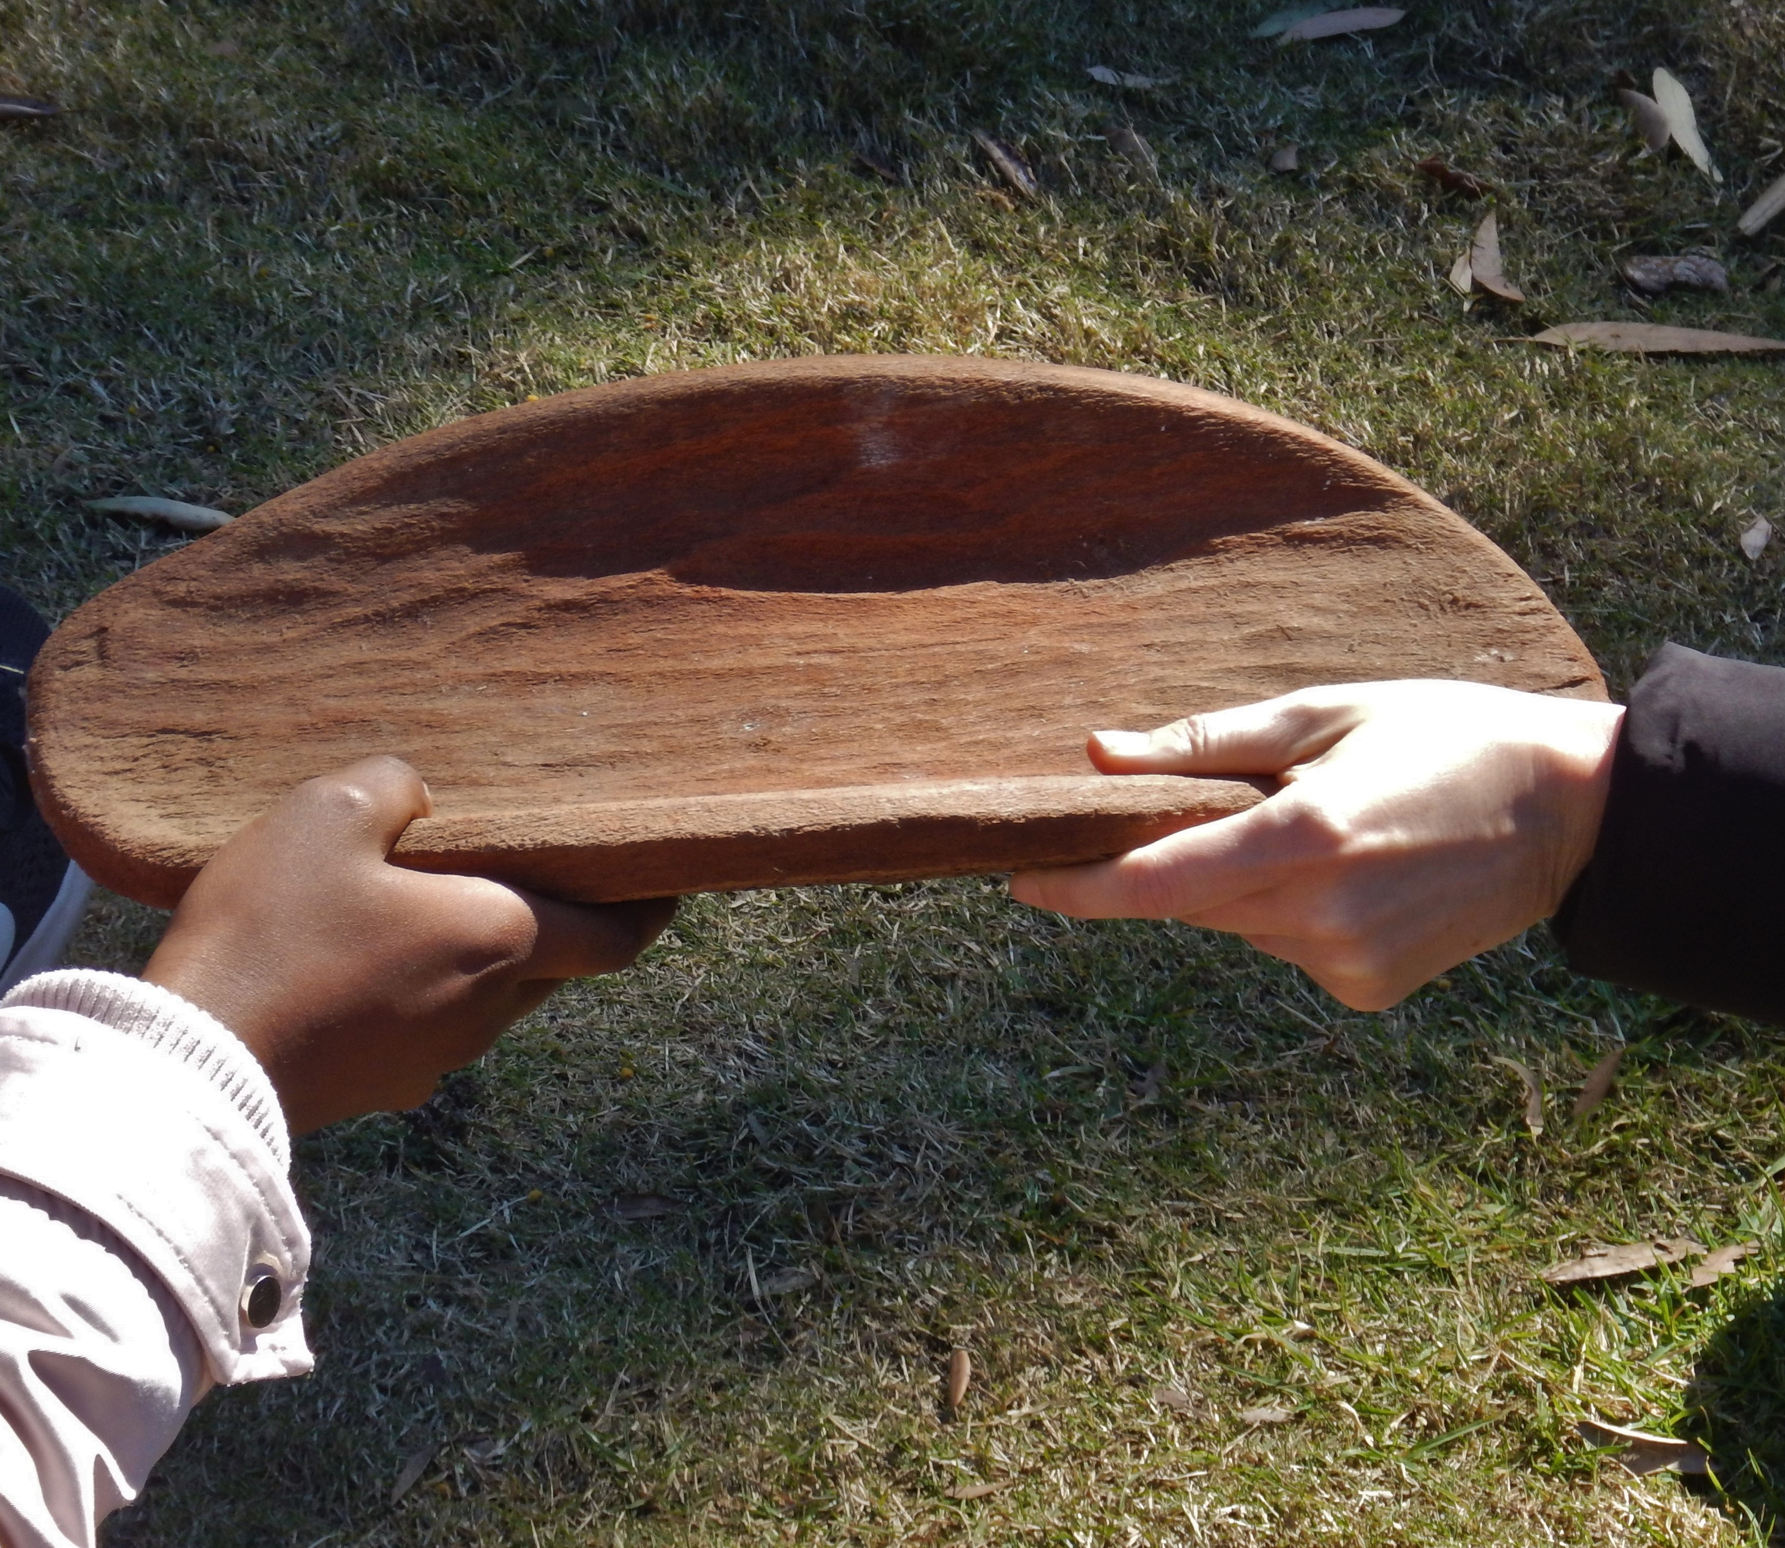
First people
Q10
Dharug people continue to practise culture in our city today – true or false?

Slide 13
First people - answers
It is a Dharug word, meaning water place of eels. The Burramatta clan, of the Dharug nation, are the traditional custodians of the area where the Parramatta CBD stands.
D - All of the above
A nawi
Yams, which are now locally extinct due to intensive colonial-era farming
D – A & C; making shelters and wrapping things
Firestick farming, also known as cultural burning
True
Clay Cliff Creek
Buru = Kangaroo
Mariyung = Emu
Wiriga = Goanna
Barragin = Echidna
10. True, Dharug people continue to practice traditional culture as it evolves.
Notes:
First People – Answers
1. Where does the name Parramatta come from? It is a Darug word, meaning water place of eels. The Barramatta clan, of the Darug nation, are the traditional custodians of the area where the Parramatta CBD stands.
2. What significance did the Parramatta River have for Darug people? D All of the above
a. As a transport and trade route
b. As a meeting place of saltwater and freshwater communities
c. As a major supply of food and fresh water
d. All of the above
3. What is a Darug canoe called? A nawi
4. What staple food of the Burramattagal grew on the floodzones of the Parramatta River? Yams, which are now locally extinct due to intensive colonial farming
5. What was the bark of the paper bark tree used for? D – A & C; making shelters and wrapping things
a. Making shelters
b. Making paper
c. Wrapping babies and food
d. A & C
6. What is the traditional method of Aboriginal land management using fire known as? Firestick farming, also known as cultural burning
7. The spiny mat-rush, or lomandra, is used for both weaving and as a food source. True or false? True
8. Along what local creek was there an ochre source, used for both ceremony and trade? Clay Cliff Creek
9. Match the Darug name with the correct animal: Darug - Buru, mariyung, wiriga, barragin English – goanna, emu, kangaroo, echidna. Buru = kangaroo, mariyung = emu, wiriga = goanna, barragin = echidna
10. Darug people continue to practise culture in our city today– true or false? True, Darug people continue to practice traditional culture as it evolves.

Slide 14
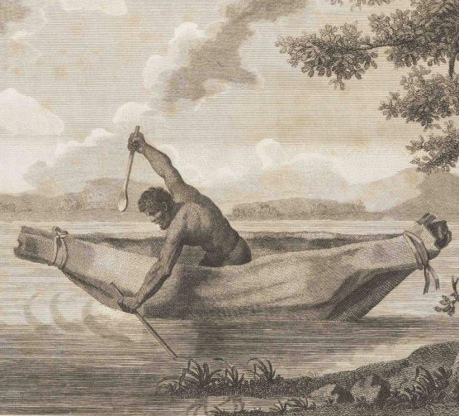
WHo AM I?
The Governor described me as “a terrible pest to the colony, but a brave and independent character”
I led raids around the Parramatta area, mostly taking corn and clothing
I once escaped from hospital, with leg irons and chains still attached
I speared the Governor’s Gamekeeper, a man feared and hated for his violence against my people, though it was claimed I was not provoked at the time
In retaliation the Governor ordered 50 soldiers to capture or kill any 6 men of my clan and bring him the heads of at least 2
I survived a confrontation that left me extremely ill, with buckshot in my head and body
My son was also shot by a colonist, but he died of his wound
It was believed by many people that I was invincible
My head was sent to England as an item of scientific interest
I led over 100 warriors against soldiers and settlers in a battle on the streets of Parramatta
Pemulwuy

