Slide 1
gatherings
Parramatta
Notes:
Before starting online meeting:
Select Slide show from top bar and click “From beginning”
You will be able to see the notes; participants will only see slides
Before starting quiz:
Check that participants have a pen and paper at the ready, to write down their answers.
Each correct answer is worth 1 point.
If playing in teams, remind groups to mute their mic as they discuss their answer, so they don’t accidentally tell other teams.
Remember to speak slowly and clearly, so everyone understands the questions.
Check that everyone is ready before moving on to next question.

Slide 2
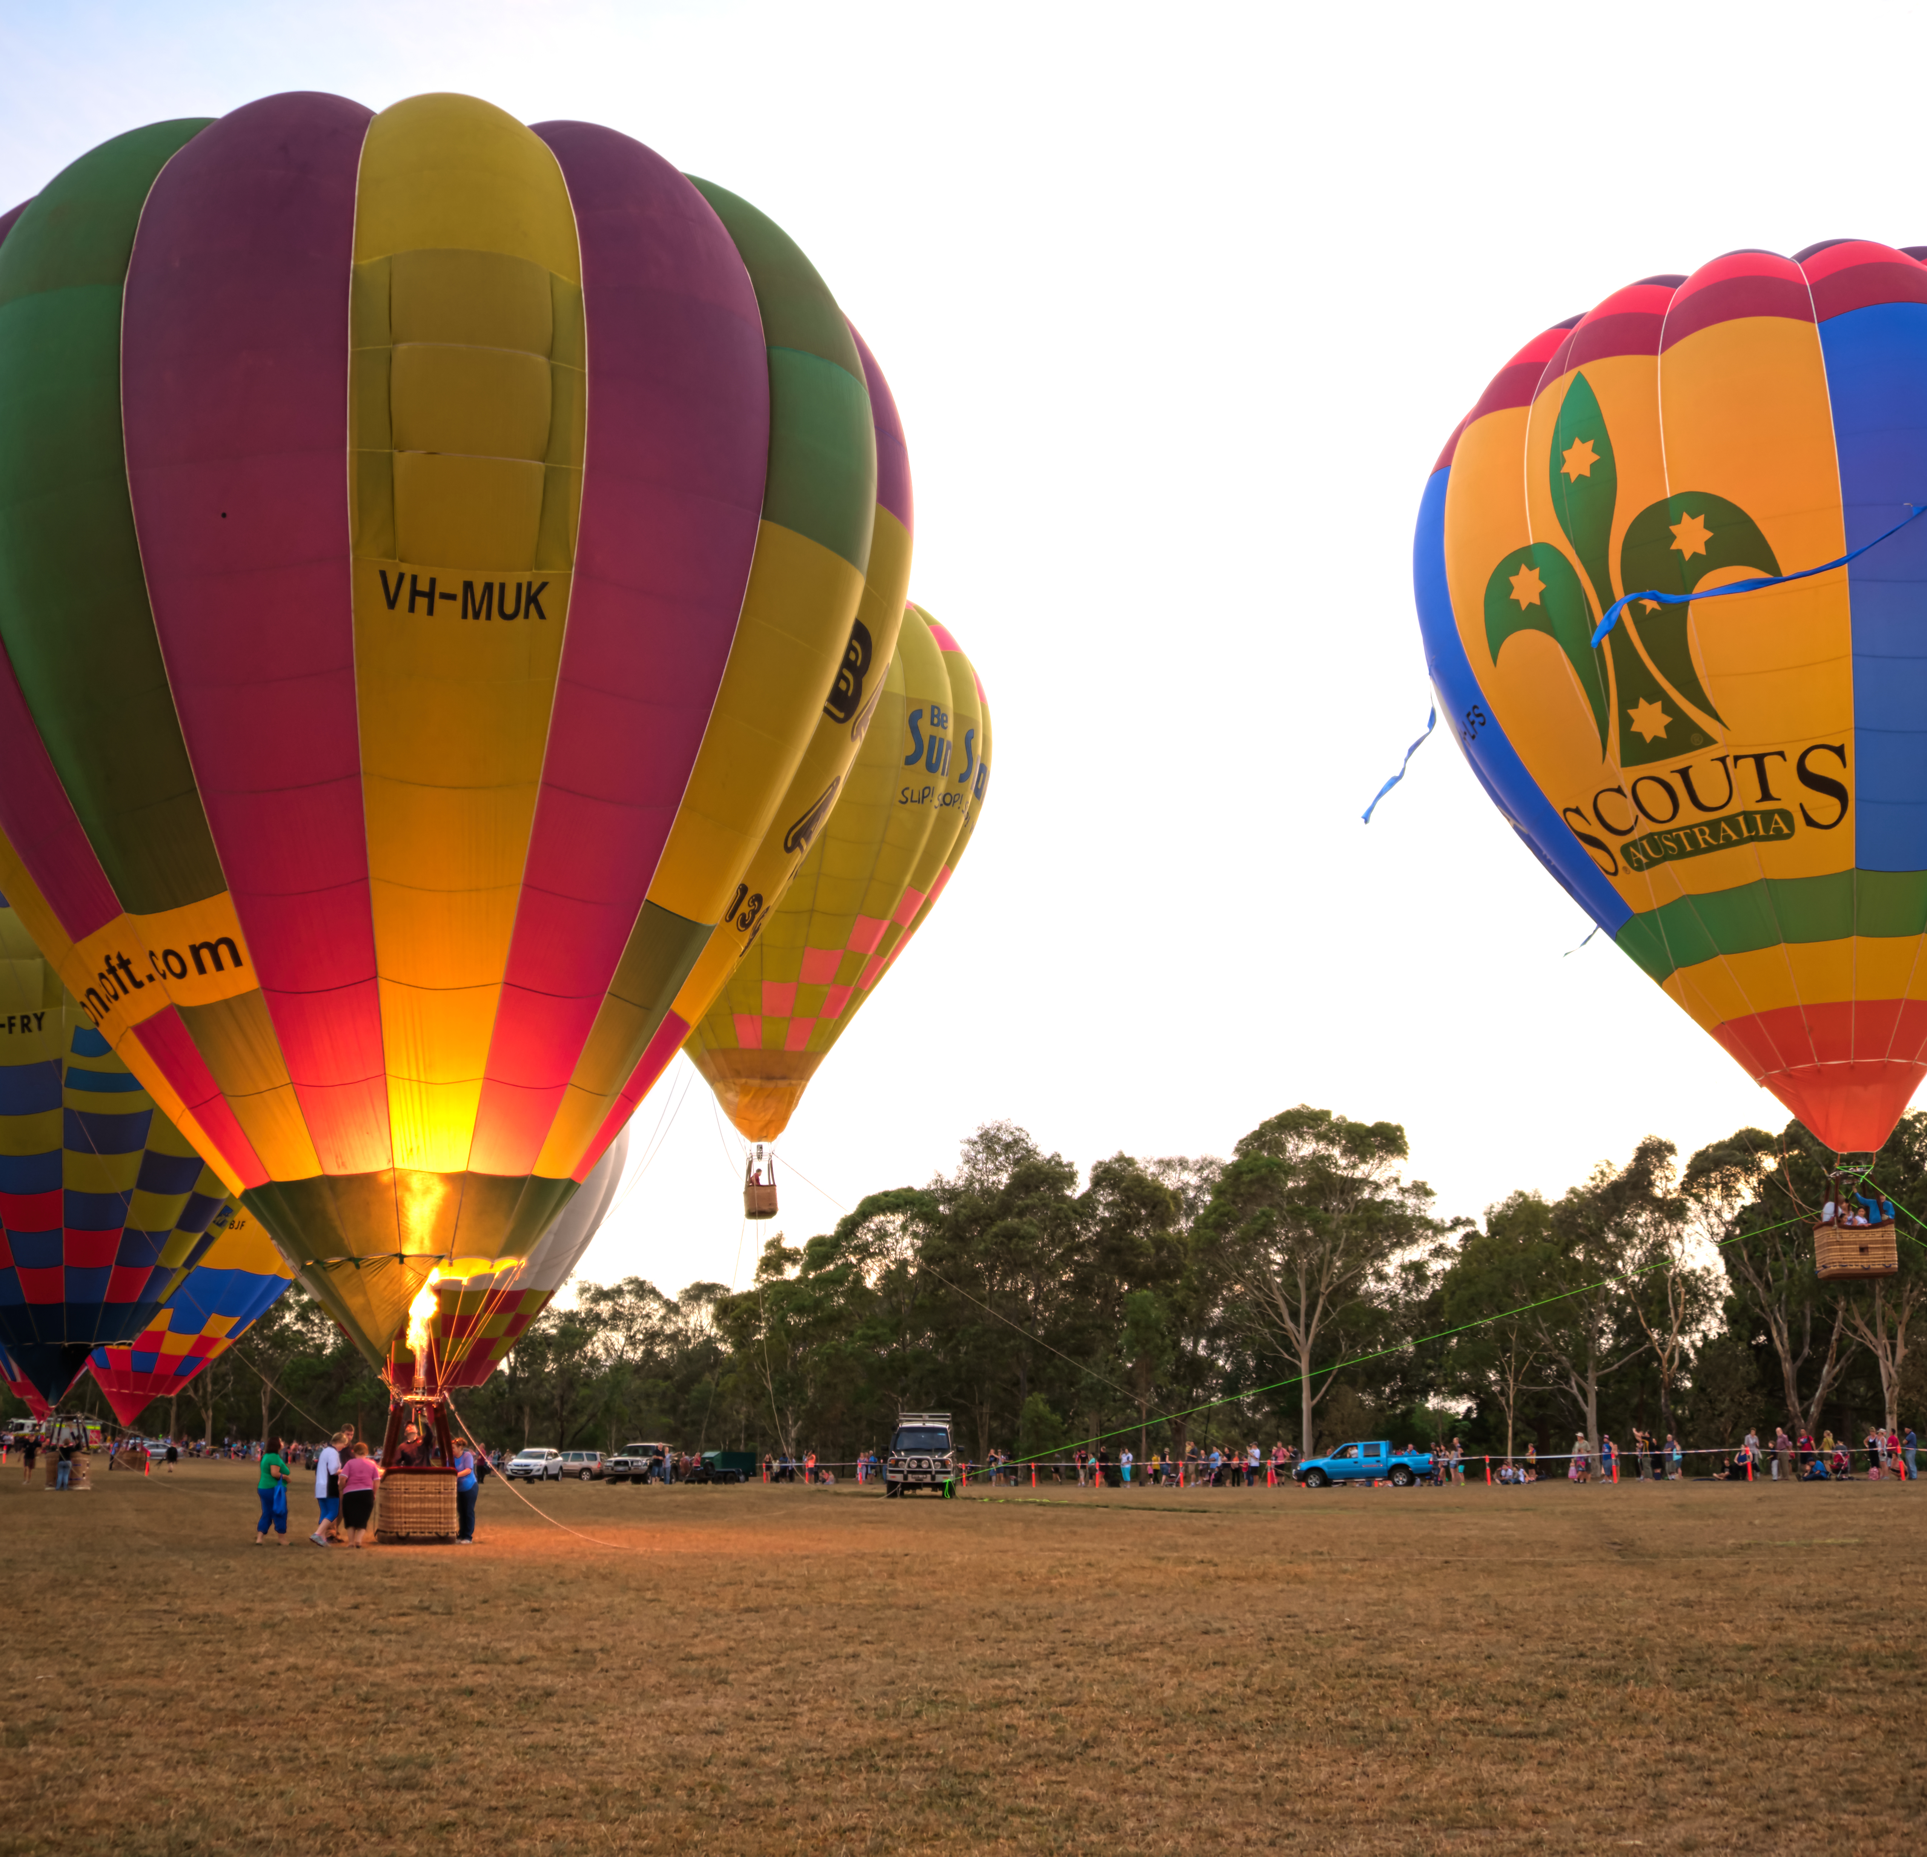
gatherings
Q1
At what event did Australia’s Biggest Citizenship Ceremony take place?

Slide 3
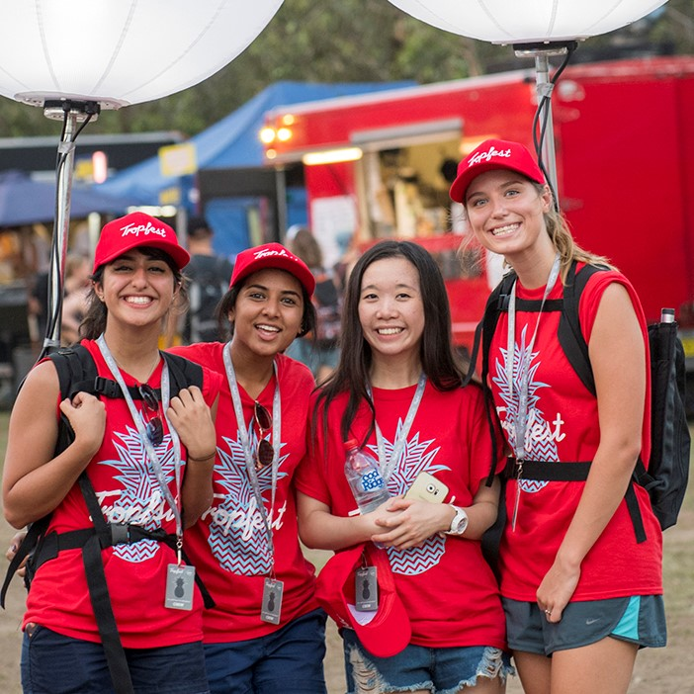
gatherings
Q2
What short film festival was first held in Parramatta in 2018?

Slide 4
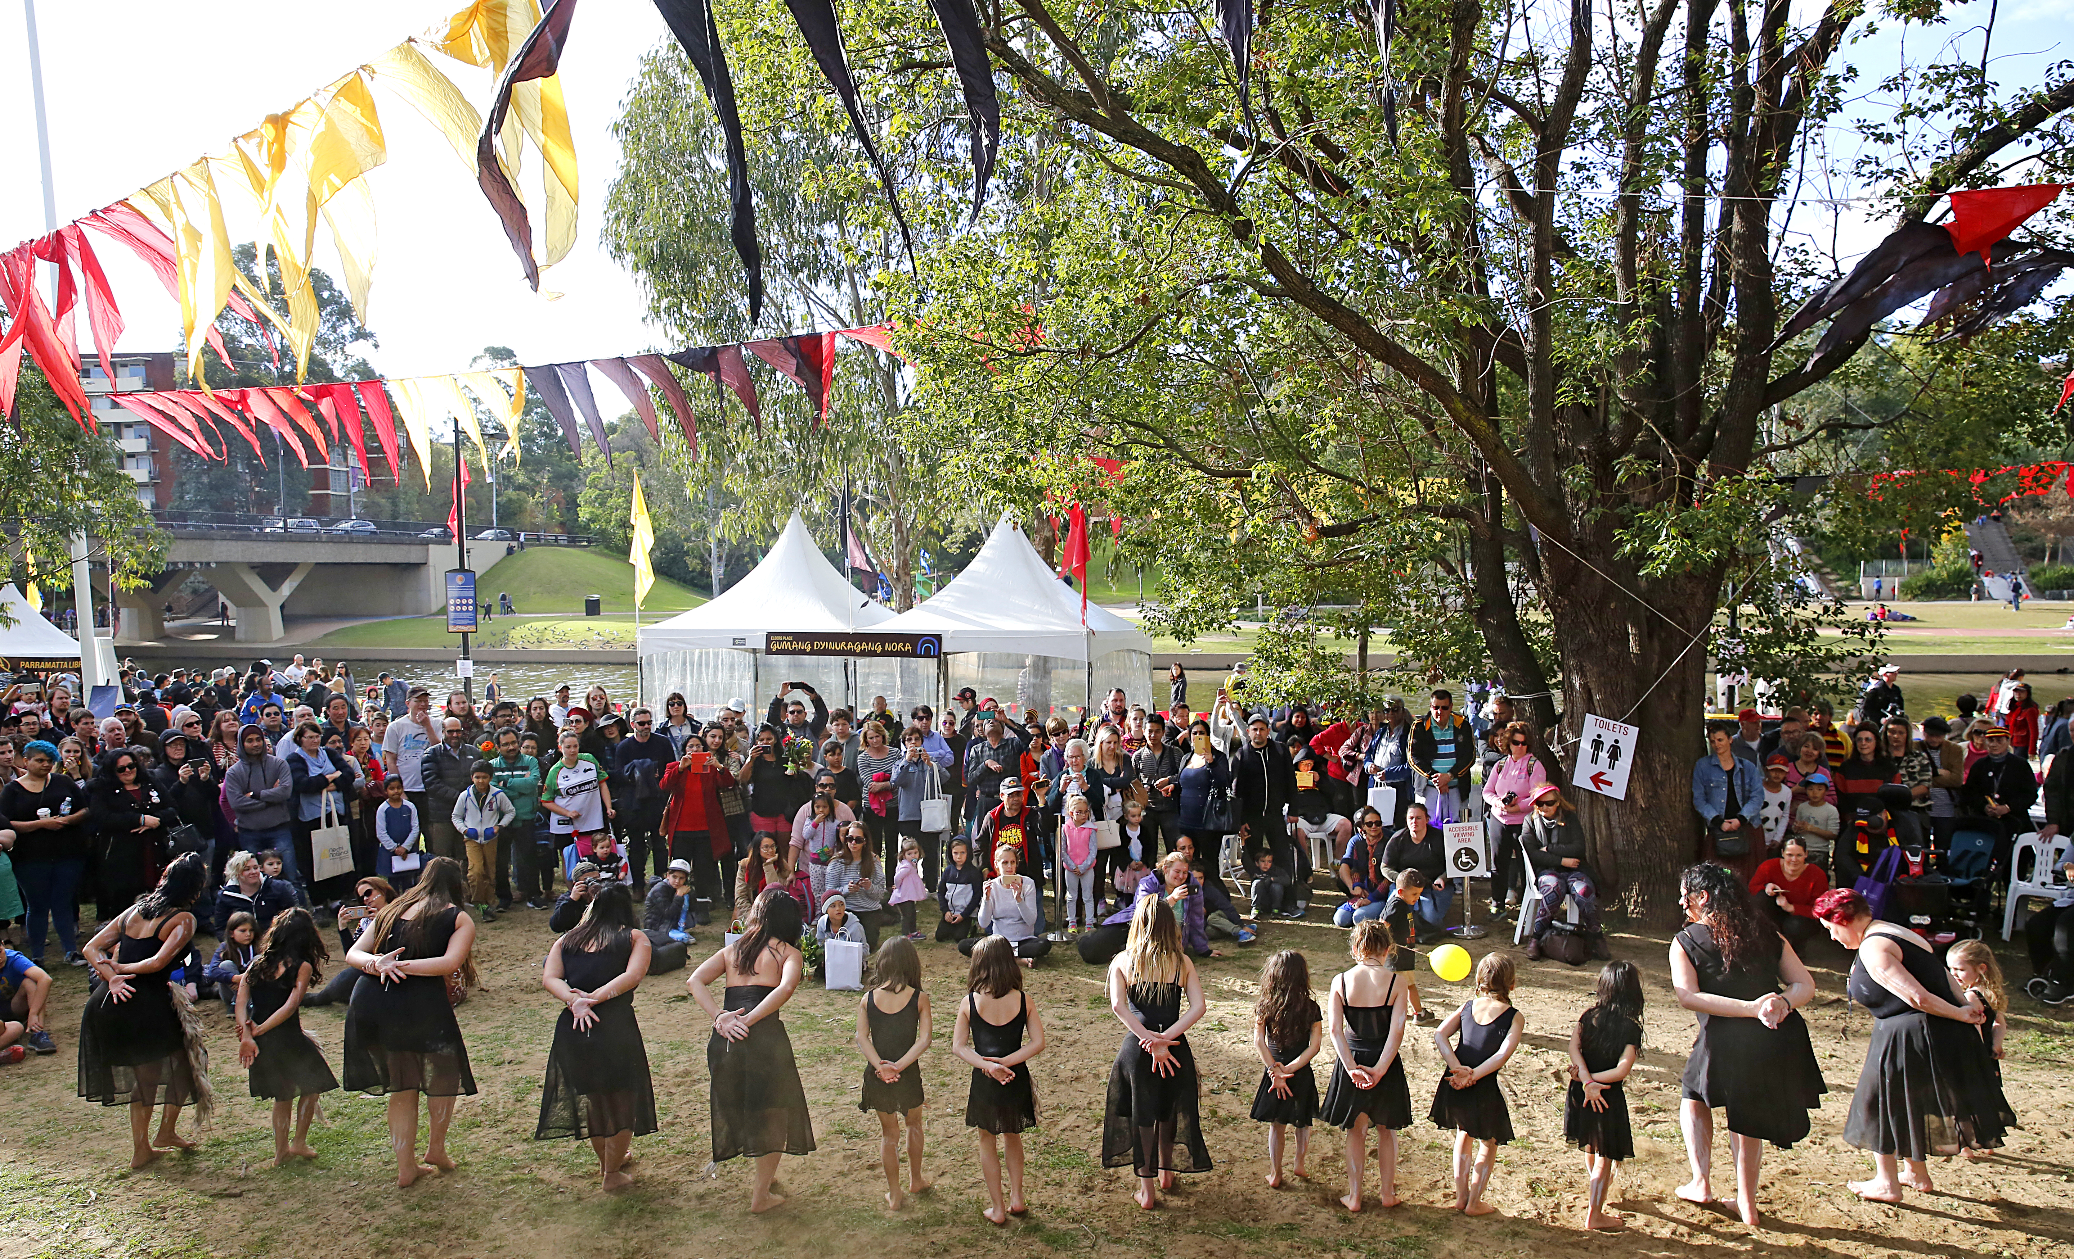
gatherings
Q3
What is Parramatta’s annual NAIDOC (National Aboriginal and Torres Strait Islander Day Observance Committee) celebration known as?

Slide 5
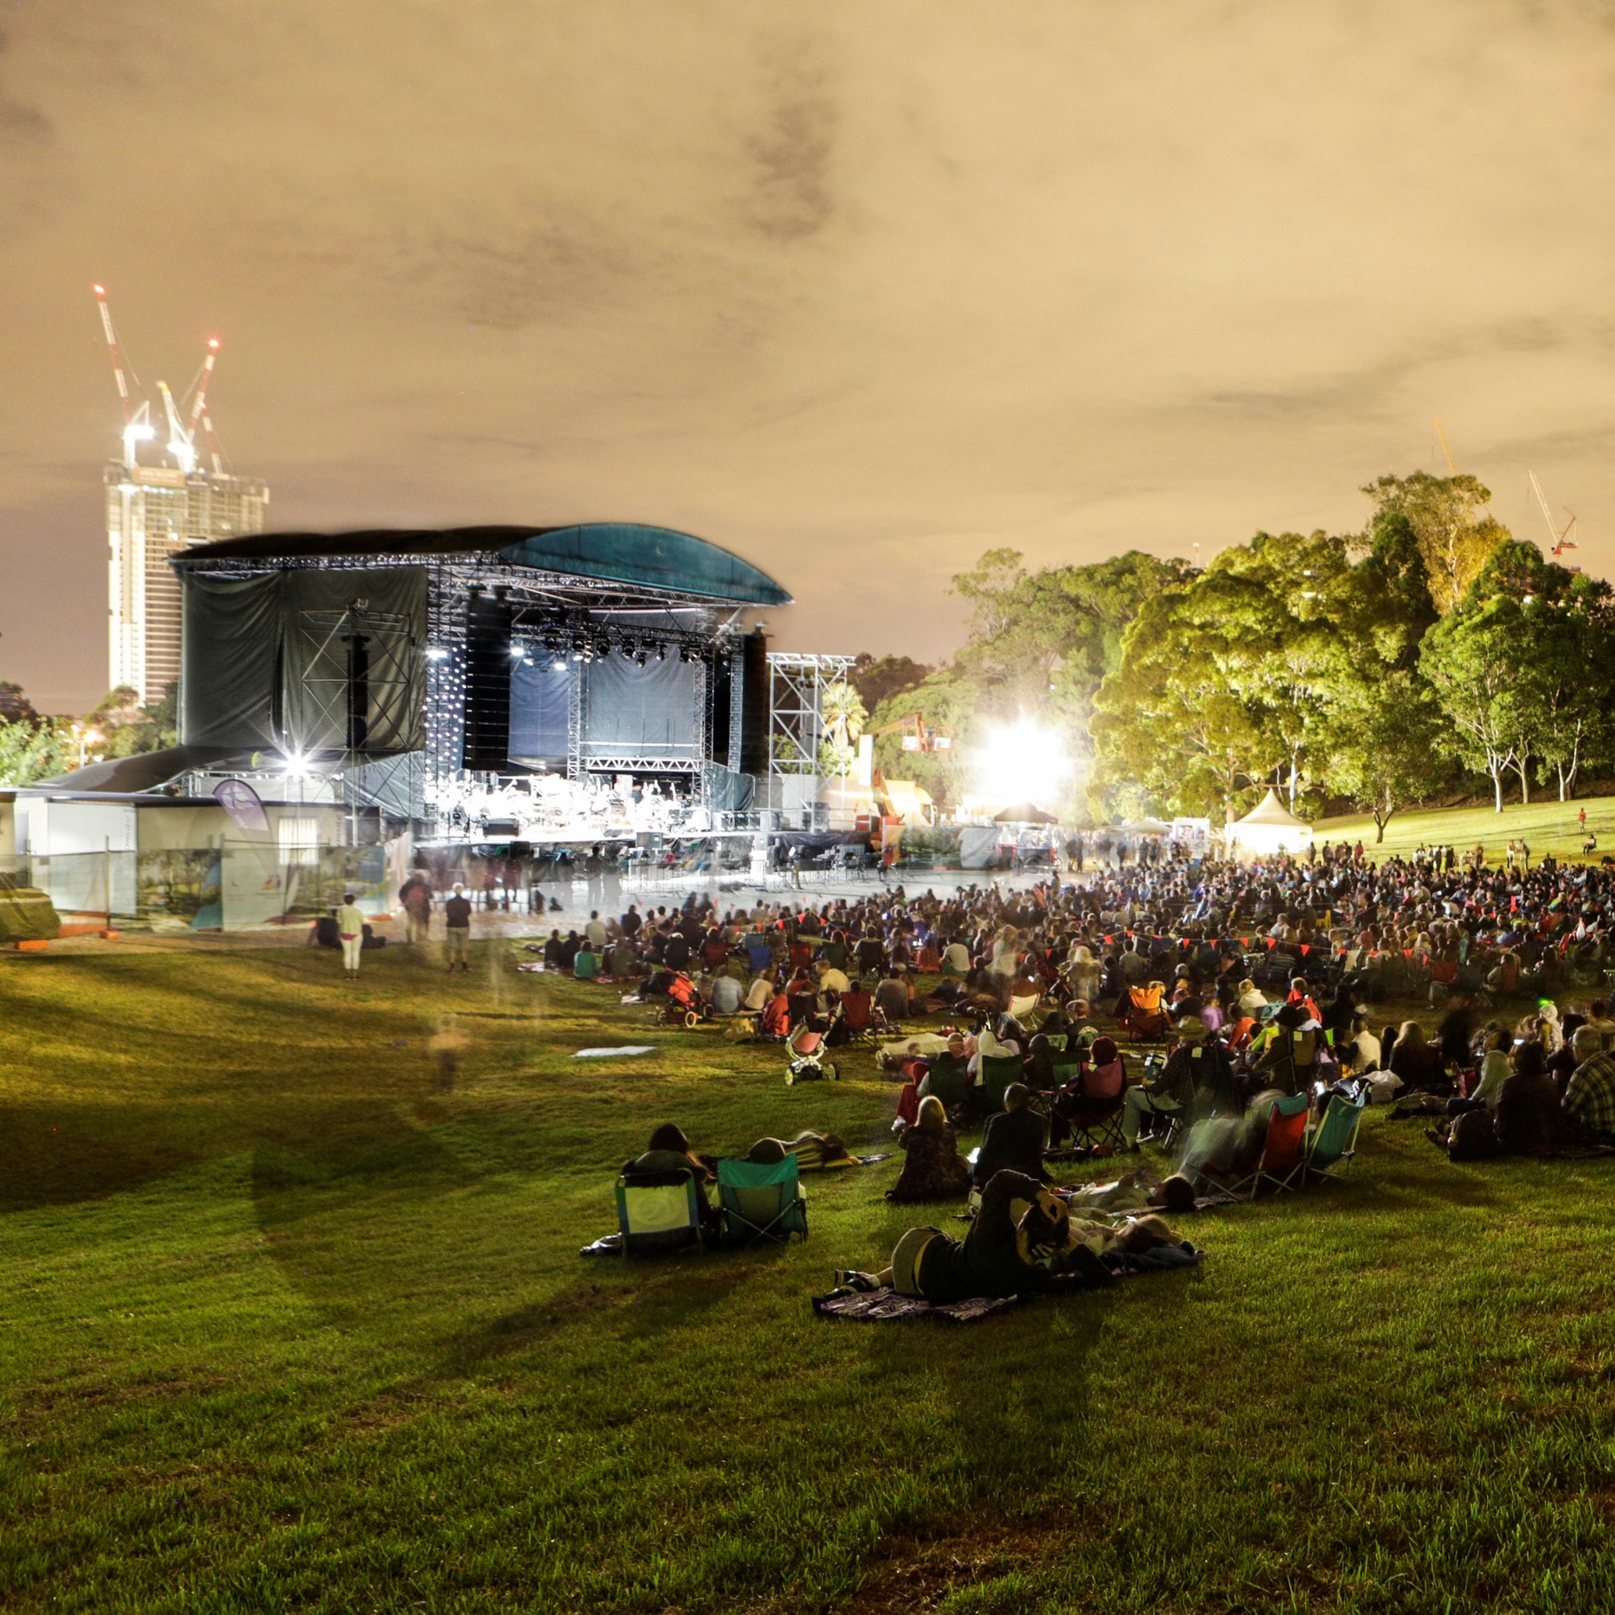
gatherings
Q4
In what part of Parramatta Park do outdoor music festivals take place?

Slide 6
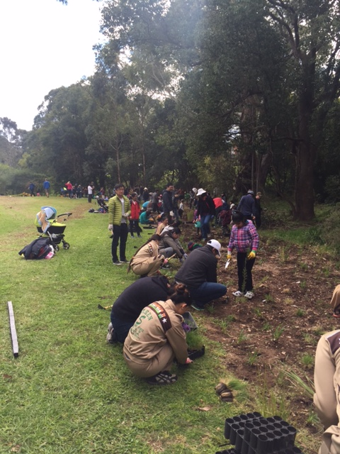
gatherings
Q5
At what annual event do volunteers plant thousands of trees in a bushland reserve in the Parramatta LGA?

Slide 7
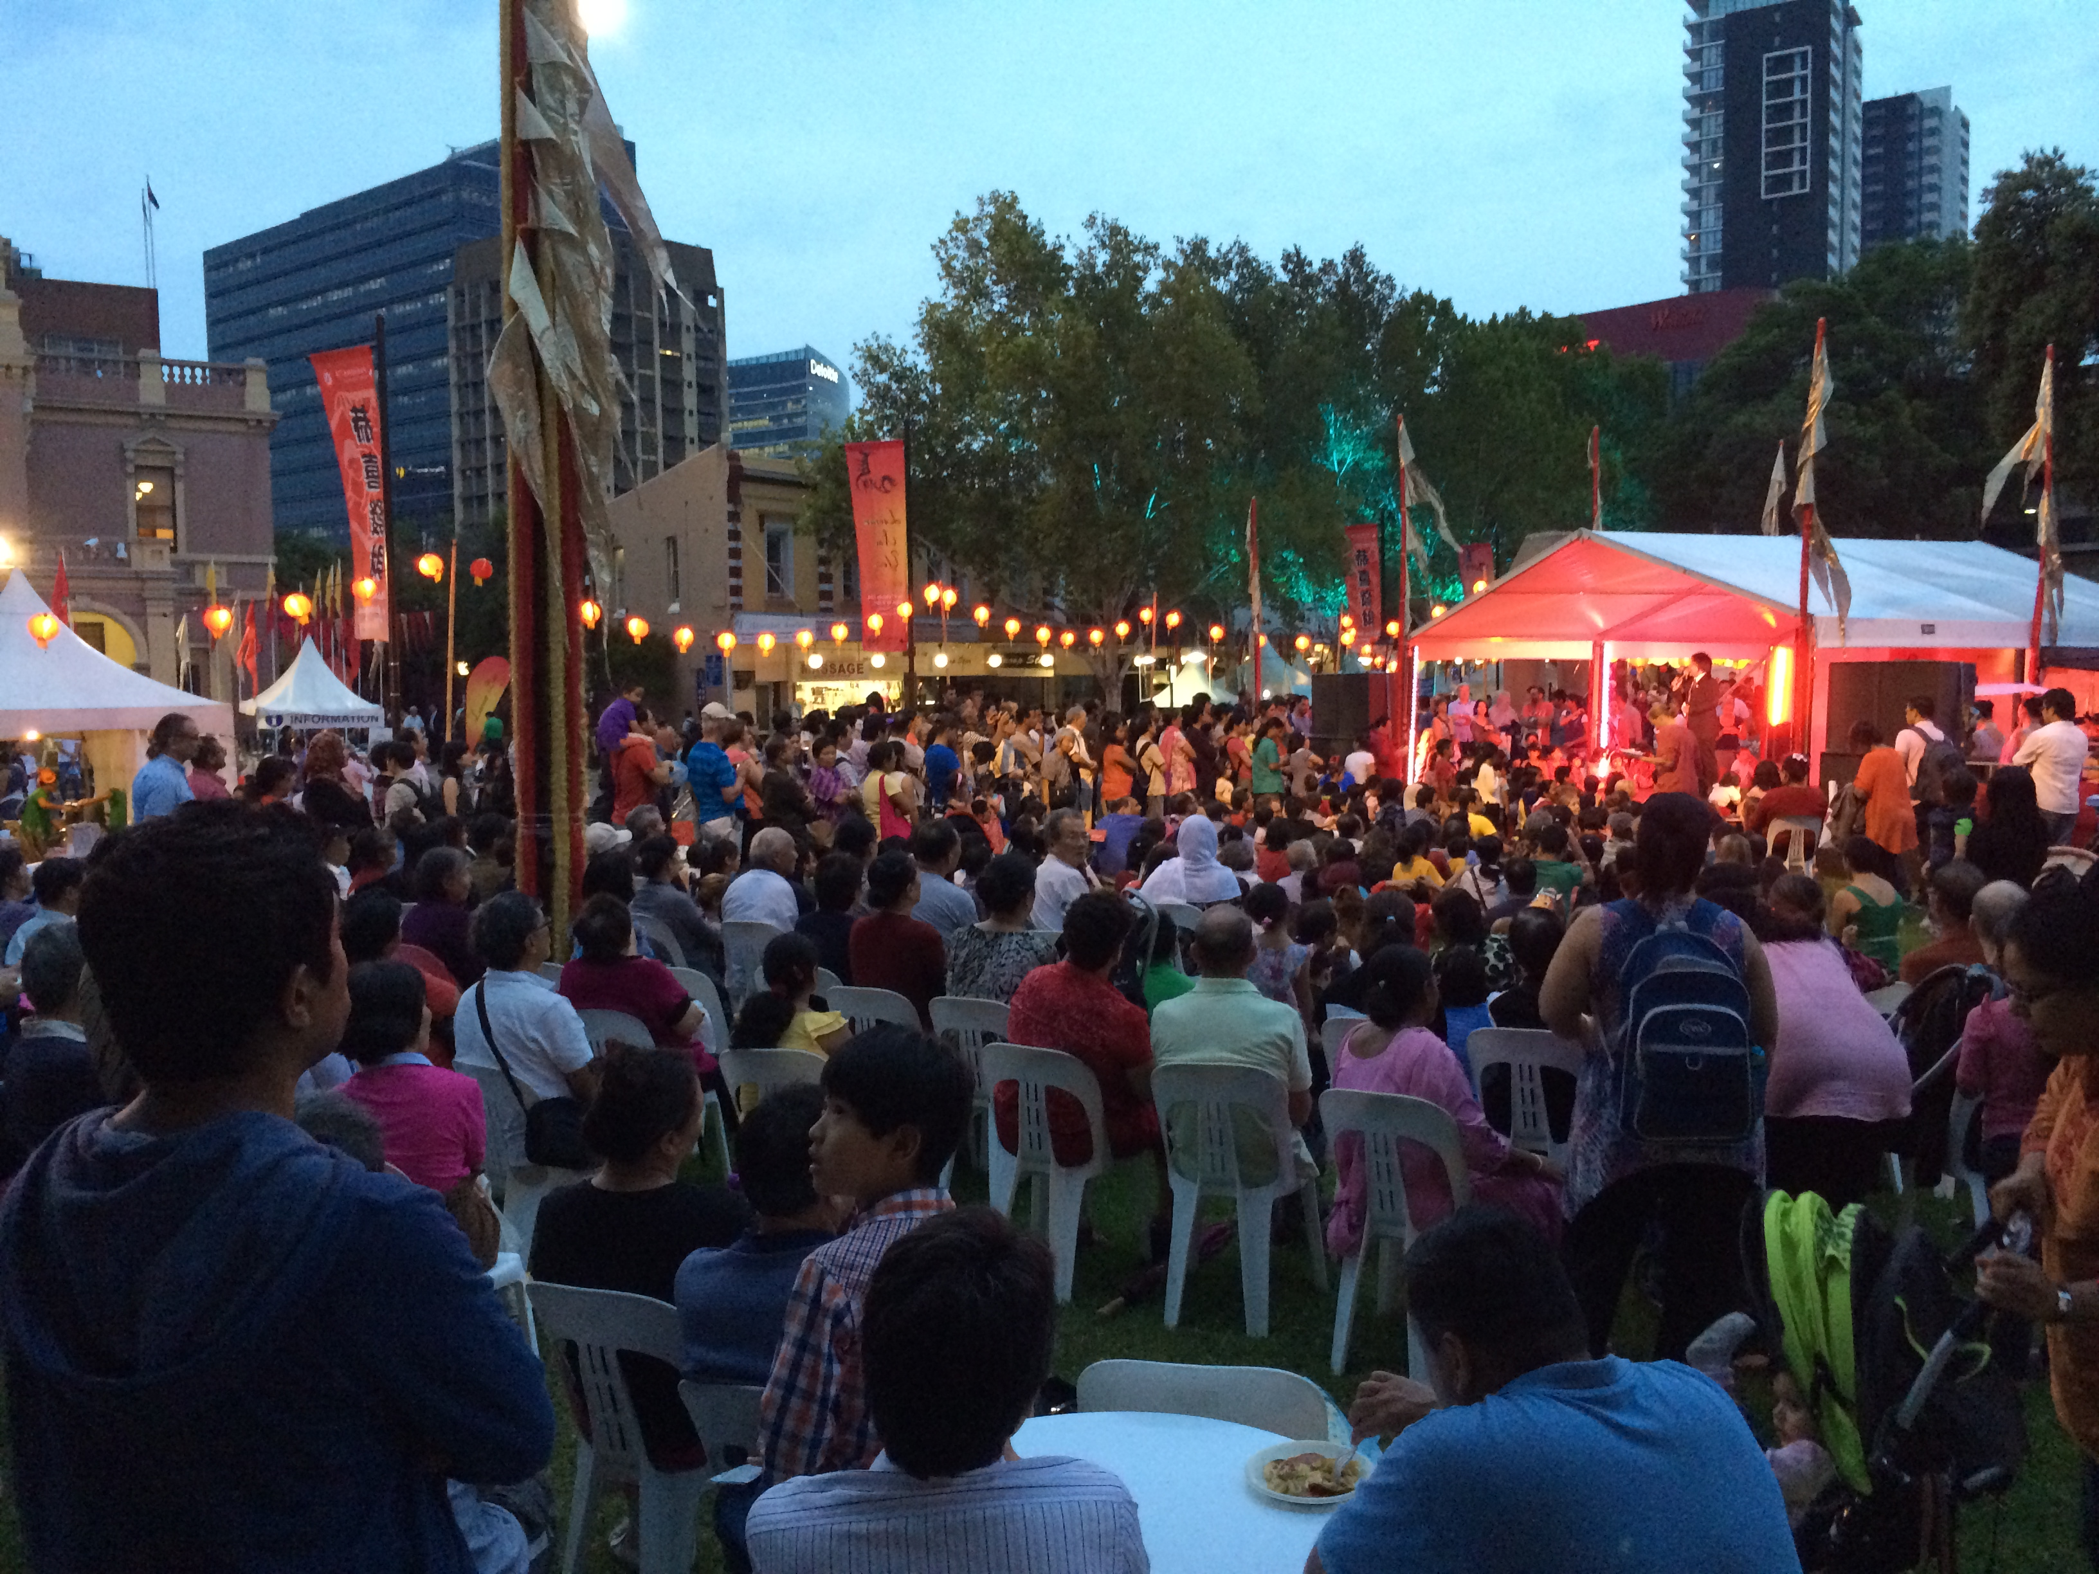
gatherings
Q6
What festival, held in Centenary Square, includes the Dragon Dance, fortune cookies and firecrackers?

Slide 8
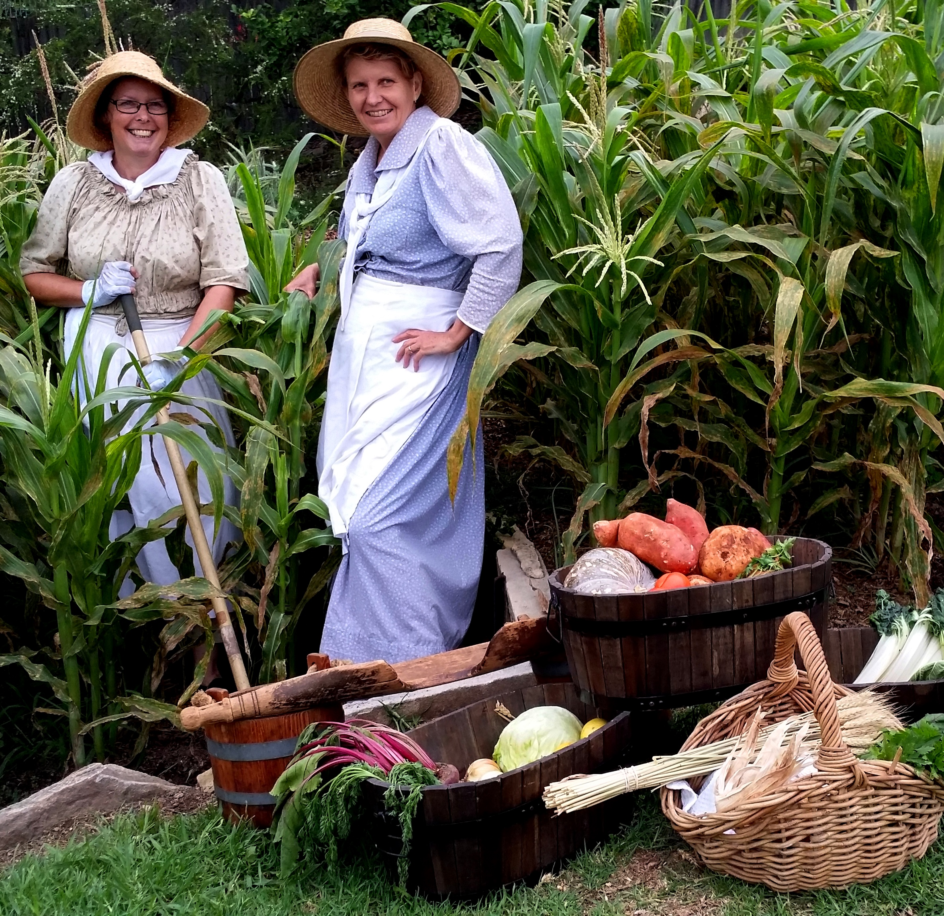
gatherings
Q7
During what national festival, running from mid-April to mid-May, does Parramatta celebrate its rich history?

Slide 9
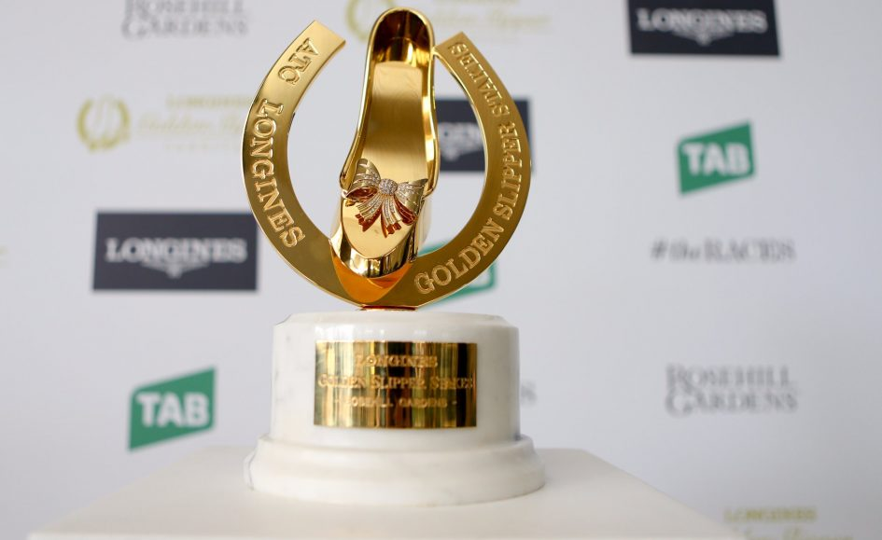
gatherings
Q8
What is the Autumn Racing Festival, with its feature race run at Rosehill Racecourse, known as?

Slide 10
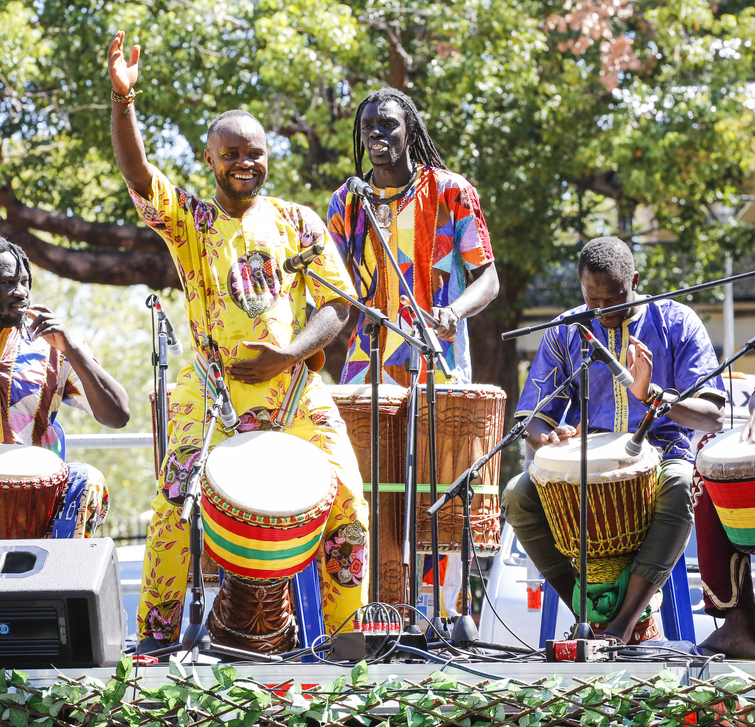
gatherings
Q9
Which multi-cultural celebration, held in March, includes workshops, live performances from across the globe and international food offerings?

Slide 11
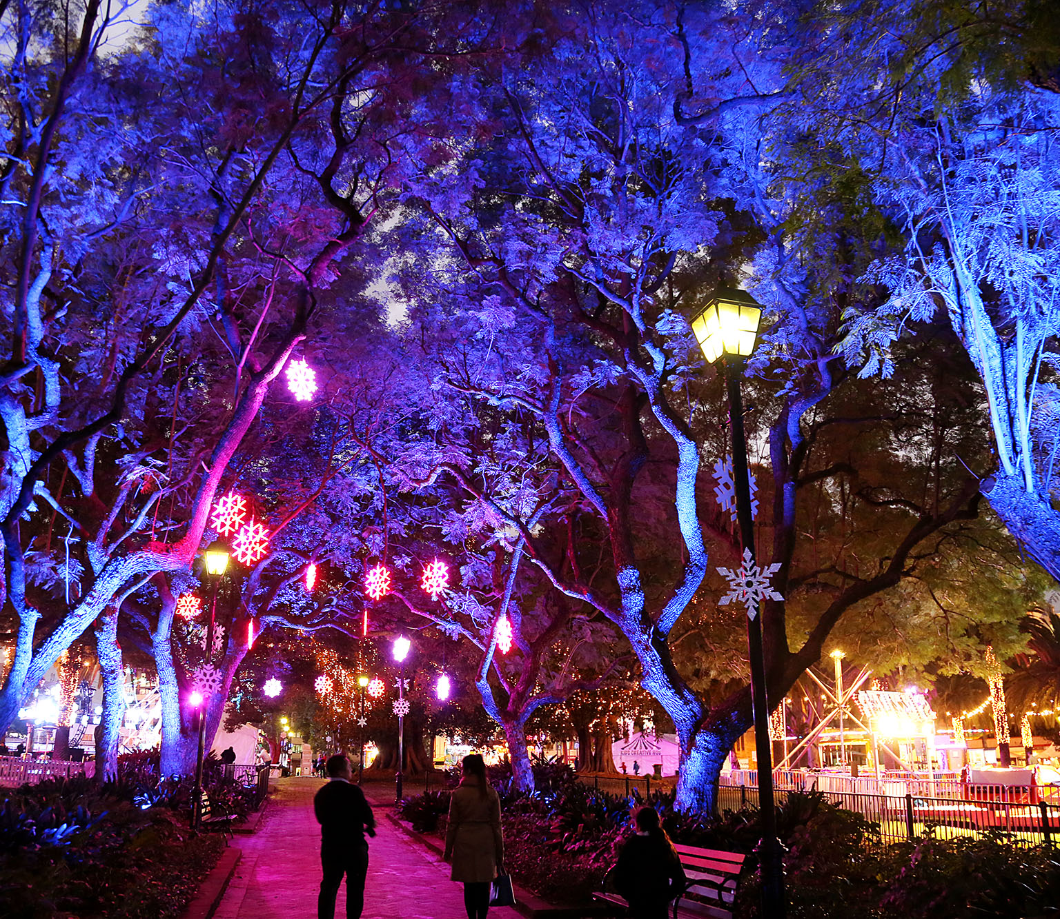
gatherings
Q10
What family festival, held in Prince Alfred Square, lights up Parramatta in the dark of winter?

Slide 12
Gatherings - answers
Australia Day in Parramatta Park 2019
Tropfest
Burramatta Day, after our traditional custodians, the Burramatagal clan of the Darug nation.
The Crescent
National Tree Day
Lunar New Year
National Trust Heritage Festival
The Golden Slipper Carnival
Parramasala
Winterlight
Notes:
Gatherings – Answers
1. At what event, in 2019, did Australia’s Biggest Citizenship Ceremony take place? Australia Day in Parramatta Park
2. What film festival was first held in Parramatta in 2018? Tropfest
3. What is Parramatta’s NAIDOC (National Aboriginal and Torres Strait Islander Day Observance Committee) Week celebration known as? Burramatta Day, after our traditional custodians the Burramatagal clan of the Darug nation.
4. In what very historic part of Parramatta Park do outdoor music festivals take place? The Crescent
5. At what event do volunteers plant thousands of trees in a bushland reserve in the Parramatta LGA? National Tree Day
6. What festival, held in Centenary Square, includes the Dragon Dance, fortune cookies and firecrackers? Lunar New Year
7. In what national festival, running from mid-April to mid-May, does Parramatta celebrate its rich history? National Trust Heritage Festival
8. What is the Autumn Racing Festival, with its feature race run at Rosehill Racecourse, known as? The Golden Slipper Carnival
9. Which multi-cultural celebration, held in March, includes workshops, live performances from across the globe and international food offerings? Parramasala
10. What family celebration, held in Prince Alfred Square, lights up Parramatta in the dark of winter? Winterlight

Slide 13
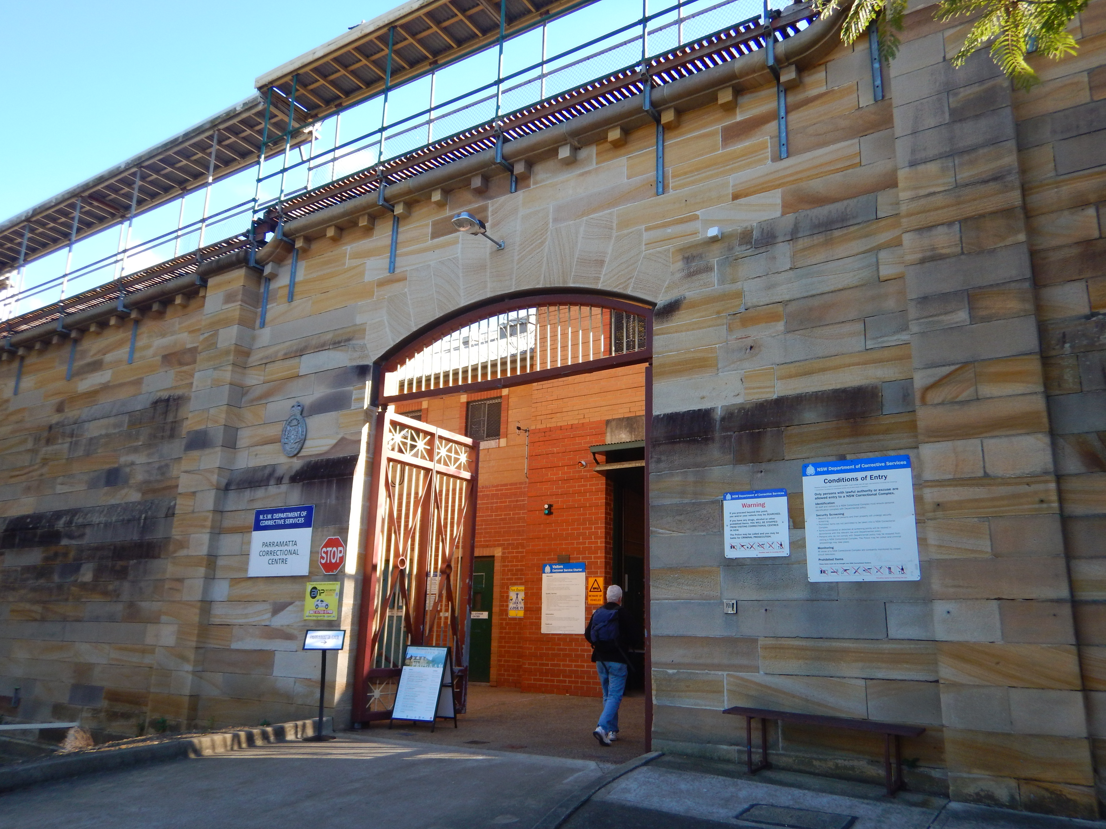
WHat AM I?
I was the third facility of my type to be built in Parramatta
I was opened by Governor Gipps
I was a manufactory producing boots, brushes, tinware, clothes, joinery and foodstuffs
In WW2 I contributed to the war effort by supplying and reconditioning military equipment
I was designed by Mortimer Lewis, built by James Houison and Nathaniel Payten, with many additions to my range of buildings over the years
I was badly damaged by fire in 1907 and my workshops were gutted by fire in 1975
I was finally closed in 2011
In 1979 Albert Productions recorded a live album on site, featuring a gathering of Australian rock royalty
Unusually, an attempt was made to break into me in 1926
My ownership was transferred to the Deerubbin Land Council in 2015
Parramatta Gaol

