Slide 1
Green & gorgeous
Parramatta
Notes:
Before starting online meeting:
Select Slide show from top bar and click “From beginning”
You will be able to see the notes; participants will only see slides
Before starting quiz:
Check that participants have a pen and paper at the ready, to write down their answers.
Each correct answer is worth 1 point.
If playing in teams, remind groups to mute their mic as they discuss their answer, so they don’t accidentally tell other teams.
Remember to speak slowly and clearly, so everyone understands the questions.
Check that everyone is ready before moving on to next question.

Slide 2
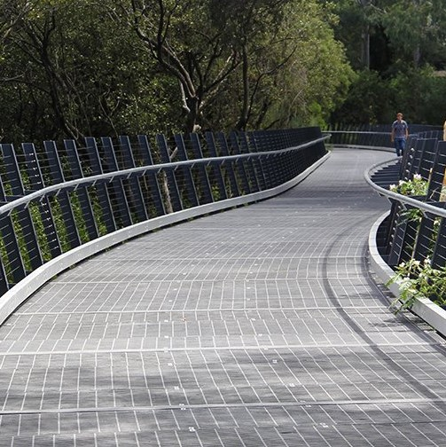
Green & gorgeous
Q1
Which riverside reserve commemorates an entrepreneurial young Aboriginal man who traded fish with the colonists?

Slide 3
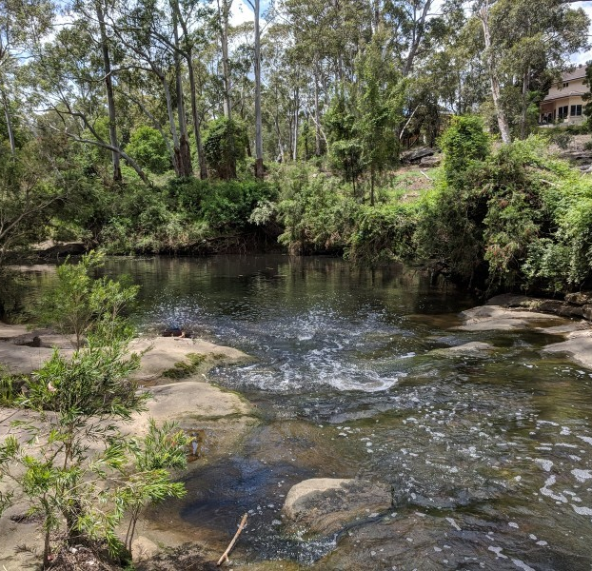
Green & gorgeous
Q2
Which bushland reserve in Winston Hills is named for its significance in colonial times?

Slide 4
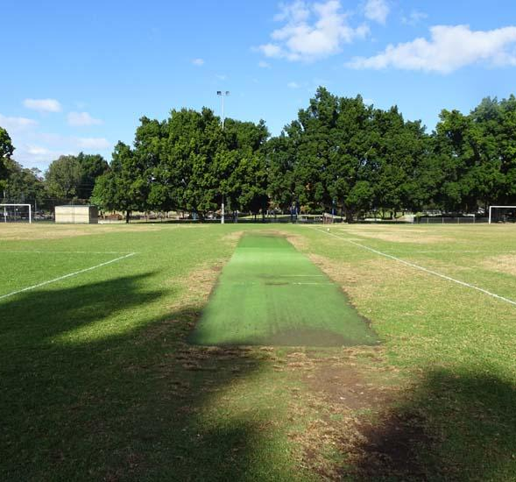
Green & gorgeous
Q3
Which popular sporting reserve is located on a site where a colonial barracks once stood?

Slide 5
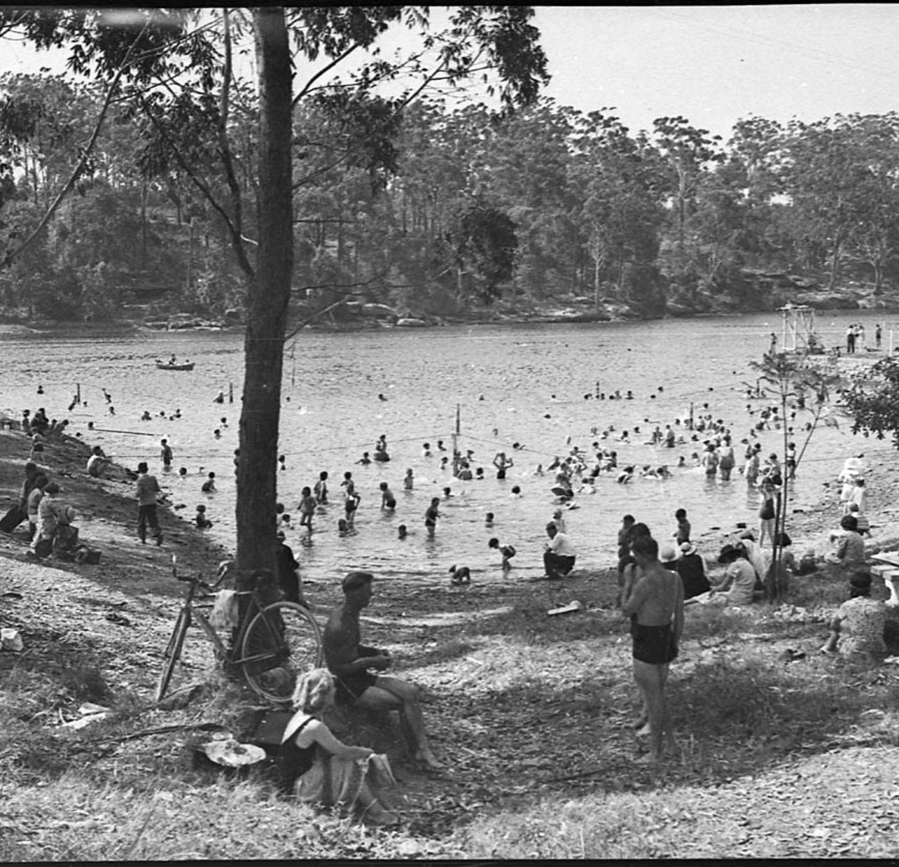
Green & gorgeous
Q4
Lifeguards were reintroduced to Lake Parramatta Reserve to safeguard swimmers during the 2014-15 season, for the first time since 1947 – true or false?

Slide 6
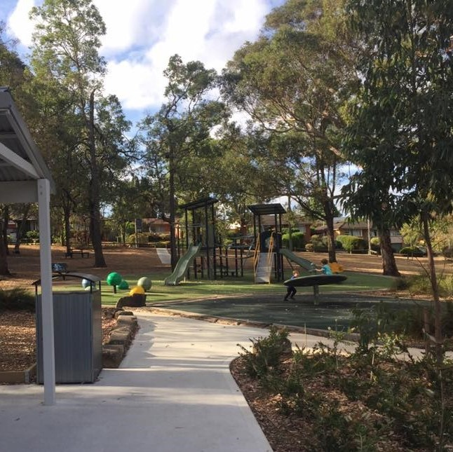
green & gorgeous
Q5
Which Australian wartime Prime Minister has a reserve named after him in Winston Hills?
  Gough Whitlam
  Joseph Cook
  John Curtin
  Robert Menzies

Slide 7
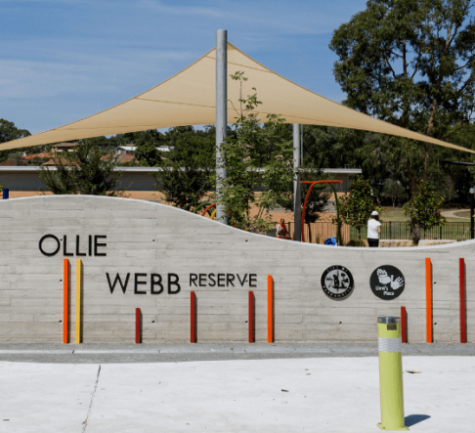
green & gorgeous
Q6
An all-inclusive playground and water play park was opened in Ollie Webb Reserve in 2020 – true or false?

Slide 8
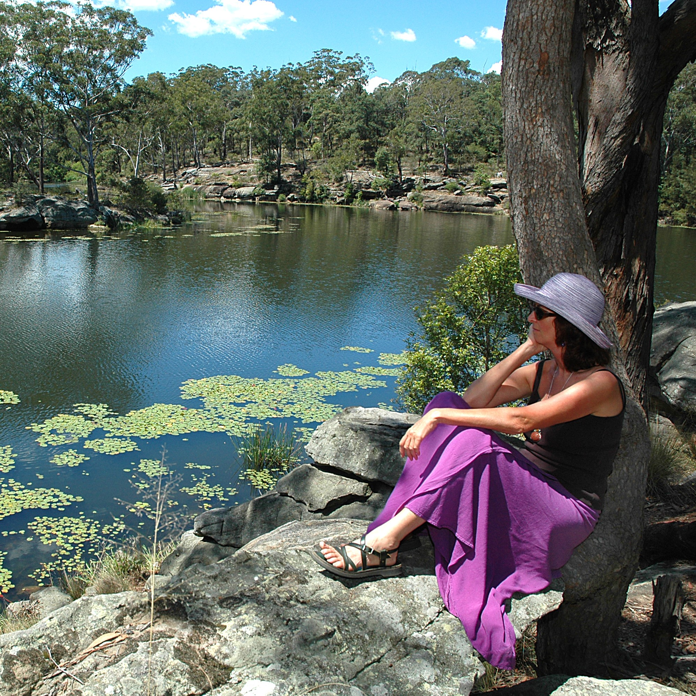
green & gorgeous
Q7
Which is the largest bushland reserve in the City of Parramatta Local Government Area?
  Arthur Philip Reserve
  Lake Parramatta Reserve
  Edna Hunt Sanctuary
  Vineyard Creek Reserve

Slide 9
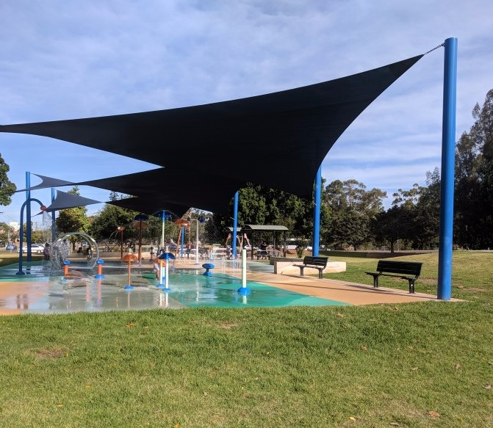
green & gorgeous
Q8
How many water playgrounds are located in the Parramatta LGA?

Slide 10
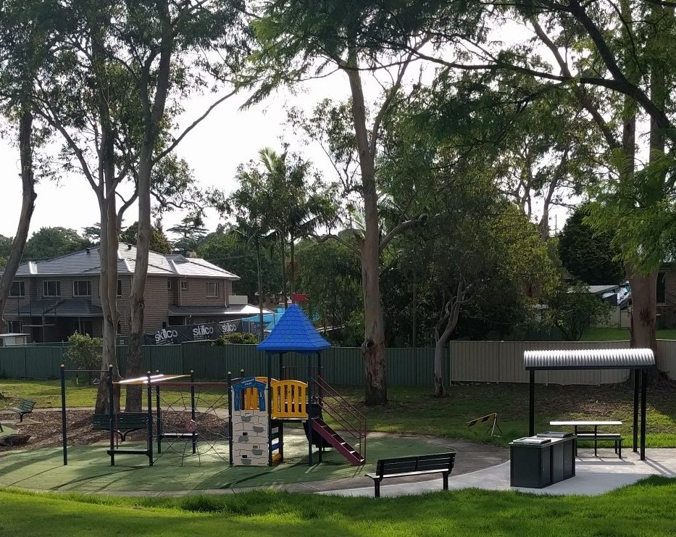
green & gorgeous
Q9
Which of the following council parks or reserves commemorates an Australian explorer?
  Sir Thomas Mitchell Reserve
  Hannibal Macarthur Park
  Sturt Park
  Both A and C

Slide 11
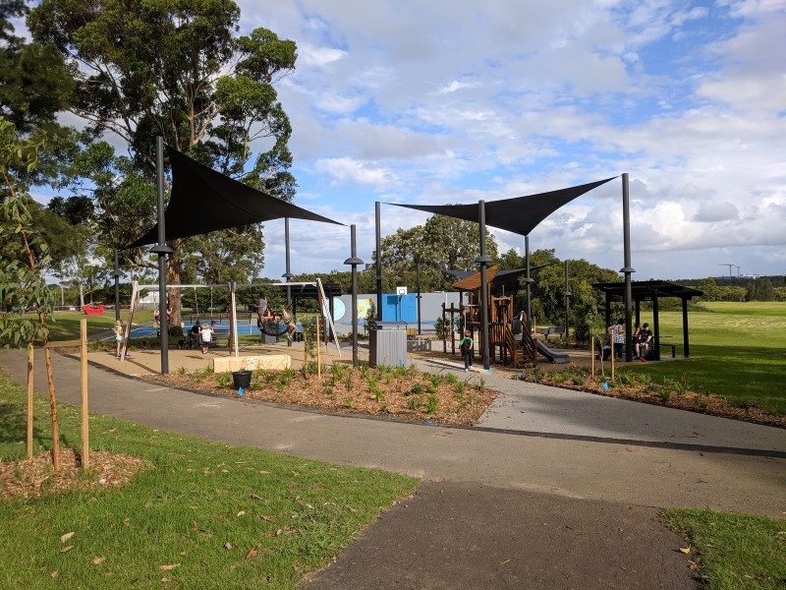
green & gorgeous
Q10
The very popular George Kendall Riverside Park boasts what amenities:
  Outdoor exercise equipment and a circuit path
  Accessible toilet and parking
  Barbecue and picnic facilities
  All of the above

Slide 12
green & gorgeous - answers
Baludarri Reserve
Third Settlement Reserve. It is on the site of the second Government Farm and was the third colonial settlement on the mainland.
Robin Thomas Reserve
False; the lake was closed for swimming from 1942-2014, during which time there were no lifesavers on duty.
C – John Curtin
True
B – at 73 hectares Lake Parramatta is the LGA’s largest bushland reserve
Three, at Ollie Webb Reserve, James Ruse Reserve and the Philip Ruddock water playground in Dundas Park
D - Both A and C; Sir Thomas Mitchell reserve and Sturt Park
D – all of the above. It also has a cycle path, meeting room, playground, tennis court and football and baseball grounds
Notes:
Green and Gorgeous - Answers
Which riverside reserve commemorates an entrepreneurial young Aboriginal man who traded fish with the colonists? Baludarri Reserve
Which bushland reserve is named for its significance in colonial times? Third Settlement Reserve, Winston Hills. It is on the site of the second government farm and was the third colonial settlement on the mainland.
Which popular sporting reserve is located on a site where a colonial barracks once stood? Robin Thomas Reserve
Lifesavers were reintroduced to Lake Parramatta Reserve to safeguard swimmers for the 2014-15 season, for the first time since 1947 – true or false? False; the lake was closed for swimming from 1942-2014, during which time there were no lifesavers on duty.
Which Australian wartime prime minister has a reserve named after him in Winston Hills? C – John Curtin
Gough Whitlam
Joseph Cook
John Curtin
Robert Menzies
An all-inclusive playground and water play park was opened in Ollie Webb Reserve, Parramatta in 2020 – true or false? True
Which is the largest bushland reserve in the City of Parramatta Local Government Area? B – at 73 hectares Lake Parramatta is the LGA’s largest bushland reserve.
Arthur Philip Reserve
Lake Parramatta Reserve
Edna Hunt Sanctuary
Vineyard Creek Reserve
How many water playgrounds are available in Parramatta LGA? Three, at Ollie Webb Reserve, James Ruse Reserve and the Philip Ruddock water playground in Dundas Park.
Which of the following council parks or reserves commemorates an Australian explorer? D - Both A and C
Sir Thomas Mitchell Reserve
Hannibal Macarthur Park
Sturt Park
Both A and C
The very popular George Kendall Riverside Park boasts what amenities: D – all of the above. It also has a cycle path, meeting room, playground, tennis court and football and baseball grounds.
Outdoor exercise equipment and a circuit path
Accessible toilet and parking
Barbecue and picnic facilities
All of the above

Slide 13
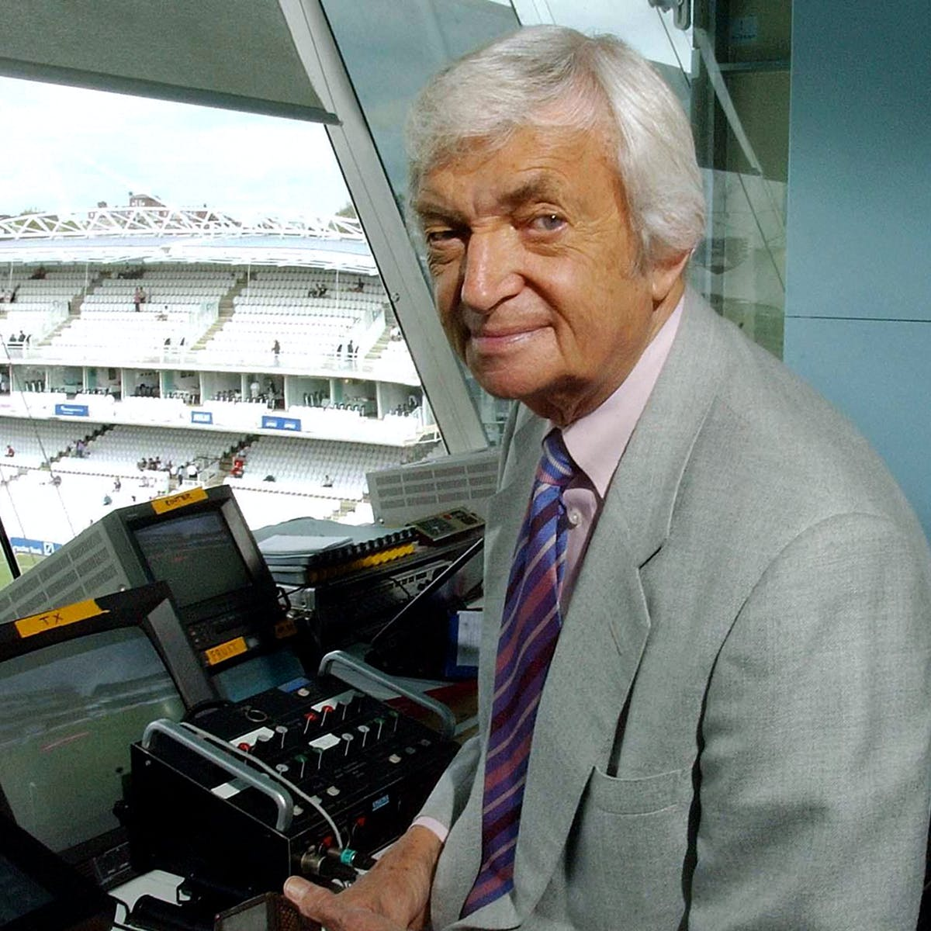
WHo AM I?
I grew up in Parramatta
I began my career playing for Cumberland
My representative career spanned 30 years, beginning with the NSW youth team and finishing as captain of a Commonwealth team
I am one of the legends in the Sport Australia Hall of Fame
My highest test batting score was 122
During the 1960-61 Frank Worrell Trophy series I played in the famous tied test
I am one of only 10 Australian cricketers to score more than 10,000 runs and take more than 500 wickets in first-grade cricket (as of 2020)
Marsden Park in North Parramatta was renamed in my honour
I had a distinguished media career, working for the BBC and the Nine network
I died in 2015
Richie Benaud

