Slide 1
heALTH & WELLBEING
Parramatta
Notes:
Before starting online meeting:
Select Slide show from top bar and click “From beginning”
You will be able to see the notes; participants will only see slides
Before starting quiz:
Check that participants have a pen and paper at the ready, to write down their answers.
Each correct answer is worth 1 point.
If playing in teams, remind groups to mute their mic as they discuss their answer, so they don’t accidentally tell other teams.
Remember to speak slowly and clearly, so everyone understands the questions.
Check that everyone is ready before moving on to next question.

Slide 2
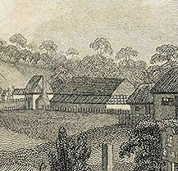
Health & wellbeing
Q1
By what name was Parramatta’s first hospital known? Hint – relating to camping

Slide 3
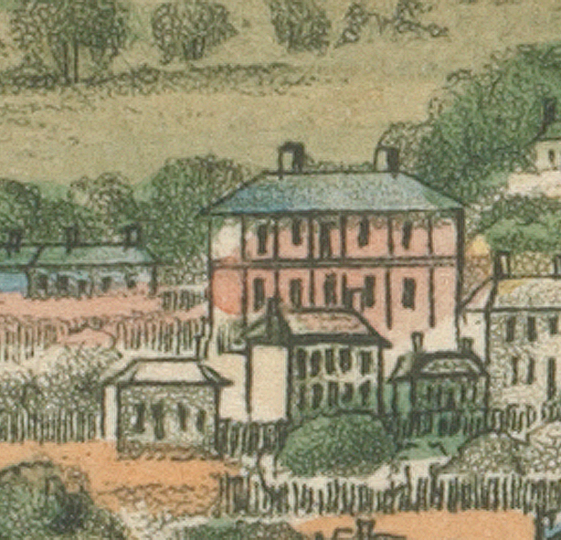
Health & wellbeing
Q2
Who wrote in 1818, 'I do not believe that there was ever such a place for want, debaucheries and for every vice as the general hospital at Parramatta’:
Judge Advocate David Collins
Governor Macquarie
Reverend Samuel Marsden
Elizabeth Macquarie

Slide 4
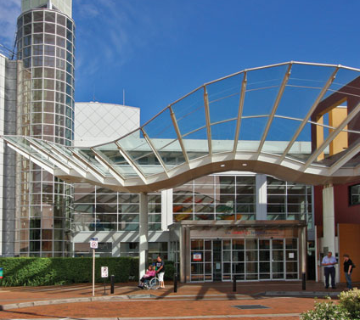
Health & wellbeing
Q3
What year was The Children’s Hospital at Westmead opened?

Slide 5
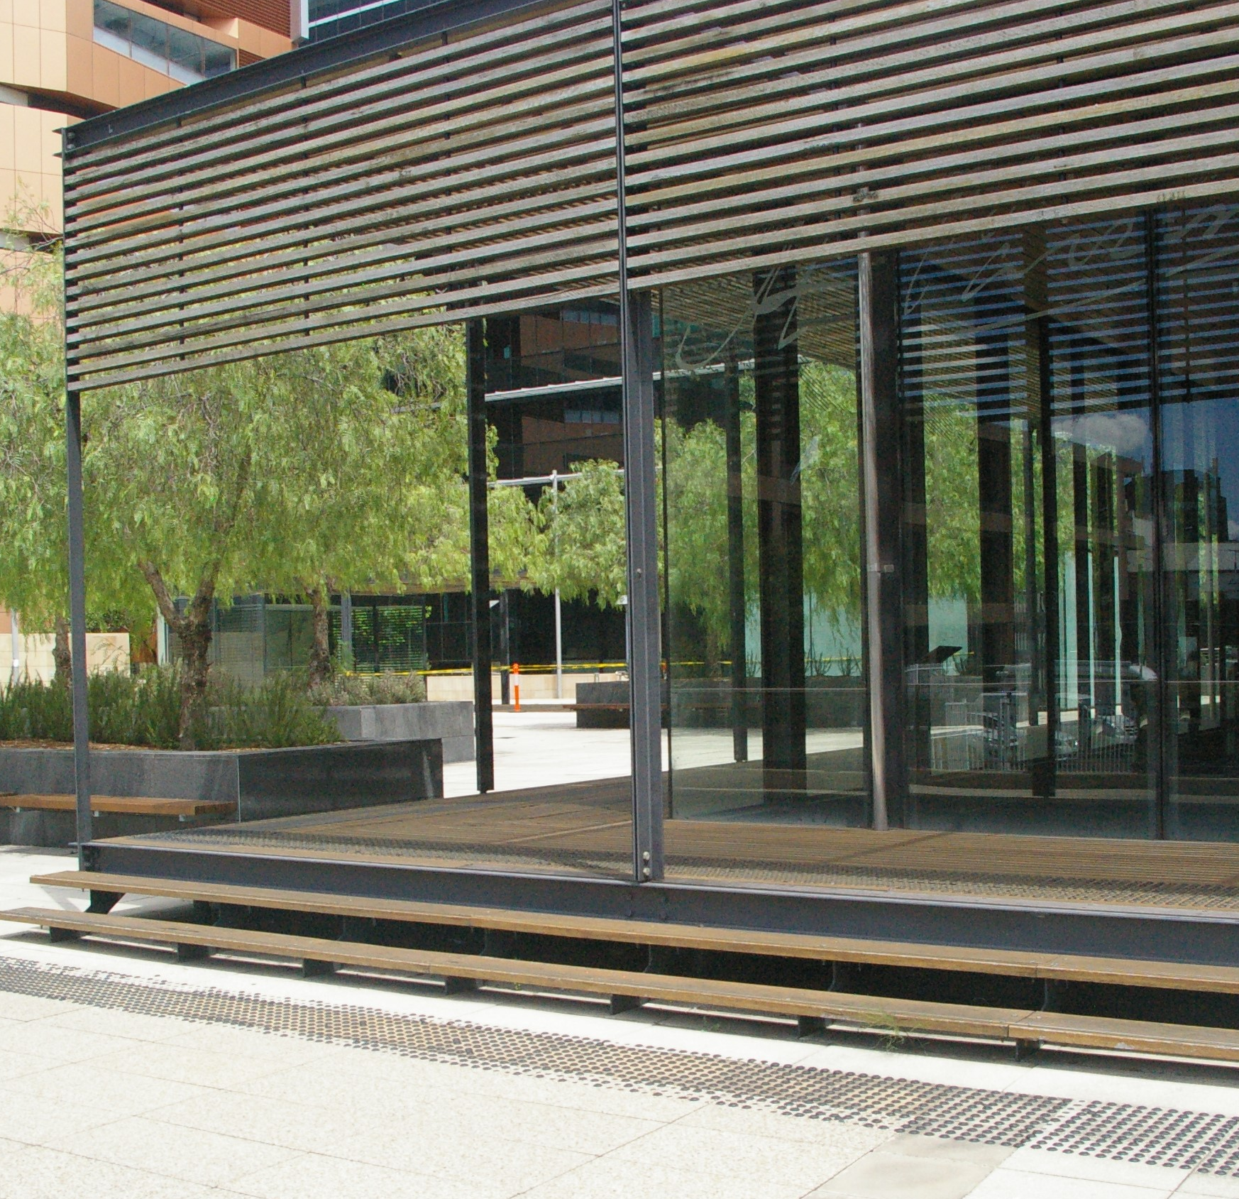
Health & wellbeing
Q4
Which remains of the Colonial Hospital can be seen in the Heritage Courtyard and Colonial Hospital Pavilion?
  Building foundations and outlines
  Artefacts found on site
  A section of convict era drain
  All of the above

Slide 6
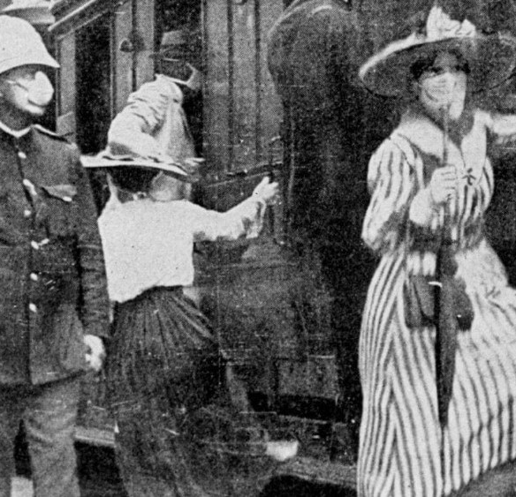
Health & wellbeing
Q5
What pandemic spread through Parramatta in 1919?

Slide 7
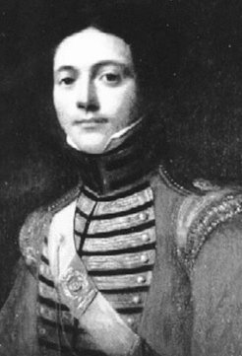
Health & wellbeing
Q6
After escaping conviction of highway robbery 3 times, who arrived as assistant surgeon in 1790 rising to principal surgeon in 1811?

Slide 8
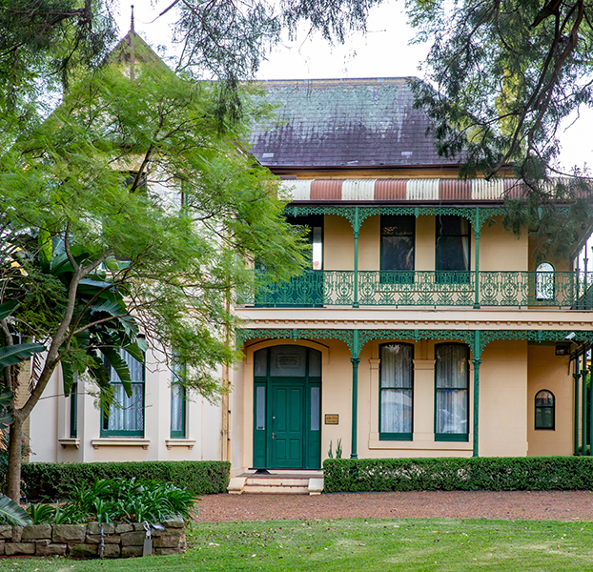
Health & wellbeing
Q7
True or false - historic Willowgrove, on Philip Street, was once a maternity hospital?

Slide 9
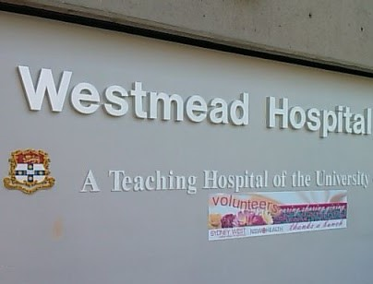
Health & wellbeing
Q8
Which university’s Clinical School is located at Westmead Hospital?

Slide 10
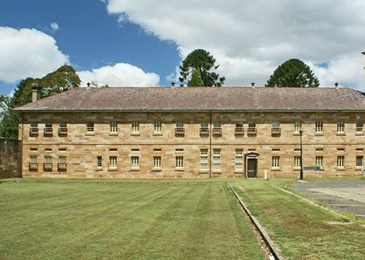
Health & wellbeing
Q9
Cumberland Hospital now provides cutting-edge mental health services in Parramatta, but what was the first psychiatric institution in Parramatta called?

Slide 11
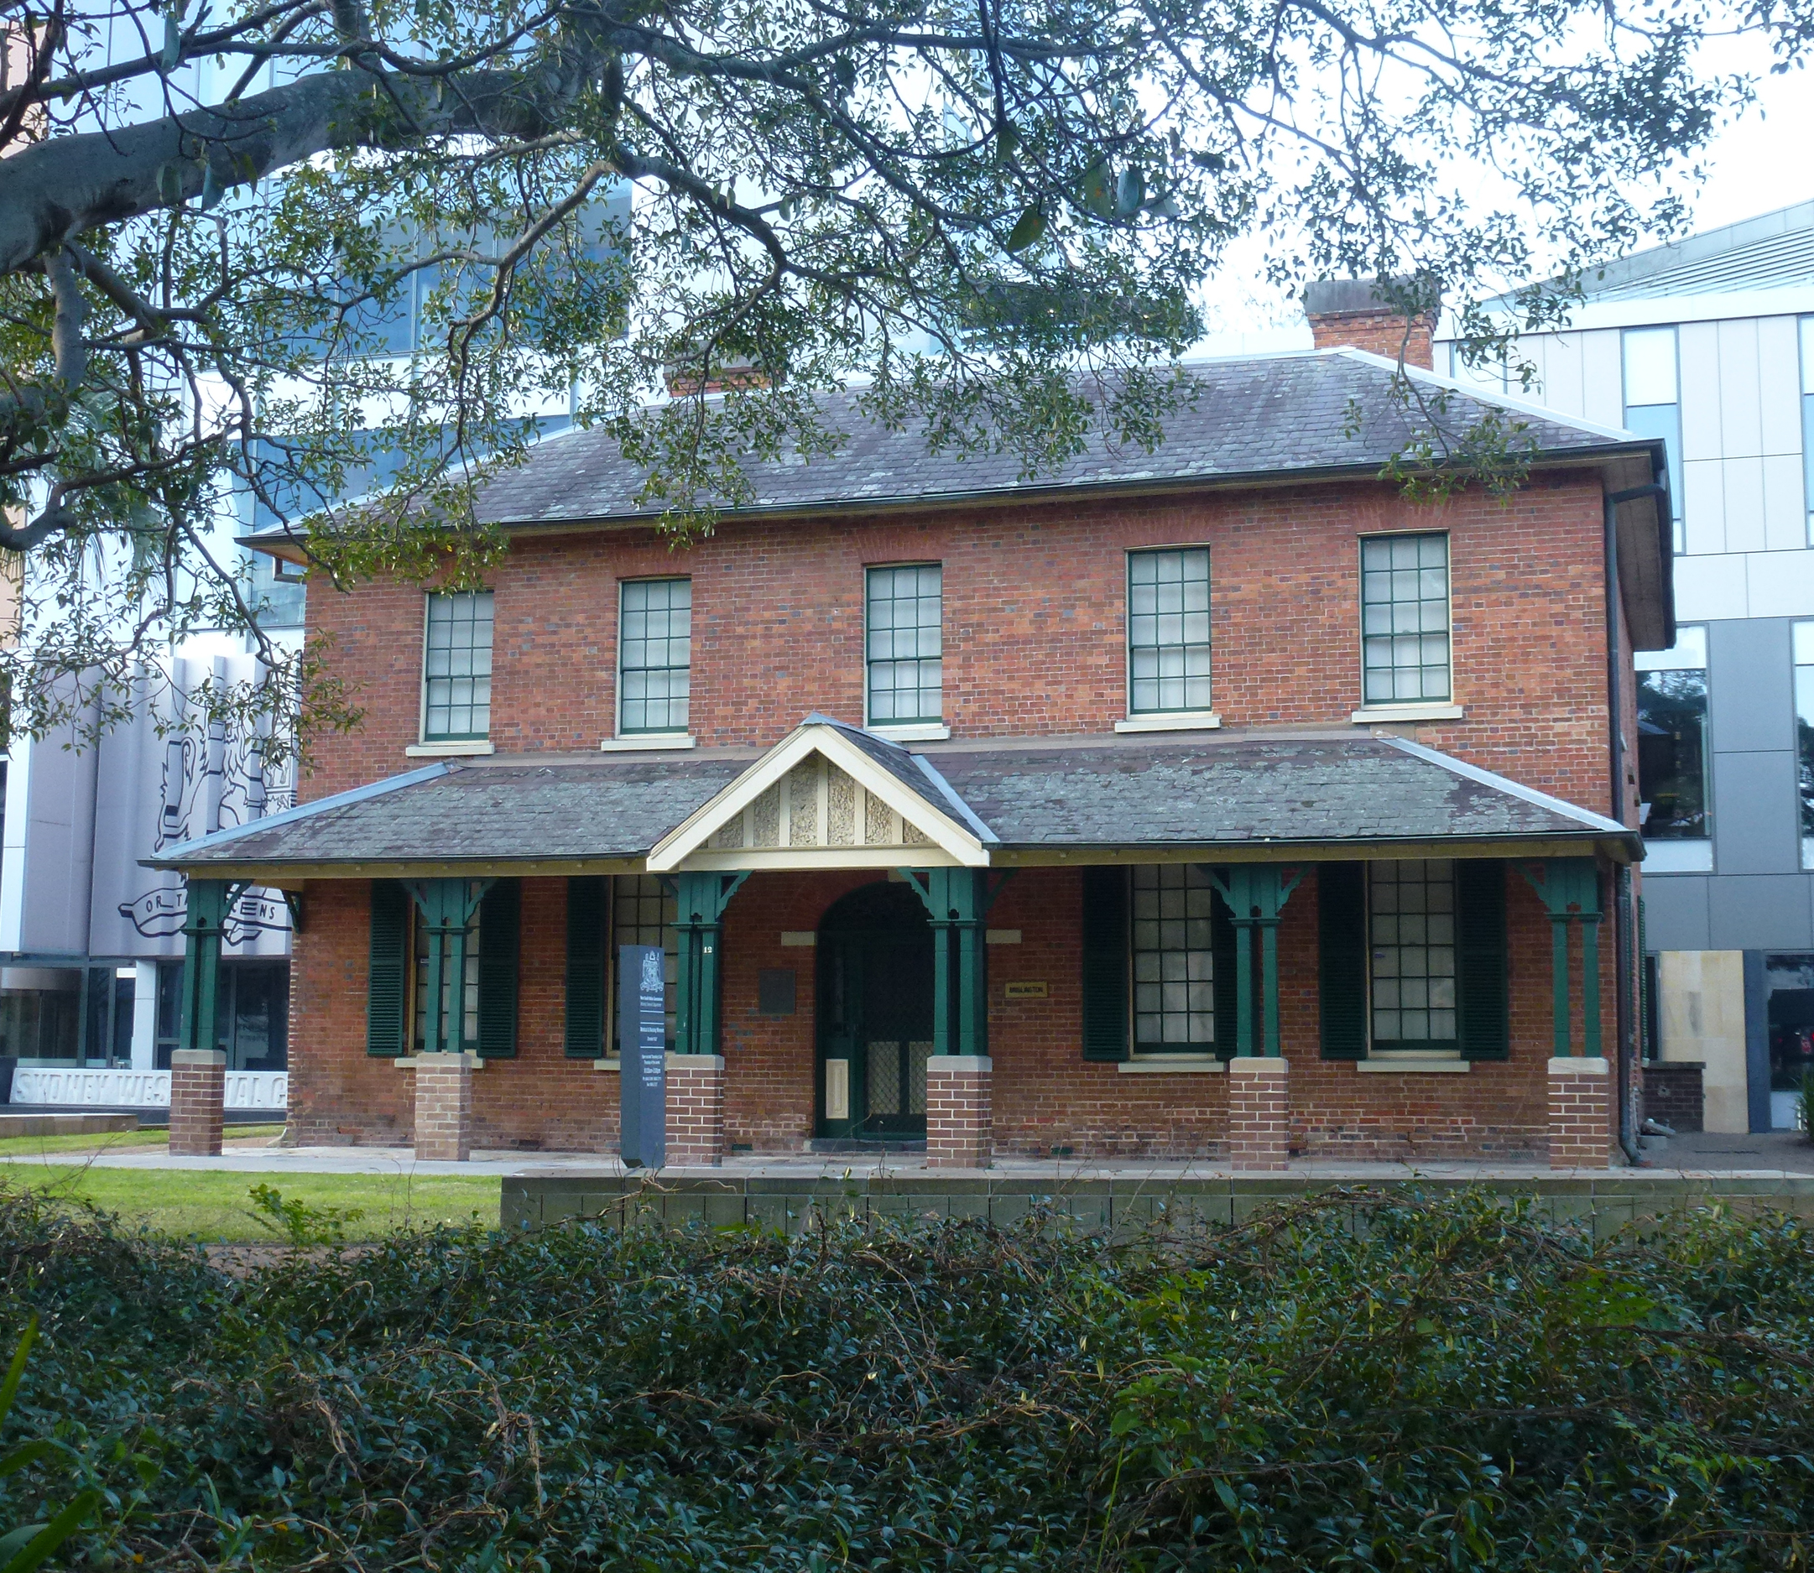
Health & wellbeing
Q10
Brislington Medical and Nursing Museum was previously used as:
  The residence and surgery of three generations of medical practitioners
  Nurses’ accommodation for Parramatta Hospital
  A bank
  Both A and B

Slide 12
Health & wellbeing - answers
The Tent Hospital
C – Samuel Marsden – who may not have been exaggerating. Surgeon Darcy Wentworth stated that in the absence of doors and locks the common knowledge that the female patients were all suffering from syphilis was the hospital’s only security against the wider male population
1995
D – All of these can be seen, along with interpretive displays including historical maps, sketches, photographs and information on the hospital and the people associated with it
The Spanish Flu, brought home by soldiers returning from World War 1.
D’Arcy Wentworth
True. There were several private maternity hospitals in Parramatta in the twentieth century, at a time when many babies were delivered in these facilities. Willowgrove was opened as Estella Private Hospital in 1919, by Matron Davidson, a trained nurse and midwife. The services of two doctors were also available if required.
University of Sydney. In addition to teaching, it undertakes internationally recognised research in health and medicine.
Parramatta Lunatic Asylum; it was established on the site of the Parramatta Female Factory in 1842
D - A and B. It was built by emancipist John Hodges between 1819-21, reputedly with his gambling winnings, but named by Dr Walter Brown, the first of three generations of his family to reside in the gracious building
Notes:
Health and Wellbeing - Answers
By what name, relating to camping, was Parramatta’s first hospital known? Tent Hospital
Who wrote in 1818 'I do not believe that there was ever such a place for want, debaucheries and for every vice as the general hospital at Parramatta'. C – Samuel Marsden – who may not have been exaggerating. Surgeon Darcy Wentworth stated that in the absence of doors and locks the common knowledge that the female patients were all suffering from syphilis was the hospital’s only security against the wider male population.
Judge Advocate David Collins
Governor Macquarie
Reverend Samuel Marsden
Elizabeth Macquarie
What year was The Children’s Hospital at Westmead opened? 1995
What remains of the Colonial Hospital can be seen in the Heritage Courtyard and Colonial Hospital Pavilion? D – All of these can be seen, along with interpretive displays including historical maps, sketches, photographs and information on the hospital and the people associated with it
Building foundations and outlines
Artefacts found on site
A section of convict era drain
All of the above
What pandemic spread through Parramatta in 1919? The Spanish Flu, brought home by soldiers returning from World War 1.
After escaping conviction of highway robbery 3 times, who arrived as assistant surgeon in 1790 rising to principal surgeon in 1811? D’Arcy Wentworth
True or false - historic Willowgrove, in Philip Street, was once a maternity hospital? True, there were several private maternity hospitals in Parramatta in the twentieth century, at a time when many babies were delivered in these facilities. Willowgrove was opened as Estella Private Hospital in 1919, by Matron Davidson, a trained nurse and midwife. The services of two doctors were also available if required.
The Westmead Clinical School of which university is located at Westmead Hospital? Sydney University. In addition to teaching it undertakes internationally recognised research in health and medicine.
Cumberland Hospital now provides cutting-edge mental health services in Parramatta, but what was the first psychiatric institution in Parramatta called? Parramatta Lunatic Asylum; it was established on the site of the Parramatta Female Factory in 1842.
Brislington Medical and Nursing Museum was previously used as: A and B. It was built by emancipist John Hodges between 1819-21, reputedly with his gambling winnings, but named by Dr Walter Brown, the first of three generations of his family to reside in the gracious building.
The residence and surgery of three generations of medical practitioners
A nurses’ home for Parramatta Hospital
A bank
Both A and B

Slide 13
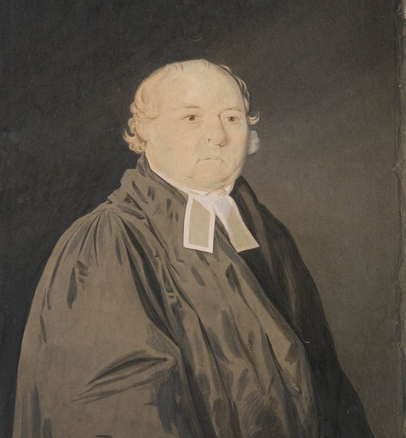
WHo AM I?
I was prominent in the life of Parramatta for nearly 50 years
I played a significant role in establishing the wool industry
I was an entrepreneur, involved in a range of commercial enterprises
I served as a magistrate in Parramatta
I once described Parramatta as ‘such a sink of iniquity that morality could be preserved only by the most rigorous disciplinary measures.’
I introduced measures to improve the lot of female convicts
I introduced guns, farm tools and the Anglican religion to New Zealand
I established a Sunday School and an Orphanage
I was widely known as the ‘flogging parson’
I was the Chief Cleric of the Colony
Samuel Marsden

Slide 14
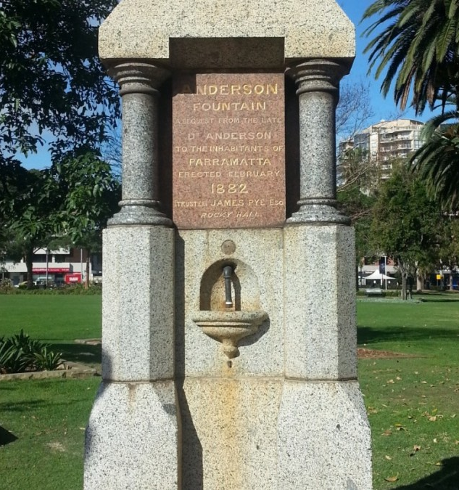
WHo AM I?
I was surgeon on 4 convict ships between 1818 and 1822, responsible for over 680 convicts and recorded only 6 deaths
I arrived in Sydney on the Castle Forbes on 15 January 1824
I was posted to Parramatta in 1827 as an Assistant Colonial Surgeon in charge of the relatively newly built hospital
I liked Parramatta so much that I settled here permanently
I was appointed a resident magistrate, earning a reputation for my zeal
In 1838 I retired after a leave of absence on the grounds of ill health
I played a key role in opening the Parramatta and District Hospital and was elected president of the Committee of Management
Understanding the health benefits of a pure water supply, I worked towards the construction of Hunt’s Creek Dam.
I died in 1850 and am buried in St Johns Cemetery
I made a large bequest for the erection of public drinking fountains in Parramatta, one of which can be found in Prince Alfred Square.
Dr Matthew Anderson

