Slide 1
It’s a wild life in the city
Parramatta
Notes:
Before starting online meeting:
Select Slide show from top bar and click “From beginning”
You will be able to see the notes; participants will only see slides
Before starting quiz:
Check that participants have a pen and paper at the ready, to write down their answers.
Each correct answer is worth 1 point.
If playing in teams, remind groups to mute their mic as they discuss their answer, so they don’t accidentally tell other teams.
Remember to speak slowly and clearly, so everyone understands the questions.
Check that everyone is ready before moving on to next question.

Slide 2
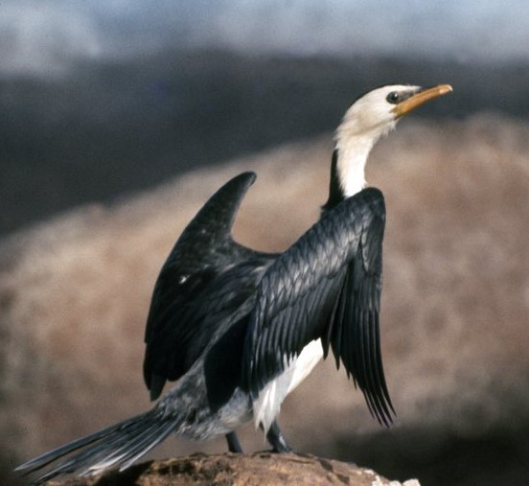
It’s a wild life…
Q1
What waterbird, also known as a shag, fishes in the Parramatta River?

Slide 3
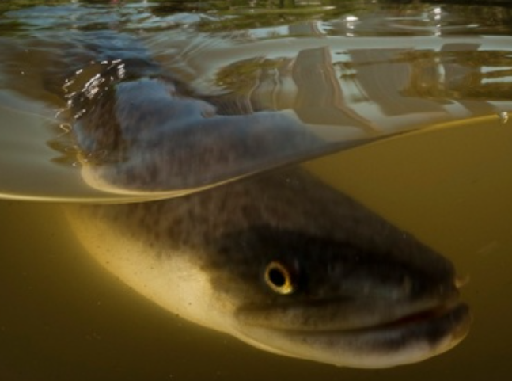
It’s a wild life…
Q2
Why did Parramatta Rugby League Club take the eel as their badge/symbol?

Slide 4
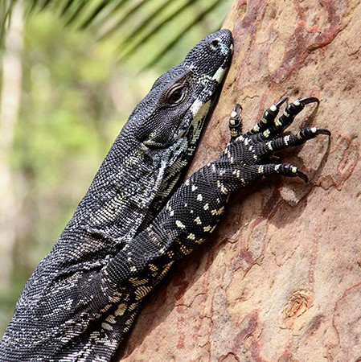
It’s a wild life…
Q3
What is the largest lizard found in Parramatta?

Slide 5
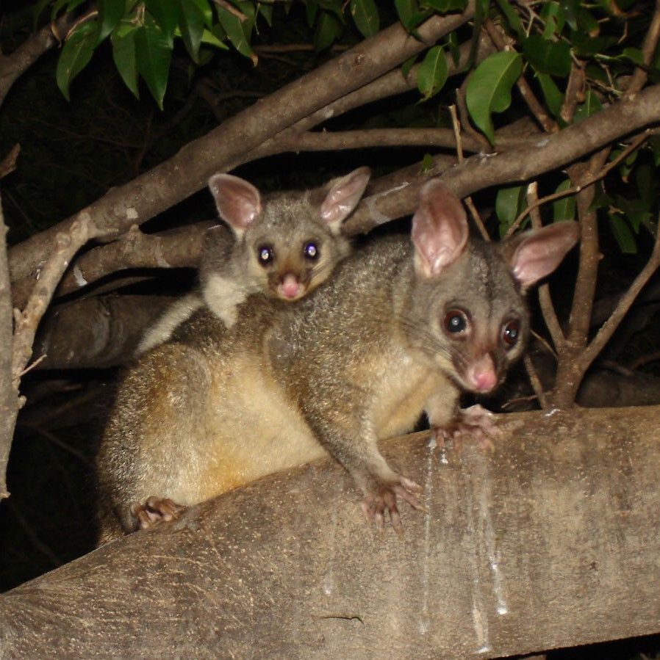
It’s a wild life…
Q4
How many native vertebrate species (animals with backbones) were found in Parramatta’s bushland reserves in the latest survey (2017)?
  37
  108
  133
  72

Slide 6
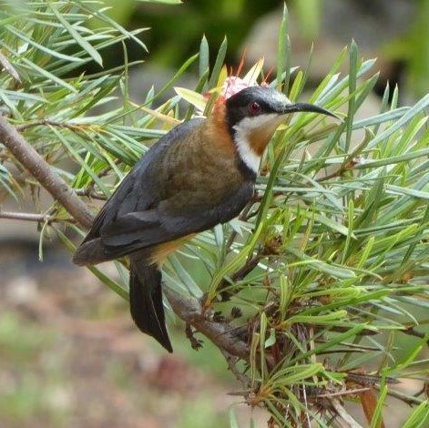
It’s a wild life…
Q5
Are there more than, or less than, 120 bird species in Parramatta?

Slide 7
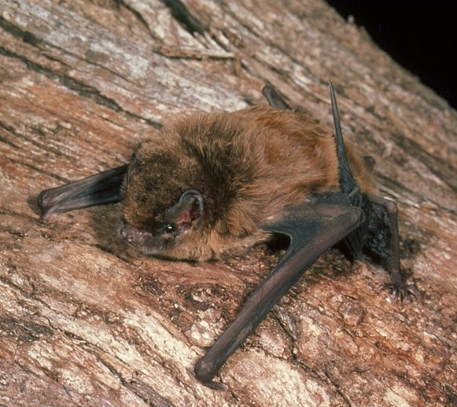
It’s a wild life…
Q6
Why should we treasure the 14 species of microbat known to live in Parramatta?

Slide 8
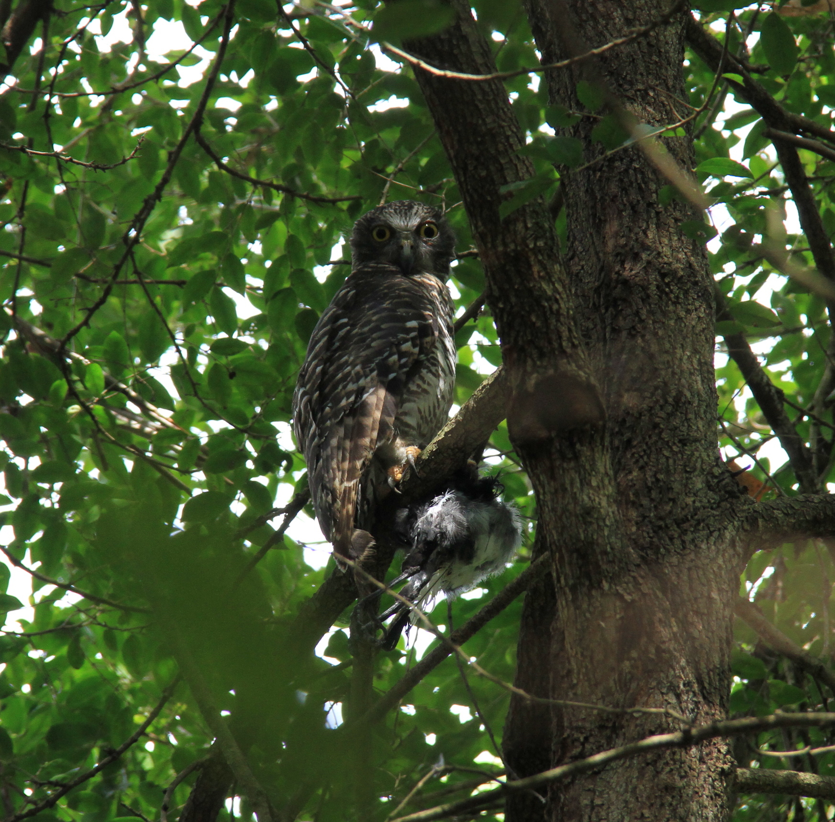
It’s a wild life…
Q7
The largest owl in Australia calls Parramatta’s bushland reserves (among other places) home; what species is it?

Slide 9
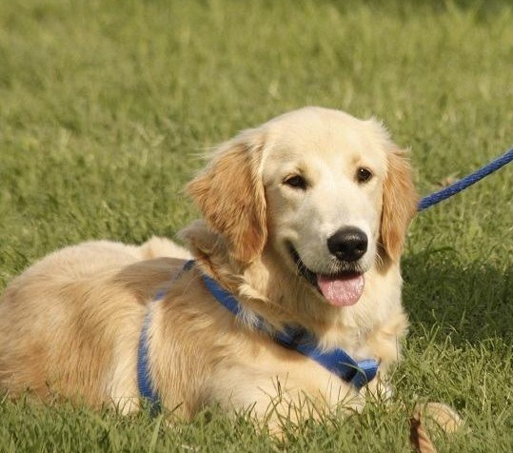
It’s a wild life…
Q8
How can we help protect our native wildlife in an urban area such as Parramatta?
  Plant a range of native plants and trees in our gardens
  Keep pets under control – cats in at night, dogs on a leash
  Bin our rubbish, where animals cannot get to it
  Keep our waterways clean
  All of the above

Slide 10
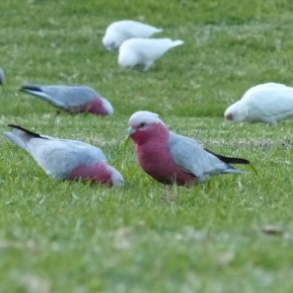
It’s a wild life…
Q9
What local parrot species is a byword for silliness, or being a “loud-mouthed idiot”?

Slide 11
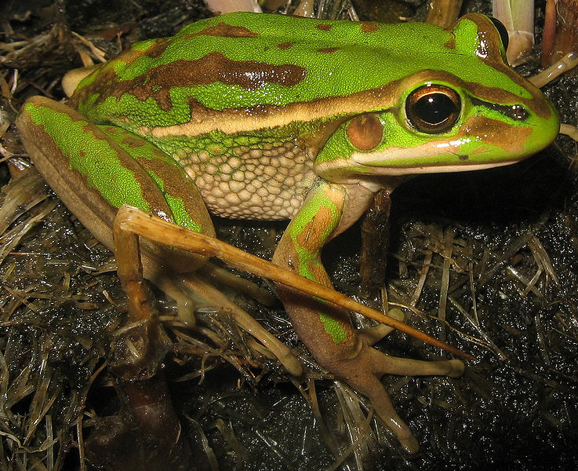
It’s a wild life…
Q10
What tiny amphibian caused major disruption to the planning of the Sydney Olympics?

Slide 12
It’s a wild life in the city - answers
Cormorant
Parramatta means place of eels in the Darug language
Lace Monitor or Goanna
C - 133
Less than 120 – 97 confirmed species, though there are unconfirmed sightings of a further eight species
They eat mosquitos and garden pests
Powerful Owl, or Ninox Strenua
E - All of the above. Our native wildlife needs all the help it can get.
Galah
Green and Golden Bell Frog. The largest known colony of this endangered frog had survived in the old State Brickpit on the planned Olympic Precinct. Tours of the Brickpit are now available through SOPA.
Notes:
It’s a Wild Life in the City - Answers
What waterbird, also known as a shag, fishes in the Parramatta River? Cormorant
Why did Parramatta Rugby League Club take the eel as their badge/symbol? Parramatta means place of eels in the Darug language
What is the largest lizard to be found in Parramatta? Lace monitor or goanna
How many native vertebrate species (animals with backbones) were found in Parramatta’s bushland reserves in the latest survey (2017)? C - 133
37
108
133
72
Are there more than, or less than, 120 bird species in Parramatta? Less than 120 – 97 confirmed species, though there are unconfirmed sightings of a further eight species.
Why should we treasure the 14 species of microbat known to live in Parramatta? They eat mosquitos and garden pests
The largest owl in Australia calls Parramatta’s bushland reserves (among other places) home; what species is it? Powerful owl, or Ninox strenua
How can we help protect our native wildlife in an urban area such as Parramatta?
Plant a range of native plants and trees in our gardens
Keep pets under control – cats in at night, dogs on a leash
Bin our rubbish, where animals cannot get to it
Keep our waterways clean
All of the above
What local parrot species is a byword for silliness, or being a “loud-mouthed idiot”? Galah
What tiny amphibian caused disruption to planning for the Sydney Olympics, resulting in the tennis centre being located at a different site? Green and Golden Bell Frog. The largest known colony of this endangered frog had survived in the old State Brickpit on the planned Olympic Precinct. Tours of the Brickpit are now available through SOPA.

Slide 13
WHat AM I?
In some cultures I am considered a delicacy
An English monarch died after eating too many of my relatives
I hibernate in winter
I was farmed as a food source by the Gunditjmara people in Victoria
My breeding migration is one of the mysteries of the animal world
I can travel through water or across dry ground
Two species of me live in local rivers and streams around Parramatta
I lay my eggs in the waters of the Coral Sea, with only about 1% surviving to adulthood
I am an important symbol of Parramatta
The Darug word for me is Burra
The Eel

