Slide 1
Lie of the land
Parramatta
Notes:
Before starting online meeting:
Select Slide show from top bar and click “From beginning”
You will be able to see the notes; participants will only see slides
Before starting quiz:
Check that participants have a pen and paper at the ready, to write down their answers.
Each correct answer is worth 1 point.
If playing in teams, remind groups to mute their mic as they discuss their answer, so they don’t accidentally tell other teams.
Remember to speak slowly and clearly, so everyone understands the questions.
Check that everyone is ready before moving on to next question.

Slide 2
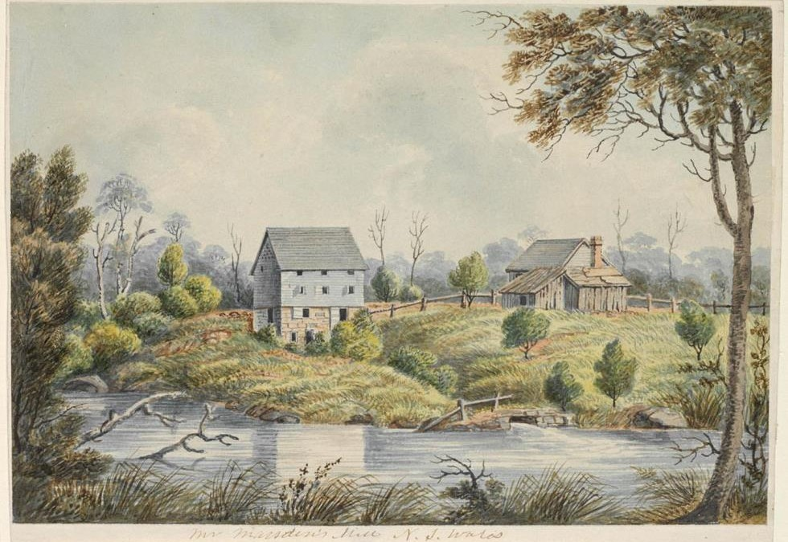
Lie of the Land
Q1
Darling Mills Creek and Toongabbie Creek are tributaries of which river?

Slide 3
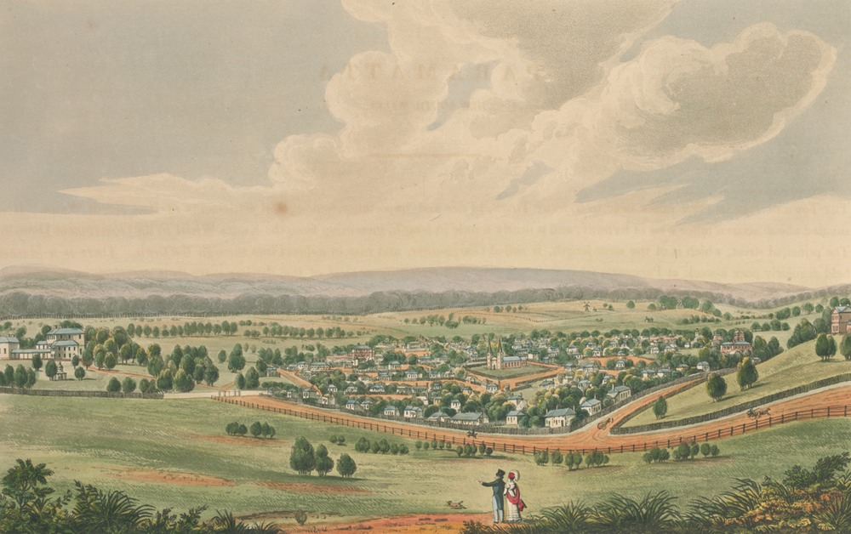
Lie of the Land
Q2
The highest point in Parramatta is 48m above sea level – true or false?

Slide 4
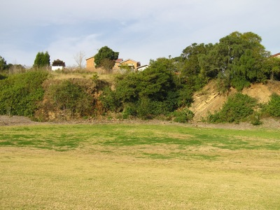
Lie of the Land
Q3
What substance, used in road building, was quarried at Dundas?

Slide 5
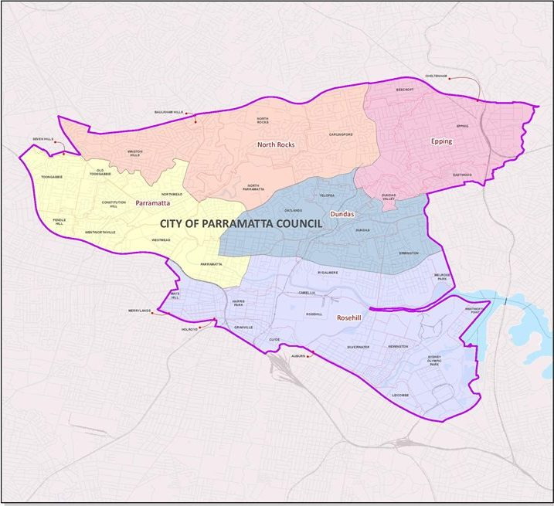
Lie of the Land
Q4
How many square kilometres does the City of Parramatta cover?
84
52
25
5.8

Slide 6
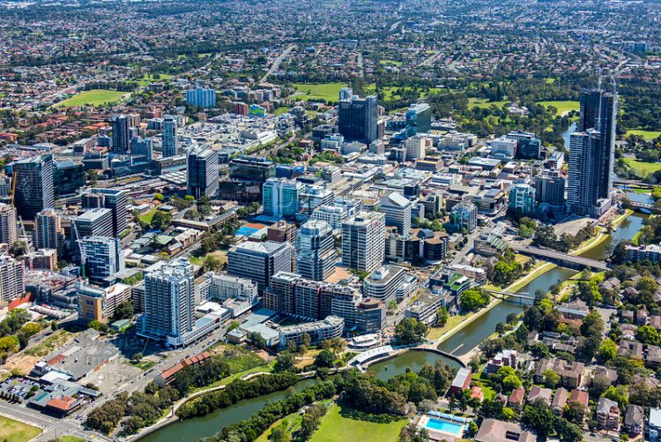
Lie of the Land
Q5
The CBD sits on a significant geological formation, which is known as:
The Wiannamatta Shale Formation
The Cumberland Plain
The Parramatta Sand Terrace
The Parramatta Sandstones

Slide 7
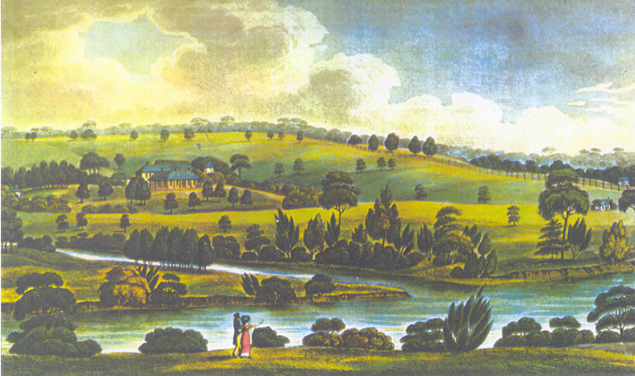
Lie of the Land
Q6
Name the creek that supplied fresh water to both Elizabeth Farm and Experiment Farm?

Slide 8
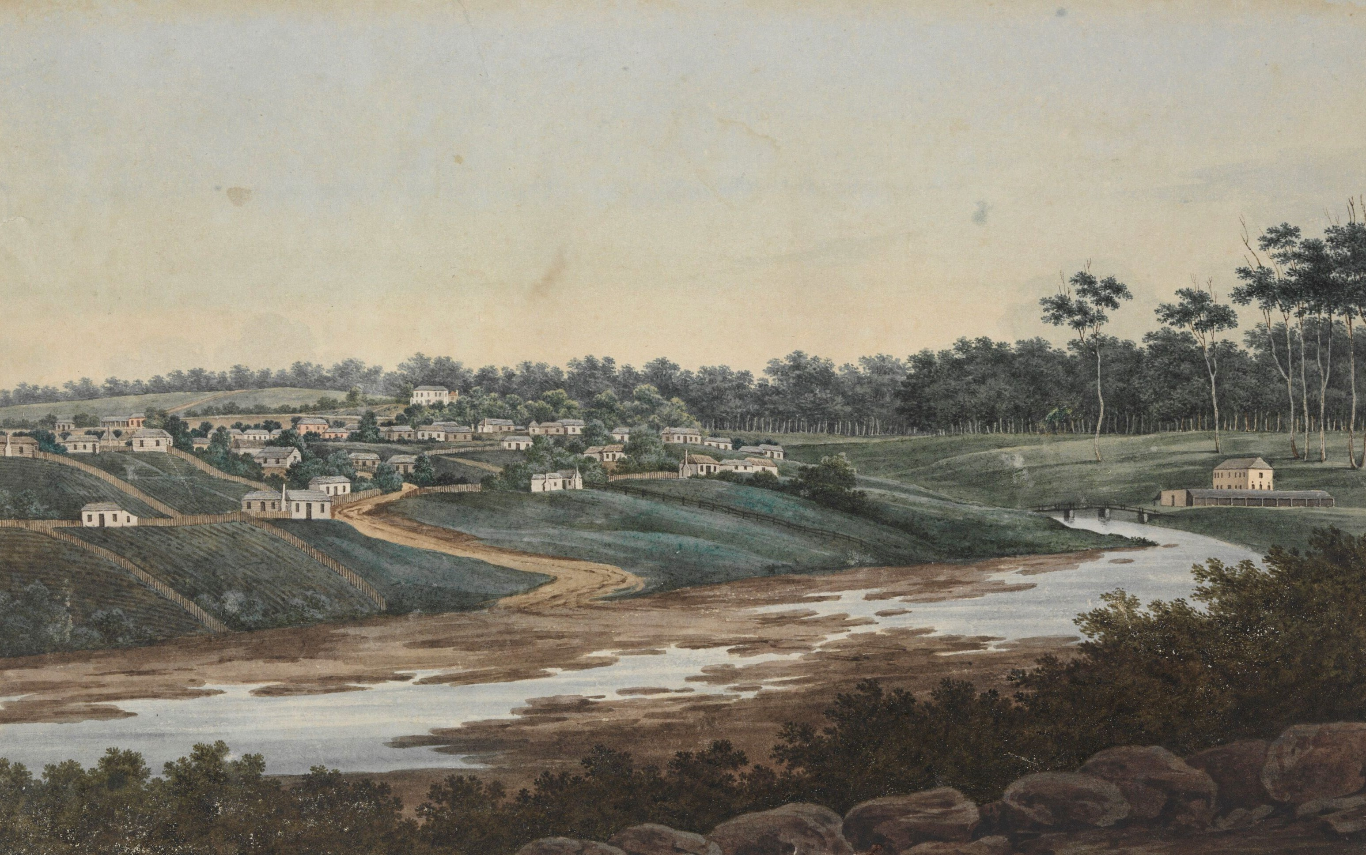
Lie of the Land
Q7
What geological attributes attracted the colonists to settle at Parramatta?
Natural harbour and fertile soils
Sandstone and fresh water
Natural harbour and sandstone
Fertile soils and fresh water

Slide 9
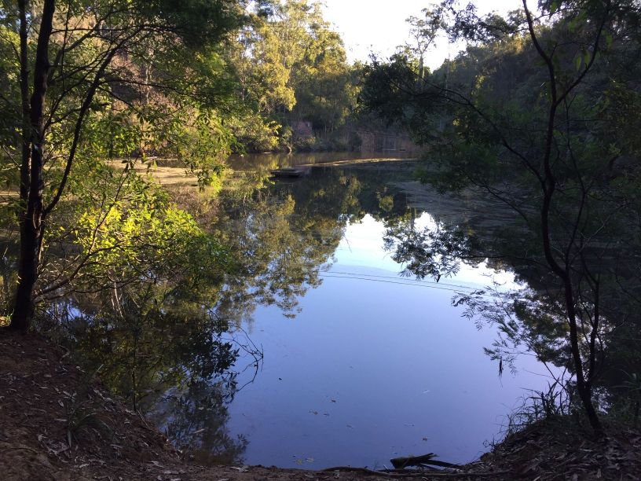
Lie of the Land
Q8
Along what waterway was Sydney’s first privately owned vineyard sited?

Slide 10
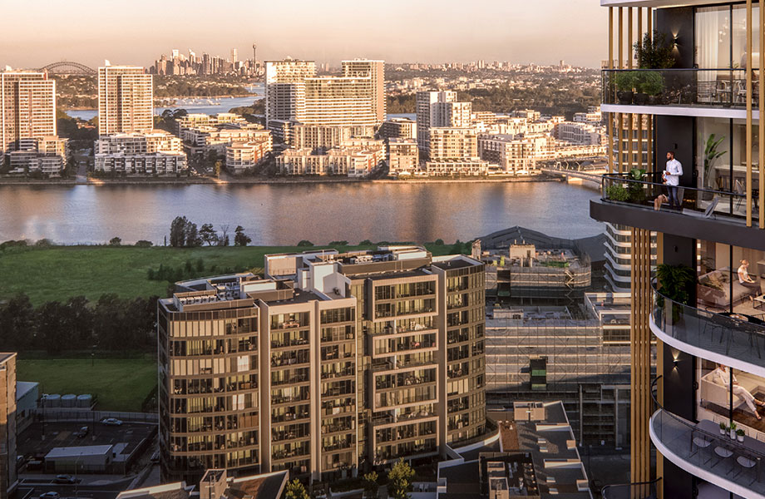
Lie of the Land
Q9
Which member of the extensive Wentworth family was Wentworth Point named after?
William Charles Wentworth, explorer
D’Arcy Wentworth, surgeon
Sarah Wentworth, convict wife of D’Arcy
Mungo Wentworth Macallum, journalist

Slide 11
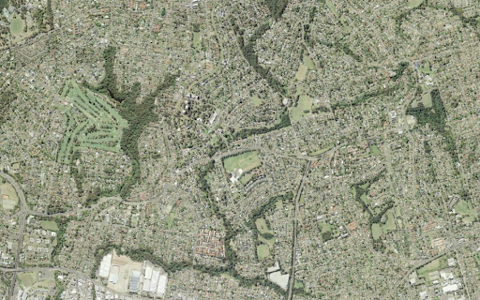
Lie of the Land
Q10
Dundas was originally named for what type of water feature?

Slide 12
Lie of the Land - answers
Parramatta River
True
Blue metal, a type of igneous rock, formed as part of a volcanic diatreme.
A – 84 square kilometres
C – The Parramatta Sand Terrace
Clay Cliff Creek
D – Fertile soils and fresh water
Vineyard Creek
B – D’Arcy, whose estate was located nearby
It was known as The Ponds, after a local freshwater lake
Notes:
Lie of the Land - Answers
Darling Mills Creek and Toongabbie Creek are tributaries of which river? Parramatta River
The highest point in Parramatta is 48m above sea level – true or false? True
What substance, used in road building, was quarried at Dundas? Blue metal, a type of igneous rock, formed as part of a volcanic diatreme.
How many square kilometres does the City of Parramatta cover? A - 84
84
52
25
5.8
The CBD sits on a significant geological formation, which is known as: C – The Parramatta Sand Terrace
The Wiannamatta Shale Formation
The Cumberland Plain
The Parramatta Sand Terrace
The Parramatta Sandstones
Name the creek that supplied fresh water to both Elizabeth Farm and Experiment Farm? Clay Cliff Creek
What geological attributes attracted the colonists to settle at Parramatta? Fertile soils and fresh water
Along what waterway was Sydney’s first privately owned vineyard sited? Vineyard Creek
Which member of the extensive Wentworth family was Wentworth Point named after? B – D’Arcy, whose estate was located nearby
William Charles Wentworth, explorer
D’Arcy Wentworth, surgeon
Sarah Wentworth, convict wife of D’Arcy
Mungo Wentworth Macallum, journalist
Dundas was originally named for what type of water feature? It was known as The Ponds, after a local freshwater lake

Slide 13
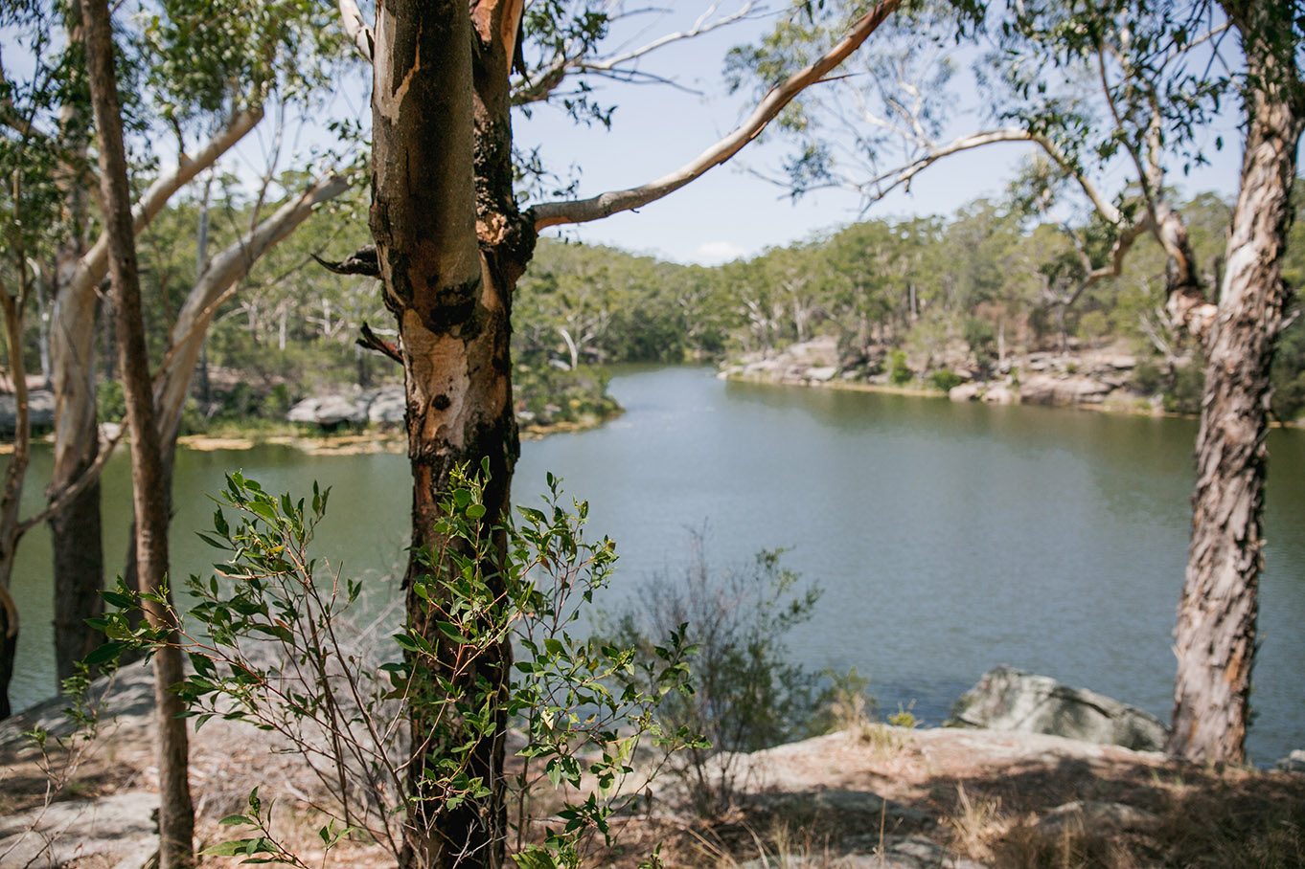
WHat AM I?
Hand-stencils, shelters, campsites and scar-trees show Aboriginal occupation of this site
Darug clans met here for corroborees before heading into Parramatta to negotiate and trade with the Europeans
My existence is due to the need for fresh water in the mid 19th century
Australia's first large engineered dam was built here in 1855
The land and stones for the dam was gifted by James Pye
A Life Saving Club held regular swimming carnivals here between 1930-1942
Today I am surrounded by 75 hectares of native vegetation and remnant bushland
I’m an important habitat for approximately 70 natives species of birds, frogs, reptiles and mammals
The Arrunga Bardo Aboriginal Bush Food Garden is found on my southern shore
On weekends you can enjoy a leisurely kayak, row or pedal boat in my picturesque surrounds
Lake Parramatta

