Slide 1
Off and racing
Parramatta
Notes:
Before starting online meeting:
Select Slide show from top bar and click “From beginning”
You will be able to see the notes; participants will only see slides
Before starting quiz:
Check that participants have a pen and paper at the ready, to write down their answers.
Each correct answer is worth 1 point.
If playing in teams, remind groups to mute their mic as they discuss their answer, so they don’t accidentally tell other teams.
Remember to speak slowly and clearly, so everyone understands the questions.
Check that everyone is ready before moving on to next question.

Slide 2
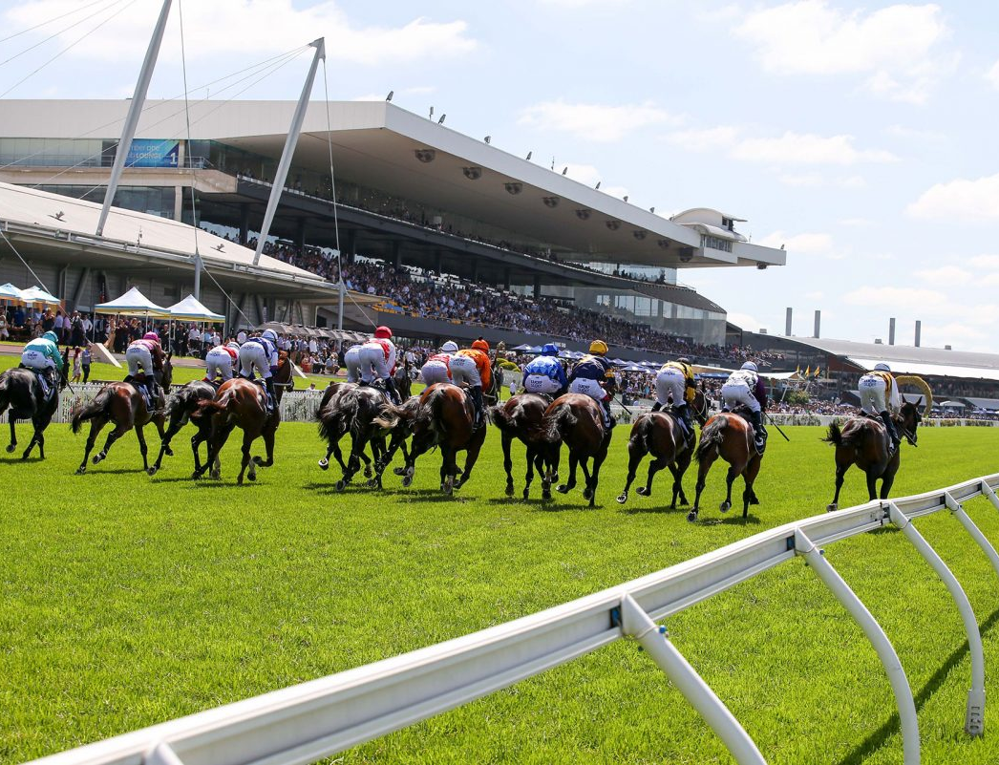
Off and racing
Q1
Which turf club owns and operates Rosehill Gardens Racecourse?

Slide 3
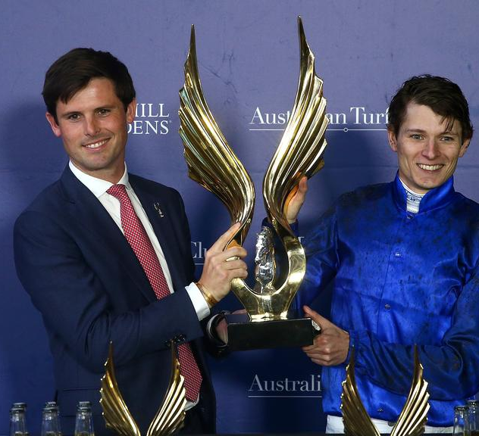
Off and racing
Q2
What is the richest race run at Rosehill called?

Slide 4
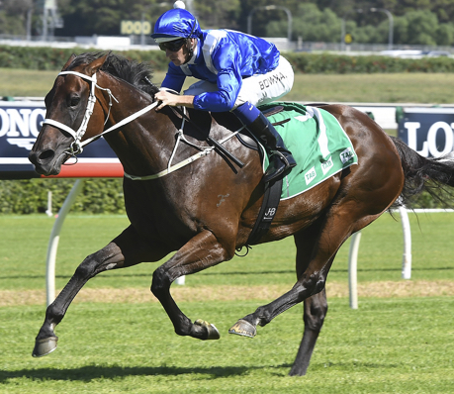
Off and racing
Q3
Which famous mare won the George Ryder Stakes for the fourth time in March 2019?

Slide 5
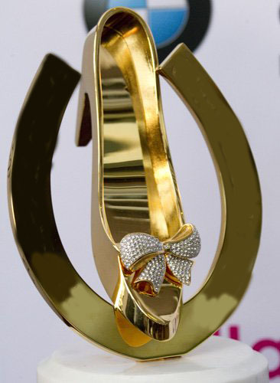
Off and racing
Q4
Name the world’s richest race for 2 year old thoroughbreds?

Slide 6
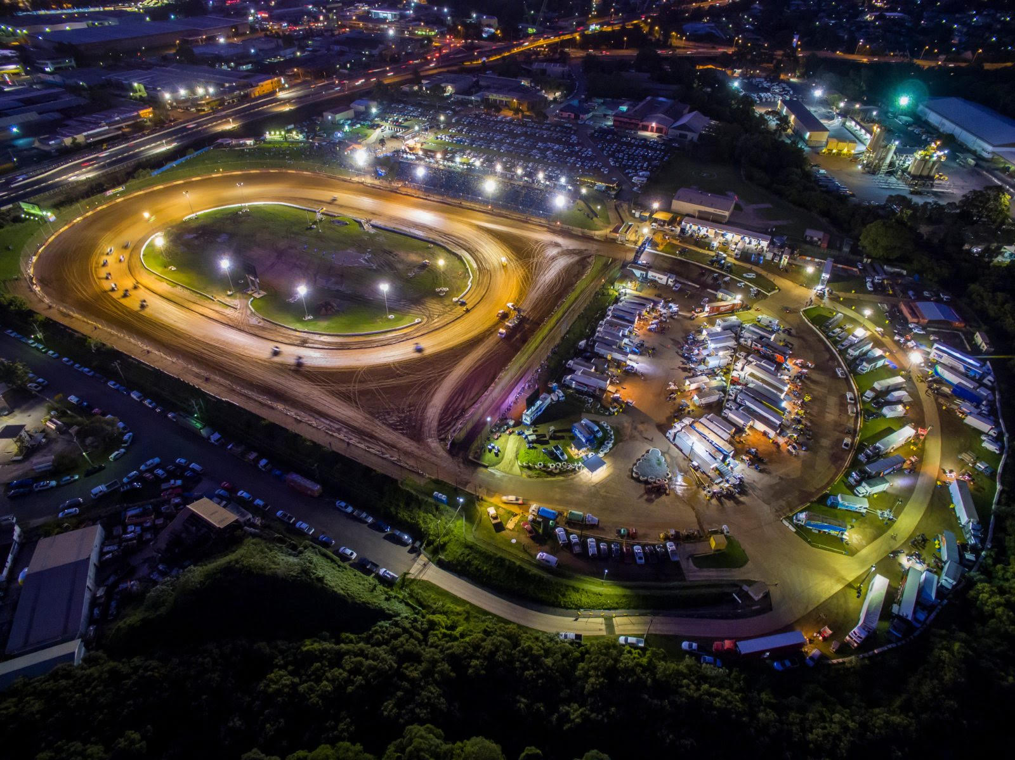
Off and racing
Q5
In 2020 what was the nearest racing facility to Rosehill?

Slide 7
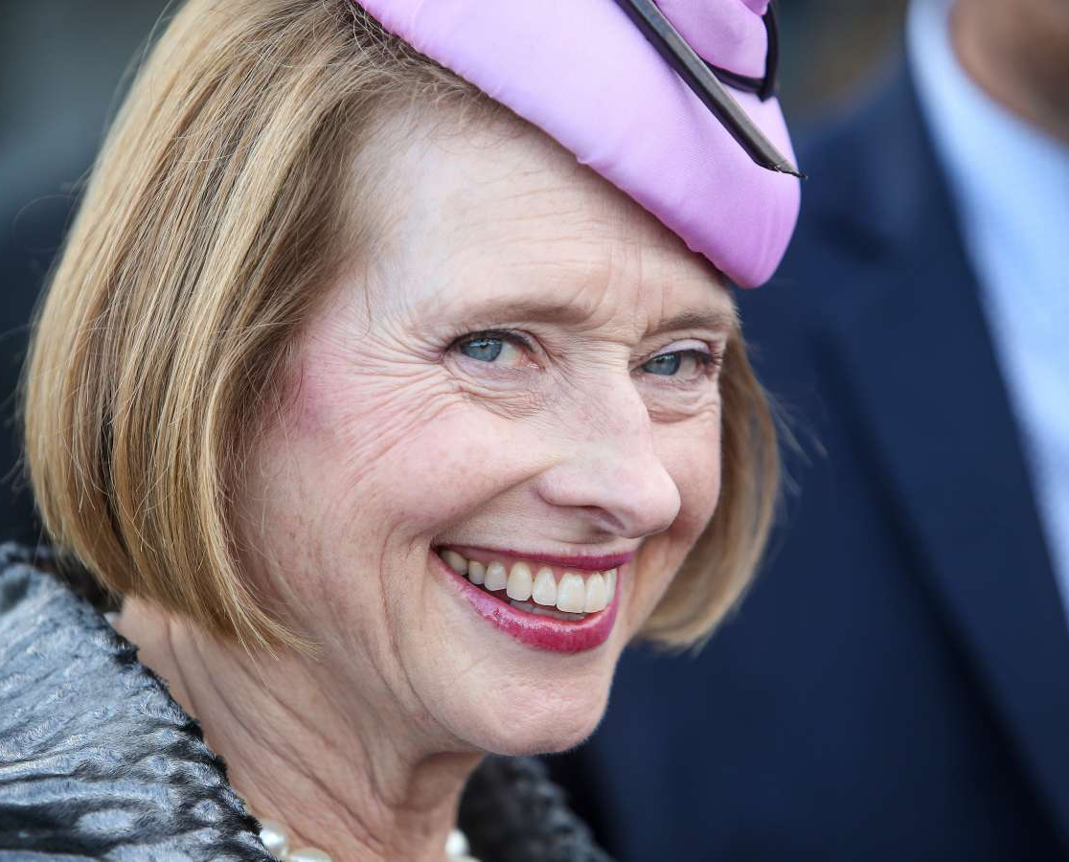
Off and racing
Q6
Who was the first woman to train a Golden Slipper winner?

Slide 8
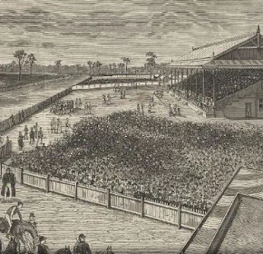
Off and racing
Q7
In what year was Rosehill Racecourse first opened?
  1862
  1885
  1903
  1924

Slide 9
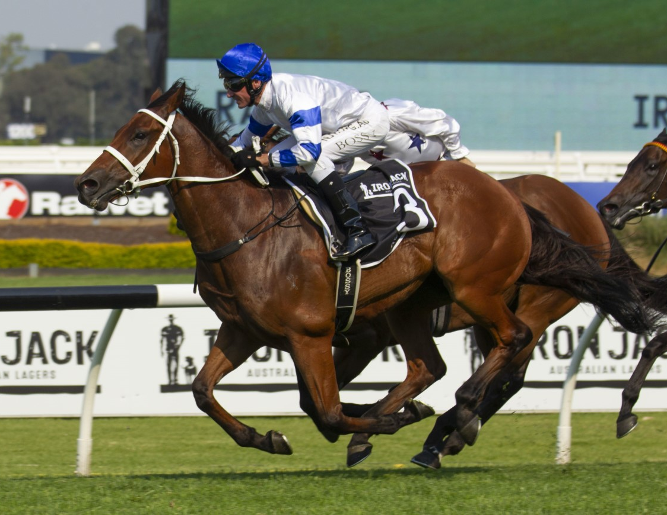
Off and racing
Q8
In 2019 which horse won the inaugural Golden Eagle (third richest horse race in the world)?

Slide 10
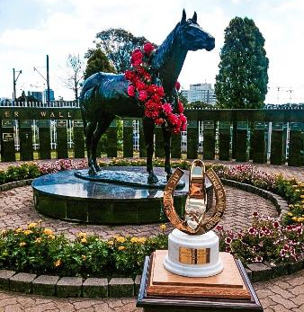
Off and racing
Q9
A sculpture of which horse is featured in the centre of the Golden Slipper Wall of Fame?

Slide 11
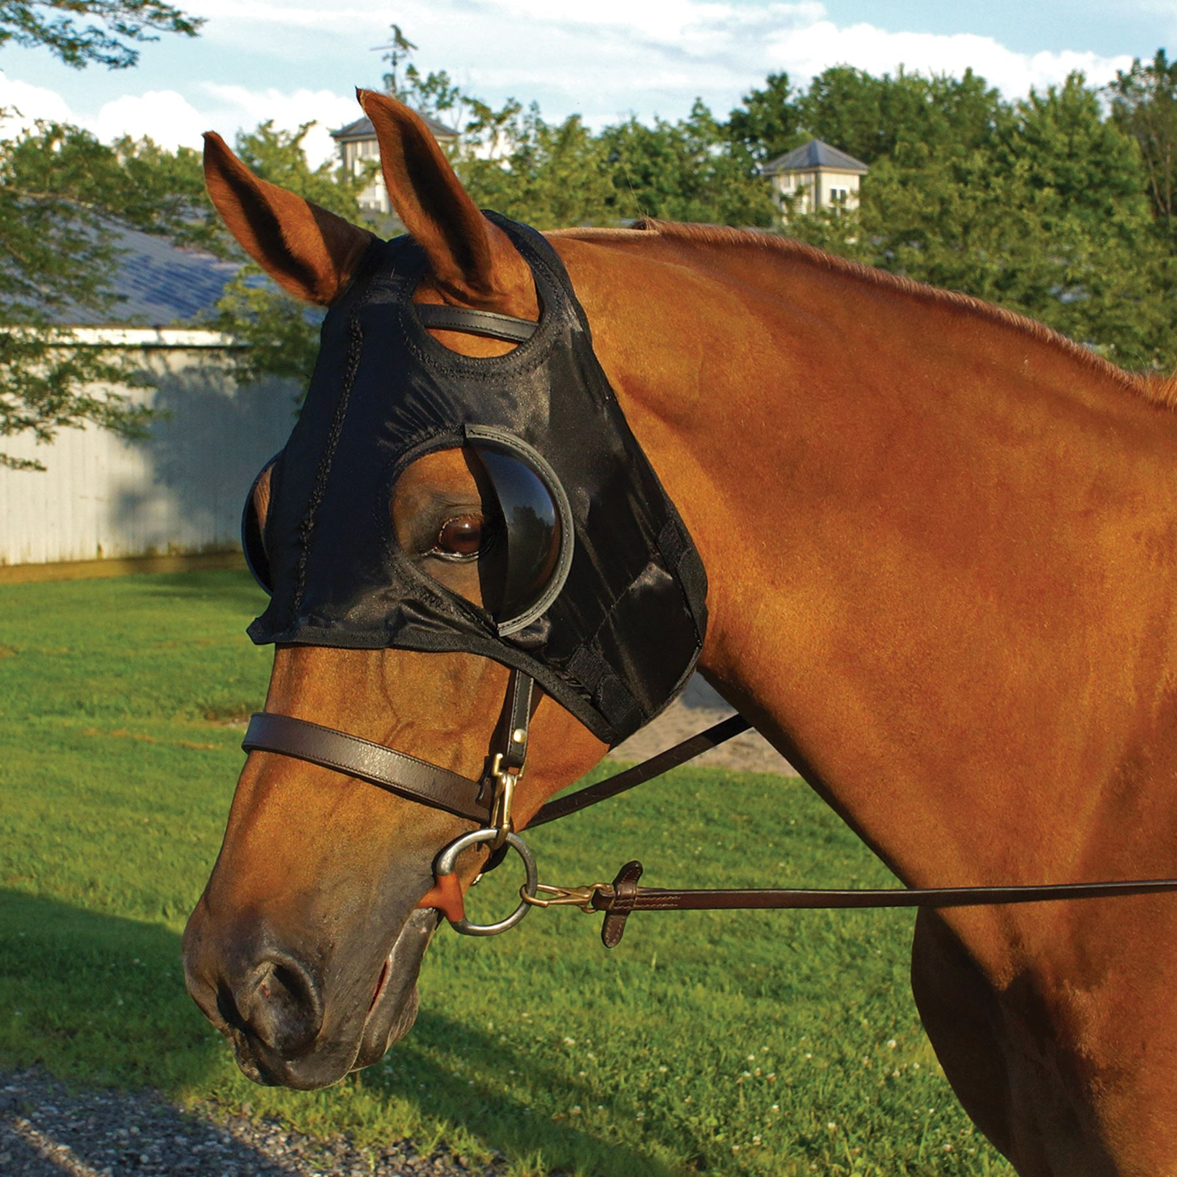
Off and racing
Q10
What headgear might feature in photos of a major race winner?
  Blinker hood
  Fascinator
  Racing helmet
  Any of the above

Slide 12
Off and racing - answers
Australian Turf Club
Golden Eagle ($7.5 million prizemoney – the third richest race in the world)
Winx
Longines Golden Slipper Stakes; $3.5 million prizemoney – previously the Tooheys New Golden Slipper Stakes
Valvoline Raceway – Speedway sprint cars
Gai Waterhouse, 2001 – with Ha Ha. She has won it a record seven times and in 2001 trained the first 3 placegetters
1885, by John Bennett
Kolding
Todman - who won the inaugural Golden Slipper
D - Any of the above
Notes:
Off and Racing - Answers
Which turf club owns and operates Rosehill Gardens? Australian Turf Club
What is the richest race run at Rosehill called? Golden Eagle ($7.5 million prizemoney – the third richest race in the world)
Which horse won the George Ryder stakes for the fourth time in March 2019? Winx
Name the world’s richest race for 2 year old thoroughbreds? Longines Golden Slipper; $3.5 million prizemoney
What is the nearest racing facility to Rosehill? Valvoline Raceway – Speedway sprint cars
Who was the first woman to train a Golden Slipper winner? Gai Waterhouse, 2001 – with Ha Ha. She has won it a record seven times and in 2001 trained the first 3 placegetters
What year was Rosehill Racecourse first opened? 1885, by John Bennett
1862
1885
1903
1924
Name the inaugural winner of the Golden Eagle (third richest horse race in the world), in 2019? Kolding
A sculpture of which horse is featured in centre of the Golden Slipper Hall of Fame? Might and Power - who never won the Golden Slipper
What headgear might feature in a photo of the connections of a major race winner? D - Any of the above
Blinker hood
Fascinator
Racing helmet
Any of the above

Slide 13
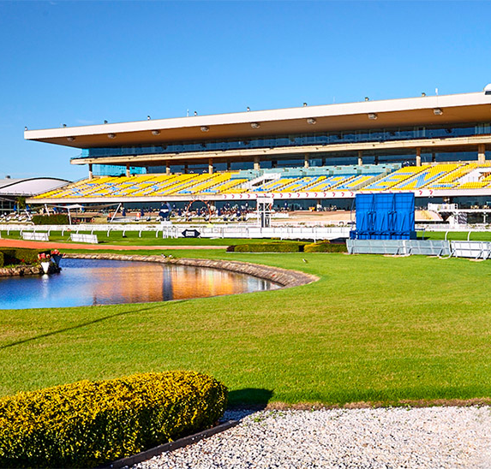
What AM I?
A private railway initially connected me to the main line
My construction began in 1883 and was completed by 1885
I was originally owned by John Bennett
My exhibition space covers 400sqm
I won the 2019 R & CA (Restaurant and Catering) Award for caterer of the Year – Sydney
I was named, indirectly, after a British politician
The land I stand on was originally granted to John Macarthur
My recent refurbishment cost $22 million
Great champions including Phar Lap have raced on my track
My most famous race is the Golden Slipper Stakes
Rosehill Gardens Racecourse

