Slide 1
Staying connected
Parramatta
Notes:
Before starting online meeting:
Select Slide show from top bar and click “From beginning”
You will be able to see the notes; participants will only see slides
Before starting quiz:
Check that participants have a pen and paper at the ready, to write down their answers.
Each correct answer is worth 1 point.
If playing in teams, remind groups to mute their mic as they discuss their answer, so they don’t accidentally tell other teams.
Remember to speak slowly and clearly, so everyone understands the questions.
Check that everyone is ready before moving on to next question.

Slide 2
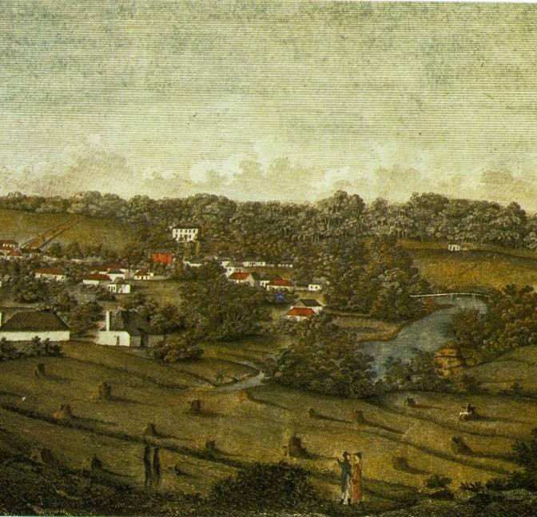
Staying connected
Q1
What was the first major travel thoroughfare from Sydney to Parramatta?

Slide 3
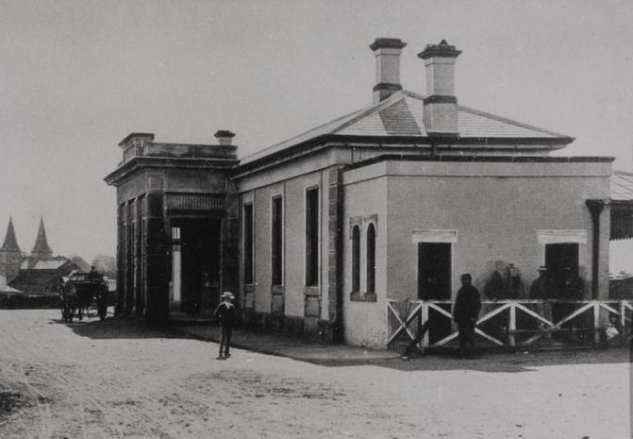
Staying connected
Q2
In what year did the railway first connect Sydney and Parramatta?

Slide 4
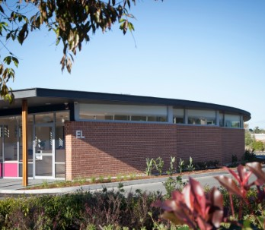
Staying connected
Q3
Which university runs a free shuttle bus between its City of Parramatta campuses?

Slide 5
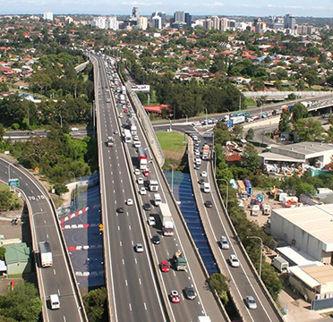
Staying connected
Q4
Between what dates was the M4 Western Motorway constructed?
  1971-1993
  1986-1995
  1971-2019
  1989-2003

Slide 6
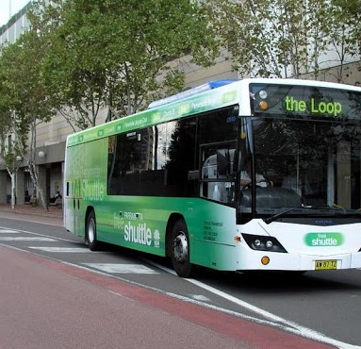
Staying connected
Q5
What is the route number of City of Parramatta’s free CBD shuttle bus service?

Slide 7
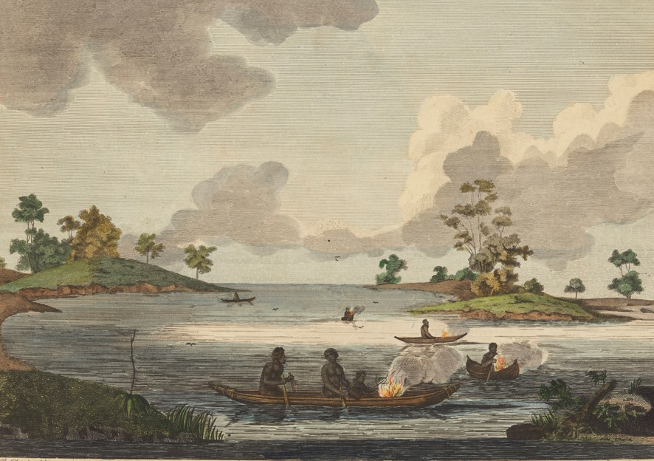
Staying connected
Q6
What is a nawi?

Slide 8
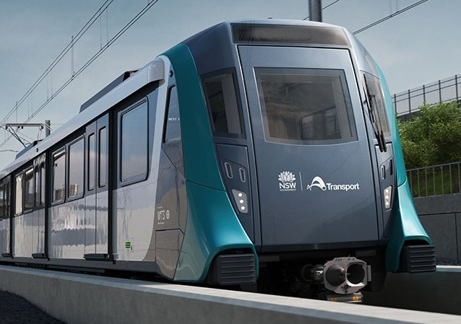
Staying connected
Q7
Between which two stations will the Sydney West Metro initially travel, with 5 stops in between?
  Parramatta and Sydney CBD
  Westmead and The Bays
  Westmead and Pyrmont
  Parramatta and Five Dock

Slide 9
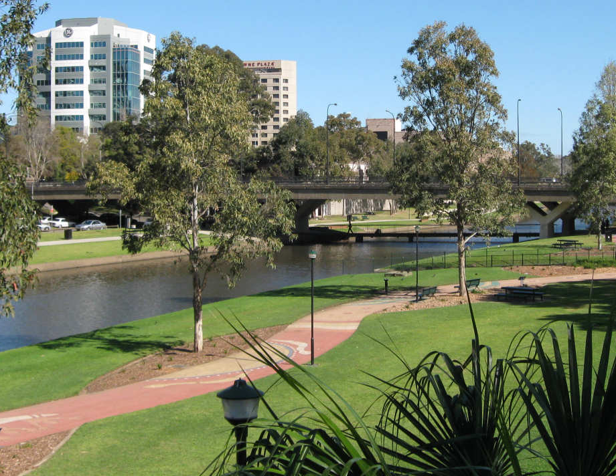
Staying connected
Q8
How many motor vehicle bridges span the Parramatta River?

Slide 10
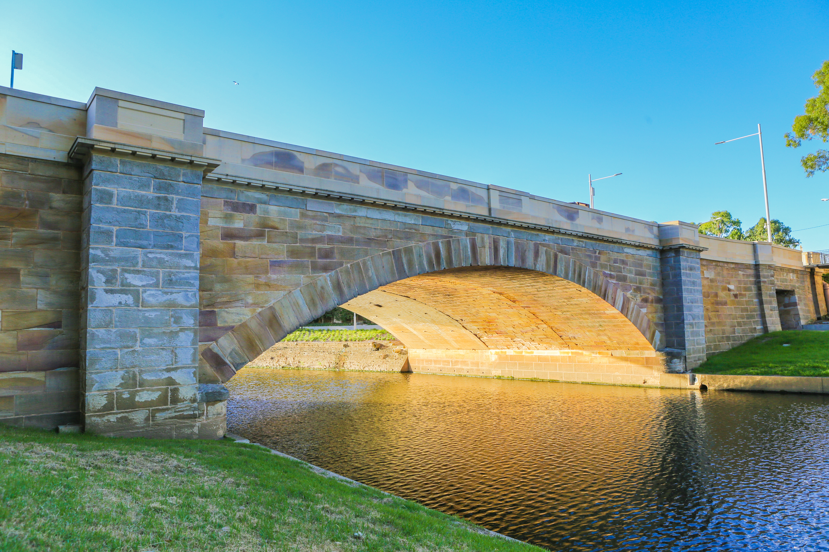
Staying connected
Q9
In how many stages was the Lennox Bridge, as we know it today, constructed?

Slide 11
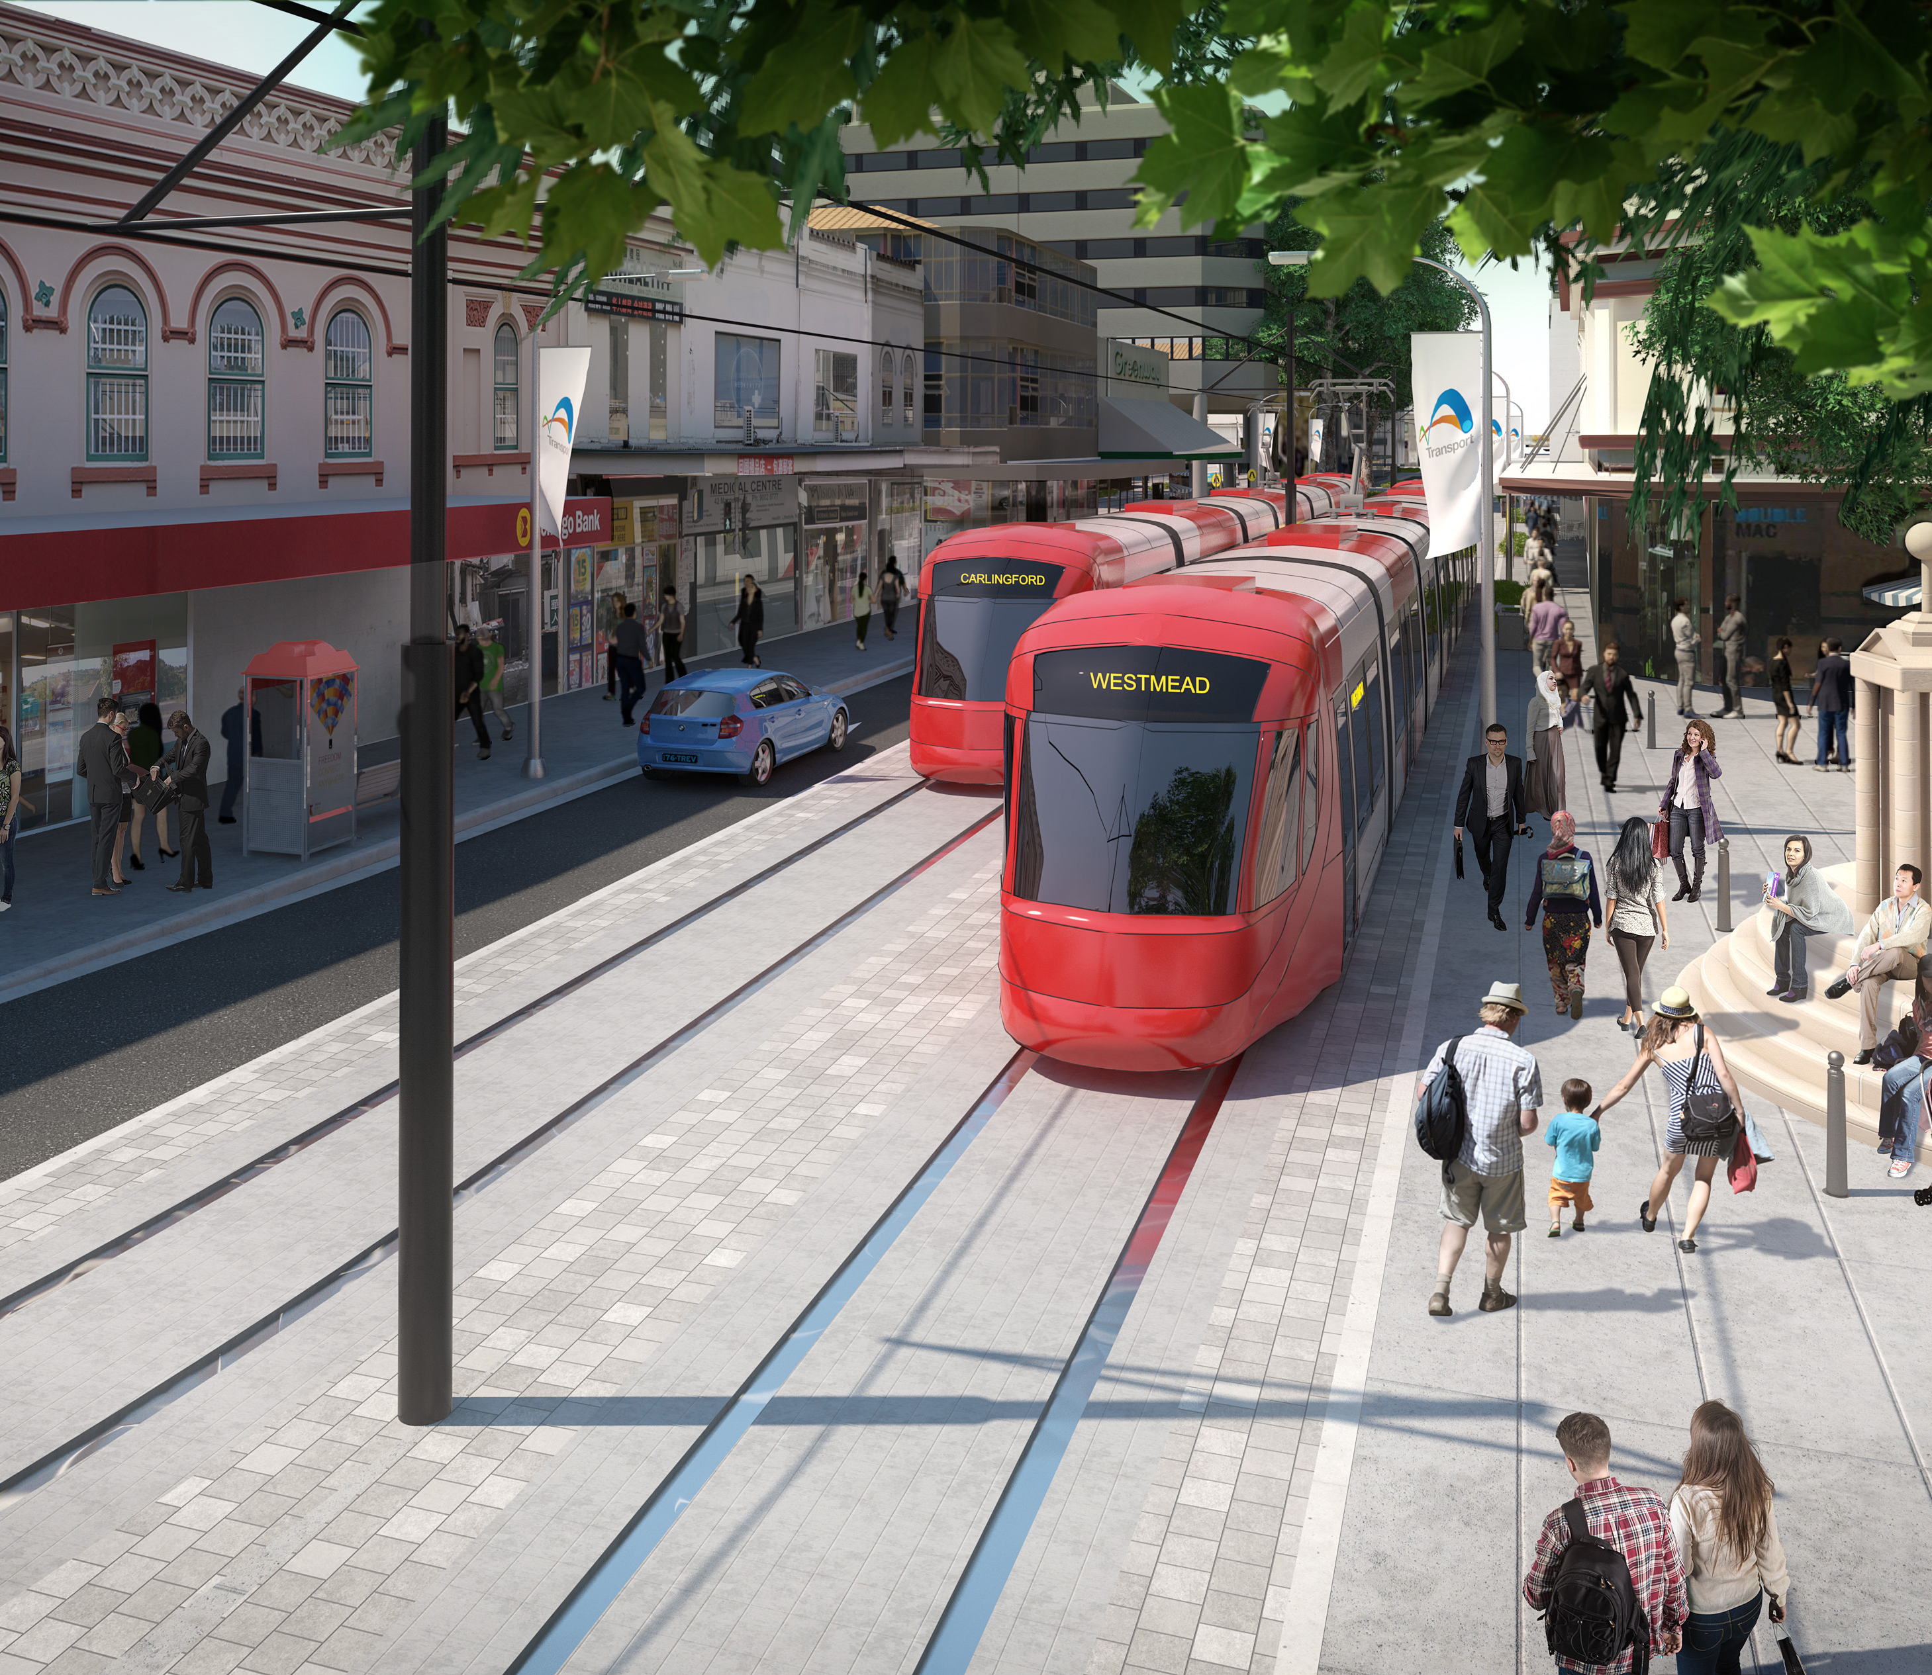
Staying connected
Q10
What distance will Stage 1 of the new Parramatta Light Rail traverse?
  6 km
  9.5km
  12 km
  17 km

Slide 12
Staying connected - answers
The Parramatta River. It was the easiest route, used by both Aboriginal people and the colonists, before Parramatta Road was opened in 1811.
In 1860, the railway having first reached as far as Parramatta Junction, which was located near Granville, in 1855.
Western Sydney University
A – 1971-1993. The M4 was built in two sections; the original section, designated the M4 Western Motorway, between 1971-93 and the new eastern tunnel extension, known as the M4 East, between 2015-2019
900
An Aboriginal bark canoe, used along the Parramatta River for fishing and transport.
B - Westmead and The Bays, with an extension to stations at Pyrmont and the CBD still being planned.
11, plus 1 railway bridge and 4 pedestrian bridges.
Four - the bridge was initially built in two stages between 1836-39; first the western part, with the Old Gaol Bridge still in situ to enable crossings to continue during construction, then the eastern side was added. In 1934-5 the bridge was reinforced and widened and in 2014 the two portals were completed to allow pedestrian and cycle access along the river. In between there were other modifications, none of which survive in the current structure.
C – 12 kilometres
Notes:
Staying Connected - Answers
What was the first major travel thoroughfare from Sydney to Parramatta? The Parramatta River. It was the easiest route, used by both Aboriginal people and the colonists, before Parramatta Road was opened as a toll road in 1811.
In what year did the railway first connect Sydney and the now heritage listed Parramatta Station? In 1860, the railway having first reached as far as Parramatta Junction, which was located near Granville, in 1855.
Which university runs a free shuttle bus between its City of Parramatta campuses? Western Sydney University
Between what dates was the M4 Western Motorway constructed? A – 1971-1993. The M4 was built in two sections; the original section, designated the M4 Western Motorway, between 1971-93 and the new eastern tunnel extension, known as the M4 East, between 2015-2019
1971-1993
1986-1995
1971-2019
1989-2003
What is the route number of City of Parramatta’s CBD shuttle bus service? 900
What is a nawi? An Aboriginal bark canoe, used along the Parramatta River for fishing and transport.
Between which two stations will the Sydney West Metro initially travel, with 5 stops in between? B - Westmead and The Bays, with an extension to stations at Pyrmont and the CBD still being planned.
Parramatta and Sydney CBD
Westmead and The Bays
Westmead and Pyrmont
Parramatta and Five Dock
How many motor vehicle bridges span the Parramatta River? 11, plus 1 railway bridge and 4 pedestrian bridges.
In how many stages was the Lennox Bridge, as we know it today, constructed? Four - the bridge was initially built in two stages between 1836-39; first the western part, with the Old Gaol Bridge still in situ to enable crossings to continue during construction, then the eastern side was added. In 1934-5 the bridge was reinforced and widened and in 2014 the two portals were completed to allow pedestrian and cycle access along the river. In between there were other modifications, none of which survive in the current structure.
What distance will Stage 1 of the new Parramatta Light Rail traverse? C – 12 kilometres
6 km
9.5km
12 km
17 km

Slide 13
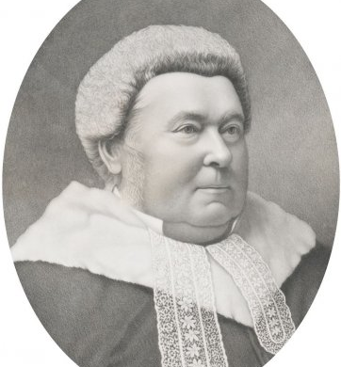
WH0 AM I?
I was born in County Cork, Ireland
My father worked as a groom at Old Government House Parramatta, from where I walked 20km to Sydney to attend school
I became a journalist, writing for the Australian newspaper, and eventually became it’s editor
I took up the law, but as a result of my humble beginnings was not accepted as belonging to the establishment
I acted as defence for Frank Gardiner’s bushranging gang in a highly publicised trial
I was a member of a committee which persuaded the British government to allow the colony to write it’s own constitution
I was admitted to the bar and made Queens Counsel in 1857
I served as Attorney General in the New South Wales government and twice briefly achieved my dream of becoming Premier of my colony
From 1873-1886 I held the post of Chief Justice of New South Wales
Twin statues of me connect Smith Street, Parramatta and Martin Place, Sydney
Sir James Martin

