Slide 1
Streets of my town
Parramatta
Notes:
Before starting online meeting:
Select Slide show from top bar and click “From beginning”
You will be able to see the notes; participants will only see slides
Before starting quiz:
Check that participants have a pen and paper at the ready, to write down their answers.
Each correct answer is worth 1 point.
If playing in teams, remind groups to mute their mic as they discuss their answer, so they don’t accidentally tell other teams.
Remember to speak slowly and clearly, so everyone understands the questions.
Check that everyone is ready before moving on to next question.

Slide 2
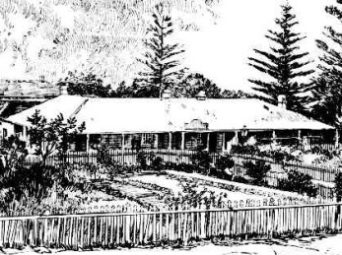
Streets of my town
Q1
Which small laneway in the centre of the CBD commemorates the beautiful garden of Hannah Walker, colonial licensee of the Red Cow Inn?

Slide 3
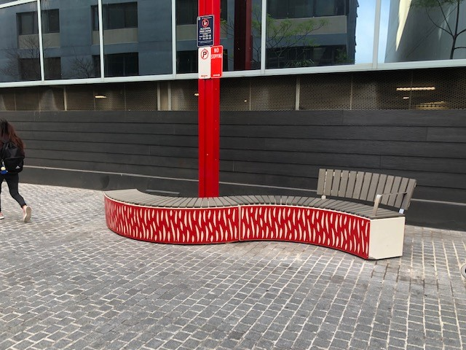
Streets of my town
Q2
How did Fire Horse Lane acquire its unusual name?

Slide 4
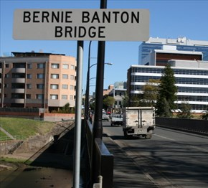
Streets of my town
Q3
Who does the Bernie Banton Bridge commemorate?
  An activist who sought compensation for sufferers of asbestos related diseases
  The first convict to marry in St Johns Cathedral
  An early Mayor of Parramatta
  The last convict to gain emancipation

Slide 5
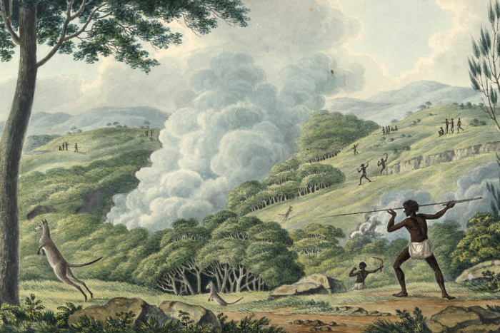
Streets of my town
Q4
Which of the following is not a street name in Parramatta?
  Firestick Place
  Dirrabarri Lane
  Fleet Street
  Alaska Street

Slide 6
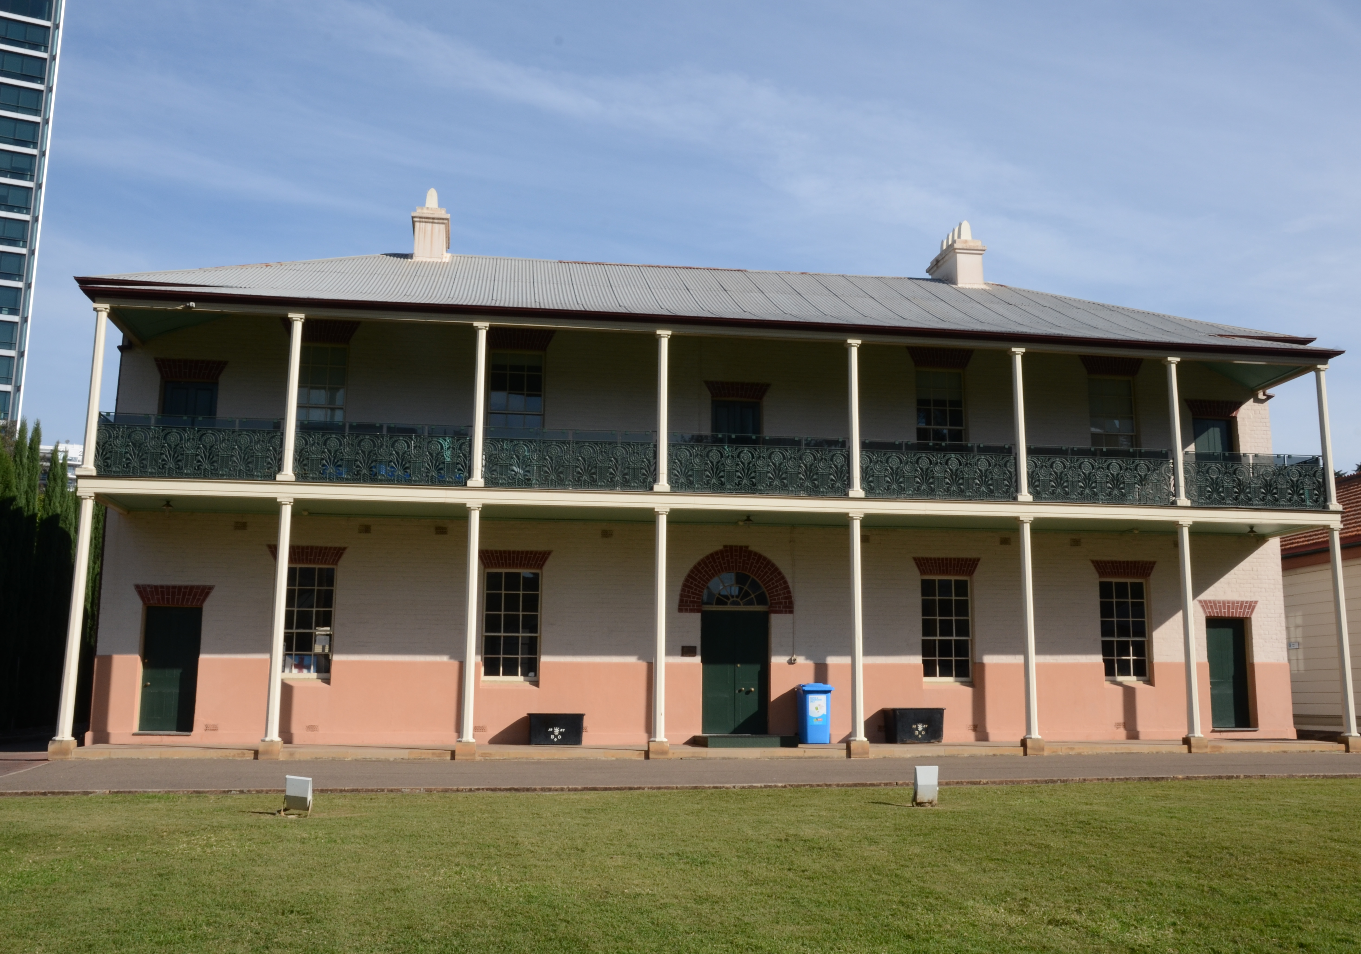
Streets of my town
Q5
On which street is the Lancer Barracks located?
  Lancer Lane
  Barrack Lane
  Macquarie Street
  Smith Street

Slide 7
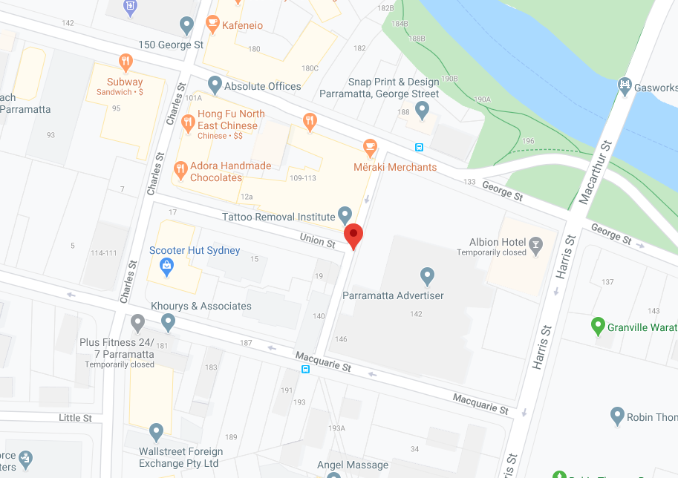
Streets of my town
Q6
Argus Lane was:
  The result of a typo – it should have been Angus Lane
  Named after the first licensee of the Albion Hotel
  Named for the local newspaper - The Cumberland Argus and Fruitgrowers' Advocate
  The first lane to be named in Parramatta

Slide 8
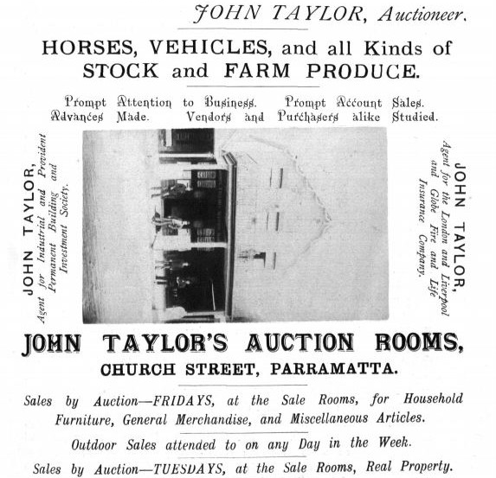
Streets of my town
Q7
John Taylor, early Parramatta entrepreneur, is commemorated in which street name?
  John Street, Rydalmere
  Taylor Place, Ermington
  Auctioneer Lane, Parramatta
  John Street, Granville

Slide 9
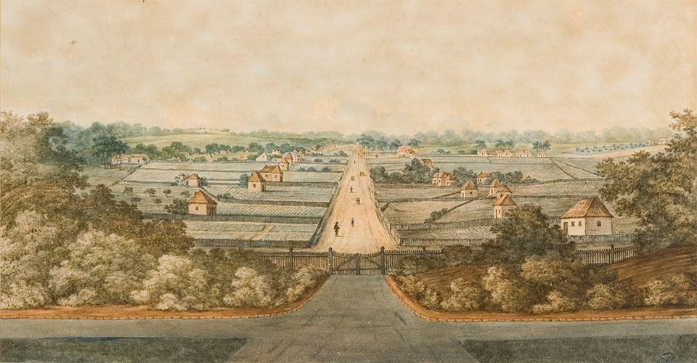
Streets of my town
Q8
What was the original name of George Street, Parramatta?

Slide 10
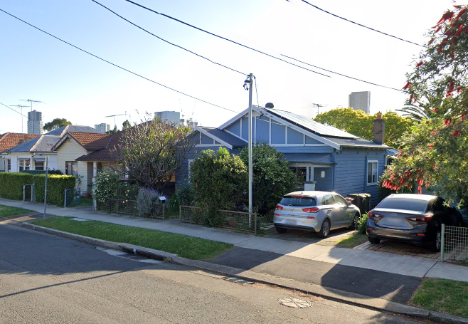
Streets of my town
Q9
Where did Gore Street, North Parramatta get its name?
  It was the site of a 19th century abattoir
  It was owned by the same landholder as Gore Hill, in the north of Sydney
  It was named for an early master of The Kings School
  None of the above

Slide 11
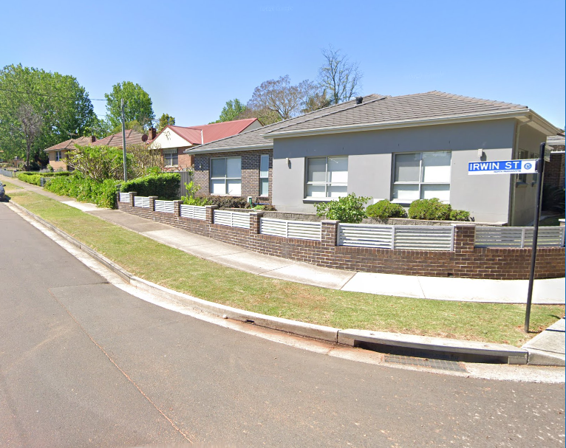
Streets of my town
Q10
Irwin Street commemorates:
  Steve Irwin, crocodile wrangler
  William John Irwin, a Parramatta alderman
  Charles Irwin, the town’s colonial hangman
  Judith Irwin, daughter of a Parramatta mayor

Slide 12
Streets of my town - answers
C - China Rose Way. Hannah was famous for both her roses (new to the colony) and her pomegranates; the inn itself is also commemorated in an adjacent laneway.
From the horses which pulled the early fire trucks from the fire station located on the site the lane now occupies
A – a victim of mesothelioma, he fought for recognition and justice for asbestos sufferers
A – Firestick Place
D - Smith Street. The barracks were built in 1818-20 for the British troops who garrisoned the colony of NSW; they remain the home of the Royal NSW Lancers.
C – Yes, that really was the name of the local paper, which was published under variations of the name between 1887-1962
C – Auctioneer Lane; he ran an auction house on Church Street
High Street
C – named for Rev W F Gore, clergyman and Kings School Master
B – William John Irwin, following a theme of naming streets after local councillors
Notes:
Streets of my Town - Answers
Which small laneway in the centre of the CBD commemorates the beautiful garden of Hannah Walker, colonial licensee of the Red Cow Inn? C - China Rose Way. Hannah was famous for both her roses (new to the colony) and her pomegranates; the inn itself is also commemorated in an adjacent laneway.
Pomegranate Place
Red Cow Lane
China Rose Way
Flora Lane
How did Fire Horse Lane acquire its unusual name? From the horses which pulled the early fire trucks from the fire station located on the site the lane now occupies.
Who does the Bernie Banton Bridge commemorate? A – a victim of mesothelioma, he fought to seek recognition and justice for asbestos sufferers
An activist who sought compensation for sufferers of asbestos related diseases
The first convict to marry in St Johns Cathedral
An early Mayor of Parramatta
The last convict to gain emancipation
Which of the following is not a street name in Parramatta? A – Firestick Place
Firestick Place
Dirrabarri Lane
Fleet Street
Alaska Street
On which street is the Lancer Barracks located? D - Smith Street. The barracks were built in 1818-20 for the British troops who garrisoned the colony of NSW; they remain the home of the Royal NSW Lancers.
Lancer Lane
Barrack Lane
Macquarie Street
Smith Street
Argus Lane was: C – Yes, that really was the name of the local paper, which was published under variations of the name between 1887-1962
The result of a typo – it should have been Angus Lane
Named after the first licensee of the Albion Hotel
Named for the local newspaper - The Cumberland Argus and Fruitgrowers' Advocate
The first lane to be named in Parramatta
John Taylor, early Parramatta entrepreneur, is commemorated in which street name? C – Auctioneer Lane; he ran an auction house on Church Street
John Street, Rydalmere
Taylor Place, Ermington
Auctioneer Lane, Parramatta
John Street, Granville
What was the original name of George Street, Parramatta? High Street
Where did Gore Street, North Parramatta get its name? C – named for Rev W F Gore, clergyman and Kings School Master
It was the site of a 19th century abattoir
It was owned by the same landholder as Gore Hill, in the north of Sydney
It was named for an early master of The Kings School
None of the above
Irwin Street commemorates: B – William John Irwin, following a theme of naming streets after Parramatta councillors
Steve Irwin, crocodile wrangler
William John Irwin, a Parramatta alderman
Charles Irwin, the town’s colonial hangman
Judith Irwin, daughter of a Parramatta mayor

Slide 13
WHat AM I?
I was first mapped by Surveyor George Evans
My name was changed on the orders of Governor Macquarie
I was realigned by James Meehan in 1810, and now was no longer straight
My early residents included convicts, soldiers and a botanist
My many famous hotels and inns included the White Horse Hotel and St Patrick’s Inn
One of my most elegant remaining buildings once housed a mortuary chapel
Several colonial buildings remain to enhance my vista
The original Kings School was located on my northern side
St Johns Greek Orthodox Church is located towards my eastern end
In colonial times I served as an important connection between the major transport hub and the Governor’s residence
George Street

