Slide 1
The numbers game
Parramatta
Notes:
Before starting online meeting:
Select Slide show from top bar and click “From beginning”
You will be able to see the notes; participants will only see slides
Before starting quiz:
Check that participants have a pen and paper at the ready, to write down their answers.
Each correct answer is worth 1 point.
If playing in teams, remind groups to mute their mic as they discuss their answer, so they don’t accidentally tell other teams.
Remember to speak slowly and clearly, so everyone understands the questions.
Check that everyone is ready before moving on to next question.

Slide 2
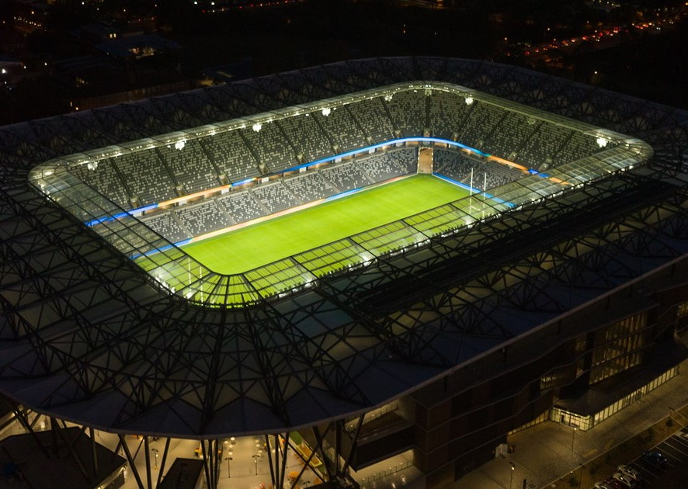
The numbers game
Q1
How many people can Bankwest Stadium seat for a game and how many for a concert?

Slide 3
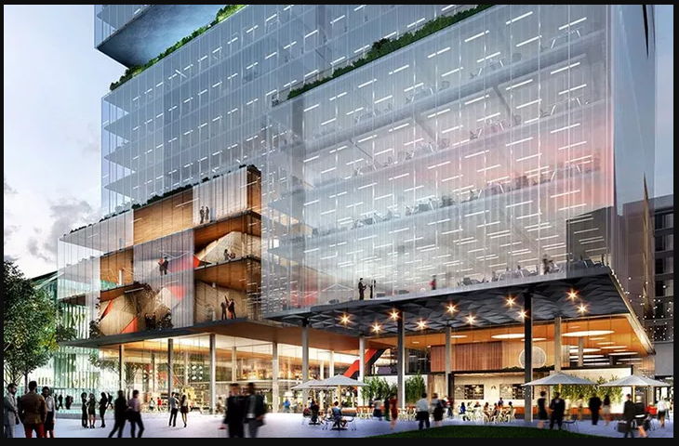
The numbers game
Q2
3 Parramatta Square, also known as the NAB Centre, is how many stories high?
  50
  6
  40
  17

Slide 4
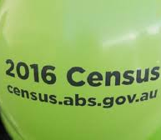
The numbers game
Q3
In the 2016 census (most recent) which had the higher percentage of professional workers, Sydney or Parramatta?

Slide 5
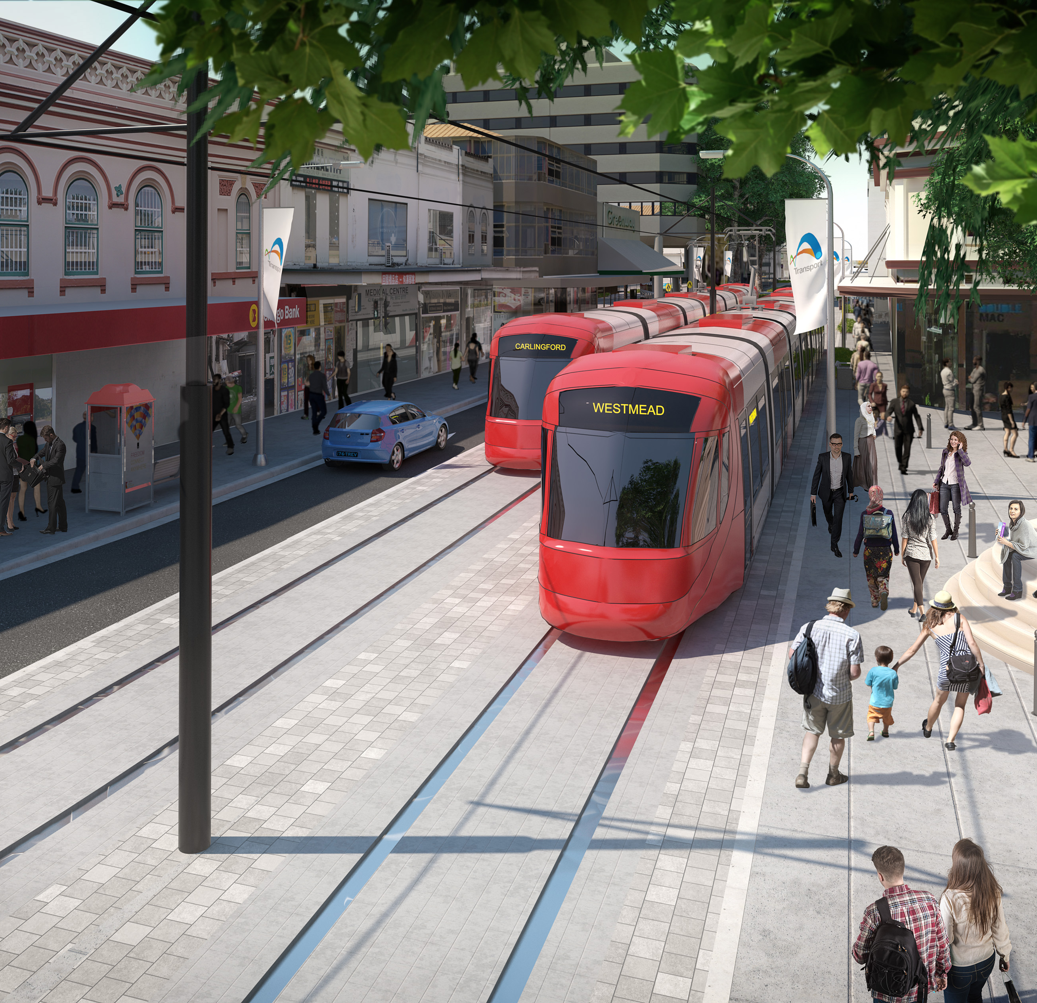
The numbers game
Q4
By 2026 how many people are predicted to use the Parramatta Light Rail every day?
  5,000
  13,000
  21,000
  28,000

Slide 6
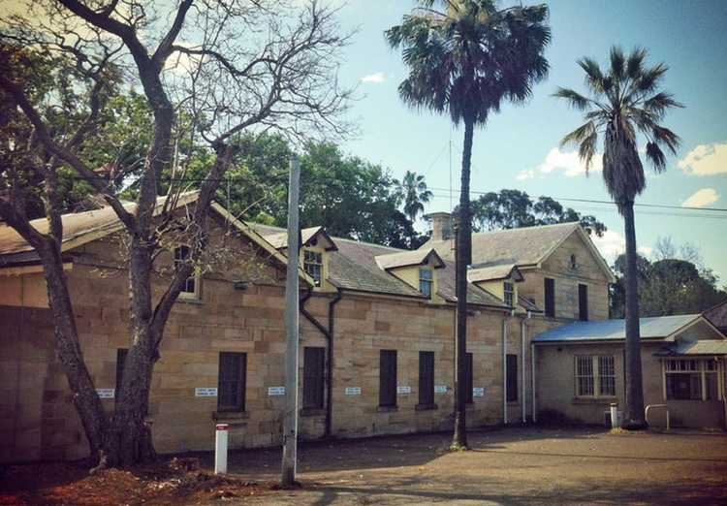
The numbers game
Q5
What percentage of Australians are believed to have had an ancestress who went through the Parramatta Female Factory?

Slide 7
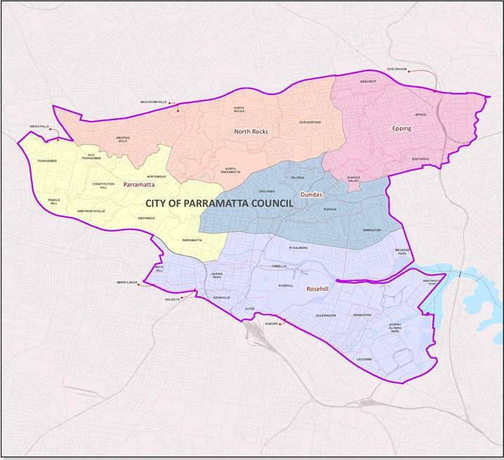
The numbers game
Q6
To the nearest percentage, by how much is the population of Parramatta expected to grow between 2019 – 2036?
  30%
  17%
  91%
  58%

Slide 8
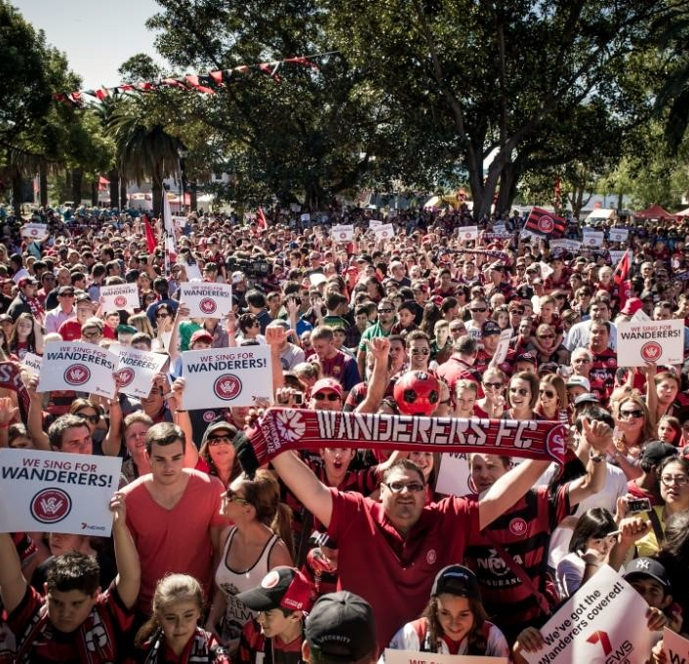
The numbers game
Q7
In what month of what year did Western Sydney Wanderer membership first reach the milestone of 20,000 members?
  June 2018
  February 2020
  April 2017
  August 2019

Slide 9
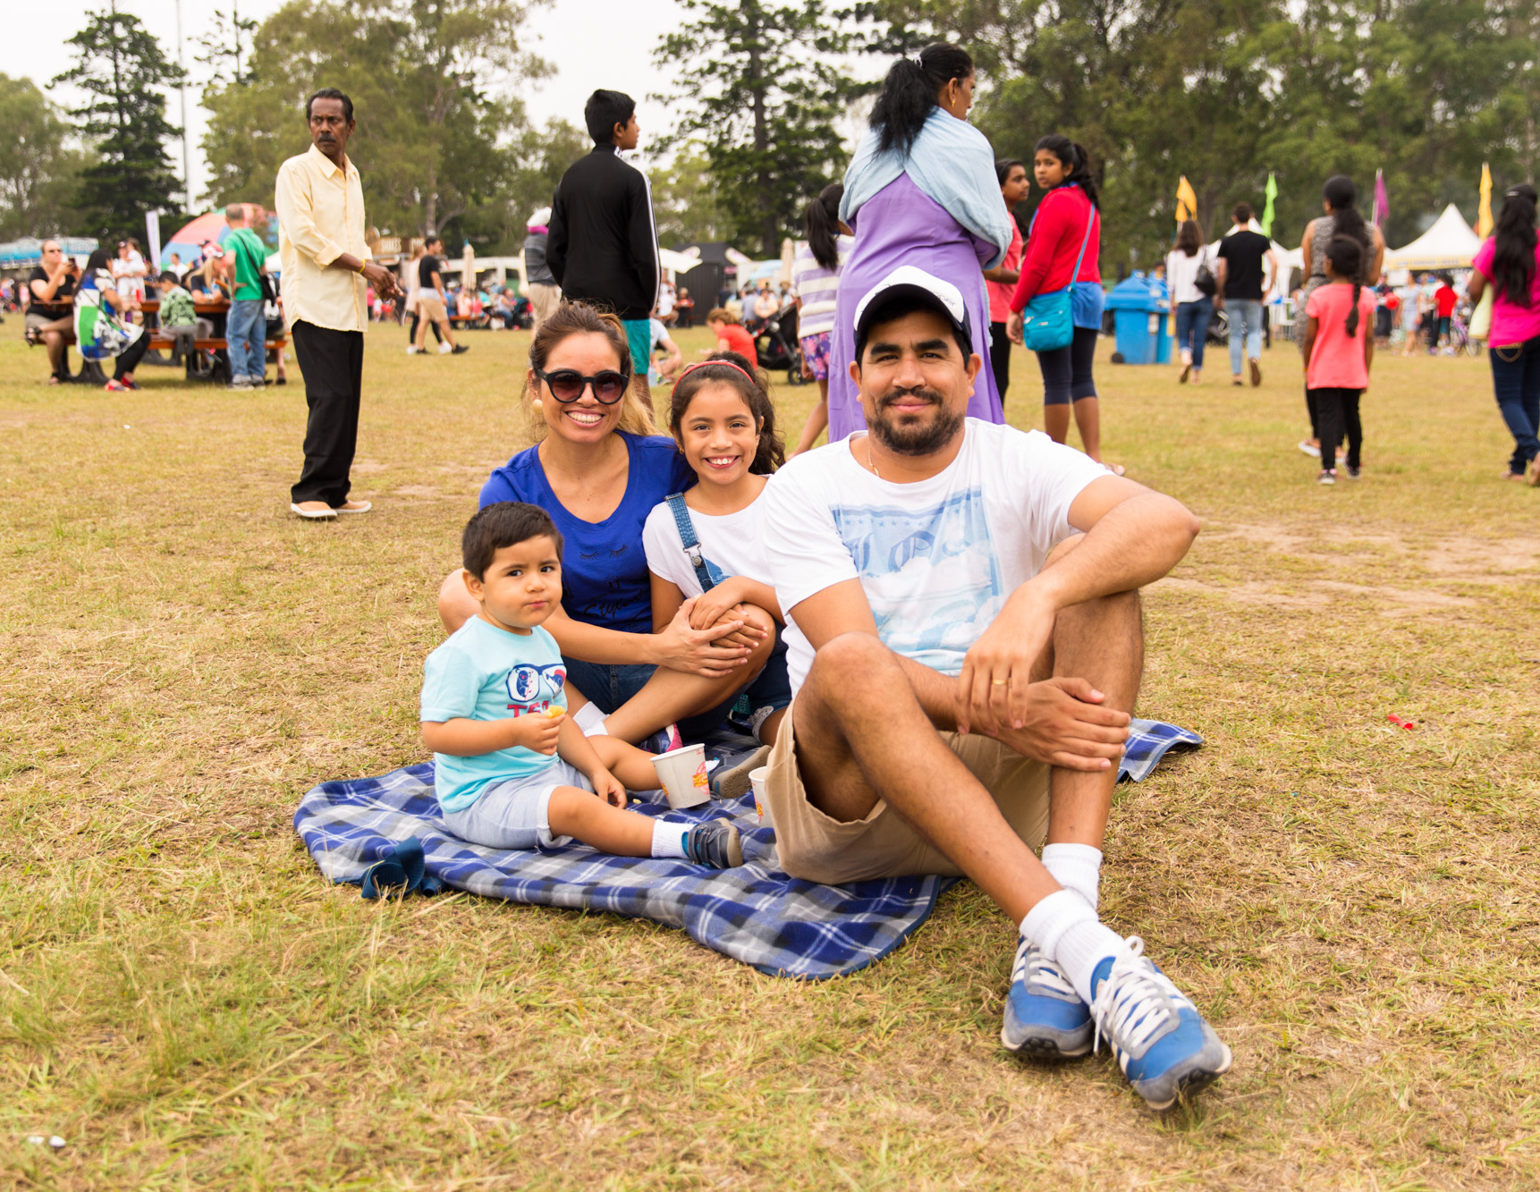
The numbers game
Q8
Which are the top three languages other than English spoken at home in Parramatta?
  Mandarin, Hindi, Cantonese
  Mandarin, Korean, Hindi
  Hindi, Mandarin, Arabic
  Cantonese, Mandarin, Korean

Slide 10
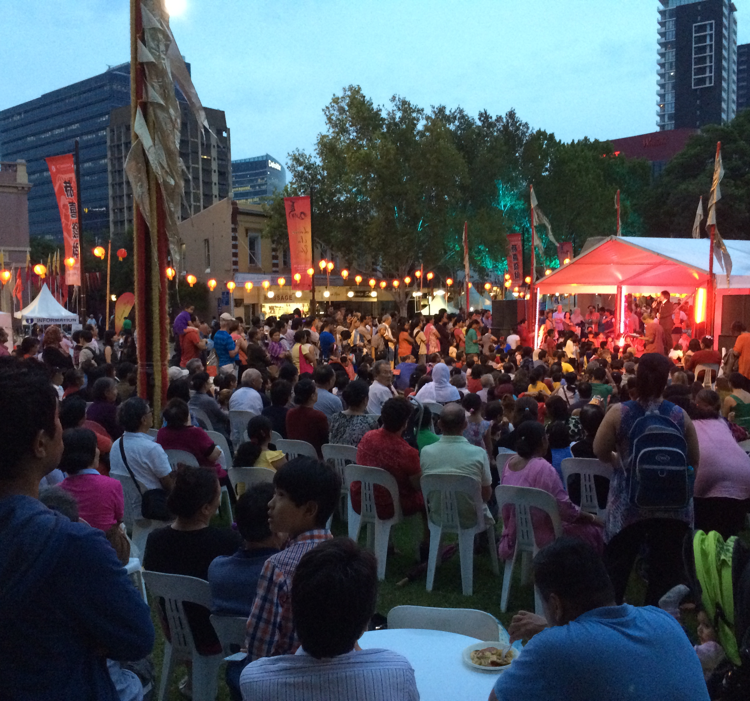
The numbers game
Q9
What was the median age of the population of the City of Parramatta in 2016?
  36 years
  46 years
  34 years
  29 years

Slide 11
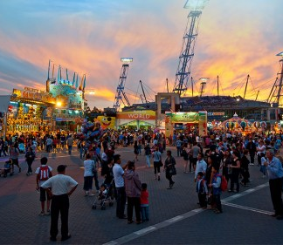
The numbers game
Q10
How many people attended the Sydney Royal Easter Show at Sydney Olympic Park in 2019?
  450,000
  720,000
  615.000
  900,000

Slide 12
The numbers game - answers
30,000 for a game; 40,000 for a concert
D - 17
Parramatta, with around 37%, compared to Sydney at around 25%. Parramatta also beats Sydney for percentage of workers with a Bachelor Degree or higher, at just under 50%
D – 28,000
About 10-14% of Australians are descended from these convict women. About 2/3 of the 12,600 convict women sent to the colony spent time in the factory. We’ll accept any answer between 10-14%.
D – 58%, or to be precise 58.18%
C - April 2017
A – Mandarin, Hindi and Cantonese
C – 34 years, compared to Greater Sydney at 36 years
D – 900,000. They cheered the 19,000 awards given across 5,500 classes; ate 50,000 scones and 15,000 cheese toasties (not to mention lots of pluto pups, ice creams, fairy floss and pies); admired over 14,000 animals; watched 240 competitors chop through 4000 blocks of wood; and took home 1.6 million showbags
Notes:
The Numbers Game
How many people can Bankwest stadium seat for a game and for a concert? 30,000 game; 40,000 for a concert
How many NAB staff members will have moved to their new offices at 3 Parramatta Square by August 2020 (COVID allowing)? A - 6,500
6,500
1,200
900
4,700
In the 2016 census (most recent) which had the higher percentage of professional workers, Sydney or Parramatta? Parramatta, with around 37%, compared to Sydney at around 25%. Parramatta also beats Sydney for percentage of workers with a Bachelor Degree or higher, at just under 50%
By 2026 how many people are expected to use the Parramatta Light Rail every day? D – 28,000
5,000
13,000
21,000
28,000
What percentage of Australians are believed to have had an ancestress who went through the Parramatta Female Factory? About 10% of Australians are descended from these convict women. About 2/3 of the 12,600 convict women sent to the colony spent time in the factory.
By how much is the population of Parramatta expected to grow between 2019 – 2036? 58.18%, or just over 58%
In what month of what year did Western Sydney Wanderer membership first reach the milestone of 20,000 members? C - April 2017
June 2018
February 2020
April 2017
August 2019
Which are the top three languages other than English spoken at home in Parramatta? A – Mandarin, Hindi and Cantonese
Mandarin, Hindi, Cantonese
Mandarin, Korean, Hindi
Hindi, Mandarin, Arabic
Cantonese, Mandarin, Korean
What was the median age of the population of the City of Parramatta in 2016? C – 34 years, compared to Greater Sydney at 36 years
36 years
46 years
34 years
29 years
How many people attended the Sydney Royal Easter Show at Sydney Olympic Park in 2019? D – 900,000. They cheered the 19,000 awards given across 5,500 classes; ate 50,000 scones, 300 custard bombs and 15,000 cheese toasties (not to mention lots of pluto pups, ice creams, fairy floss and pies); admired over 14,000 animals; watched 240 competitors chop through 4000 blocks of wood; and took home 1.6 million showbags
450,000
720,000
615.000
900,000

Slide 13
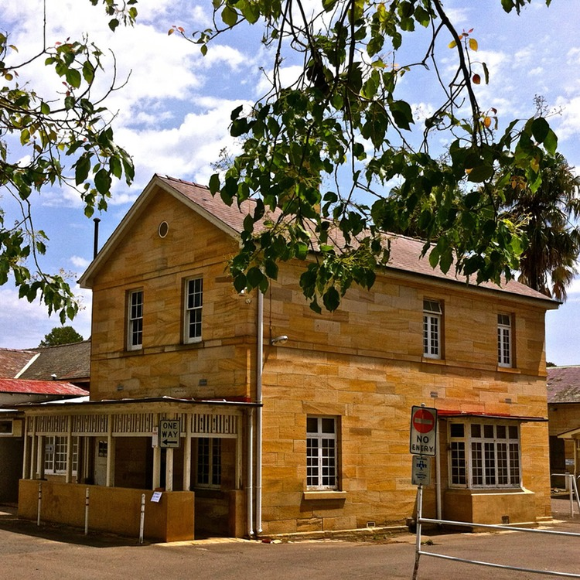
WHat AM I?
Many of my buildings were designed by Francis Greenway
My inmates had a range of over 180 trades
My third class inmates were required to break rocks or pick oakum
My original, lesser-known location was in what was later to become Prince Alfred Square
My looms produced woollen cloth, blankets, fine linen, sailcloth and more
Punishments included long stretches in solitary confinement and head shaving
5 riots were recorded as taking place before I shut down
My site was later repurposed into an insane asylum
1 in 7 Australians is said to descend from my alumni
5000 women passed through my gates
Parramatta Female Factory

