Slide 1
The sporting life
Parramatta
Notes:
Before starting online meeting:
Select Slide show from top bar and click “From beginning”
You will be able to see the notes; participants will only see slides
Before starting quiz:
Check that participants have a pen and paper at the ready, to write down their answers.
Each correct answer is worth 1 point.
If playing in teams, remind groups to mute their mic as they discuss their answer, so they don’t accidentally tell other teams.
Remember to speak slowly and clearly, so everyone understands the questions.
Check that everyone is ready before moving on to next question.

Slide 2
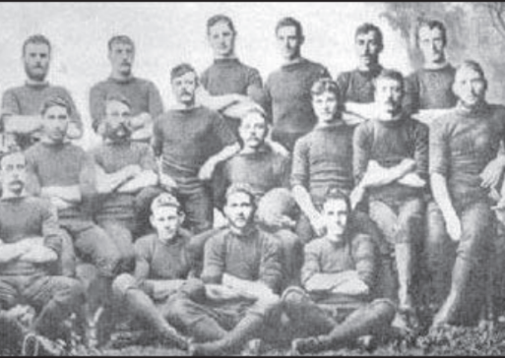
The sporting life
Q1
What two teams contested the first international rugby match in Australia?

Slide 3
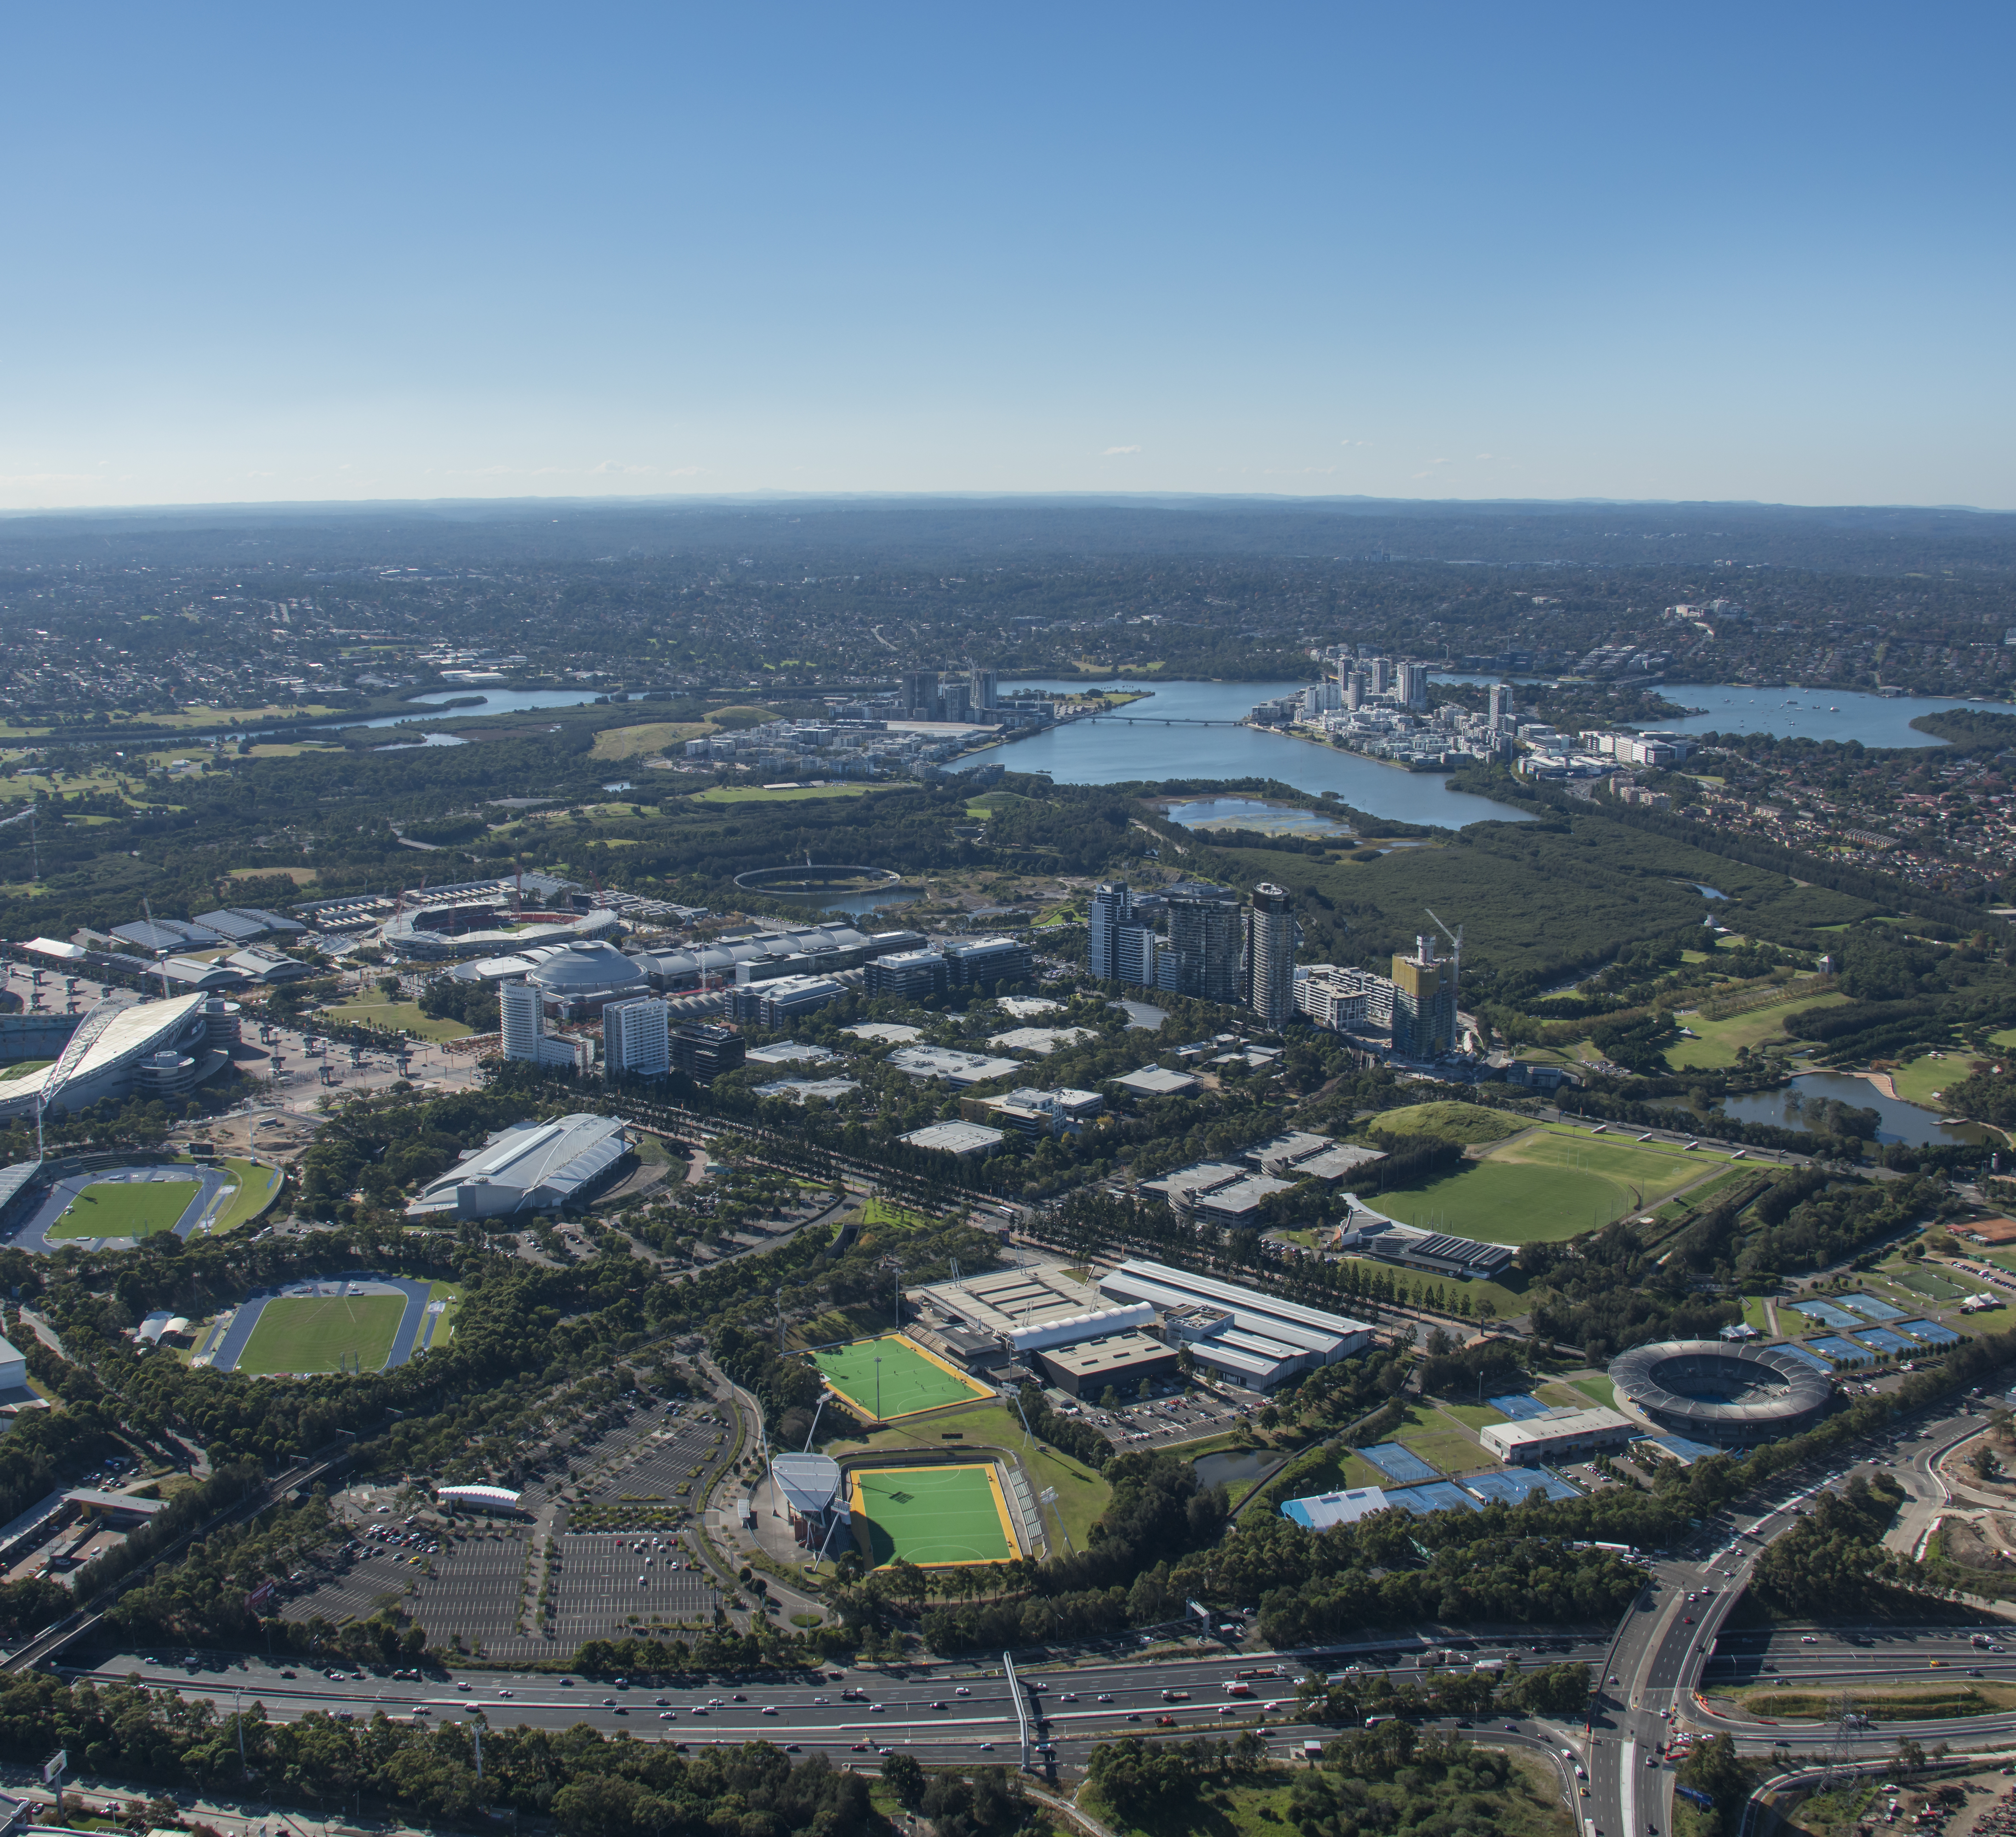
The sporting life
Q2
Which Sydney Olympic Venue is not located in Parramatta LGA?
  Stadium Australia
  State Sports Centre (table tennis and Taekwondo)
  Dunc Gray Velodrome
  Sydney International Archery Park

Slide 4
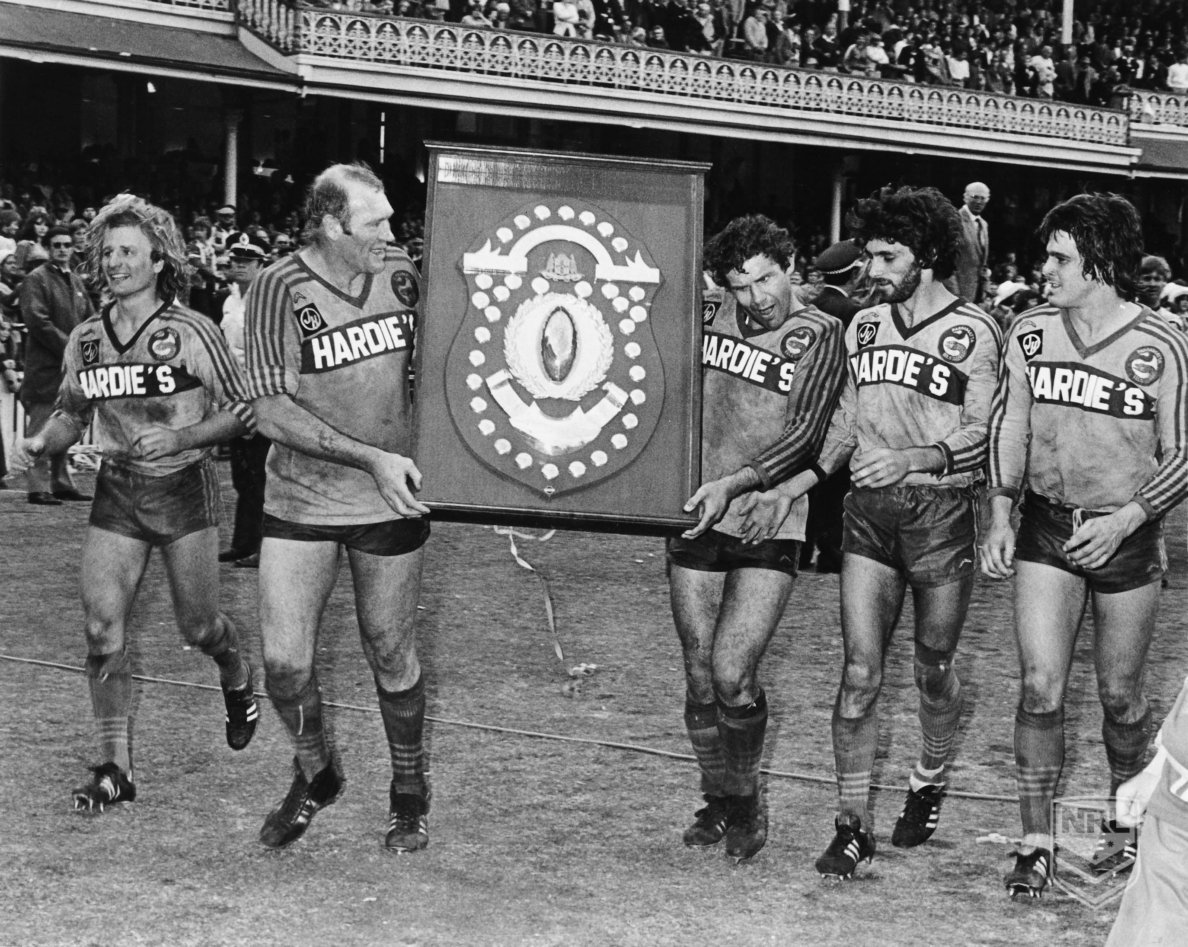
The sporting life
Q3
How did the Parramatta Eels fans celebrate their first ever Grand Final win in 1981?
  A few quiet drinks at the Parramatta Leagues Club
  A ticker-tape parade through the city
  Burning down the grandstand at Cumberland Oval
  An all-in brawl with the fans of the defeated Newtown team

Slide 5
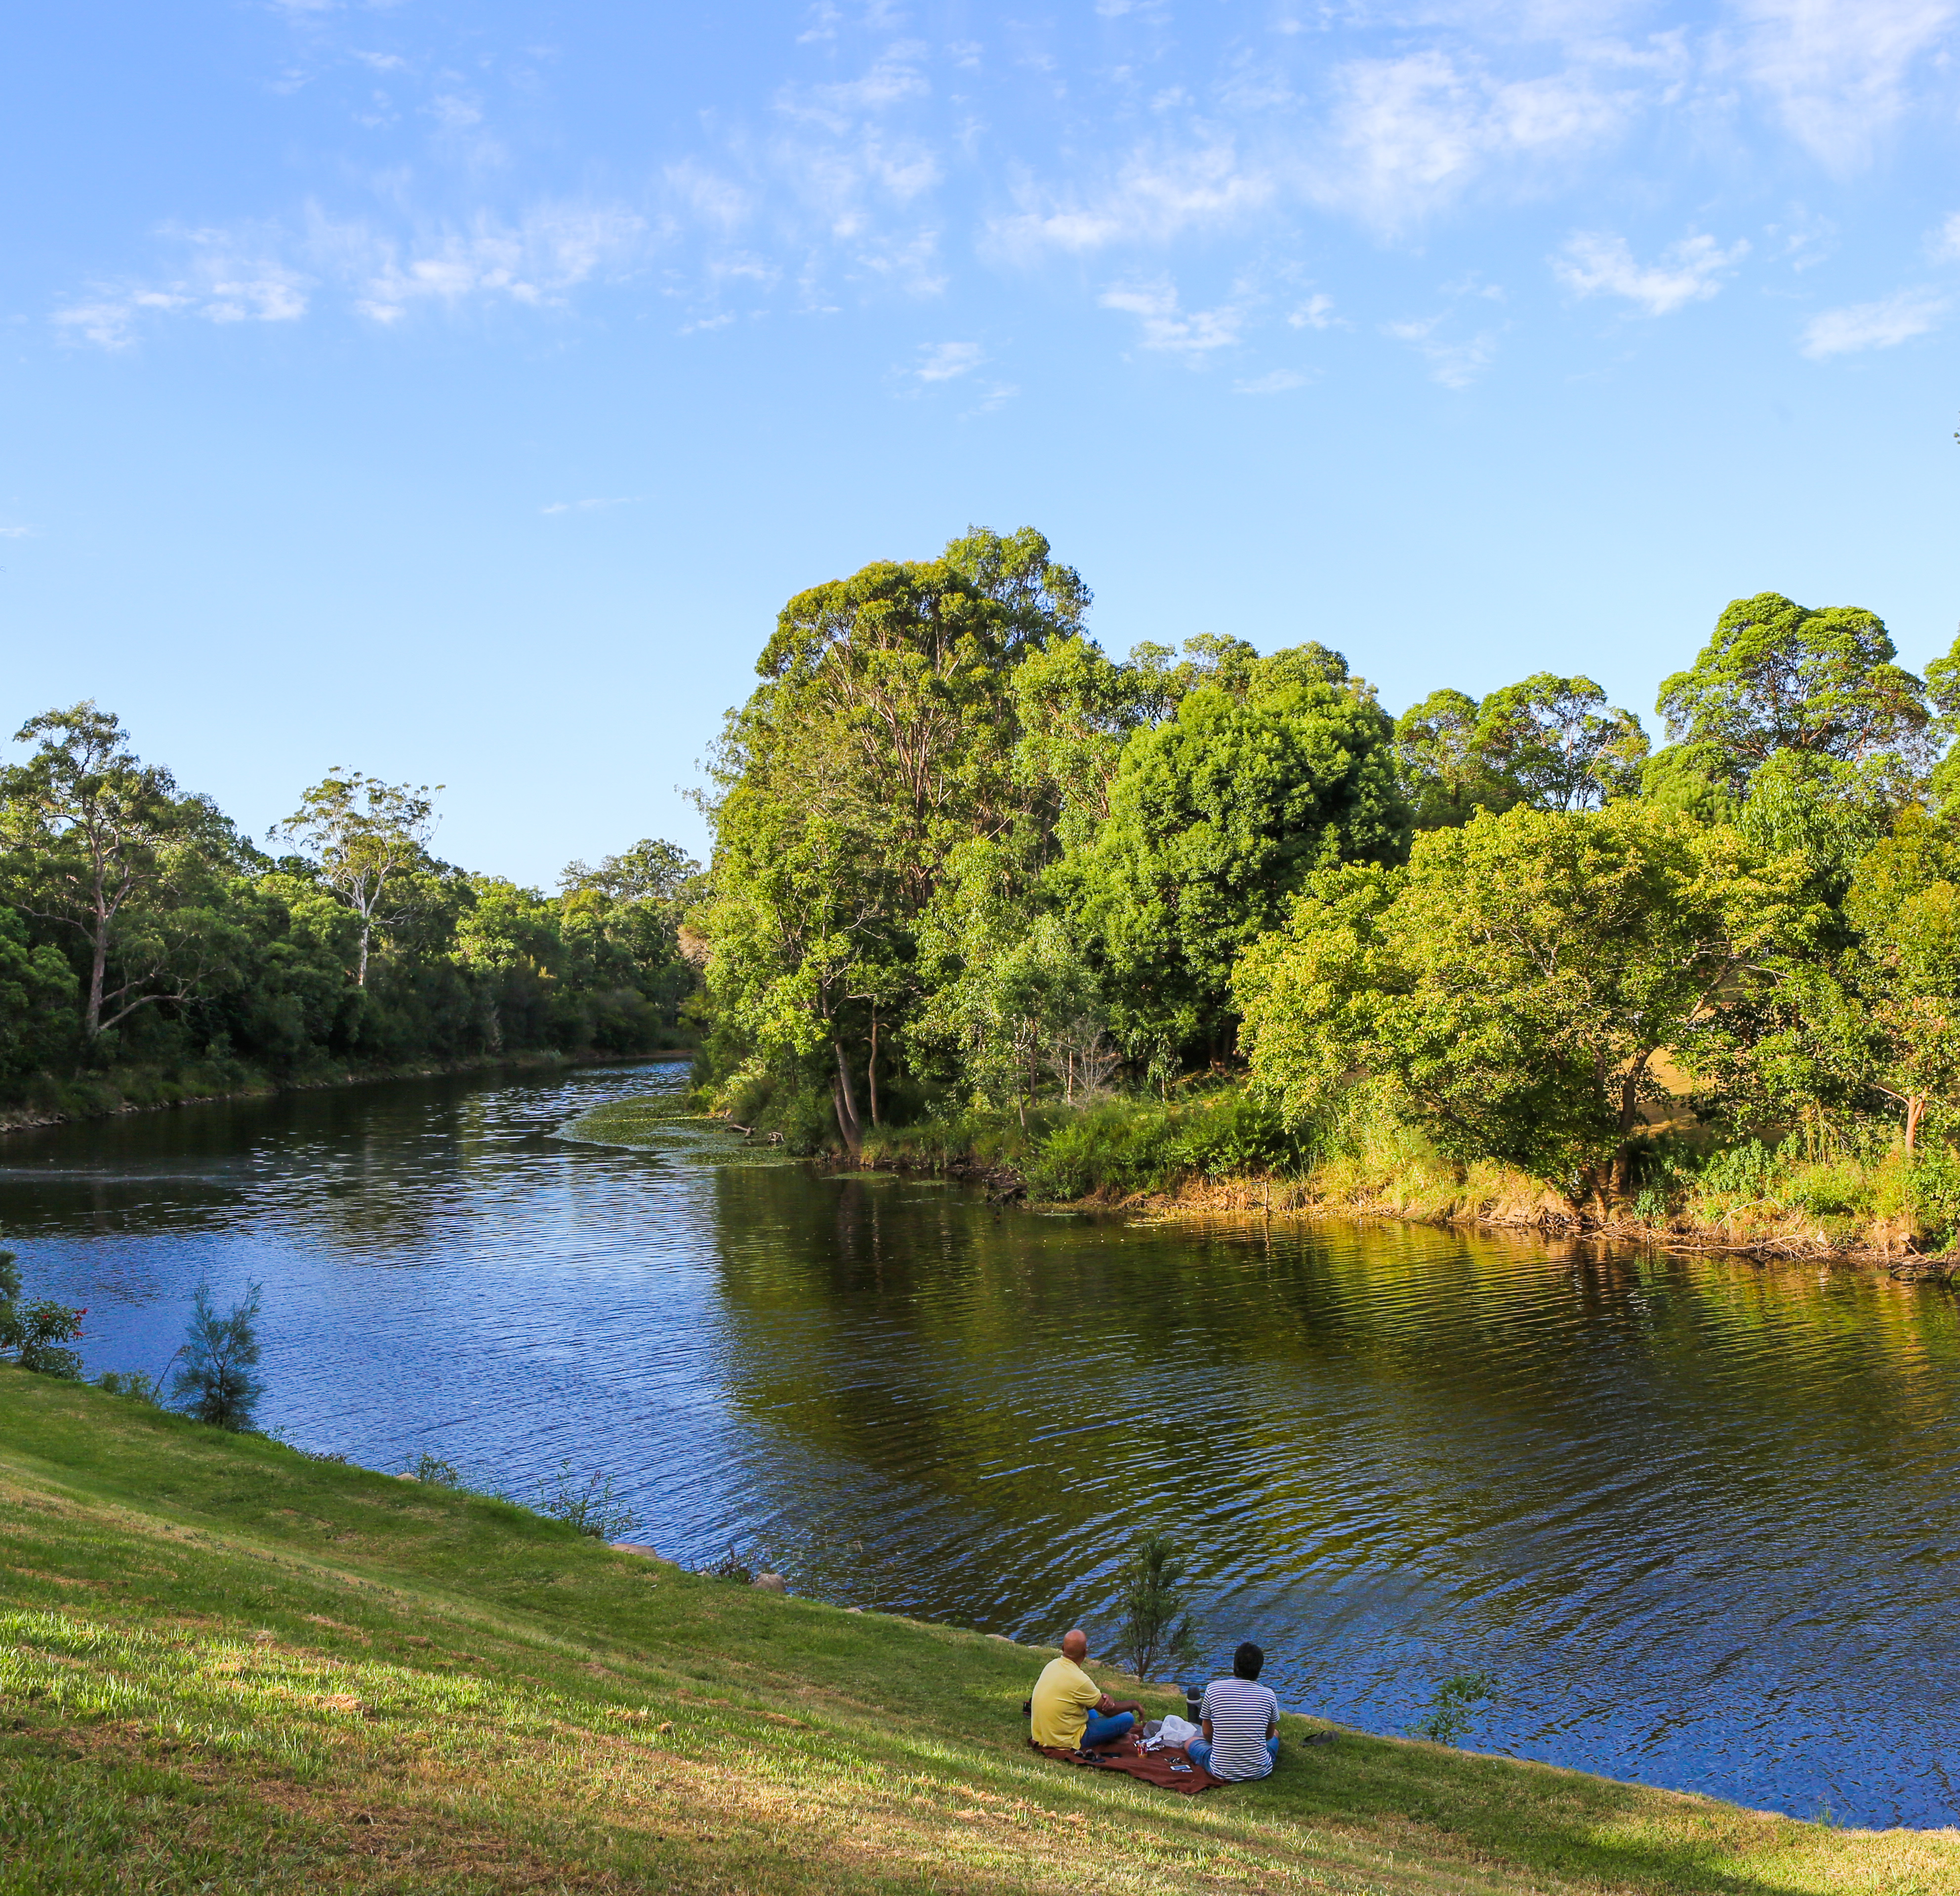
The sporting life
Q4
What type of racing took place in Parramatta Park from 1952-55?

Slide 6
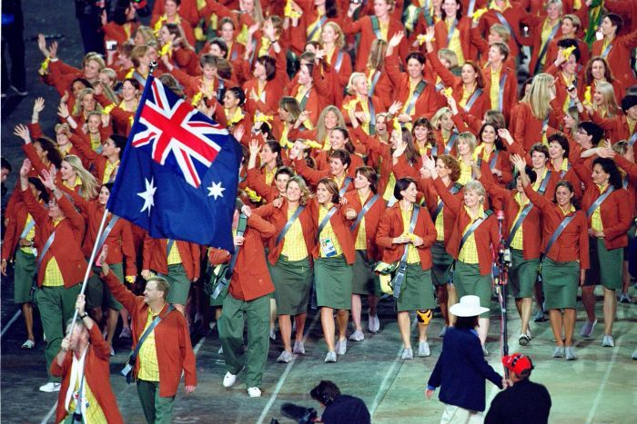
The sporting life
Q5
Who was the flag bearer for Australia at the opening ceremony of the Sydney Olympics?

Slide 7
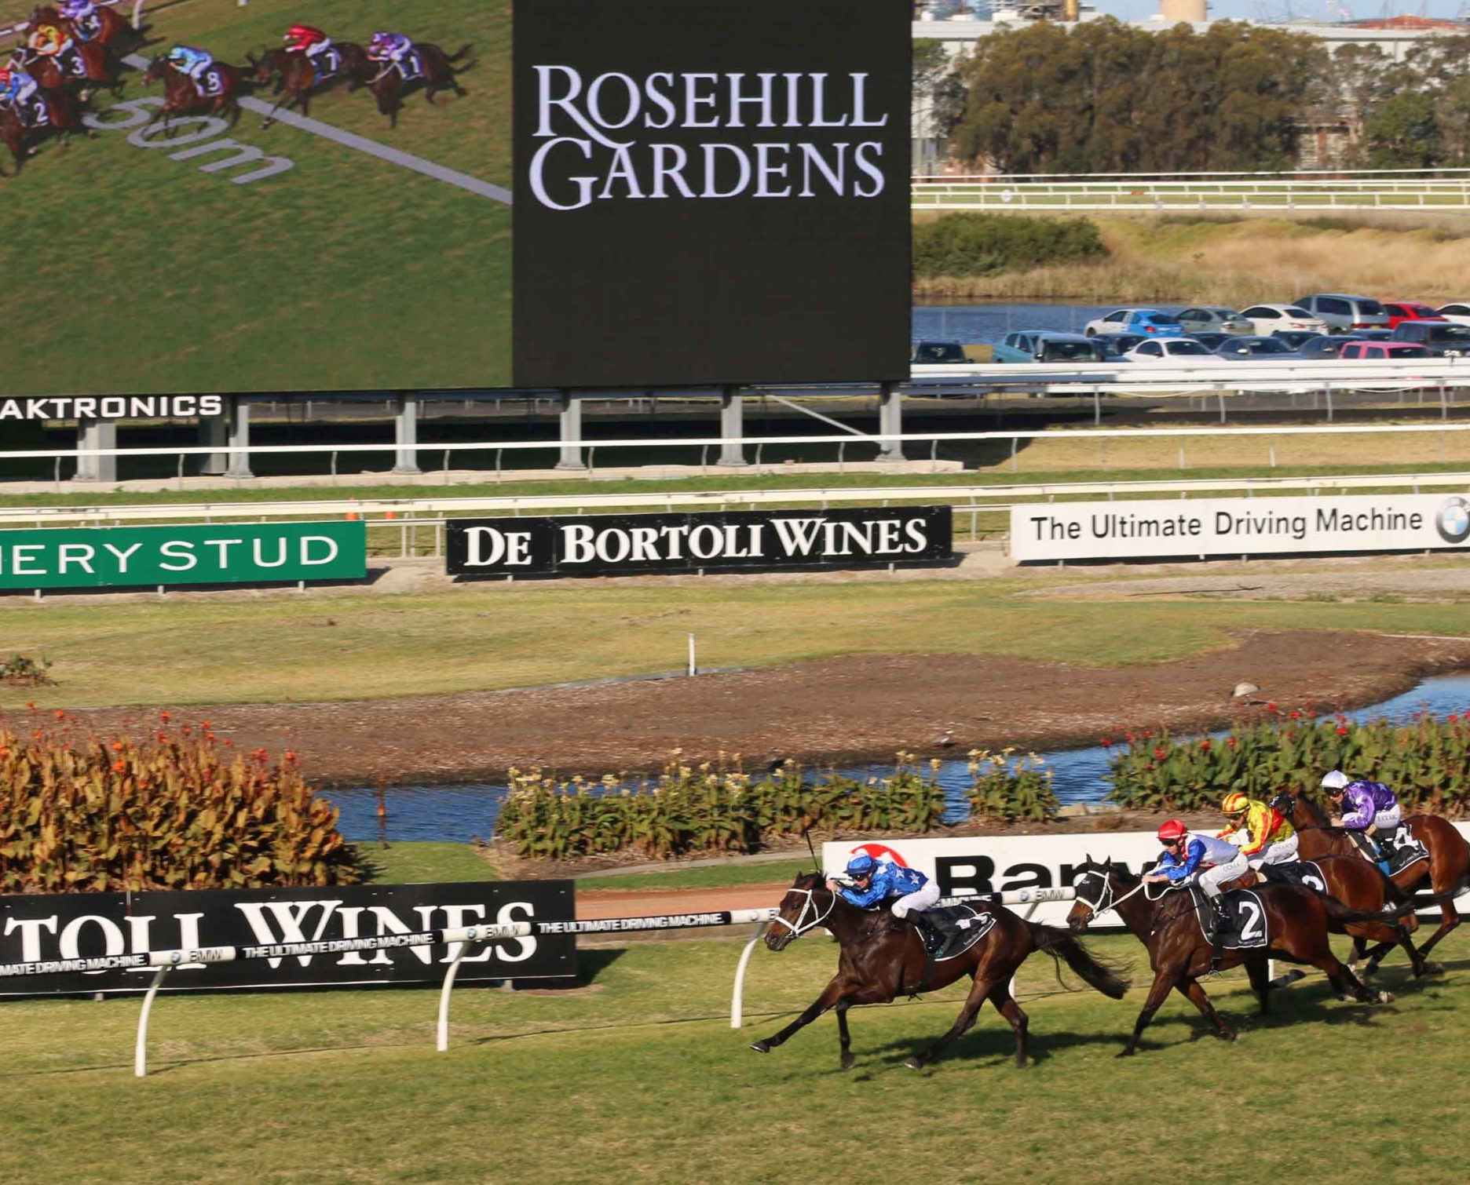
The sporting life
Q6
Which two clubs combined to become the Australian Turf Club, which currently owns and manages Rosehill Gardens Racecourse?

Slide 8
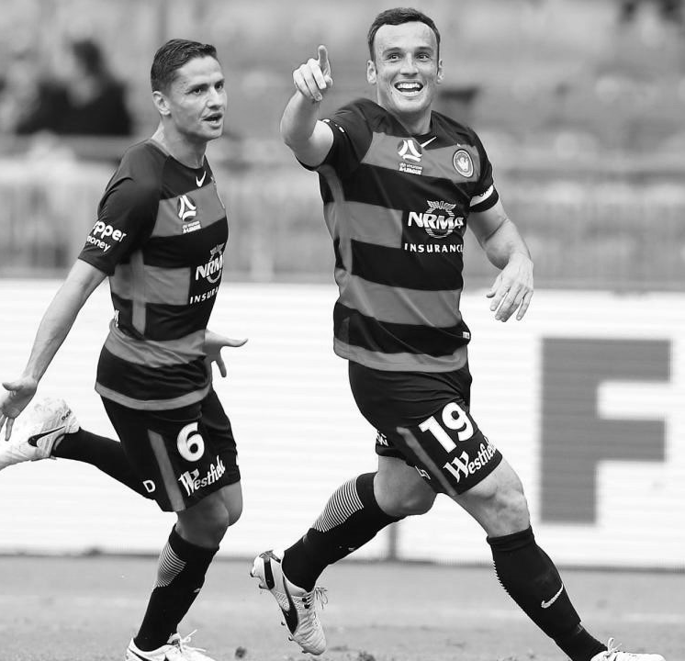
The sporting life
Q7
What is the name of the local soccer (football) team and what are their club colours?

Slide 9
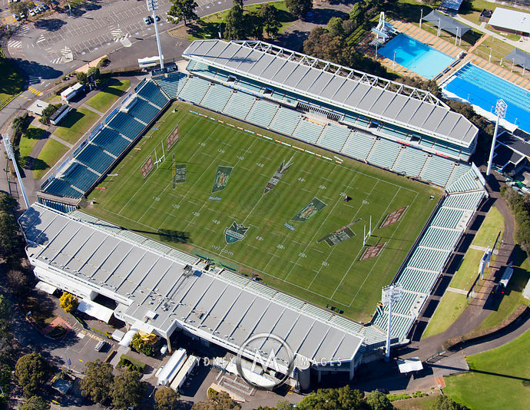
The sporting life
Q8
Which group of sportspeople were very unhappy about the redevelopment of Pirtek Stadium?

Slide 10
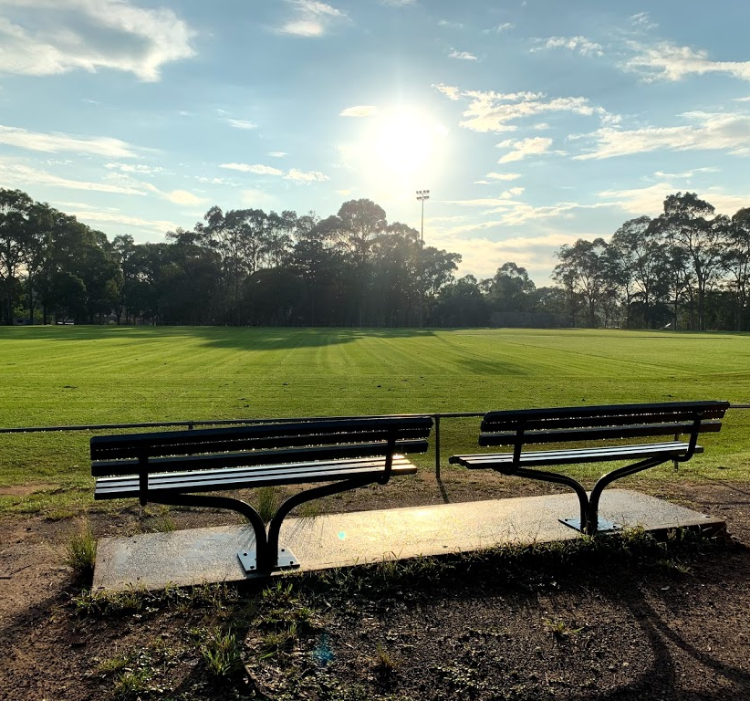
The sporting life
Q9
After which famous cricketer and commentator is a cricket ground in North Parramatta named?

Slide 11
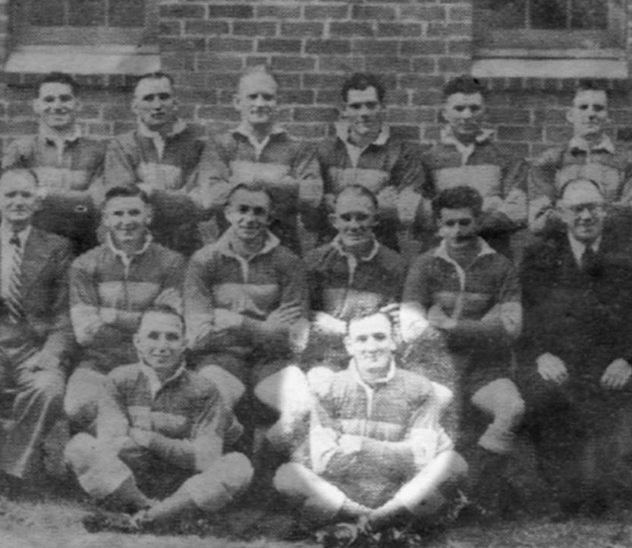
The sporting life
Q10
In what year was the Parramatta Eels Rugby League Team formed?

Slide 12
The numbers game - answers
New Zealand (a private team at the time) and Cumberland County, at the Kings School Cricket Ground, Parramatta in 1884. New Zealand won 33:0.
Dunc Gray Velodrome – it’s in Bankstown
C – the destruction of Cumberland Oval left the eels homeless for five years
Motor racing (Car and bike). A Grand Prix had been scheduled in 1938, with a field of international drivers, but to the fury of the competitors, council and fans the Police Commissioner banned it at the last minute, claiming the tight bends were too dangerous for both drivers and spectators.
Andrew Gaze (basketballer)
Australian Jockey Club and Sydney Turf Club
Western Sydney Wanderers; red and black
Swimmers – because it meant the destruction of Parramatta Swimming Centre, without a replacement for several years
Richie Benaud Oval, previously known as Belmore Park
1947, as the Parramatta District Rugby League Football Club
Notes:
The Sporting Life - Answers
What two teams contested the first international rugby match in Australia? New Zealand (a private team at the time) and Cumberland County, at the Kings School Cricket Ground, Parramatta in 1884. New Zealand won 33:0.
Which Sydney Olympic Venue is not located in Parramatta LGA? Dunc Gray Velodrome – it’s in Blacktown
Olympic Stadium
State Sports Centre (table tennis and Taekwondo)
Dunc Gray Velodrome
Sydney International Archery Park
How did the Parramatta Eels fans celebrate their first ever Grand Final win in 1981? C – the destruction of Cumberland Oval left the eels homeless for five years
A few quiet drinks at the Parramatta Leagues Club
A ticker-tape parade through the city
Burning down the grandstand at Cumberland Oval
An all-in brawl with the fans of the defeated Newtown team
What type of racing took place in Parramatta Park from 1952-55? Motor racing (Car and bike) A Grand Prix had been scheduled in 1938, with a field of international drivers, but to the fury of the competitors, council and fans the Police Commissioner banned it at the last minute, claiming the tight bends were too dangerous to participants and the public.
Who was the flag bearer for Australia at the opening ceremony of the Sydney Olympics? Andrew Gaze (basketballer)
Which two clubs combined to become the Australian Turf Club which currently owns and manages Rosehill Gardens Racetrack? Australian Jockey Club and Sydney Turf Club
What is the name of the local soccer (football) team and what are their club colours? Western Sydney Wanderers; red and black
What famous local girl (born in Merrylands, grew up in Ermington) won three athletics gold medals at the 1956 Melbourne Olympics? Betty Cuthbert
After which famous cricketer and commentator is a cricket ground in North Parramatta named? Richie Benaud Oval, previously known as Belmore Park
In what year was the Parramatta Eels Rugby League Team formed? 1947, as the Parramatta District Rugby League Football Club

Slide 13
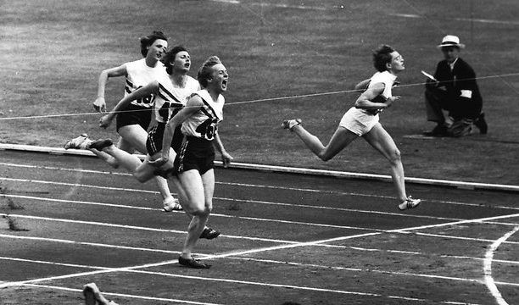
Who AM I?
I once said “Everything I did that required effort, I opened my mouth. Even to catch a ball, I opened my mouth.”
I was born in Merrylands and grew up in Ermington
I was a sprinter
I was inducted into the IAAF (international Association of Athletics Federations) Hall of Fame in 2012
I held 10 individual world records
In later life I suffered from multiple sclerosis
My biography, Golden Girl was published in 1966
I won a total of 4 Olympic gold medals, three at the one Olympics
After the Melbourne Olympics a victory parade was held for me in Parramatta on 11 December 1956
Cathy Freeman said of me: “____ is an inspiration and her story will continue to inspire Australian athletes for generations to come.”
Betty Cuthbert

