Slide 1
Watering holes
Parramatta
Notes:
Before starting online meeting:
Select Slide show from top bar and click “From beginning”
You will be able to see the notes; participants will only see slides
Before starting quiz:
Check that participants have a pen and paper at the ready, to write down their answers.
Each correct answer is worth 1 point.
If playing in teams, remind groups to mute their mic as they discuss their answer, so they don’t accidentally tell other teams.
Remember to speak slowly and clearly, so everyone understands the questions.
Check that everyone is ready before moving on to next question.

Slide 2
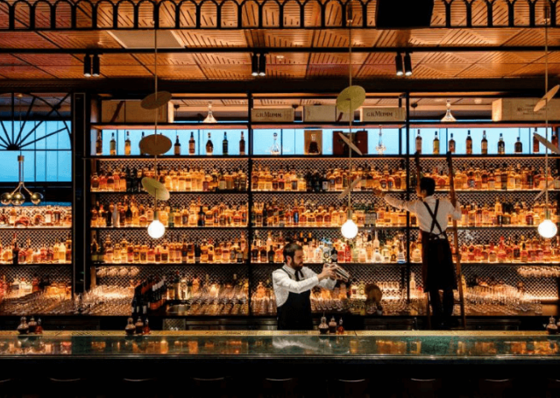
Watering holes
Q1
What bar, described by Concrete Playground as a “sophisticated space” with a “tight” cocktail offering, is inspired by Dashiell Hammett’s novel, The Thin Man?

Slide 3
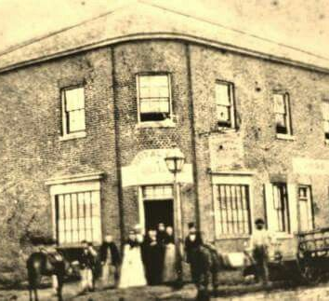
Watering holes
Q2
Which heritage pub, established in 1831 and located on Church St, shut its doors for the last time on Australia Day 2020?

Slide 4
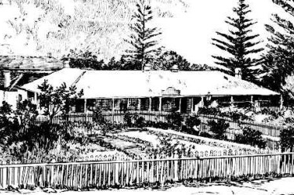
Watering holes
Q3
Which colonial pub, famous for its gardens and gracious hospitality and named for a type of livestock popular in the colony, was run by Charles and Hannah Walker?

Slide 5
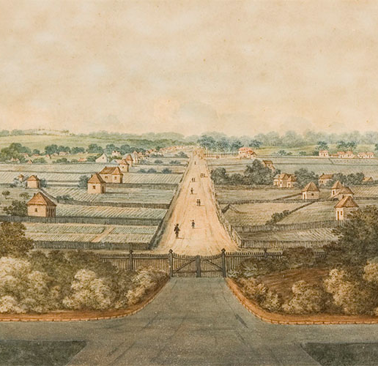
Watering holes
Q4
How many licensed inns did Parramatta have in 1817?
None
12
46
5

Slide 6
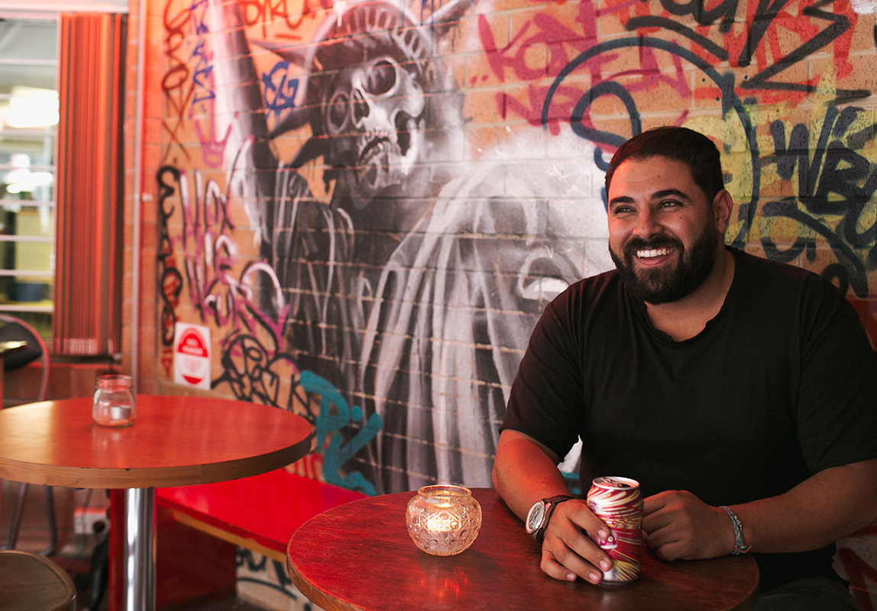
Watering holes
Q5
Which bar, with a Brooklyn aesthetic and style, was the first of Parramatta’s modern small bars?

Slide 7
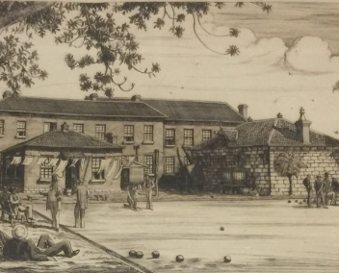
Watering holes
Q6
Which hotel hosted Parramatta’s first bowling green?

Slide 8
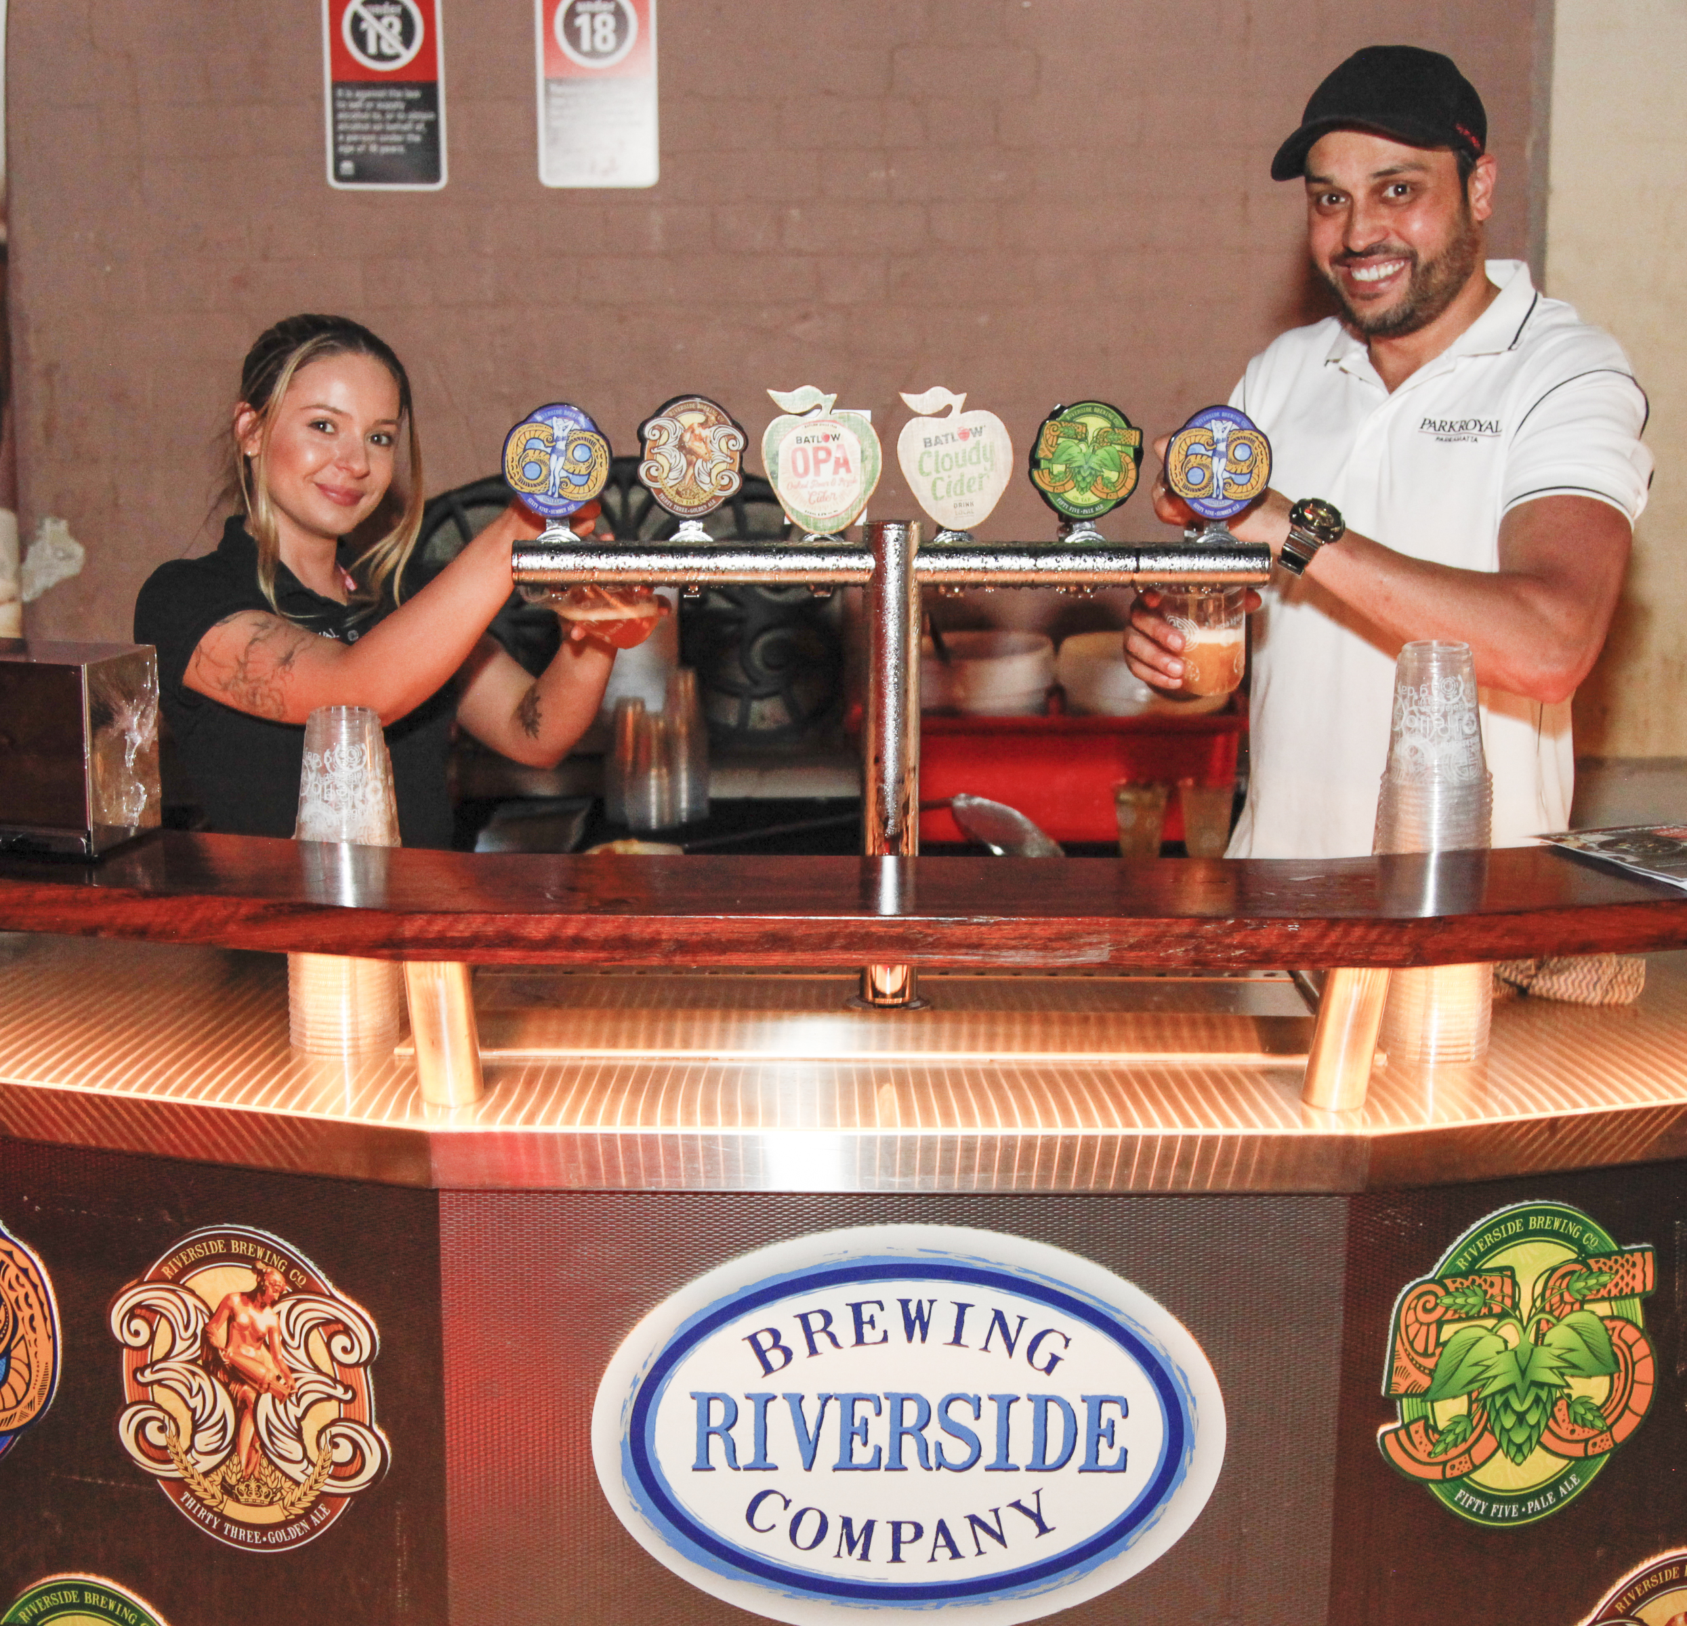
Watering holes
Q7
Name Parramatta’s craft brewing company?

Slide 9
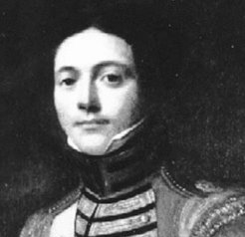
Watering holes
Q8
Which of the colony’s early doctors, thrice charged with highway robbery, once owned the land on which the General Bourke Hotel stands?
  John White
  William Balmain
  D’Arcy Wentworth
  James Bowman

Slide 10
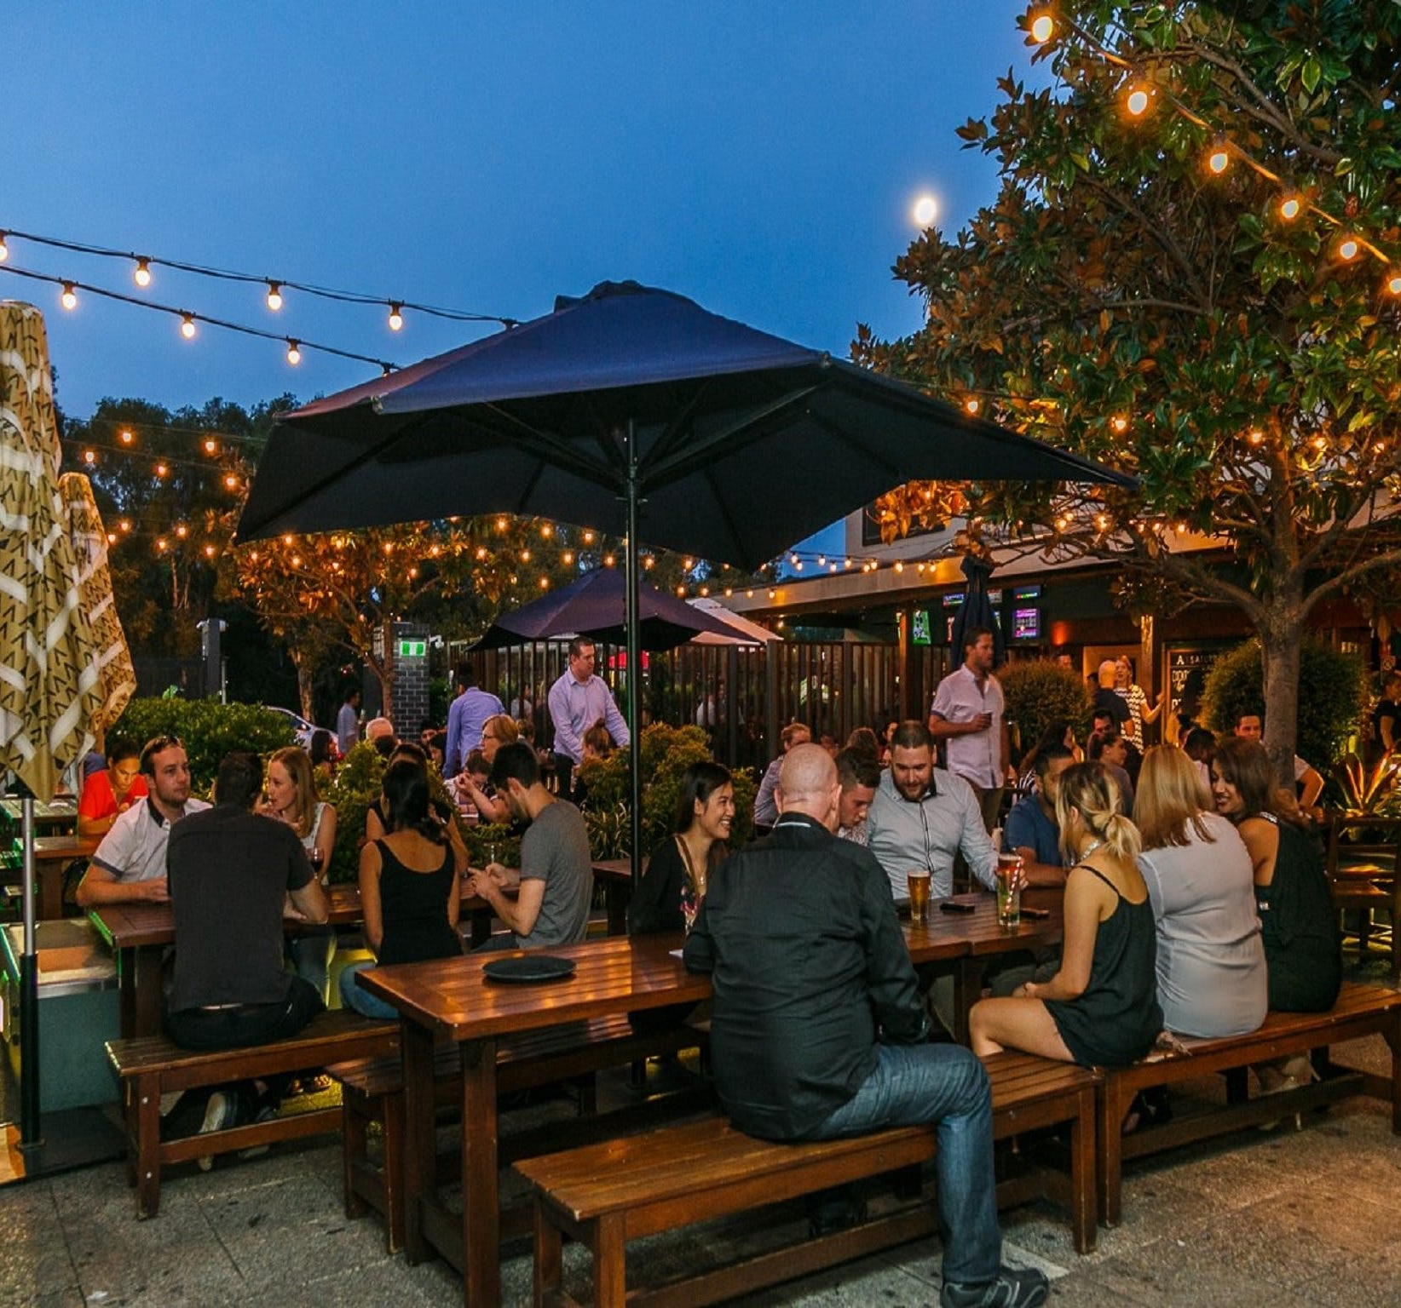
Watering holes
Q9
Which Parramatta pub can be linked to King Arthur?

Slide 11
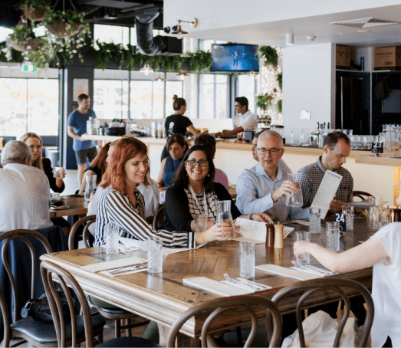
Watering holes
Q10
What sleek restaurant and bar, perched over the Parramatta River, has a three-hour Happy Hour from Monday - Friday?

Slide 12
Watering holes - answers
Nick and Nora’s, on the 26th floor of the V by Crown development.
The Royal Oak
The Red Cow Inn
B – 12
Uncle Kurt’s
The Woolpack Inn. In 1869 it had 3 greens and a year later its own bowling club – The Woolpack Club
Riverside Brewing Company – they must have had a few when they chose the name – it’s beside Darling Mills Creek, which is not quite a river yet, though it is a tributary of the mighty Parramatta River.
C - D’Arcy Wentworth, whose son William was one of the three explorers who famously crossed the Blue Mountains in 1813
The Albion Hotel, which takes its name from the earliest name for Britain, which, it was prophesised, King Arthur would reunite.
Alex & Co.
Notes:
Watering Holes - Answers
What bar, described by Concrete Playground as a “sophisticated space” with a “tight” cocktail offering, is inspired by Dashiell Hammett’s novel, The Thin Man? Nick and Nora’s, on the 26th floor of the V by Crown development.
Which heritage pub, established in 1831 and located on Church St, shut its doors for the last time on Australia Day 2020? The Royal Oak
Which colonial pub, famous for its gardens and gracious hospitality and named for a type of livestock popular in the colony was run by Charles and Hannah Walker? The Red Cow Inn
How many licensed inns did Parramatta have in 1817 B - 12
Which bar, with a Brooklyn aesthetic and style, was Parramatta’s first small bar? Uncle Kurt’s
Which hotel hosted Parramatta’s first bowling green? The Woolpack Inn. In 1869 it had 3 rinks and a year later its own bowling club – The Woolpack Club
Name Parramatta’s craft brewing company? Riverside Brewing Company – they must have had a few when they chose the name – it’s beside Darling Mills Creek, which is not quite a river yet, though it is a tributary of the mighty Parramatta River.
Which of the colony’s early doctors, thrice charged with highway robbery, once owned the land on which the General Bourke Hotel stands? C - D’Arcy Wentworth, whose son William was one of the three explorers who famously crossed the Blue Mountains in 1813
John White
William Balmain
D’Arcy Wentworth
James Bowman
Which Parramatta pub can be linked to King Arthur? The Albion Hotel, which takes its name from the earliest name for Britain, which, it was prophesised, King Arthur would reunite.
What sleek restaurant and bar, perched over the Parramatta River, has a three hour Happy Hour from Monday - Friday? Alex & Co.

Slide 13
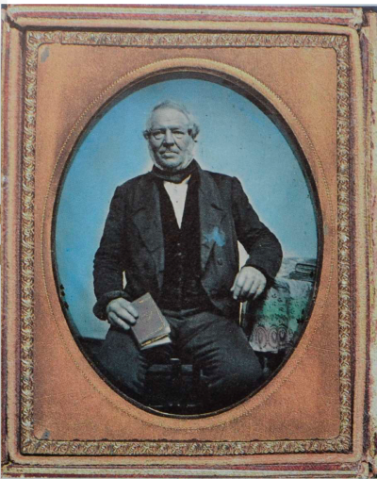
Who AM I?
I arrived in the colony in 1832, with a suitcase, ambition and education
My partnership with Nathaniel Payton was very successful for both of us
I have left quite a mark on the fabric of Parramatta
I was civic minded, serving both as a councillor and on the hospital board
My sons followed in my footsteps, with one becoming the president of the Parramatta and District Historical society
I was innovative, being one of the first to introduce verandahs as a feature of colonial architecture
I proved my adaptability, building in a range of styles including Palladian, Georgian and Colonial
Beginning as a builder, I worked my way up to become an architect
Many inhabitants of my most famous building may have previously spent time in Parramatta’s watering holes.
Many of my buildings are listed on the State Heritage Register including Macarthur House, St John’s Cathedral, Endrim and the Parramatta Gaol
James Houison

