Slide 1
Waves of people
Parramatta
Notes:
Before starting online meeting:
Select Slide show from top bar and click “From beginning”
You will be able to see the notes; participants will only see slides
Before starting quiz:
Check that participants have a pen and paper at the ready, to write down their answers.
Each correct answer is worth 1 point.
If playing in teams, remind groups to mute their mic as they discuss their answer, so they don’t accidentally tell other teams.
Remember to speak slowly and clearly, so everyone understands the questions.
Check that everyone is ready before moving on to next question.

Slide 2
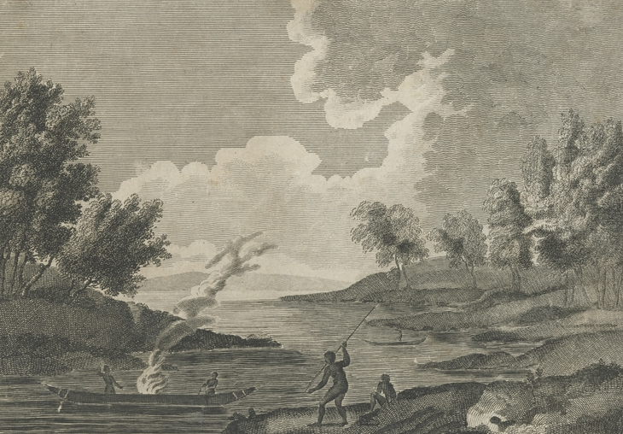
Waves of people
Q1
Radiocarbon dating of archaeological artefacts suggests continual Aboriginal occupation of Parramatta for how long?
  2,700 years
  15,000 years
  30,000 years
  5,500 years

Slide 3
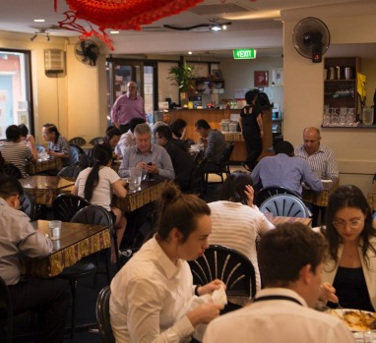
Waves of people
Q2
What nationality is the owner of the iconic Temasek restaurant?

Slide 4
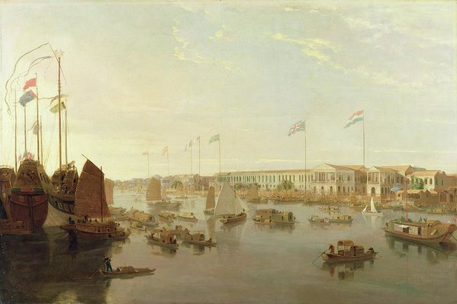
Waves of people
Q3
After the colonial farmers had moved on to the more fertile soils of the Hawkesbury, where did Parramatta’s next wave of market gardeners come from?

Slide 5
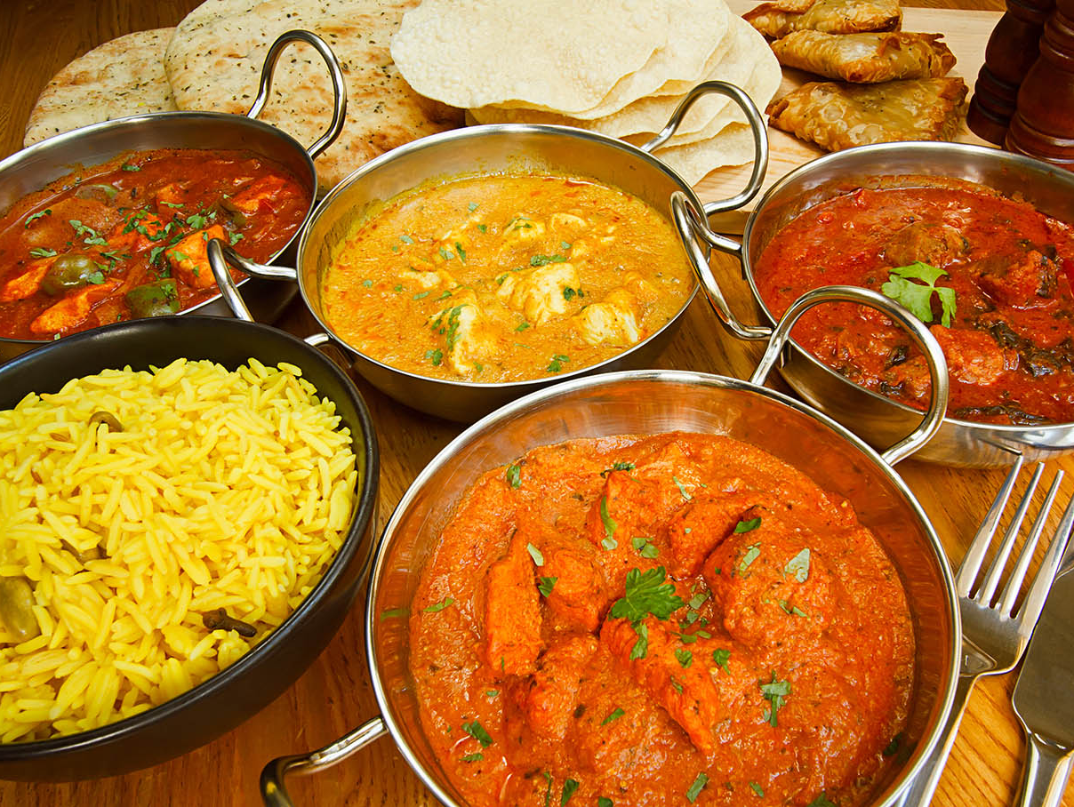
Waves of people
Q4
Where would you find the popular “Little India” foodie destination?

Slide 6
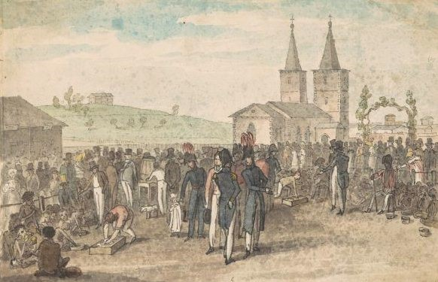
Waves of people
Q5
What annual gathering of Aboriginal people did Governor Macquarie initiate to promote enrolments in the Parramatta Native Institute?

Slide 7
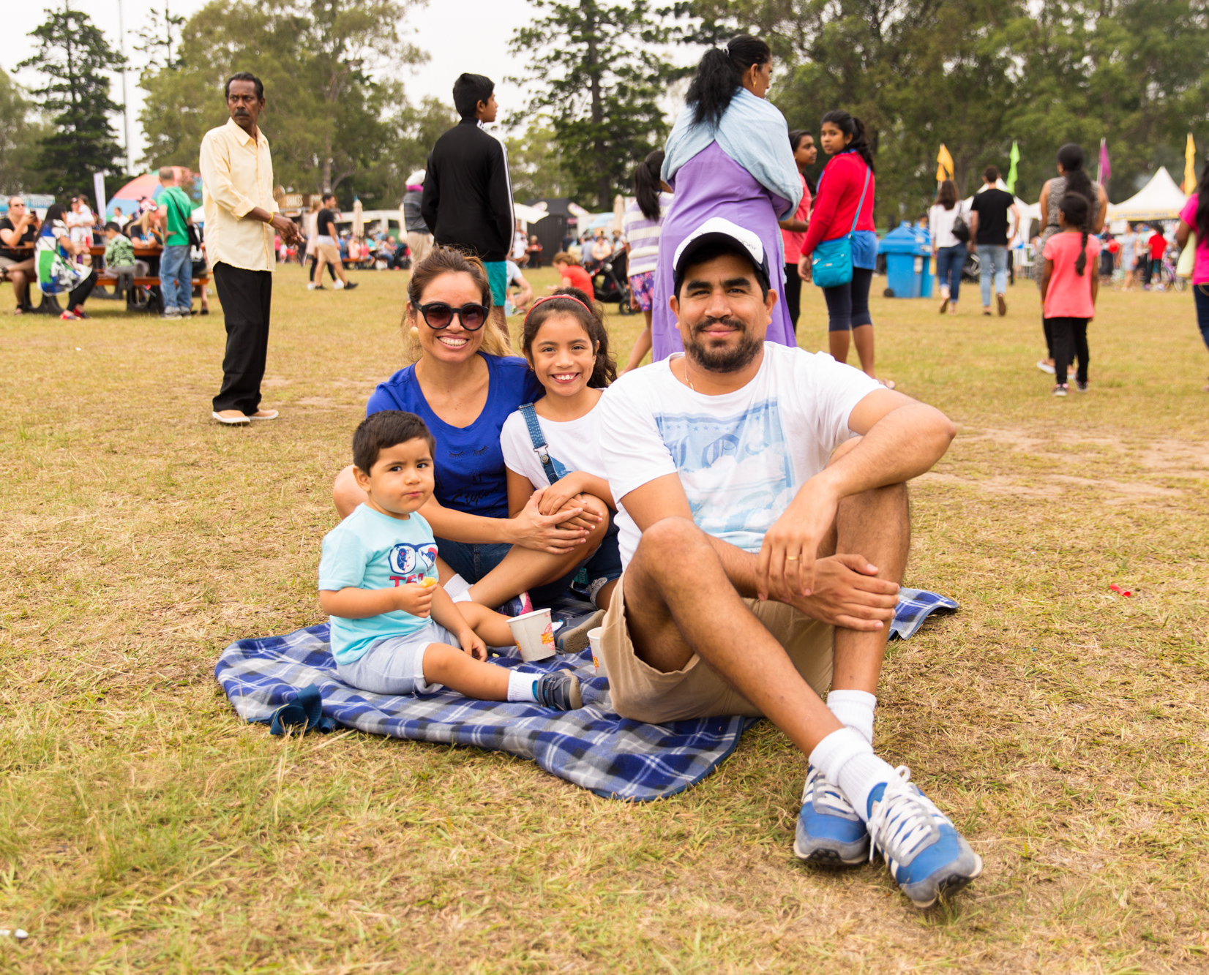
Waves of people
Q6
In the 2016 census where did the top 3 migrant groups to Parramatta come from?
  United Kingdom, China and India
  India, New Zealand and China
  India, China and South Korea
  China, India and Lebanon

Slide 8
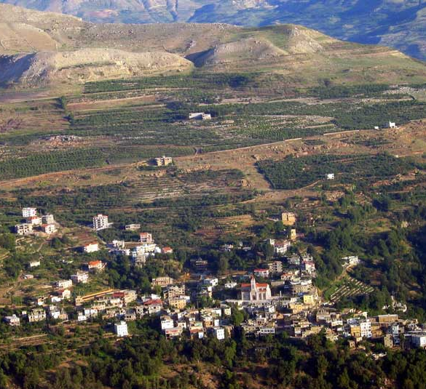
Waves of people
Q7
Which Lebanese village has named its main road Parramatta Road, and why?
  Dimane; because many migrants from Dimane settled first in Parramatta
  Hawqa; as part of a strategy to lobby for better road access to their village
  Kfarsghab; because Parramatta is such a significant centre of Kfarsghab settlement
  Fraidis; because migrants from here, working as hawkers, travelled along the road, selling their wares

Slide 9
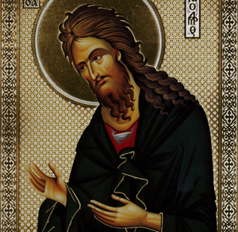
Waves of people
Q8
Which Greek Orthodox Parish in Parramatta celebrated its 60th anniversary in May 2020?
  St Georgios
  St Lydia
  St Ioannis
  St Dimitrios

Slide 10
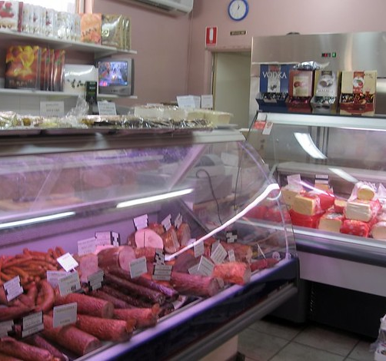
Waves of people
Q9
What landmark European style Delicatessen, once clearly seen from the rail line, has now moved to the Entrada Centre?

Slide 11
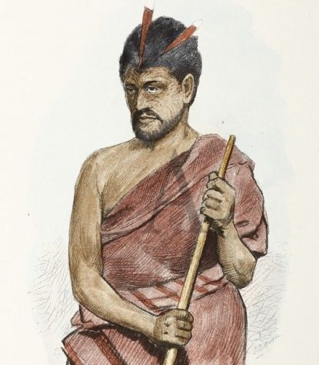
Waves of people
Q10
In 1805 Governor King presented Te Pahi, first Maori leader to visit the colony, which with two gifts:
A boomerang and a bag of wheat seed
A prefabricated house and a silver medal
A bible and a naval officer’s uniform
A chief plate and a musket

Slide 12
Waves of people- answers
C – 30,000 years
Singaporean. The Malaysian/Singaporean restaurant, opened in 1992, is famous for its laksa, Singapore chilli crab and Hainanese chicken.
Canton, China. They used new methods of fertilisation to enrich the soils once more.
Harris Park, a suburb with a high population of Indian migrants and excellent chefs.
The Native Feast (sometimes called the Native Conference)
C – India, China and South Korea
C – Kfarsghab; by 2006 over 10,000 people living in Parramatta could trace their ancestry to this village. They first came in the 1890s;
  many worked as hawkers and they sent vital funds back to the village, encouraging others to join them.
C - St Ioannis, which moved premises from Hassall St to George St in 2015
Tatra Polish Delicatessen; its proprietors source produce from Europe and European butchers in Australia and also stock a range of freshly prepared European style delicacies
B – a pre-fabricated brick house, which became the first permanent European style house in New Zealand and a silver medal, stolen by raiding whalers and rediscovered when an auction house offered it for sale in 2014.
Notes:
Waves of People - Answers
Radiocarbon dating of archaeological artefacts suggests continual Aboriginal occupation of Parramatta for how Long? C – 30,000 years
2,700 years
15,000 years
30,000 years
5,500 years
What nationality is the owner of the iconic Temasek restaurant? Singaporean. The Malaysian/Singaporean restaurant, opened in 1992, is famous for its laksa, Singapore chilli crab and Hainanese chicken.
After the colonial farmers had moved on to the more fertile soils of the Hawkesbury, where did Parramatta’s next wave of market gardeners come from? Canton, China. They used new methods of fertilisation to enrich the soils once more.
Where would you find the popular “Little India” foodie destination? Harris Park, a suburb with a high population of Indian migrants.
What annual gathering of Aboriginal people did Governor Macquarie initiate to promote enrolments in the Parramatta Native Institute? The Native Feast (sometimes called the Native Conference)
In the 2016 census where did the top 3 migrant groups to Parramatta come from? C – India, China and South Korea
United Kingdom, China and India
India, New Zealand and China
India, China and South Korea
China, India and Lebanon
Which Lebanese village has named its main road, Parramatta Road, and why? C – Kfarsghab; by 2006 over 10,000 people living in Parramatta could trace their ancestry to this village. They first came in the 1890s; many worked as hawkers and they sent vital funds back to the village, encouraging others to join them.
Dimane; because many migrants from Dimane settled first in Parramatta
Hawqa; as part of a strategy to lobby for better road access to their village
Kfarsghab; because it is such a significant centre of Kfarsghab settlement
Fraidis; because migrants from here, working as hawkers, travelled along the road, selling their wares
Which Greek Orthodox Parish in Parramatta celebrated its 60th anniversary in May 2020? C - St Ioannis, which moved premises from Hassall St to George St in 2015
St Georgios
St Lydia
St Ioannis
St Dimitrios
What landmark European style Delicatessen, once clearly seen from the rail line, moved from Darcy Street to the Entrada Centre, making way for the reconstruction of Parramatta Square? Tatra Polish Delicatessen; its proprietors source produce from Europe and European butchers in Australia and also stock a range of freshly prepared European style delicacies
In 1805 Governor King presented Te Pahi, first Maori leader to visit the colony, which with two gifts: B – a pre-fabricated brick house, which became the first permanent European style house in New Zealand and a silver medal, stolen by raiding whalers and rediscovered when an auction house offered it for sale in 2014.
A boomerang and a bag of wheat seed
A prefabricated house and a silver medal
A bible and a naval officer’s uniform
A chief plate and a musket

Slide 13
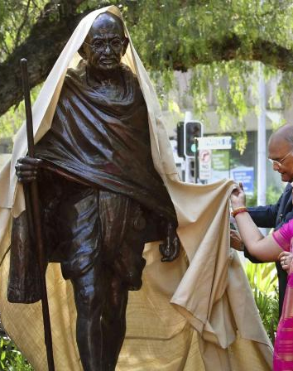
Who AM I?
I was born in 1869
I had little formal education and my school record was mediocre
I spent many years in prison, some of them in South Africa
I have been described as an anti-colonial nationalist
I studied law in Britain, qualifying as a barrister
Many consider me the father of my country
I was a rebellious teenager – even eating meat
My statue was unveiled in Jubilee Park, Harris Park in 2018 by the President of India
My birthday, 2 October, is a national holiday in India
I am famous for my doctrine of non-violent resistance
Mahatma Gandhi

