Slide 1
Where it’s at
Parramatta
Notes:
Before starting online meeting:
Select Slide show from top bar and click “From beginning”
You will be able to see the notes; participants will only see slides
Before starting quiz:
Check that participants have a pen and paper at the ready, to write down their answers.
Each correct answer is worth 1 point.
If playing in teams, remind groups to mute their mic as they discuss their answer, so they don’t accidentally tell other teams.
Remember to speak slowly and clearly, so everyone understands the questions.
Check that everyone is ready before moving on to next question.

Slide 2
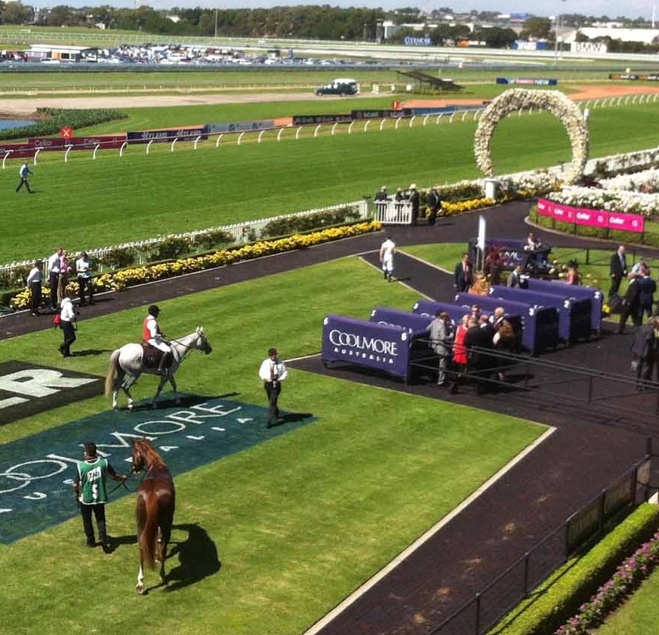
Where it’s at
Q1
Where would you go to watch the world’s richest race for two-year-old thoroughbred horses?

Slide 3
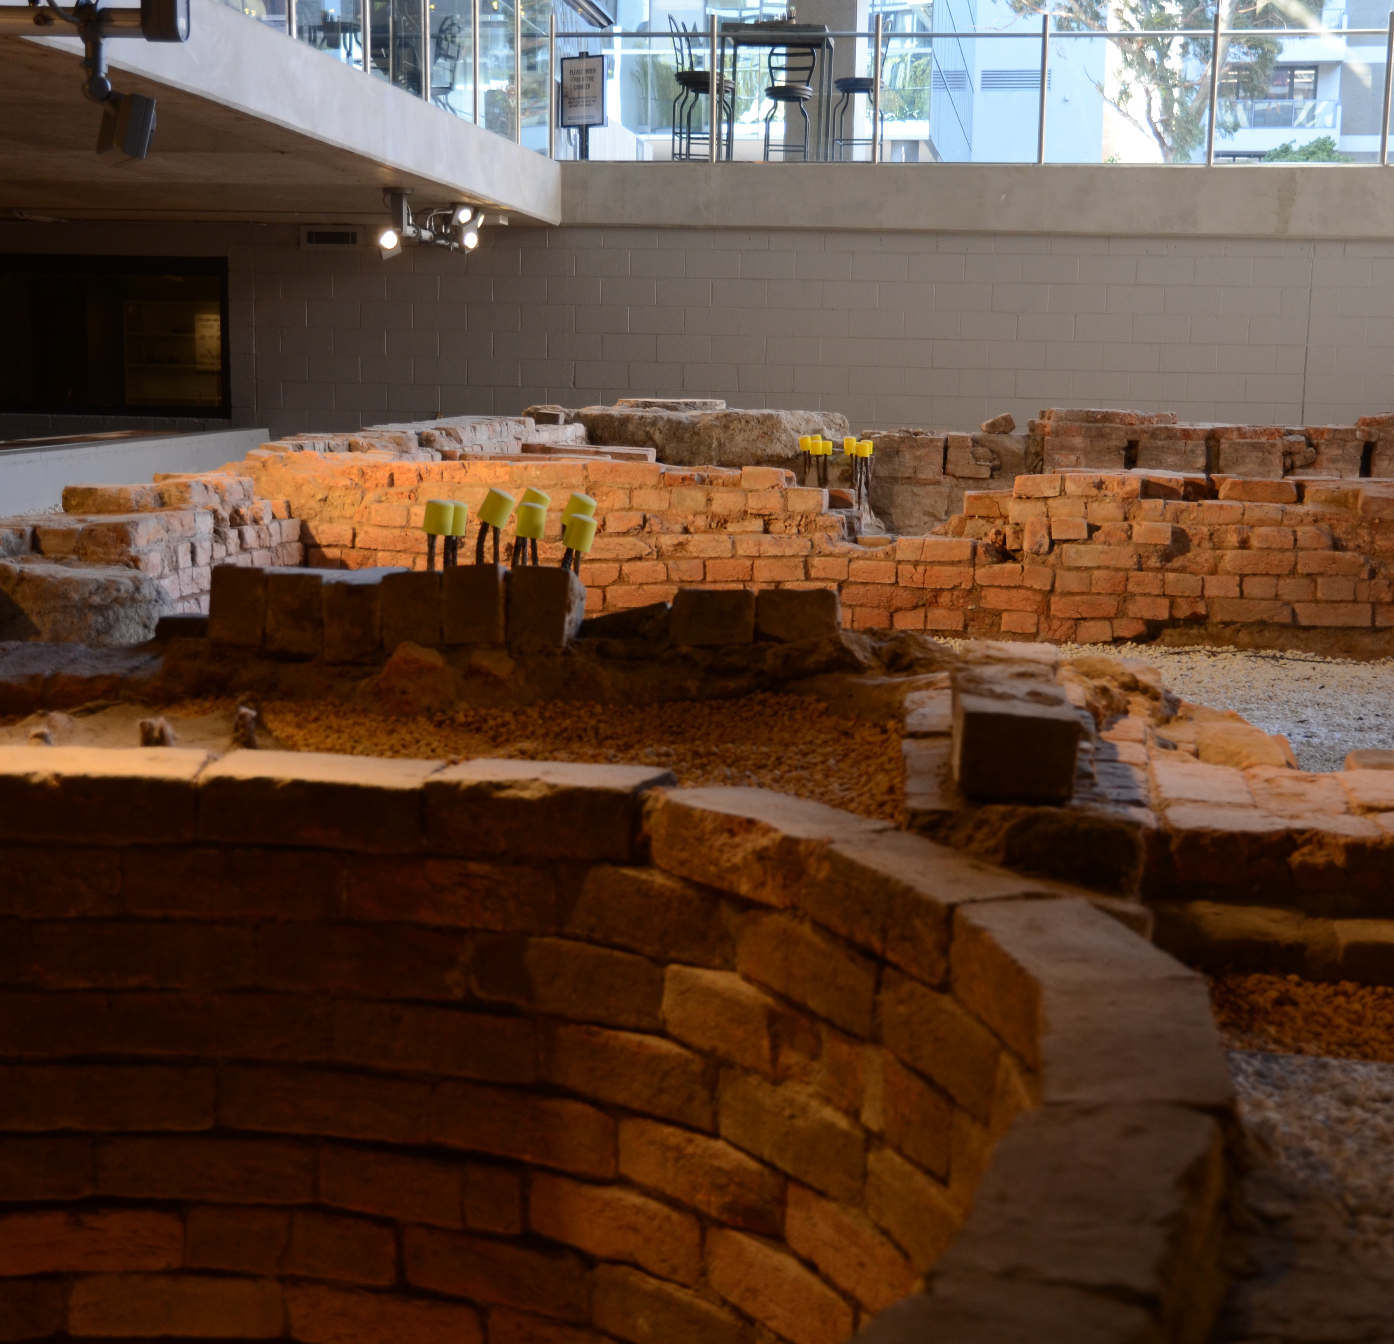
Where it’s at
Q2
With an open archaeological site to check out below and a stunning view from the popular bar above, where am I?

Slide 4
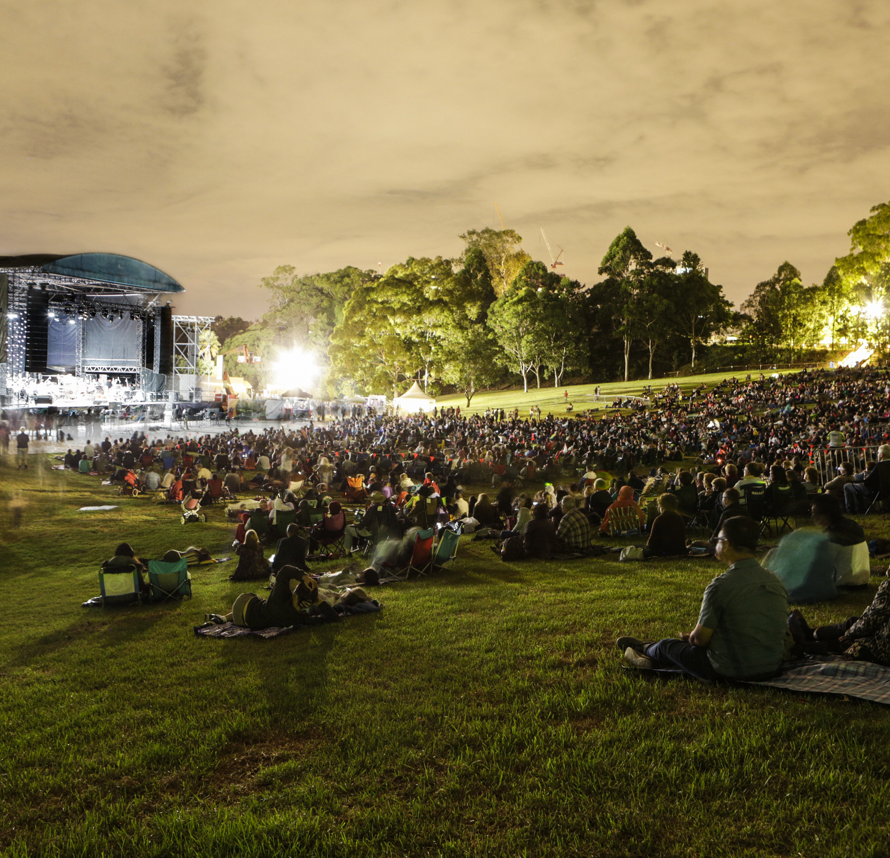
Where it’s at
Q3
Where should you go to listen to Symphony Under the Stars?

Slide 5
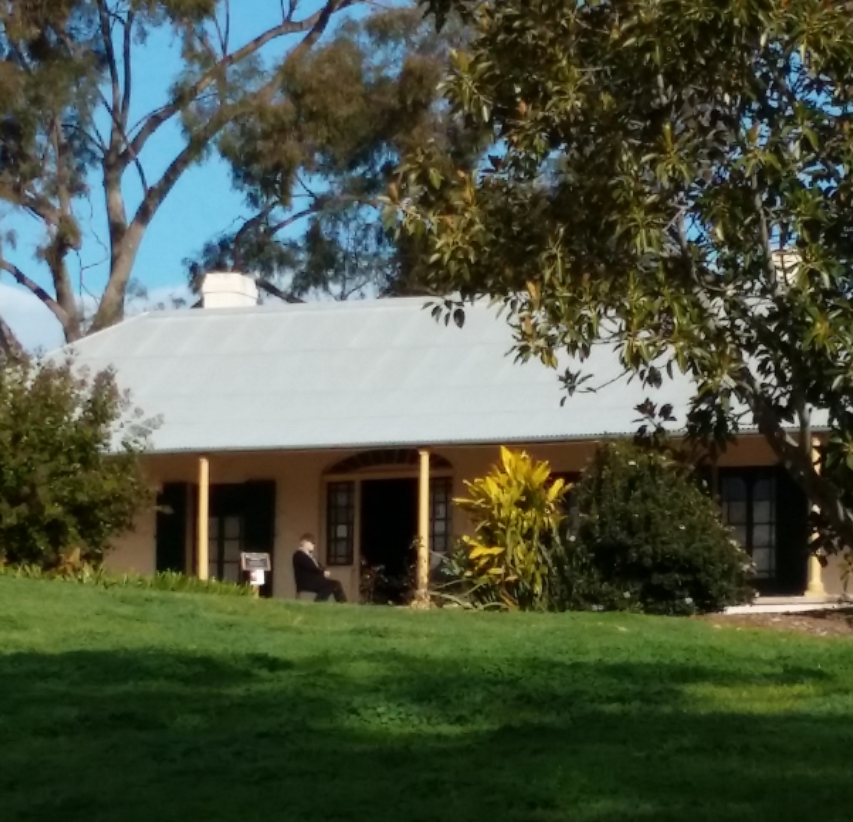
Where it’s at
Q4
What property, in the Harris Park Heritage Area, is associated with John and Elizabeth Macarthur, pioneers of the wool industry?

Slide 6
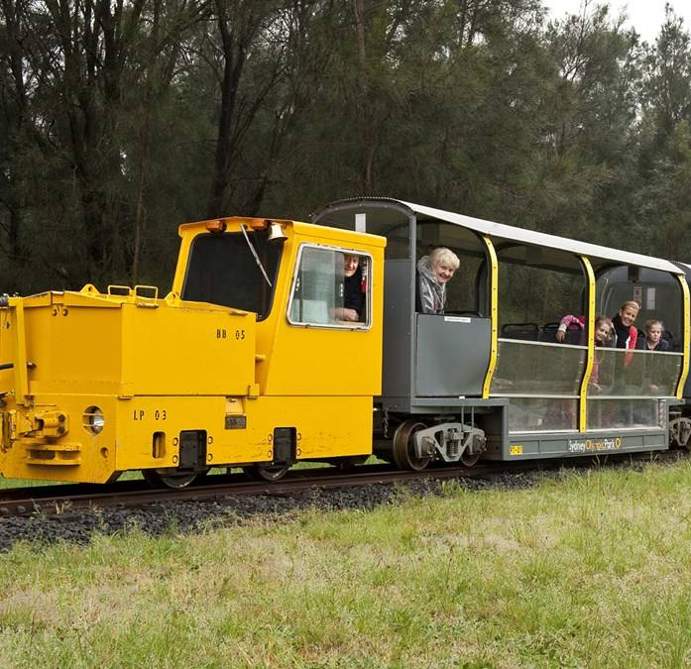
Where it’s at
Q5
Where can you ride a narrow-gauge railway to discover a hidden precinct listed on the NSW State Heritage Register?

Slide 7
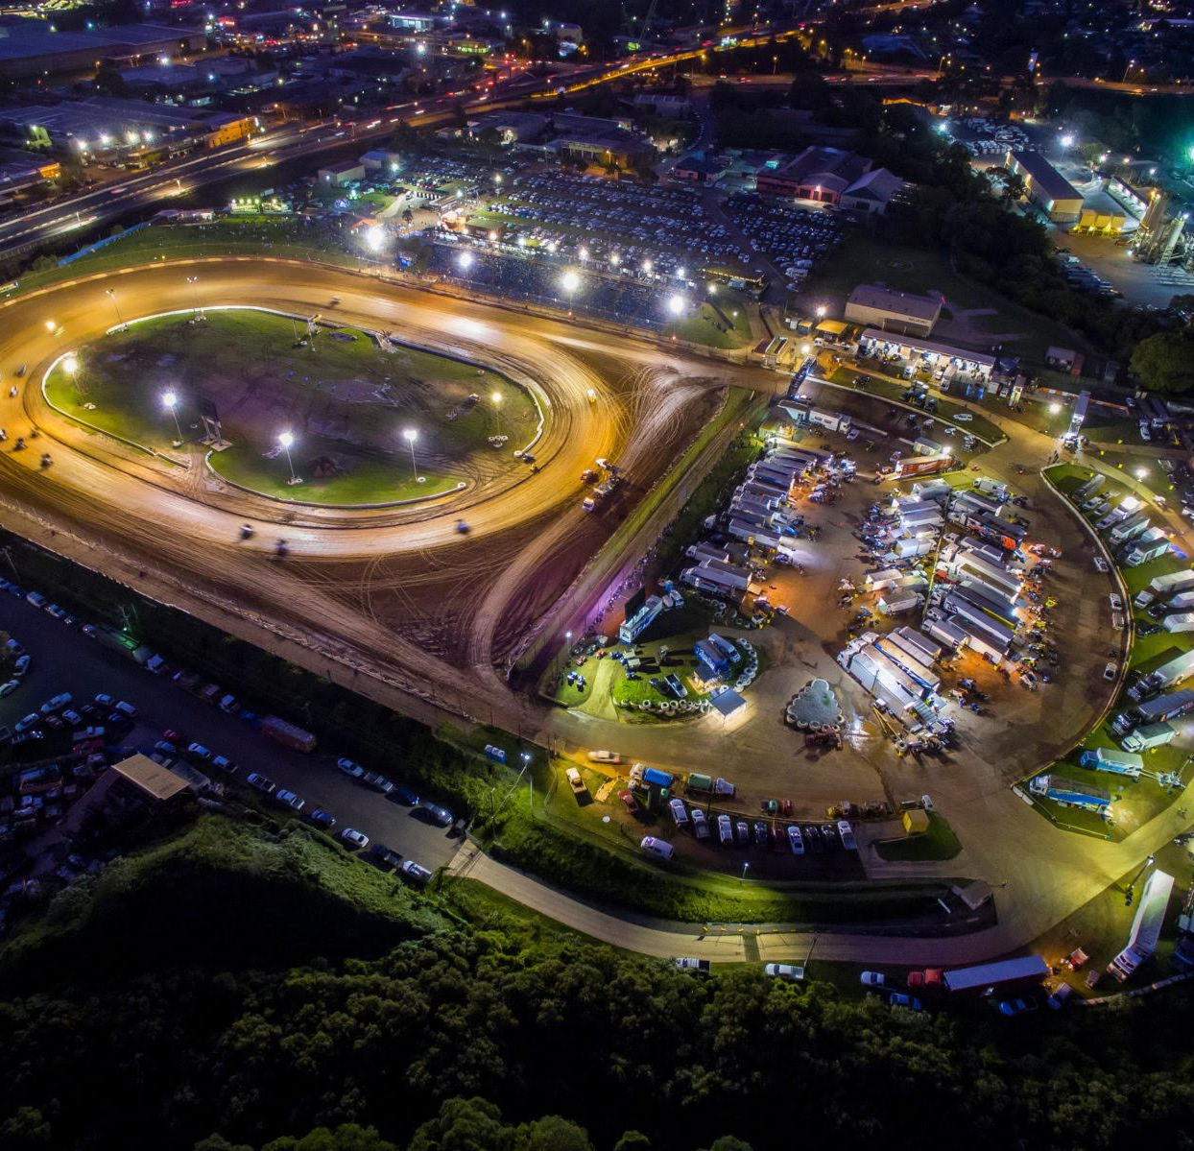
Where it’s at
Q6
The smell of petrol, the roar of engines, the excitement of the crowd – where am I?

Slide 8
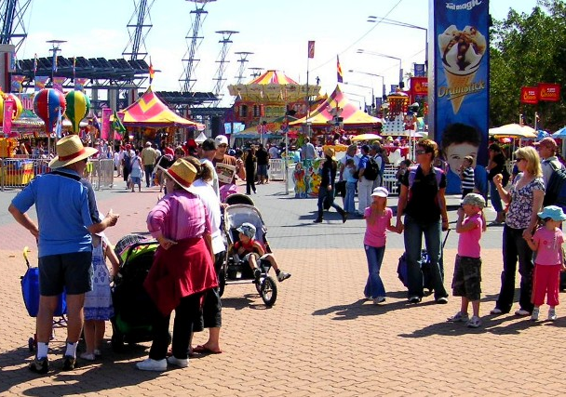
Where it’s at
Q7
Which annual event attracts close to a million attendees and showcases Australian culture, from arts and craft to rural traditions and live entertainment?

Slide 9
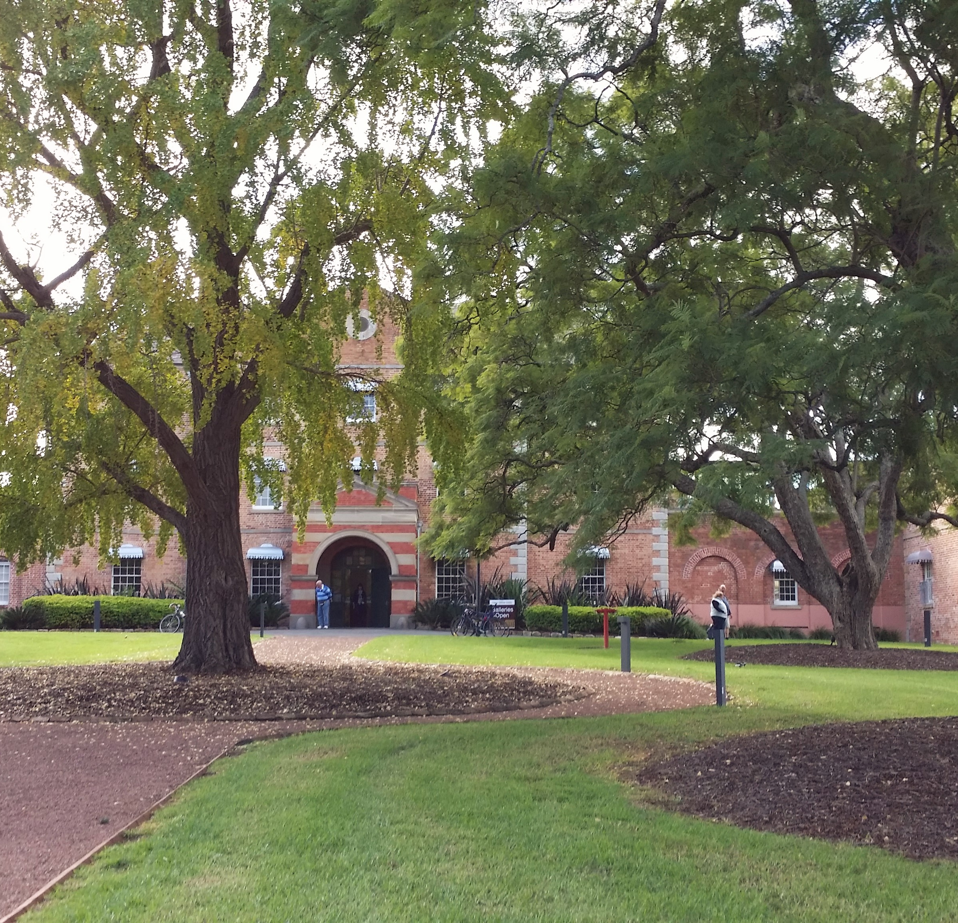
Where it’s at
Q8
At which historic site, located within which university, is the Whitlam Institute found?

Slide 10
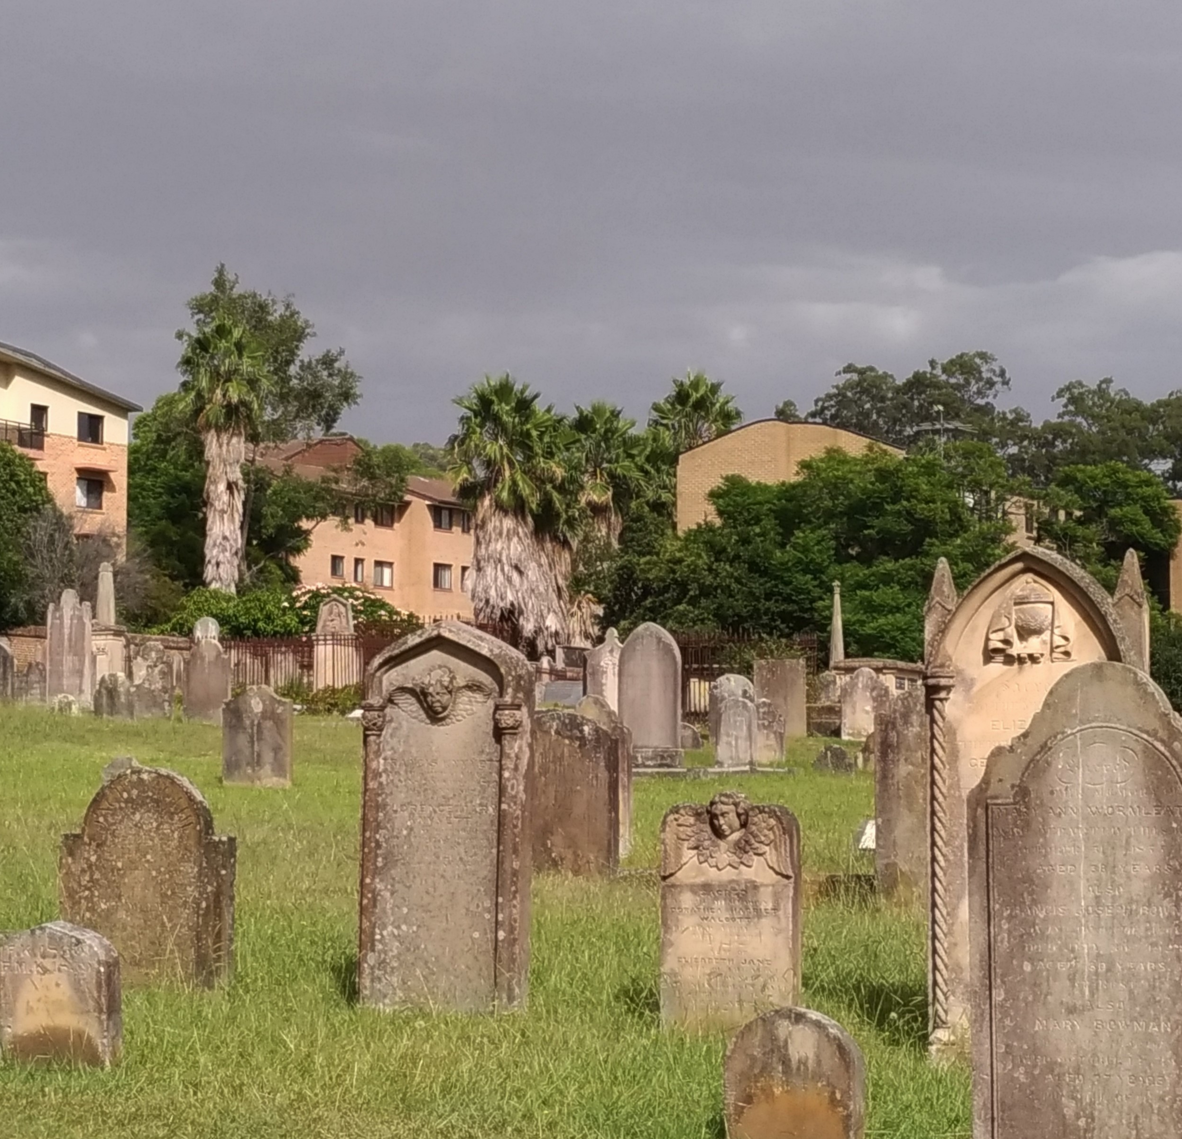
Where it’s at
Q9
St John’s Cemetery, the oldest European burial place in Australia, contains how many first fleet burials?

Slide 11
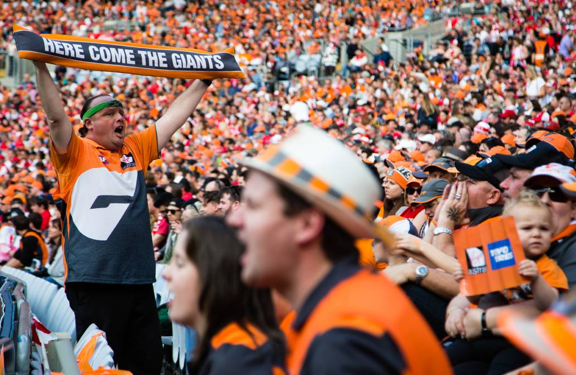
Where it’s at
Q10
Where is the GWS Giants home stadium and what is it called?

Slide 12
Where it’s at - answers
Rosehill Gardens
V by Crown Building, corner Macquarie St and Marsden Street. You can visit the Phillip Ruddock Heritage Centre at no charge to discover what the dig revealed then enjoy an elegantly crafted cocktail at Nick and Nora’s while taking in the panorama.
The Crescent, Parramatta Park
Elizabeth Farm
Newington Armory, Sydney Olympic Park
Valvoline Raceway (aka Parramatta Speedway), or maybe Parramatta Park back in the 50s when it was a Grand Prix racetrack.
Sydney Royal Easter Show
The Female Orphan School, within Western Sydney University
63. The cemetery is very evocative and includes some fascinating inscriptions on its picturesque gravestones.
Sydney Olympic Park, Giants Stadium
Notes:
Where It’s At - Answers
Where would you go to watch the world’s richest race for two-year-old thoroughbred horses? Rosehill Gardens
With an open archaeological site to check out below and a stunning view from the popular bar above, where am I? V by Crown Building, corner Macquarie St and Marsden Street. You can visit the Phillip Ruddock Heritage Centre at no charge to discover what the dig revealed then enjoy an elegantly crafted cocktail at Nick and Nora’s while taking in the panorama.
Where should you go to listen to Symphony Under the Stars? The Crescent, Parramatta Park
What property, in the Harris Park Heritage Area, is associated with John and Elizabeth Macarthur, pioneers of the wool industry? Elizabeth Farm
Where can you ride a narrow-gauge railway to discover a hidden precinct listed on the NSW State Heritage Register? Newington Armory, Sydney Olympic Park
The smell of petrol, the roar of engines, the excitement of the crowd – where am I? Valvoline Raceway (aka Parramatta Speedway), or maybe Parramatta Park back in the 50s when it was a Grand Prix racetrack.
Which annual event attracts close to a million attendees and showcases Australian culture, from arts and craft to rural traditions and live entertainment? Sydney Royal Easter Show
At which historic site, located within which university, is the Whitlam Institute found? The Female Orphan School, within Western Sydney University
St John’s Cemetery, the oldest European burial place in Australia and final resting place of some of the founders of the colony, contains how many first fleet burials? 63. The cemetery is very evocative and includes some fascinating inscriptions on its picturesque gravestones.
Where is the GWS Giants home stadium and what is it called? Sydney Olympic Park, Giants Stadium

Slide 13
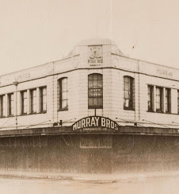
WHat AM I?
I began as two separate businesses selling hardware, pianofortes and sewing machines
My proprietors introduced an innovative and highly successful system of time payment with no interest on purchases
As business expanded, my owners sold jam made in their own Parramatta factory
My proprietors also operated the Parramatta Woollen Mill
Our exhibition of uniforms won a gold medal at the Franco-British exhibition of uniforms in 1908
My proprietors were civic minded, donating 1000 pounds to the war effort during World War 2
My furniture display achieved a Certificate of Merit for colonial made furniture from the Royal Agricultural Society
My proprietors regularly participated in Parramatta’s Foundation week parades
My doors closed in 1978, after 102 years of trading in Parramatta
I was Parramatta’s first shopping emporium, with my buildings still remaining as a Parramatta landmark
Murray Brothers Store

