Slide 1
World heritage
Parramatta
Notes:
Before starting online meeting:
Select Slide show from top bar and click “From beginning”
You will be able to see the notes; participants will only see slides
Before starting quiz:
Check that participants have a pen and paper at the ready, to write down their answers.
Each correct answer is worth 1 point.
If playing in teams, remind groups to mute their mic as they discuss their answer, so they don’t accidentally tell other teams.
Remember to speak slowly and clearly, so everyone understands the questions.
Check that everyone is ready before moving on to next question.

Slide 2
World heritage
Q1
What is the criteria for inclusion on the United Nations World Heritage list?
The site must be of international scientific or historic interest
The site must transcend national boundaries and be of common importance for present and future generations of all humanity
The site must include significant heritage structures or natural landscapes, in excellent condition
The site must be of interest to both domestic and international travellers

Slide 3
World heritage
Q2
What World Heritage site can be found in Parramatta?

Slide 4
World heritage
Q3
How many World Heritage sites does Australia have listed in 2020?

Slide 5
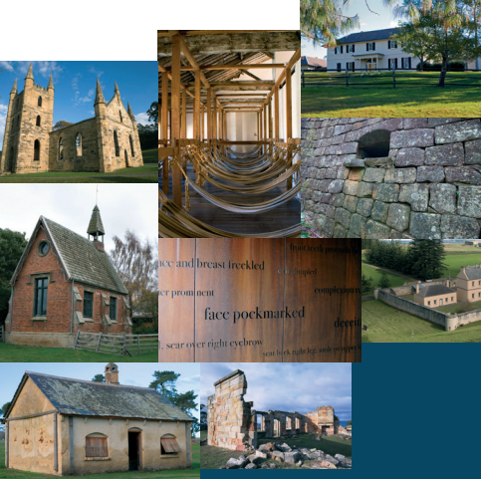
World heritage
Q4
What is the most accurate description of a World Heritage serial listing?
A listing which covers more than one location with thematic links
A listing that covers sites linked to internationally known serial killers
A listing where the series of locations, rather than individual components, are of outstanding universal value
A listing of several properties or locations

Slide 6
World heritage
Q5
Is Old Government House and Domain listed for its cultural significance, natural significance, or both?

Slide 7
World heritage
Q6
How many Australian World Heritage sites are listed for cultural values?

Slide 8
World heritage
Q7
What year was ex-convict George Salter granted 30 acres, which Macquarie later purchased and added to the Government Domain?
1788
1806
1812
1795

Slide 9
World heritage
Q8
How many serial listings does Australia have on the World Heritage register?

Slide 10
World heritage
Q9
Which of the following are all included in the Convict Sites serial listing?
Old Government House and Domain, Coal Mines Historic Site, Fremantle Prison, Sarah Island
Port Arthur, Cockatoo Island, Old Government House and Domain, The Rocks
Coal Mines Historic Site, Old Great North Road, Old Government House and Domain, Norfolk Island Historic Area
The Rocks, Cascades Female Factory, Hyde Park Barracks, Old Government House and Domain

Slide 11
World heritage
Q10
What year was the Australian Convict Sites World Heritage Property inscribed on the UNESCO World Heritage list?

Slide 12
World heritage - answers
B - The site must be of outstanding universal value; it must also meet at least one of the specific category criteria
Old Government House and Domain (in Parramatta Park)
20
C - A listing where the series of locations, rather than individual components, are of outstanding universal value
Cultural values
Four cultural only (Australian Convict Sites, Sydney Opera House, Royal Exhibition Building and Carlton Gardens, Budj Bim Cultural Landscape), plus 4 with mixed values
(both cultural and natural values) – Willandra Lakes, Uluru-Kata Tjuta, Tasmanian Wilderness, Kakadu)
D - 1795. Salter’s cottage still stands, a rare example of an emancipist’s cottage and convict workplace. Tours are available through Parramatta’s Visitor Information Centre.
Four - Budj Bim, Australian Fossil Mammal Sites, Australian Convict Sites, Gondwana Rainforests
C - Coal Mines Historic Site, Old Great North Road, Old Government House and Domain, Norfolk Island Historic Area
2010
Notes:
World Heritage - Answers
What is the criteria for inclusion on the United Nations World Heritage list? B - The site must be of outstanding universal value; it must also meet at least one of the specific category criteria
The site must be of international scientific or historic interest
The site must transcend national boundaries and be of common importance for present and future generations of all humanity
The site must include significant heritage structures or natural landscapes, in excellent condition
The site must be of interest to both domestic and international travellers
What is Parramatta’s World Heritage Site? Old Government House and Domain (in Parramatta Park)
How many World Heritage sites does Australia have? 20
What is the most accurate description of a World Heritage serial listing? C
A listing which covers more than one location with thematic links
A listing that covers sites linked to internationally known serial killers
A listing where it is the series of locations, rather than individual components, that are of outstanding universal value
A listing of several properties or locations
Is Old Government House and Domain listed for its cultural or natural significance, or both? Cultural values
How many Australian listings are for cultural values? Four cultural only (Australian Convict Sites, Sydney Opera House, Royal Exhibition Building and Carlton Gardens, Budj Bim Cultural Landscape), plus 4 with mixed values (both cultural and natural values) – Willandra Lakes, Uluru-Kata Tjuta, Tasmanian Wilderness, Kakadu)
What year was ex-convict George Salter granted 30 acres, which Macquarie later purchased and added to the Government Domain? D - 1795. Salter’s cottage still stands, a rare example of an emancipist’s cottage and convict workplace. Tours are available.
How many serial listings does Australia have on the World Heritage register? Four - Budj Bim, Australian Fossil Mammal Sites, Australian Convict Sites, Gondwana Rainforests
Which of the following are all included in the Convict Site serial listing? C
Old Government House and Domain, Coal Mines Historic Site, Fremantle Prison, Maria Island
Port Arthur, Cockatoo Island, Old Government House and Domain, The Rocks
Coal Mines Historic Site, Old Great North Road, Old Government House and Domain, Norfolk Island Historic Area
The Rocks, Cascades Female Factory, Hyde Park Barracks, Old Government House and Domain
What year was Old Government House and Domain added to the World Heritage list? 2010

Slide 13
Who AM I?
I was born in Devon, England in 1766
I was an amateur botanist and astronomer
My journals and correspondence provide a valuable record of life in colonial New South Wales
I raised five sons and four daughters, ensuring they were well educated, as I had been
In 1995 I was commemorated on an Australian $5 coin, part of a proof set entitled Colonial Australia
I befriended many Aboriginal people who were welcome on my estates and in my home
I was said to have a positive and cheerful nature and was held in high esteem by all
Though of good social standing, my family was considered too controversial to mix with the colonial elite
I was a major player in the establishment of the wool industry in New South Wales
I oversaw the extensive family estates while my husband was living in England for extended periods of time
Elizabeth Macarthur

