Slide 1
governors
Parramatta
Notes:
Before starting online meeting:
Select Slide show from top bar and click “From beginning”
You will be able to see the notes; participants will only see slides
Before starting quiz:
Check that participants have a pen and paper at the ready, to write down their answers.
Each correct answer is worth 1 point.
If playing in teams, remind groups to mute their mic as they discuss their answer, so they don’t accidentally tell other teams.
Remember to speak slowly and clearly, so everyone understands the questions.
Check that everyone is ready before moving on to next question.

Slide 2
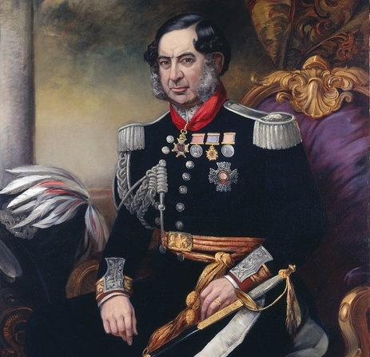
governors
Q1
Who was the last Governor to reside at Old Government House in Parramatta?

Slide 3
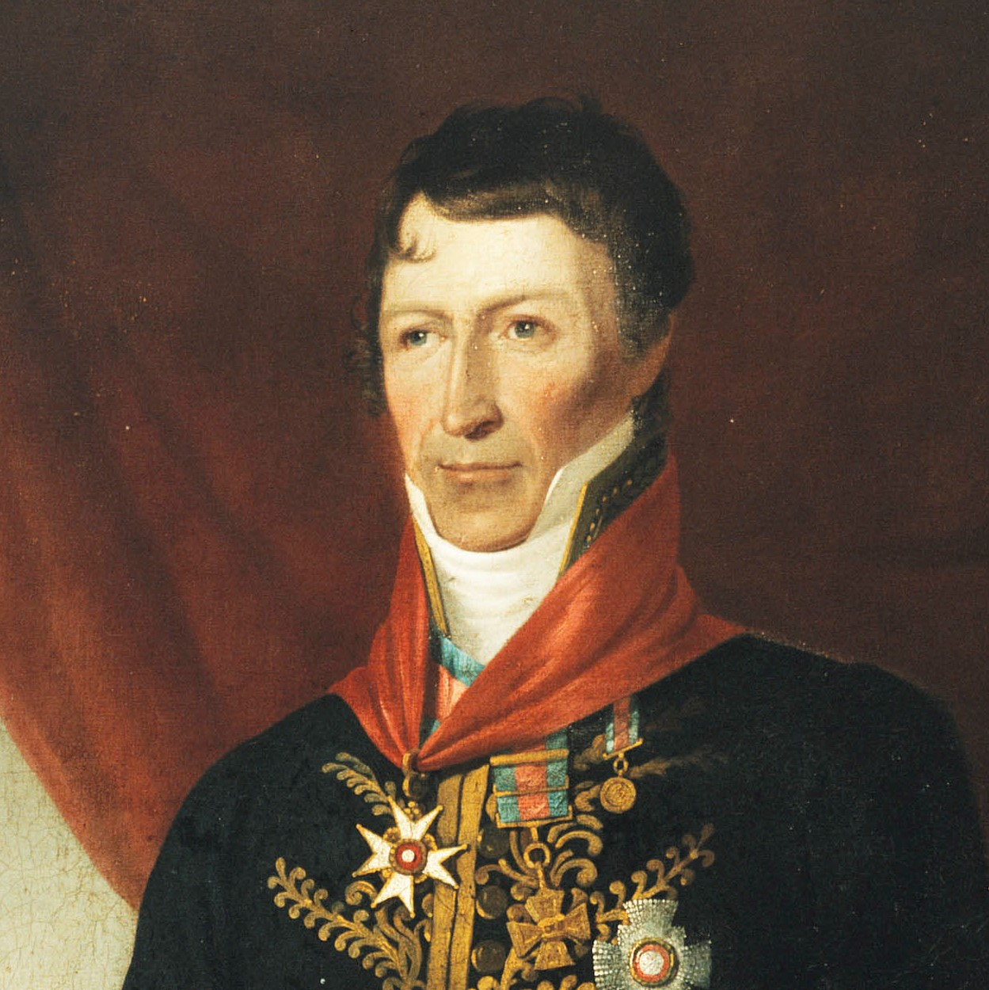
governors
Q2
Who was the first non-military Governor of NSW and what enticed him to accept the position?

Slide 4
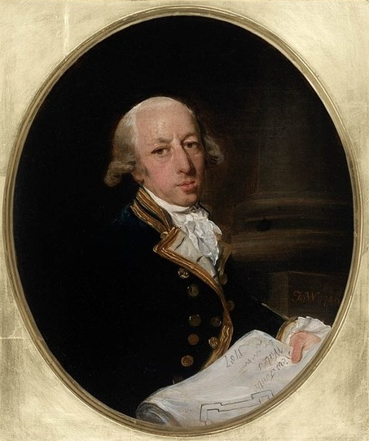
governors
Q3
Which Governor was the first to explore the Nepean River?

Slide 5
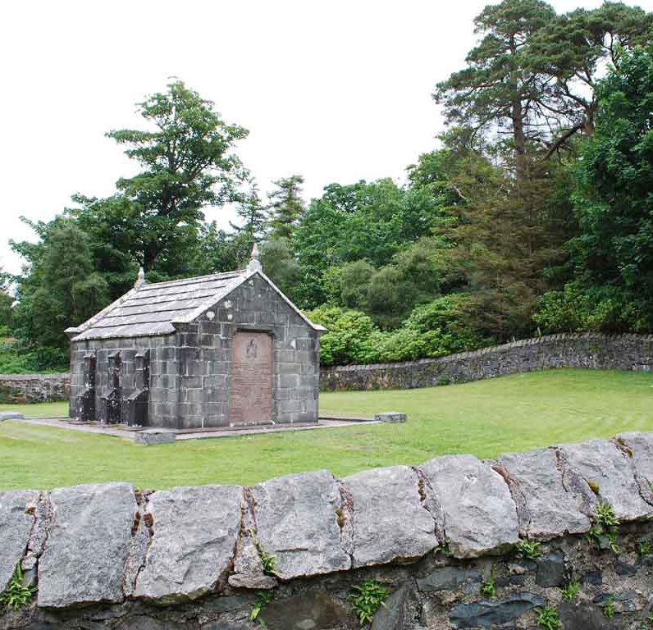
governors
Q4
Which Governor, buried on the Scottish Isle of Mull, is known as the Father of Australia?

Slide 6
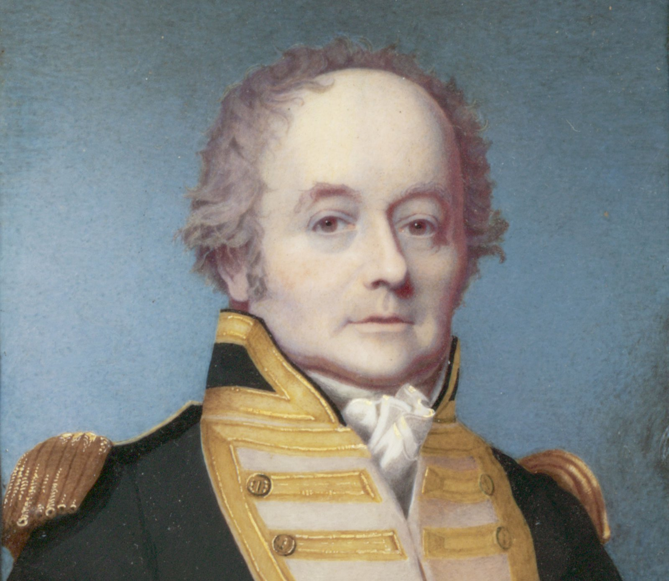
governors
Q5
The Rum Rebellion aimed to overthrow which Governor?

Slide 7
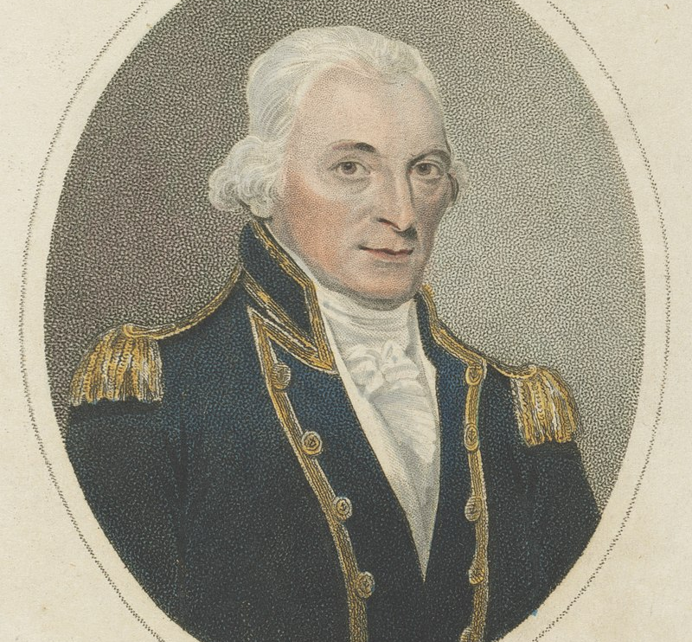
governors
Q6
Which Governor described the convict women of the Parramatta Female Factory as:
“ ... the disgrace of their sex, are far worse than the men, and are generally found at the bottom of every infamous transaction committed in the colony.”

Slide 8
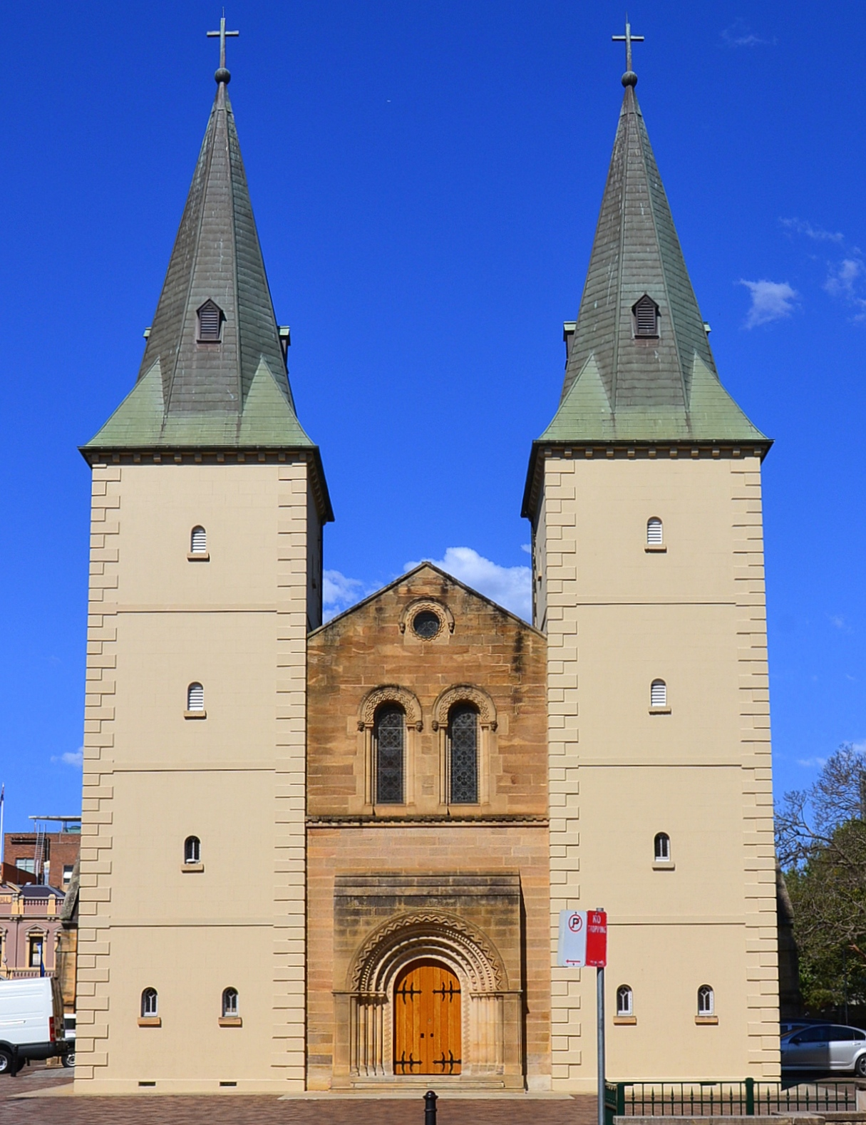
governors
Q7
The towers of St Johns Cathedral were designed by which Governor’s wife?

Slide 9
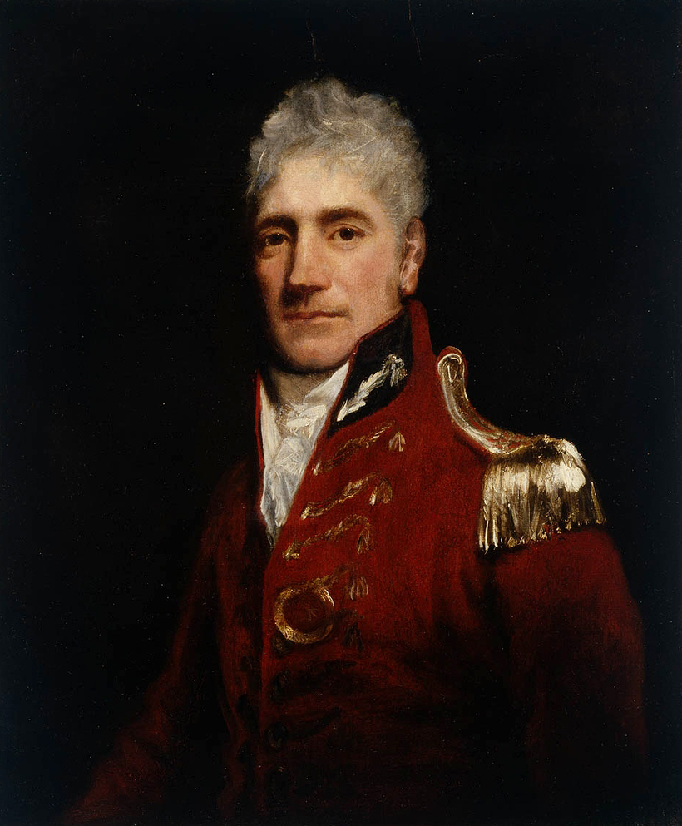
governors
Q8
Which of these was Governor Macquarie responsible for:
The current iteration of Old Government House
The punitive expedition that led to the Appin Massacre
The Governors Bathhouse
Both A and B

Slide 10
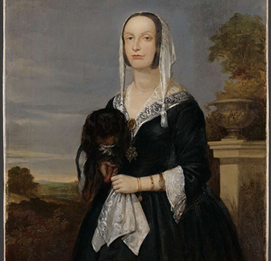
governors
Q9
Who was the Governor’s daughter whose second husband became administrator of the colony?

Slide 11
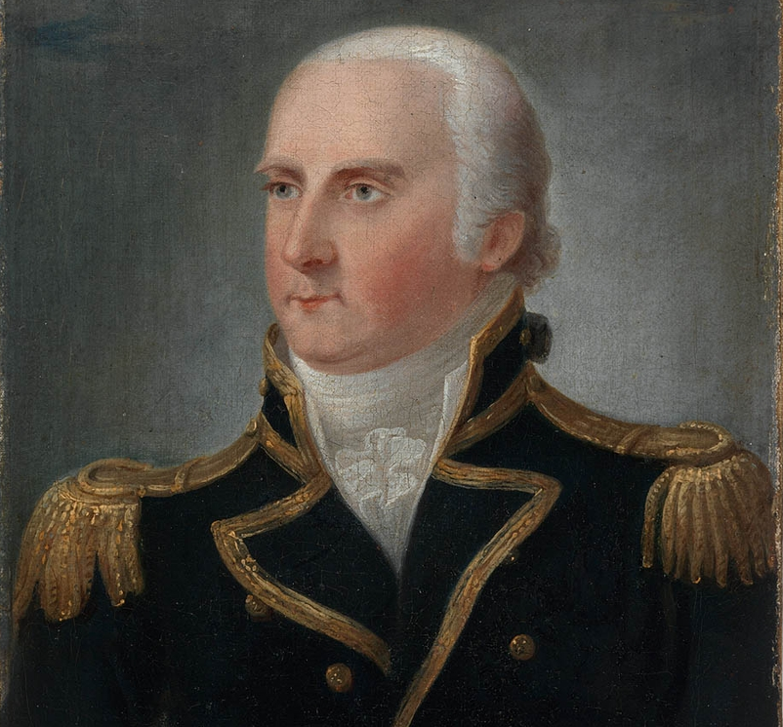
governors
Q10
Which Governor, writing to his successor, said of the Aboriginal people: “I have ever considered them the real proprietors of the soil…”

Slide 12
Governors - answers
Governor Fitzroy
Governor Brisbane; clear southern skies – he was an astronomer
Governor Arthur Phillip
Governor Macquarie
Governor Bligh
Governor Hunter
Elizabeth Macquarie
D – Current version of Old Government House and the Appin Massacre
Mary Putland/Mary O’Connell, fierce supporter of her father Governor Bligh
Governor King
Notes:
Governors - Answers
Who was the last governor to reside at Old Government House in Parramatta? Governor Fitzroy
Who was the first non-military Governor of NSW and what enticed him to accept the position? Gov Brisbane; clear southern skies – he was an astronomer
Which governor was the first to explore the Nepean River? Gov Arthur Phillip
Which Governor, buried on the Scottish Isle of Mull, is known as the Father of Australia? Gov Macquarie
Which governor did the Rum Rebellion aim to overthrow? Governor Bligh
Which Governor described the convict women of the Female Factory as:
“ ... the disgrace of their sex, are far worse than the men, and are generally found at the bottom of every infamous transaction committed in the colony.” Governor Hunter
Which wife of a governor designed the towers of St Johns Cathedral? Elizabeth Macquarie
Which of these was Governor Macquarie responsible for: D – OGH and the Appin Massacre
The current iteration of Old Government House
The punitive expedition that lead to the Appin Massacre
The Governors Bathhouse
A and B
Who was the governor’s daughter whose second husband later became the administrator of the colony as it awaited the arrival of another governor? Mary Putland/Mary O’Connell, fierce supporter of her father Governor Bligh
Which governor, writing to his successor, said of the Aboriginal people: “I have ever considered them the real proprietors of the soil…” Governor King

Slide 13
WHo AM I?
I was born in 1762
I am buried on the Island of Mull
Before being posted to New South Wales I served in Nova Scotia, Jamaica and Bombay
I extensively renovated and extended my Parramatta residence
I had a skill for doing deals to get things strategically done at little or no expense to the government
I was frequently rebuked for overstepping my role and overspending my budget
I was a great supporter of emancipated convicts, even appointing some as magistrates, a move which led to a commission of enquiry into the colony
I established the Parramatta Native Institute in 1814
Two major rivers are named after me, along with numerous thoroughfares
I am famous for establishing five new towns in New South Wales
Lachlan Macquarie

