Slide 1
Food, glorious food
Our favourite preoccupation
Notes:
Before starting, check that participants have a pen and paper at the ready, to write down their answers.
Each correct answer is worth 1 point.
If playing in teams, remind groups to mute their mic as they discuss their answer, so they don’t accidentally tell other teams.
Remember to speak slowly and clearly, so everyone understands the questions.
Check that everyone is ready before moving on to next question.

Slide 2
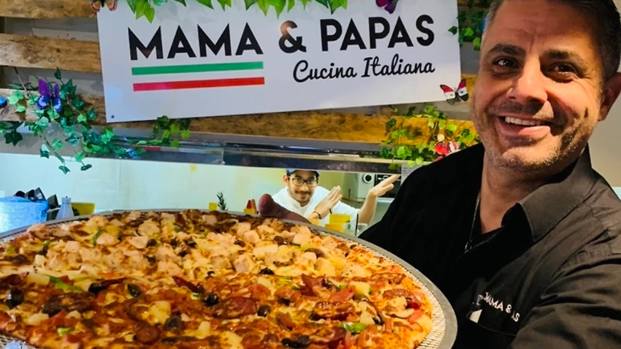
Food, glorious food
Q1
What is Parramatta CBD’s dining precinct known as?

Slide 3
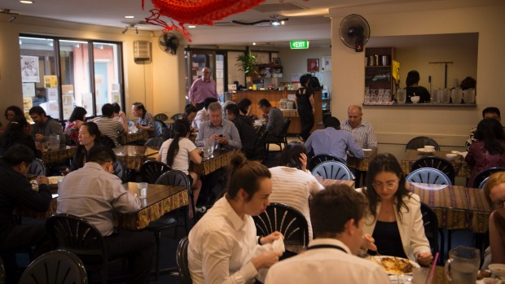
Food, glorious food
Q2
Name Parramatta’s longest running Singaporean/ Malaysian restaurant.

Slide 4
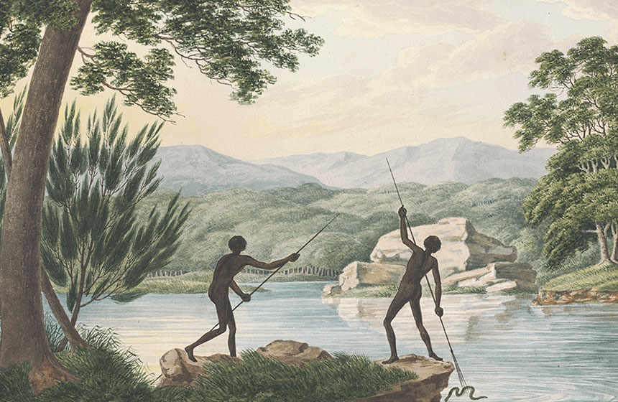
Food, glorious food
Q3
In Dharug culture men and women typically caught fish in different ways; what were they?

Slide 5
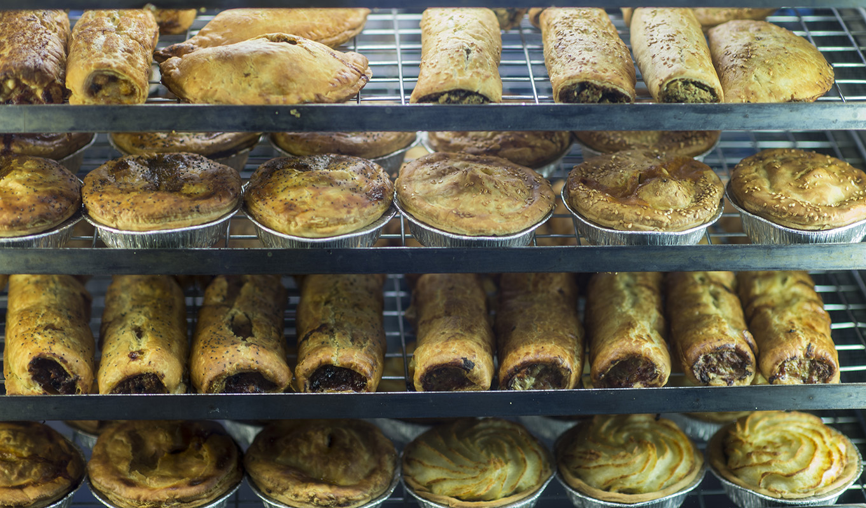
Food, glorious food
Q4
Which social enterprise bakery is famous for its award-winning pork and fennel sausage roll?

Slide 6
Food, glorious food
Q5
Who was the first colonist to be credited with self-sufficiency in food production?

Slide 7
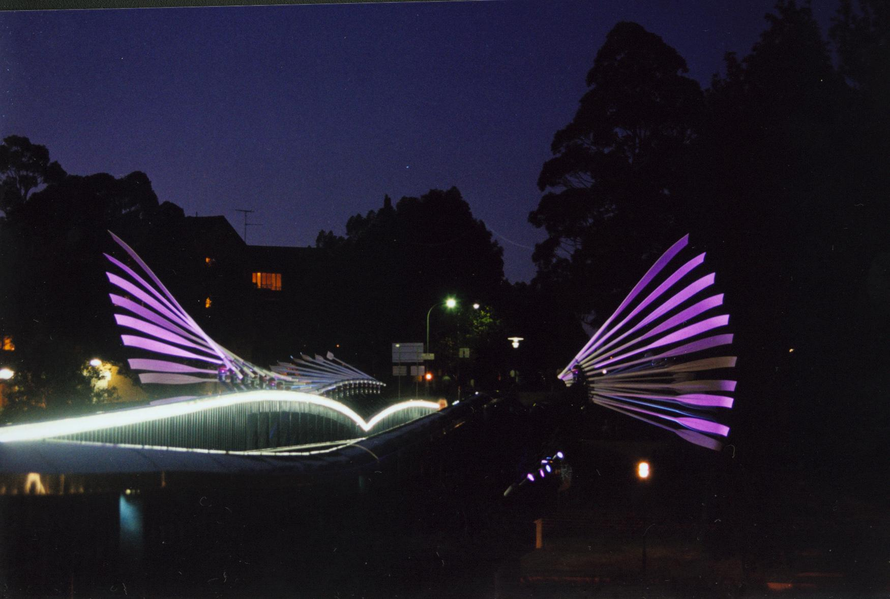
Food, glorious food
Q6
Which Parramatta restaurant would you head to on a Friday night to enjoy both belly dancing and a view of the colourful public artwork “Wake”?

Slide 8
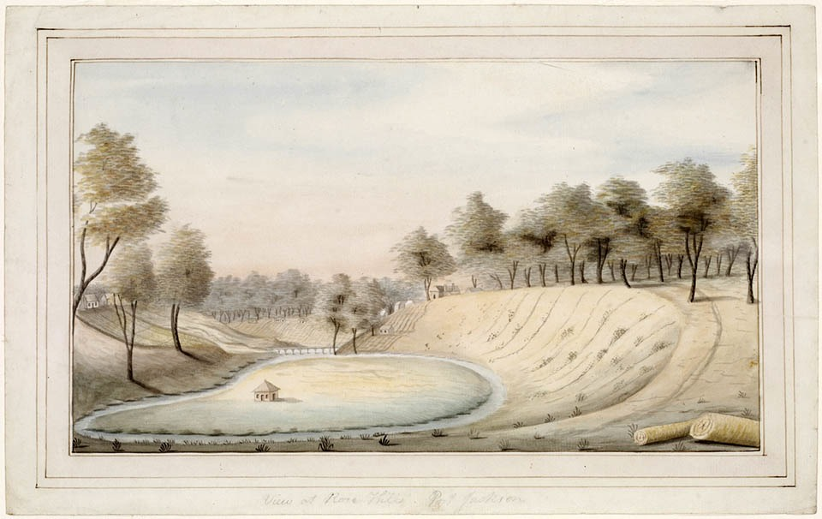
Food, glorious food
Q7
  Henry Dodd, Supervisor of the Government Farm, presented Governor Phillip with a very special dish as part of his Christmas dinner in 1789; what was it?
  A forked carrot, believed to be a sign of good luck
  A 26lb cabbage
  A haunch of kangaroo
  A smoked eel

Slide 9
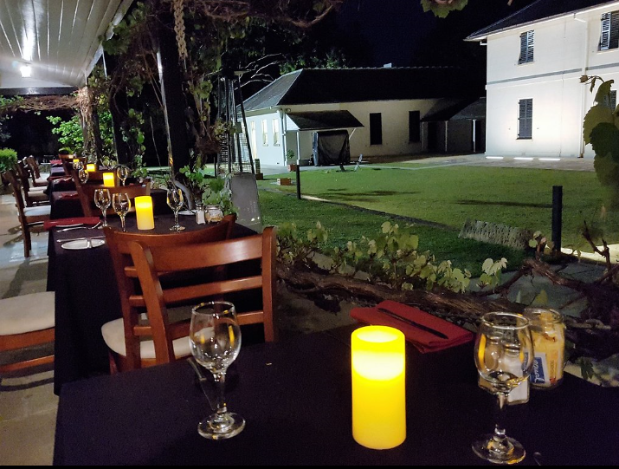
Food, glorious food
Q8
Which fine dining restaurant is located within a World Heritage site in Parramatta?

Slide 10
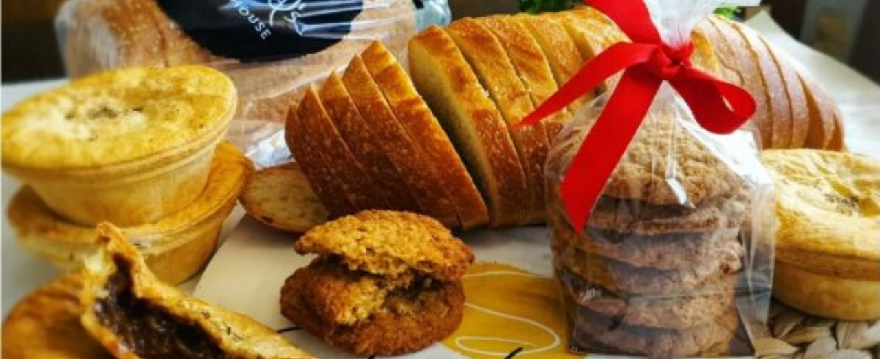
Food, glorious food
Q9
Where would you take your mates on Friday to choose your great-value lunch from a wide selection of food trucks?

Slide 11
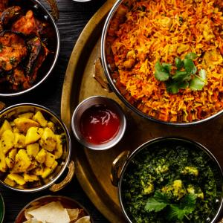
Food, glorious food
Q10
What is Harris Park’s famous dining precinct known as?

Slide 12
Food, glorious food - answers
Eat Street
Temasek. Located adjacent to the Roxy theatre, it was opened in 1992 and still gets rave reviews.
Women with a fishing line, usually from a nawi (canoe); men with a spear, often from the shore.
Bourke St Bakery, on Centenary Square. We also highly recommend their lamb, almond and harissa sausage roll - yum!
James Ruse. However, he was ably assisted by Elizabeth Parry, who he married in 1790. He described her as “the only good thing to come off the second fleet”.
Sahra by the River
B – a 26lb cabbage he had grown himself, a sign that the soils in Parramatta were more fertile than those of Sydney
Lachlan’s at Old Government House
Parramatta Farmers Market, Centenary Square. You could then find a seat in the sun to enjoy it while listening to live music.
Little India
Notes:
What is Parramatta CBD’s dining precinct known as? Eat Street
Name Parramatta’s longest running Singaporean/Malaysian restaurant. Temasek. Located adjacent to the Roxy theatre, it was opened in 1992 and still gets rave reviews.
In Darug culture men and women typically caught eels in different ways; what were they? Women with a fishing line, usually from a nawi (canoe); men with a spear, often from the shore.
Which social enterprise bakery is famous for its award-winning pork and fennel sausage roll? Bourke St Bakery, on Centenary Square. We also highly recommend their lamb, almond and harissa sausage roll - yum!
Who was the first colonist to be credited with self-sufficiency in food production? James Ruse. However, he was ably assisted by Elizabeth Parry, who he married in 1890. He described her as “the only good thing to come off the second fleet”.
Which Parramatta restaurant would you head to on a Friday night to enjoy both belly dancing and a view of the colourful public artwork, titled “Wake”? Sahra by the River
Henry Dodd, Supervisor of the Government Farm presented Governor Phillip with a very special dish as part of his Christmas dinner in 1789; what was it? B – a 26lb cabbage he had grown himself, a sign that the soils in Parramatta were more fertile than those of Sydney
A forked carrot, believed to be a sign of good luck
A 26lb cabbage
A haunch of kangaroo
An eel
Which fine dining restaurant is located within a World Heritage site in Parramatta? Lachlan’s
Post-Covid19 where will you take your mates on Friday to choose your great-value lunch from a wide selection of food trucks? Parramatta Farmers Market, Centenary Square. You could then find a seat in the sun to enjoy it while listening to live music.
Located in Westfield Parramatta, what restaurant is a favourite go-to for awesome yum cha? Phoenix. Yum cha – yum, yum!

Slide 13
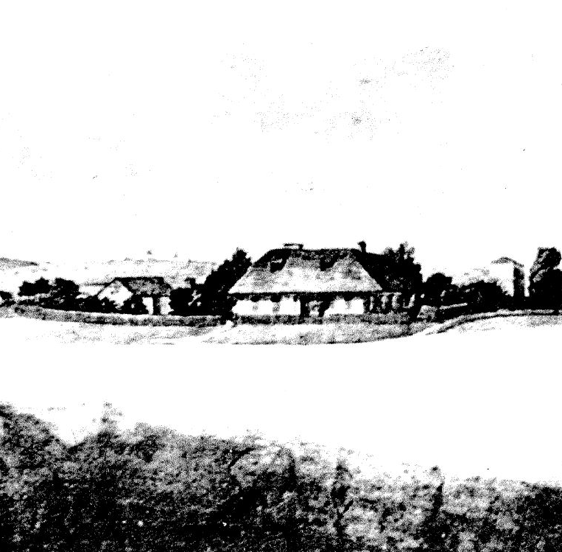
WHAT AM I?
My superintendent was a woman for most of my operating years
My training of girls as domestic servants set a pattern that was to be repeated in many institutions to follow
I was an initiative of Governor Macquarie
My residents were instructed in reading, writing and arithmetic, with boys also taught agriculture and mechanical arts, while girls learnt needlework and domestic skills
Burgon, an elder of the Awabakal Aboriginal people, sent his son to me to be educated
The Bigge Report noted that 37 boys and 27 girls had been educated within my walls
Some of my inmates had been selected from the ‘Prisoners of War’ resulting from the Hawkesbury Punitive Expedition
Once enrolled my residents could not be removed by their relatives, though several of them absconded
In 1819 one of my students won first prize in the anniversary school examination ahead of 20 of her peers and 100 European students
I am considered by many to be the site of the first instance of a Stolen Generation
The Parramatta Native Institute
Notes:
Only first answer of each participants count – no second guesses!
Scale of marks:
If correct after 1 clue – 10 points
If correct after 2 clues – 9 points
If correct after 3 clues – 8 points
If correct after 4 clues – 7 points
If correct after 5 clues – 6 points
If correct after 6 clues – 5 points
If correct after 7 clues – 4 points
If correct after 8 clues – 3 points
If correct after 9 clues – 2 points
If correct after 10 clues – 1 point
Or, for a less competitive contest, the first person to get the answer right scores 5 points.

